Slide 1
ASIAN AMERICANS IN MEDIA
Week 1: The Silent Film Era – Broken Blossoms

Slide 2
Key Terms:
Yellow Peril
Early cinema
Interracial romance / rape / anti-miscegenation

Slide 3
When discussing a film in this class, we consider the following:
Context - How / when / why was this film made? Who made it, and under what circumstances?)
Form - shots, editing, sound, mise-en-scene, special effects, etc.

Slide 4
Narrative – how is the story told, from whose perspective (subjectivity) how do we react to it as an audience?
Subject - race, gender, sexuality, class, etc.

Slide 5
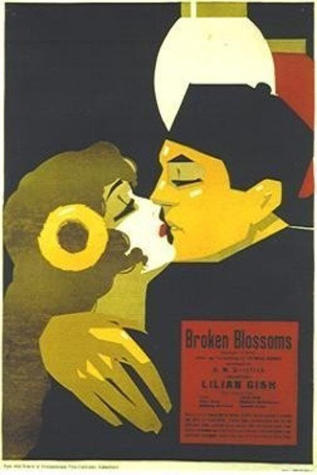
Broken Blossoms
(1919)
Dir. D.W. Griffith
Starring Lillian Gish & Richard Barthelmess

Slide 6
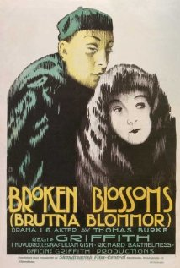
Based on Thomas Burke’s short story “The Chink and The Child”
Set in London’s Limehouse district
Promoted as an “art” film by Griffith ($3 tickets, dance performance)

Slide 7
Produced during a time of anti-Chinese /Asian xenophobia
Griffith made the notorious The Birth of A Nation in 1915
Drew from existing images (stereotypes): pulp novels, popular songs, vaudeville/theater, cartoons and posters

Slide 8
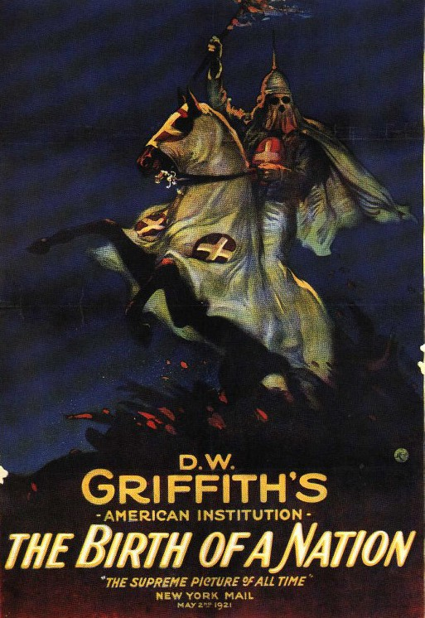
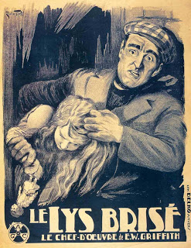

Slide 9
Discussion:
Compare Broken Blossoms (as a film) to the last film you watched in a theatre.

Slide 10
Discussion:
Compare Broken Blossoms (as a film) to the last film you watched in a theatre.
Did any aspect of the film surprise you?

Slide 11
Race & Class Politics:
Do you think Griffith’s portrayal of the Yellow Man as positive or negative representation of an Asian American? Why – explain your reasons.

Slide 12
Race & Class Politics:
Do you think Griffith’s portrayal of the Yellow Man as positive or negative representation of an Asian American? Why – explain your reasons.
How is race represented in the film?

Slide 13
Race & Class Politics:
Do you think Griffith’s portrayal of the Yellow Man as positive or negative representation of an Asian American? Why – explain your reasons.
How is race represented in the film?
In light of Griffith’s previous films (e.g. BOT), does this film somehow make him less racist?

Slide 14
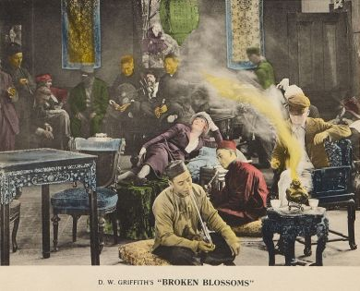
From Marchetti:
Upper-middle-class progressiveism
Bourgeois domesticity
Melodrama

Slide 15
Gender Politics:
Describe the two different portrayals of masculinity between Cheng and Burrows?

Slide 16
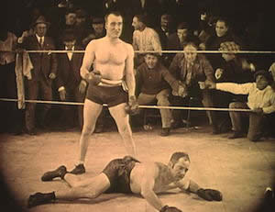
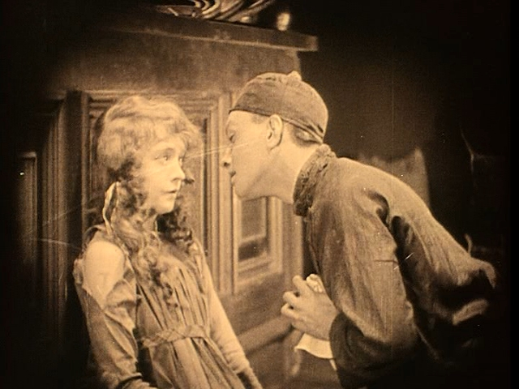
Comparative Analysis:
Boxing / kissing scenes

Slide 17
Gender Politics:
Describe the two different portrayals of masculinity between Cheng and Burrows?
What about the other men in the film (e.g. Evil Eye)?

Slide 18
Gender Politics:
Describe the two different portrayals of masculinity between Cheng and Burrows?
What about the other men in the film (e.g. Evil Eye)?
What about the portrayal of Lucy?

Slide 19
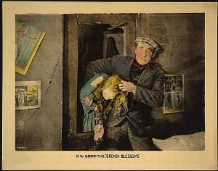
From Marchetti:
Bourgeois family as both the justification of its class’ right to rule and as a site of internal conflict and contradiction.
Yellow Man vs. Battling Burrows
The Victorian Cult of the Virgin Child
Rape-lynching fantasy

Slide 20
“Broken Blossoms sees the Western patriarchy as a site of violence, decay, and exploitation. Rather than lionizing capitalism and consumerism as the source of new vitality for the bourgeois home, Broken Blossoms depicts the poverty and squalor of the proletariat and subproletariat as a hopeless mire that the traditional, bourgeois domestic values can do little to remedy.”
(P. 34)

Slide 21
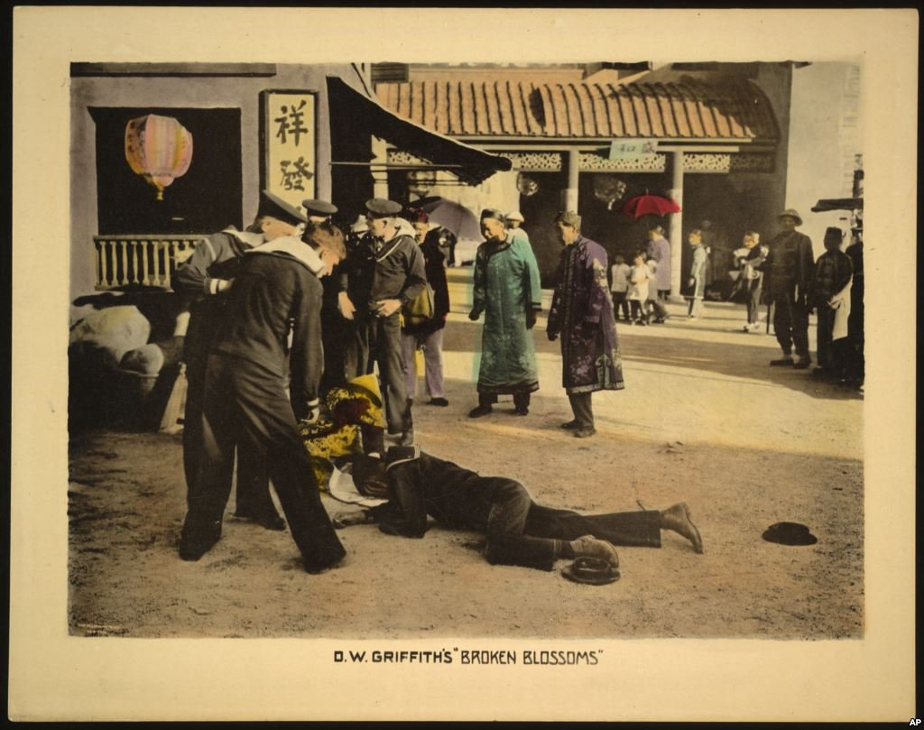
Spatial Politics:
How is Limehouse (Chinatown) represented in the film?

Slide 22
Spatial Politics:
How is Limehouse (Chinatown) represented in the film?
A site of perversity

Slide 23
Spatial Politics:
How is Limehouse (Chinatown) represented in the film?
A site of perversity
Slum: opium den, prostitution, poverty etc.

Slide 24
Spatial Politics:
How is Limehouse (Chinatown) represented in the film?
A site of perversity
Slum: opium den, prostitution, poverty etc.
“…it is an environment in which an unprotected white virgin can be possessed by an Asian other.” (P. 38)

