Slide 1
ASIAN AMERICANS IN MEDIA
Week 2: The Yellow Peril Genre– Daughter of The Dragon

Slide 2
Key Terms:
Yellow Peril
Asians in early Hollywood
Racial discrimination in Hollywood
Dismantling stereotypes / re-functioning representation

Slide 3
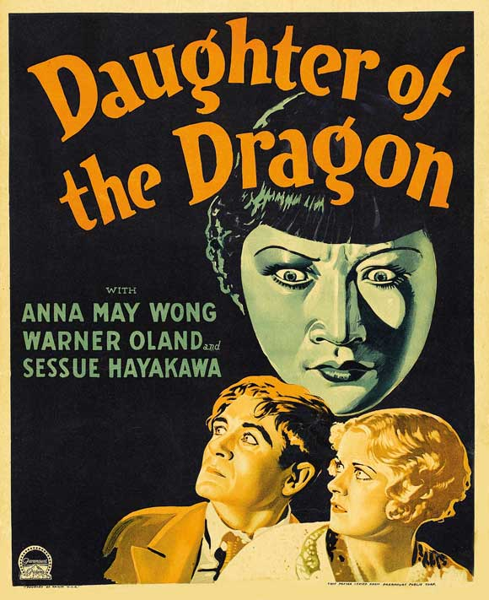
Daughter of The Dragon (1931)
Dir. Lloyd Corrigan
Starring Anna May Wong, Sessue Hayakawa & Warner Oland

Slide 4
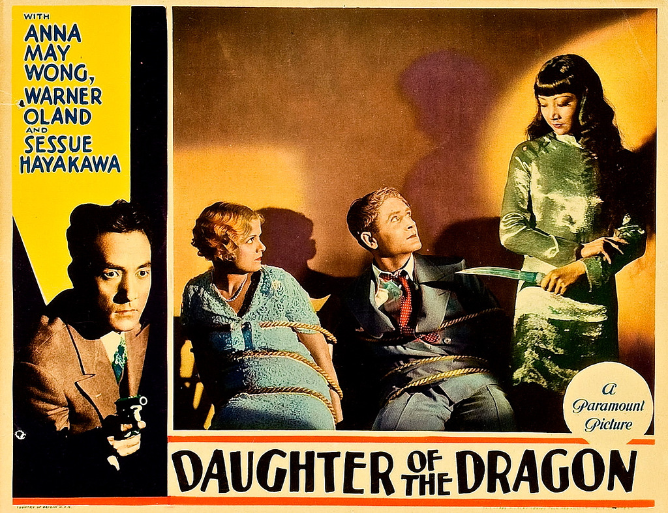
Based on the novel The Daughter of Fu Manchu by Sax Rohmer
Fu Manchu played by Oland in yellowface

Slide 5
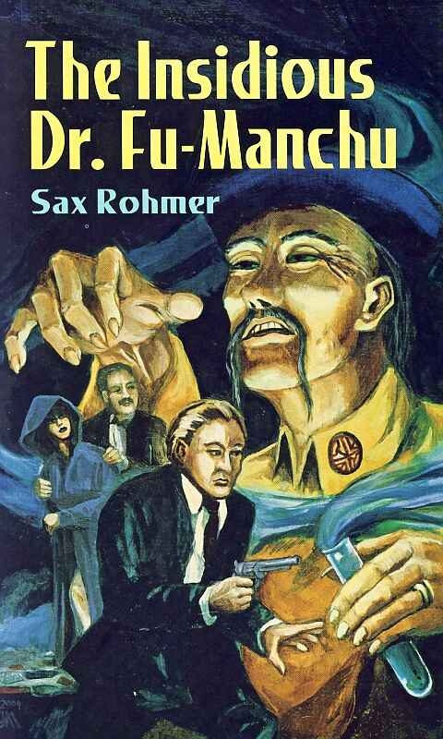
Representations of Yellow Peril: The Case of Dr. Fu Manchu
These images and stereotypes already exist in popular culture
Sax Rohmer (Arthur Henry Ward - the creator of Dr. Fu Manchu) was born in Birmingham, UK.

Slide 6
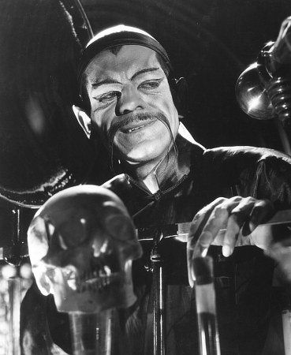
Fu Manchu stories were told in books, radio shows, film, television, and comics.
Eugene Wong tells Rohmer’s story of how he created the character of Fu Manchu in his essay (P. 56-8)

Slide 7
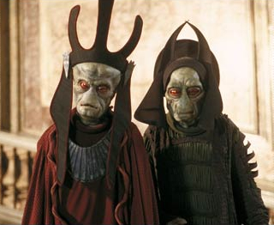
Fu Manchu vs. Charlie Chan: a dichotomy of early media representation of Asian American masculinity
More recent examples: Ming, the Merciless in Flash Gordon; David Lo Pan in Big Trouble in Little China; the Neimoidians in reboot of Star Wars

Slide 8
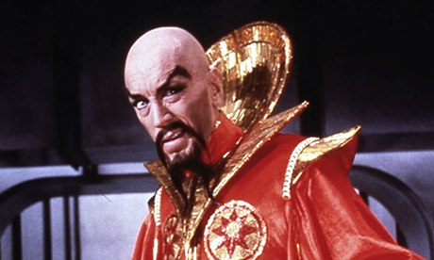
Ming, The Merciless in Flash Gordon (1980)

Slide 9
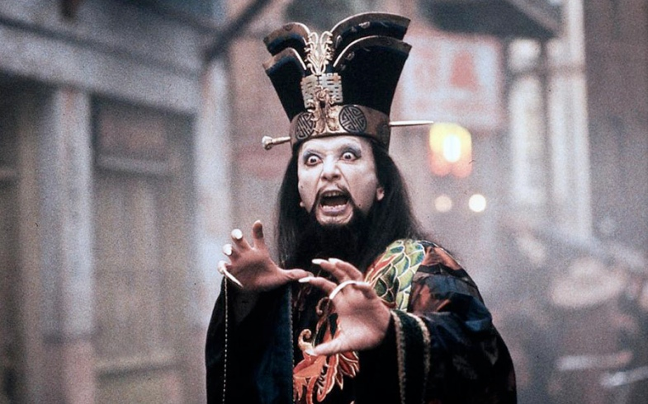
David Lo Pan in Big Trouble in Little China (1986)

Slide 10
Group Discussion / Debate: Dismantling Stereotypes / Re-Functioning Representation
The class divide into 2 groups, each representing one of these positions (from Liu) (15-20 mins.)
  First, discuss these concepts and come to a common understanding of their meaning in relationship to Asian American media representation;

Slide 11
  Then each group will formulate an opening statement, which should contain an argument representing your perspective—your statement should have a thesis.
  Then the group should discuss and formulate as many supporting arguments as possible to support your opening statement.
  As much as possible, use concrete examples from the two films you have seen to support your argument, you are also encouraged to draw from the class reading you have done, and discussions we have had in class;
6 mins.
Each group will have 3 mins to present their opening statement;
9 mins.
Going in order, each group will have 3 chances to present their supporting arguments, either in support of their thesis, or to challenge the other team’s thesis. 1-2 mins for each supporting argument
Concluding discussion
5-10 mins.
Which of these two positions is more convincing?
Do you see more evidence for one or the other in the films we have watched in class?
Are there issues and perspectives that are not adequately addressed by these two positions?

Slide 12
2. Each group will have 3 mins to present their opening statement; (6 mins)
3. Going in order, each group will have 3 chances to present their supporting arguments, either in support of their thesis, or to challenge the other team’s thesis. (1-2 mins for each supporting argument)
4. Concluding discussion (5-10 mins.)

Slide 13
Questions to Further Consider:

Slide 14
Questions to Further Consider:
Which of these two positions is more convincing?

Slide 15
Questions to Further Consider:
Which of these two positions is more convincing?
Do you see more evidence for one or the other in the films we have watched in class?

Slide 16
Questions to Further Consider:
Which of these two positions is more convincing?
Do you see more evidence for one or the other in the films we have watched in class?
Are there issues and perspectives that are not adequately addressed by these two positions alone?

Slide 17
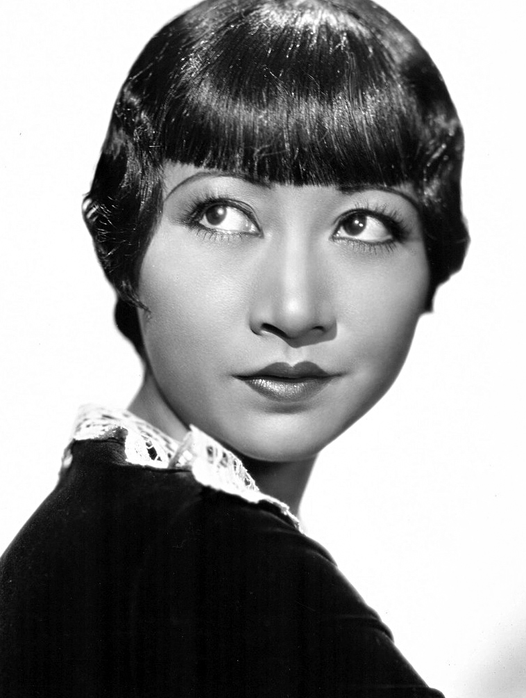
Anna May Wong
Born 1905 in Los Angeles, her career extended into television in the 1950s.
First credited role when she was 16, in Bits of Life (1921).
Best known for her role in Shanghai Express (1932) opposite Marlene Dietrich.

Slide 18
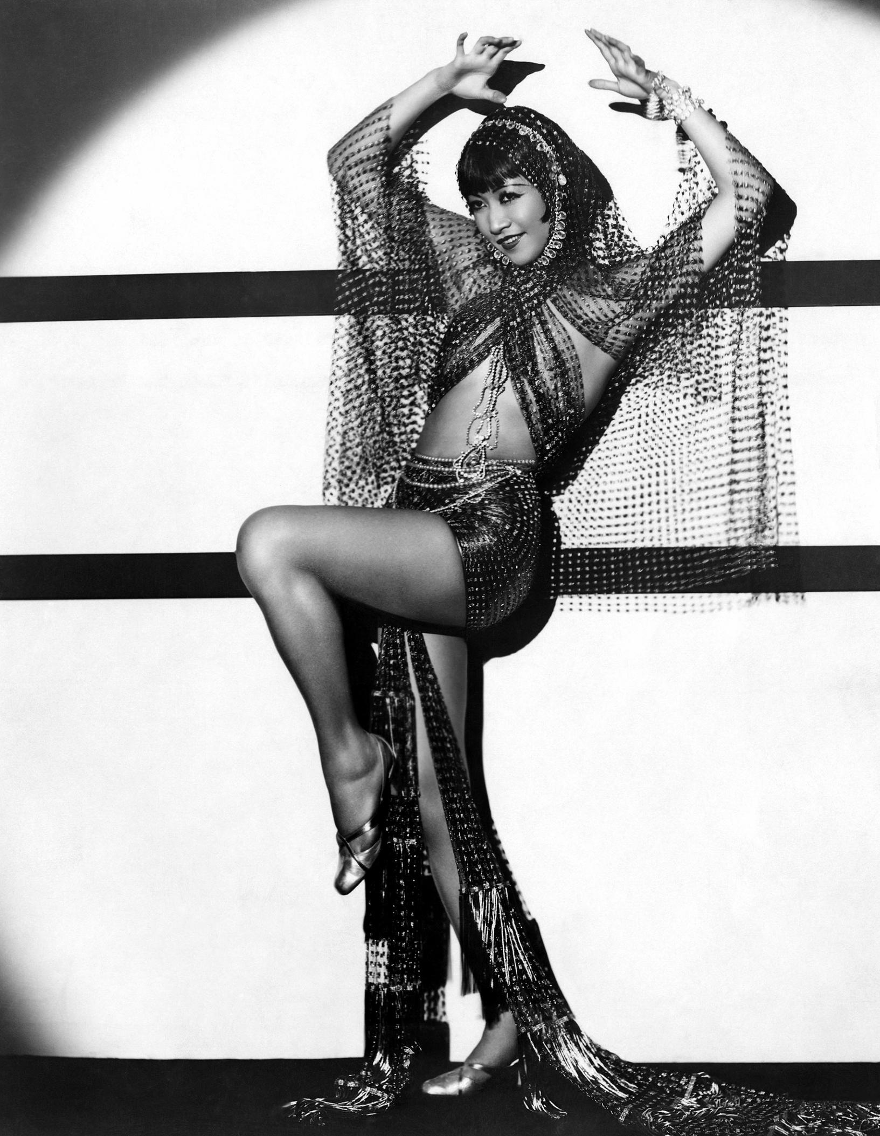
She successfully transitioned into the “talkies, also made films in UK and Germany.
Passed over for “positive” Chinese roles (e.g. O-Lan in The Good Earth) but starred in B movies such as The Daughter of Shanghai (1937) in which she was the heroine of the story.

Slide 19
In a 1933 interview for Film Weekly entitled "I Protest", Wong criticized the negative stereotyping in Daughter of the Dragon, saying, "Why is it that the screen Chinese is always the villain? And so crude a villain – murderous, treacherous, a snake in the grass! We are not like that. How could we be, with a civilization that is so many times older than the West?"

Slide 20
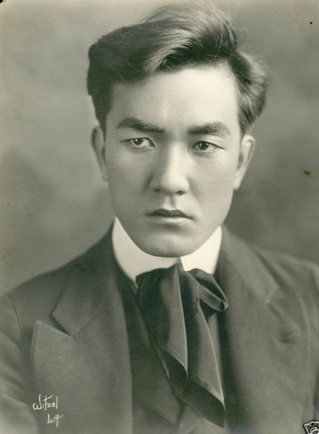
Sessue Hayakawa
Born 1889 in Japan, came to US to study in 1911.
His first role was in Typhoon (1914). It was an instant hit and resulted in a contract with Famous Players-Lasky (now Paramount).

Slide 21
His second film with Famous Players-Lasky was The Cheat (1915) directed by Cecil B. DeMille.
After the success of The Cheat, Hayakawa became the first Asian American leading man in Hollywood. He was a heartthrob who specialized on playing villains.
He formed his own studio, Hayworth Pictures Corporation in 1918. Over the next three years, he produced 23 films.

Slide 22
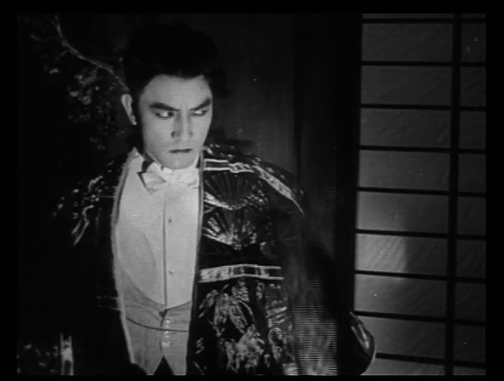
Hayakawa in The Cheat

Slide 23
In the 1930s, his career suffered from the rise of ‘talkies’ and a growing anti-Japanese sentiment before WWII.
After WWII, he had supporting roles in films such as The Bridge on the River Kwai (1957, playing a Japanese army colonel)
He retired from acting in 1966, and returned to Japan after the death of his wife (actress Tsuru Aoki)

Slide 24
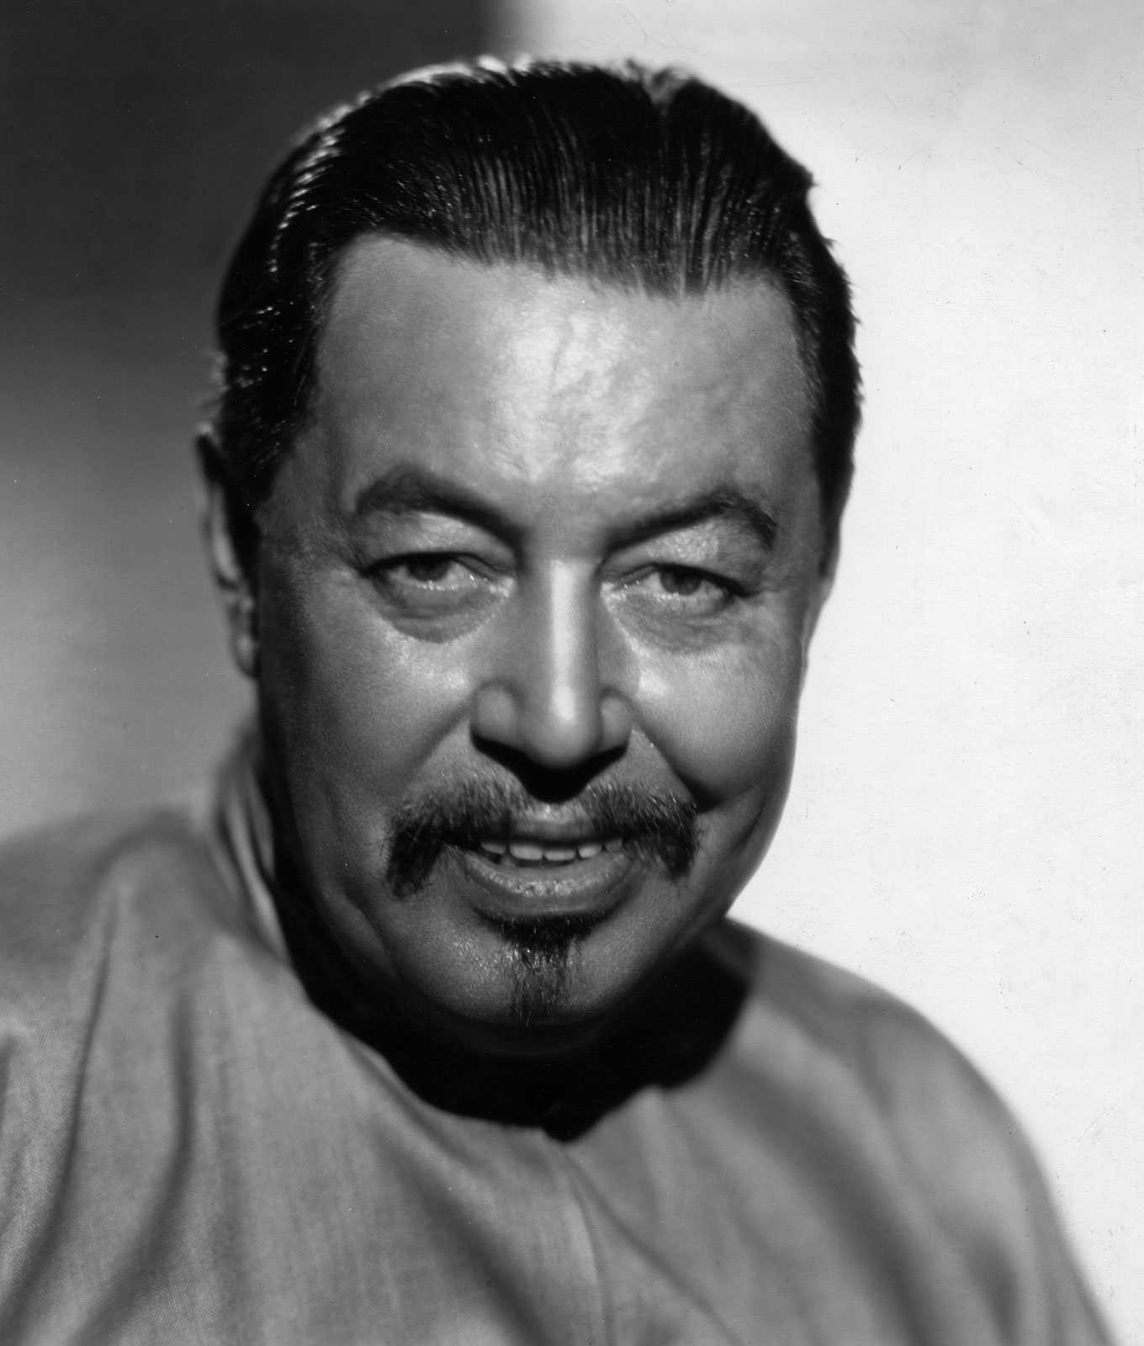
Warner Oland
Born 1879 in Sweden. (he claims he has Mongolian ancestry) His family emigrated to the US in 1892.
He acted in theatre in the early 1900s. His first film role was in the silent film Pilgrim’s Progress (1912)

Slide 25
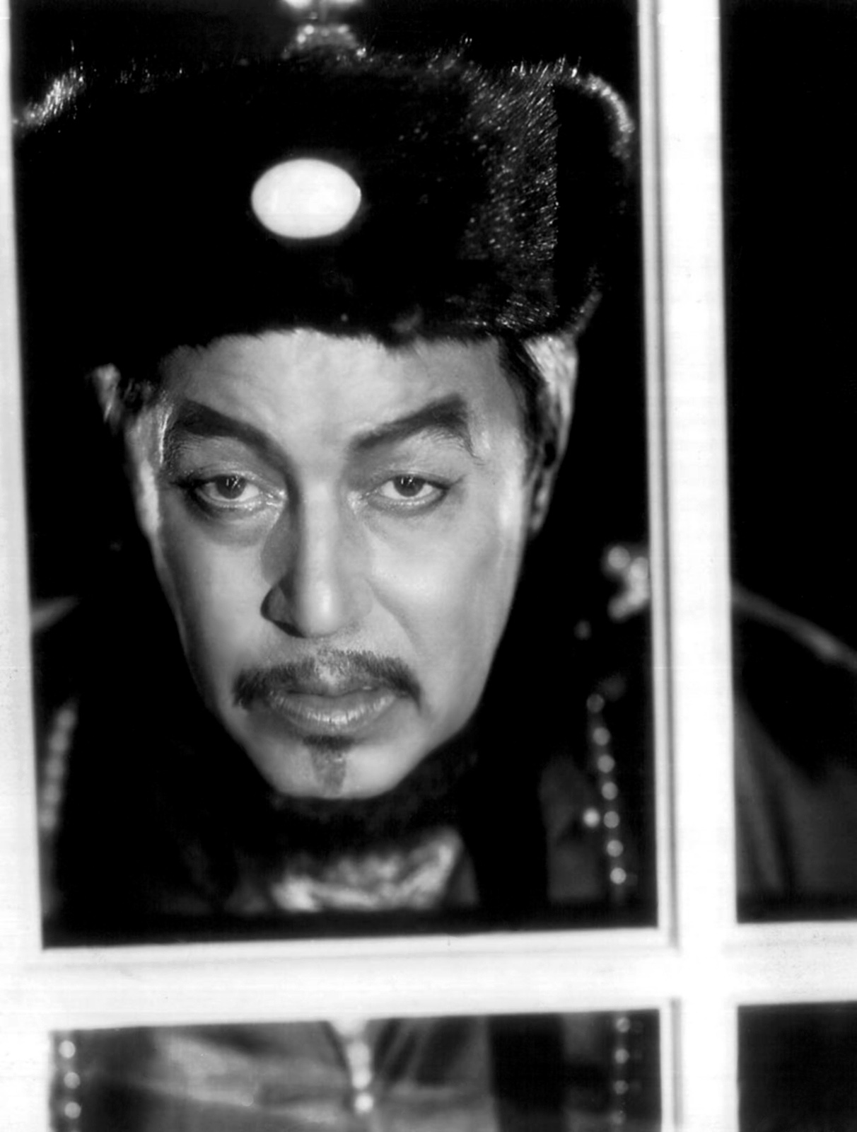
He played Dr. Fu Manchu in The Mysterious Dr. Fu Manchu (1929) and The Return of Dr. Fu Manchu (1930) as well as in Daughter of The Dragon.
He starred in a total of 16 films featuring the Chinese detective Charlie Chan.

Slide 26
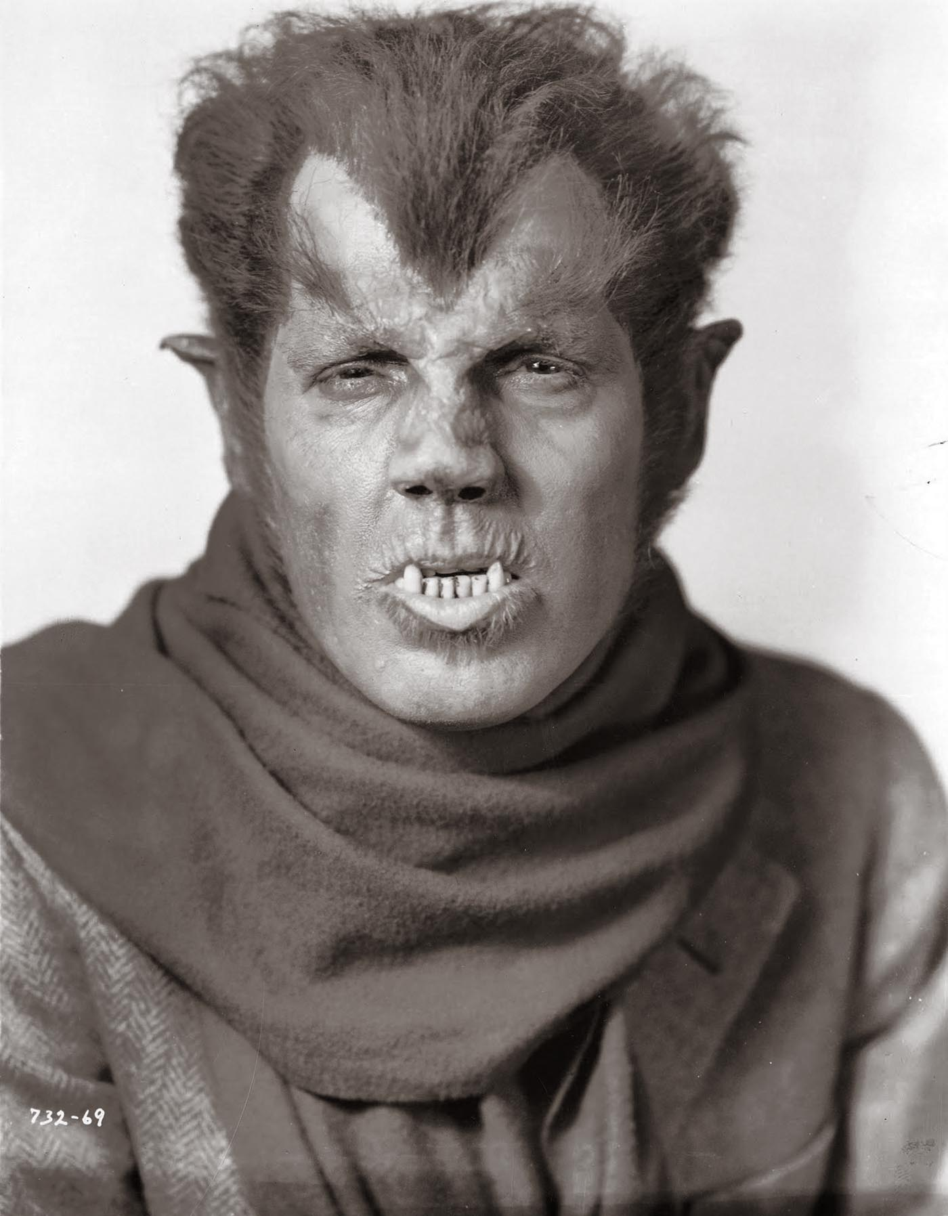
Oland was also the first actor to play a werewolf in a major Hollywood film, in Werewolf of London (1935) filmed at Universal Studios

