Slide 1
ASIAN AMERICANS IN MEDIA
Week 4: Assimilation, Model Minorities, & The Cold War —Flower Drum Song

Slide 2
Key Terms:
Cold War politics
Assimilation / hybridity
The model minority myth – “separate but equal”
Camp, performativity, realism
Community

Slide 3
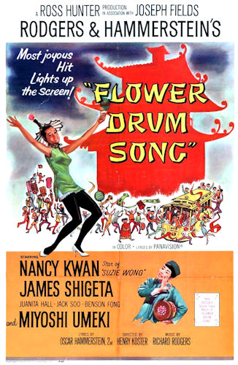
Flower Drum Song (1961)
Dir. Henry Koster
Starring Nancy Kwan, James Shegeta, Jack Soo, and Miyoshi Umeki.

Slide 4
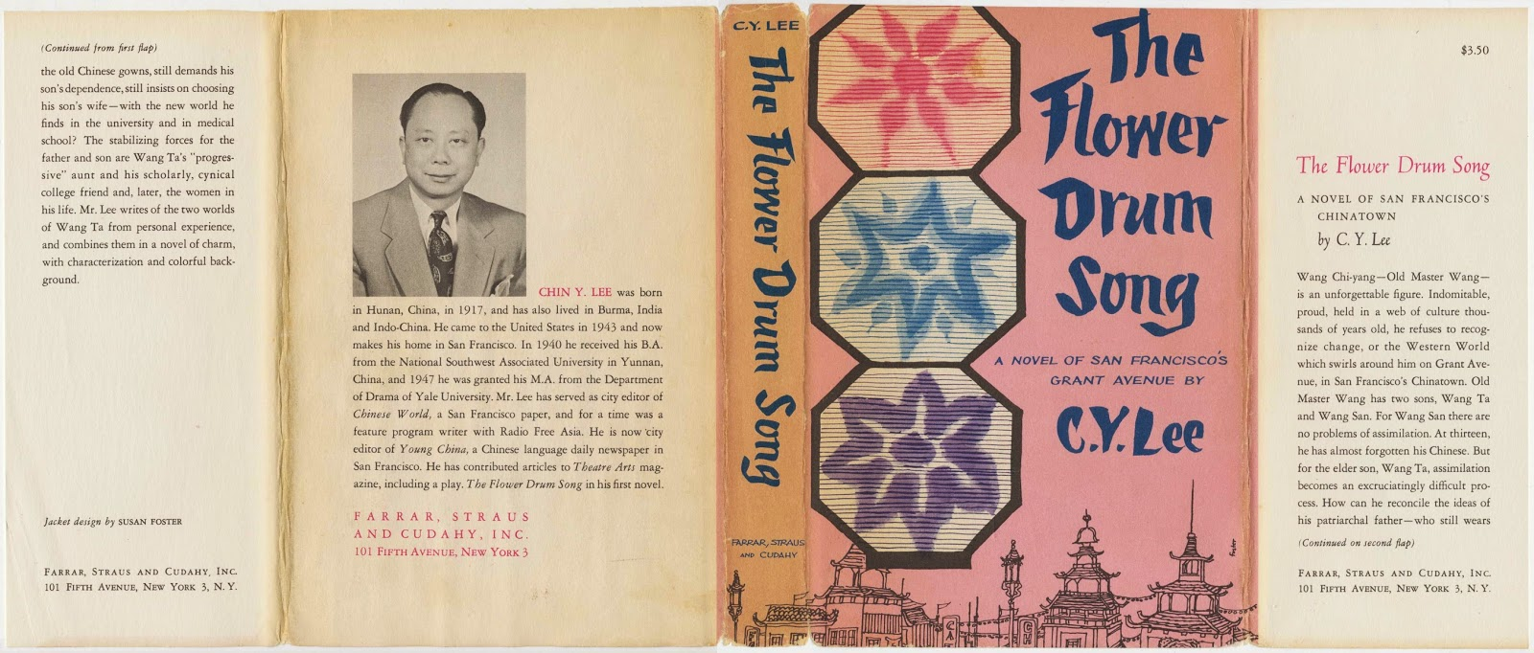
Based on a novel of the same title by C.Y. Lee, published in 1957.
Chin Yang Lee (黎錦揚); born 1917 in Hunan, China.

Slide 5
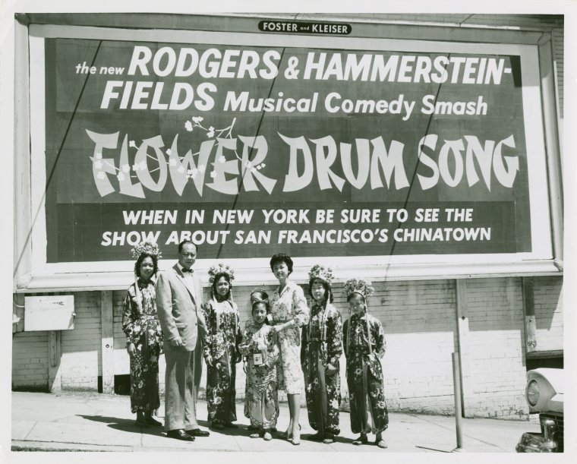
Lee earned a Bachelor of Arts degree from Xi'nan University, then emigrated to the United States of
America in 1943 and earned a Master of Fine Arts degree in playwriting from Yale University in 1947. (Photo: Lee with FDS billboard unveiling, San Francisco, 1960)

Slide 6
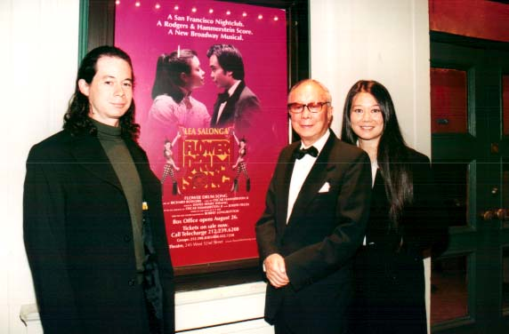
Lee was a journalist living in and working for two San Francisco Chinatown
newspapers,
at the time, in the early 1950s, when he was writing Flower Drum Song, expanding it from a short story to a novel. He lived in Alhambra, California, until 2018. (Photo: Lee with his children in 2002)

Slide 7
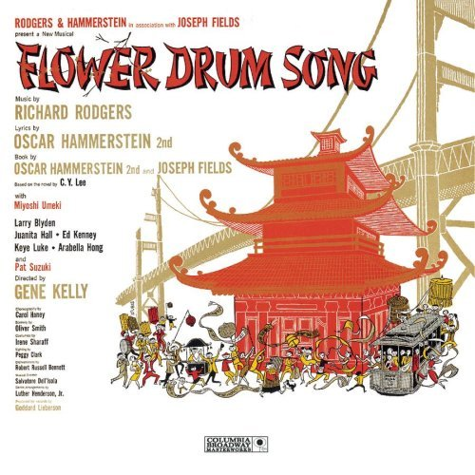
Richard Rodgers and Oscar Hammerstein – the successful American musical theater writing team who produced musicals including The King and I (1951) and
The Sound of Music (1959) turned Lee’s novel into a theater production, which opened in 1958 on Broadway.

Slide 8
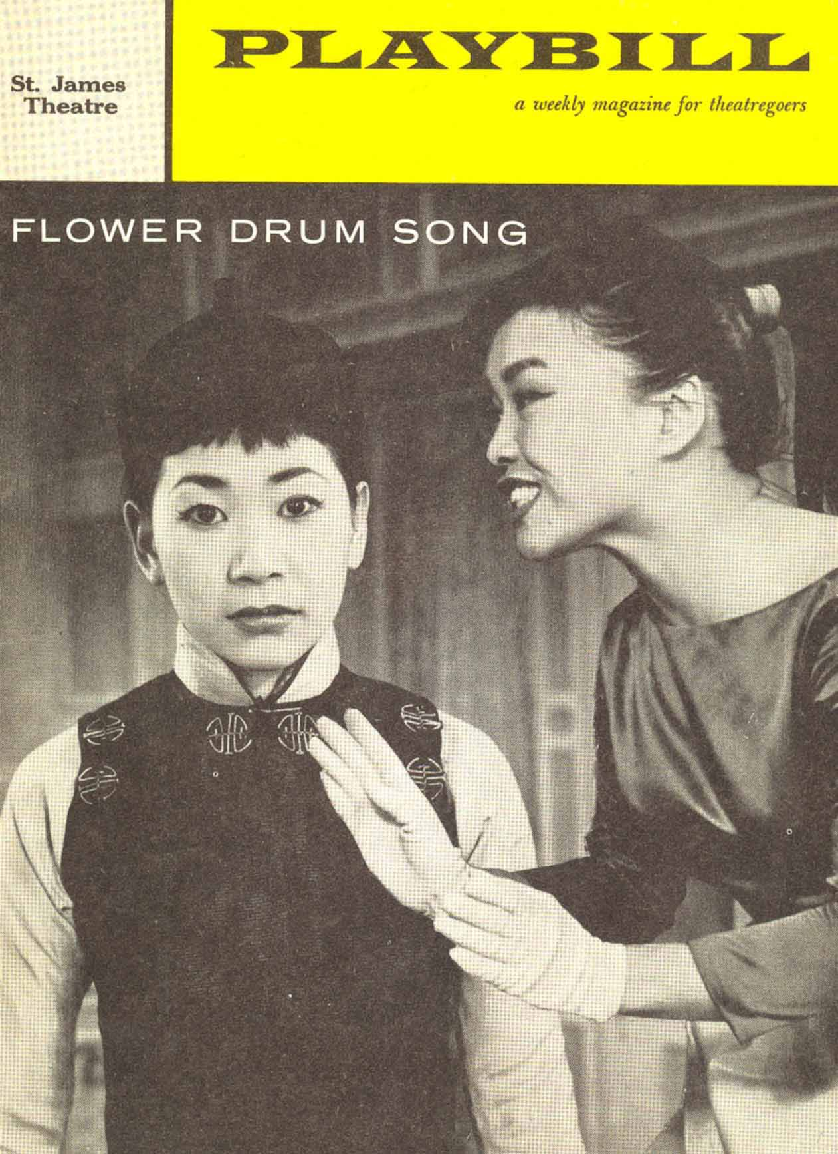
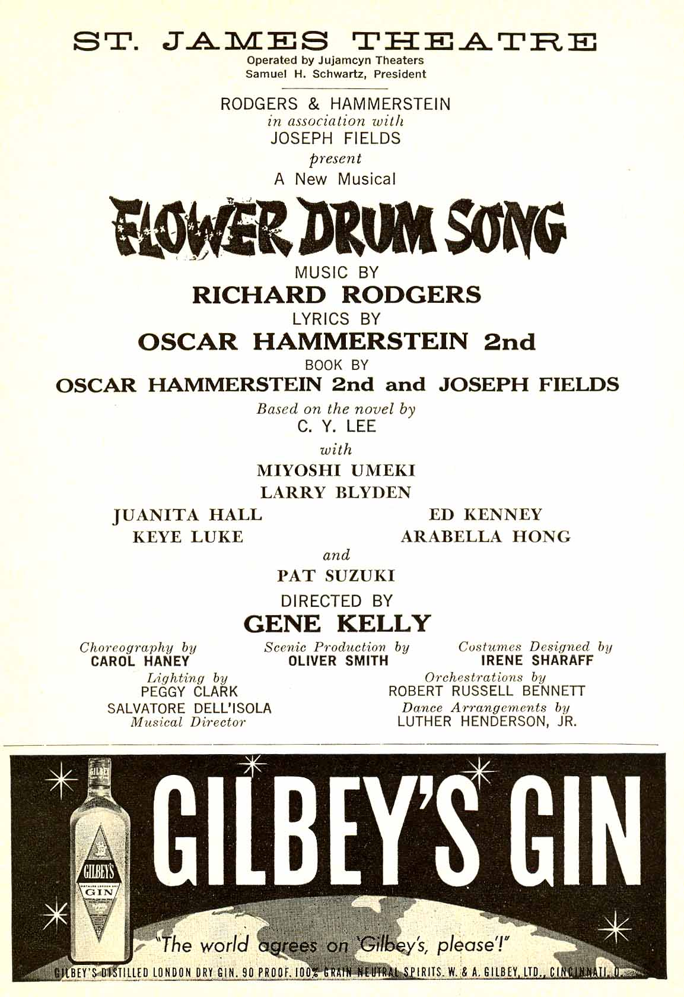

Slide 9
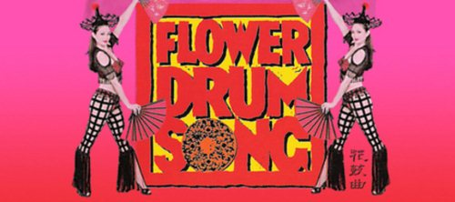
In 2002, a new version with a plot by Chinese American playwright David Henry Hwang (but retaining most of the original songs) opened on Broadway after a successful Los Angeles run.

Slide 10
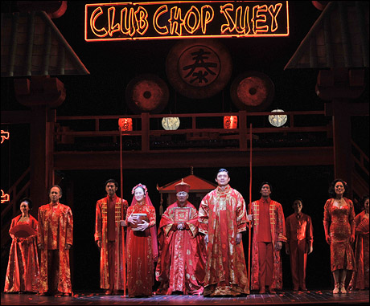
Hwang's story retains the Chinatown setting and the
inter-generational and immigrant themes, and emphasizes the romantic relationships.

Slide 11
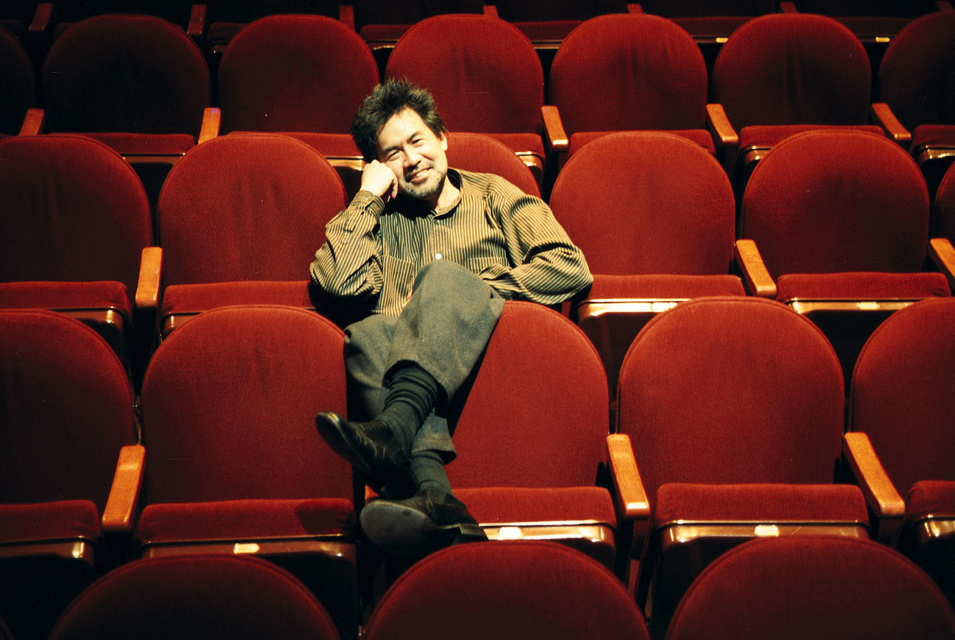

Slide 12
A first for this class in many ways:
Filmed in color
A musical
Predominantly Asian American cast
Set in the U.S., San Francisco in the early ‘60s
The storyline itself features the quintessential Asian American theme of immigrants’ acculturation to life in the U.S., and inter-generation relationships.

Slide 13
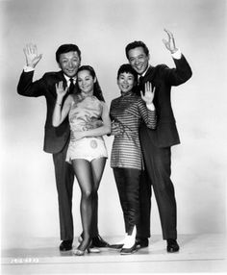
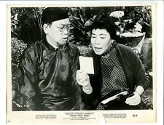

Slide 14
Discussion Questions:

Slide 15
Discussion Questions:
How is the Chinese (American) community represented in this film?

Slide 16
Discussion Question:
How is the Chinese (American) community represented in this film?
Compare to the other films we watched in class.

Slide 17
Discussion Question:
How is the Chinese (American) community represented in this film?
Compare to the other films we watched in class. (Hello paper assignment!)

Slide 18
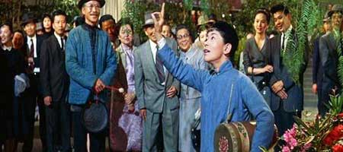
Musical number: “A Hundred Million Miracles”

Slide 19
WWII: Two weeks after the Japanese attack on Pearl Harbor brought the U.S. into the War, Life magazine ran a two-page pictorial entitled “How to Tell Japs from the Chinese” (Lee, 147)
Asian Americans as the “model minority” (Lee, 149-153)
Red Menace: the fear of Communism
Assimilation: nuclear family (middle class, heterosexual, white)

Slide 20
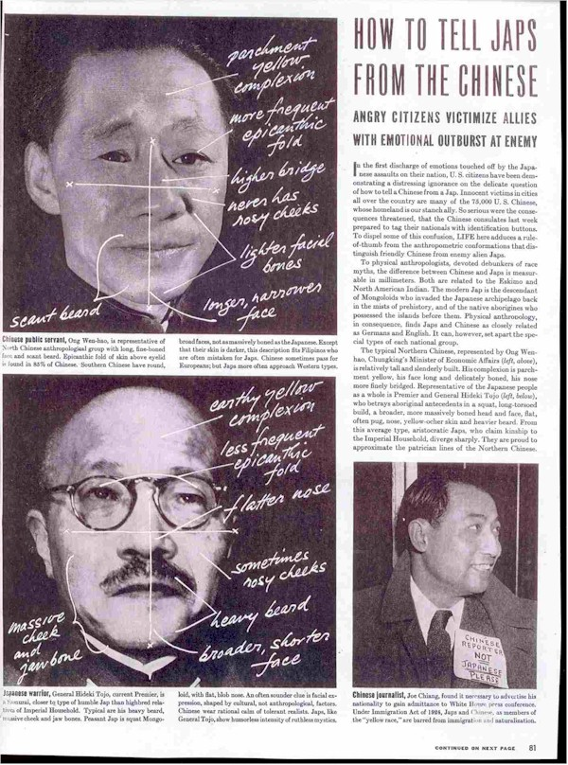
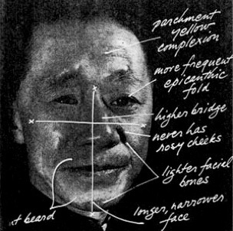
The top picture is an image of the Minister of Economic Affairs of the Chinese government, captioned “Chinese public servant.”

Slide 21
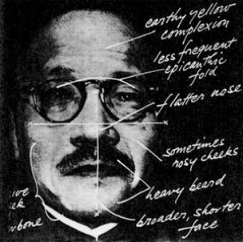
The bottom picture is Admiral Tojo, the Japanese Prime Minister, captioned “Japanese warrior.”

Slide 22
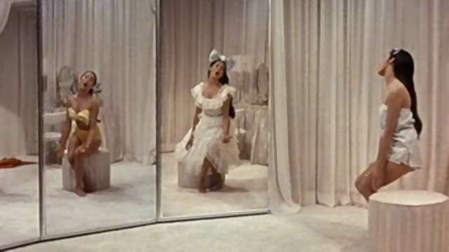
Musical number: “I Enjoy Being A Girl”

Slide 23
Discussion Questions:

Slide 24
Discussion Questions:
How are gender and sexuality represented in this film?

Slide 25
Discussion Questions:
How are gender and sexuality represented in this film?
What, if any, relationships do you see between these issues and class, economics, and consumerism?

Slide 26
Discussion Questions:
How are gender and sexuality represented in this film?
What, if any, relationships do you see between these issues and class, economics, and consumerism?
Do women have agency in this film?

Slide 27
Discussion Questions:
How are gender and sexuality represented in this film?
What, if any, relationships do you see between these issues and class, economics, and consumerism?
Do women have agency in this film? What about the men?

Slide 28
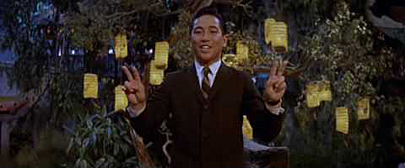
Musical number: “Chop Suey”

Slide 29
Discussion Questions:

Slide 30
Discussion Questions:
How is the community of San Francisco’s Chinatown represented in this number?

Slide 31
Discussion Questions:
How is the community of San Francisco’s Chinatown represented in this number?
And through what elements in the number?

Slide 32
Discussion Questions:
How is the community of San Francisco’s Chinatown represented in this number?
And through what elements in the number?
Do you think this is an authentic representation of an Asian American community?

