Slide 1
ASIAN AMERICANS IN MEDIA
Week 10: Contemporary Topics I
Asian American Feature Films — Mississippi Masala

Slide 2
Key Terms:
Asian American feature films
South Asian diaspora
Interracial relations
Stereotype and realism

Slide 3
Opening / Credit Sequence:
What does this sequence tell you about the film you are about to see?

Slide 4
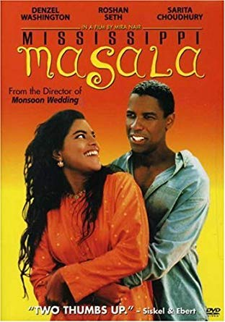
Mississippi Masala (1991)
Dir. Mira Nair
Starring Denzel Washington, Sarita Choudhury, Roshan Seth, Sharmila Tagore, Charles S. Dutton, Joe Seneca

Slide 5
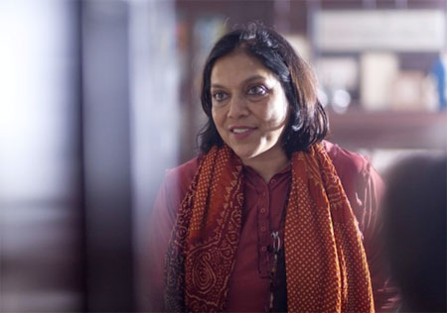
Mira Nair
Born in India, 1957, educated in India and the U.S.
Began her filmmaking career producing documentaries.
Her first feature film is Salaam Bombay! Which won the Camera D’or and Prix du

Slide 6
  Public at the Cannes Film Festival in 1988, and was nominated for Best Foreign Language Film at the Academy Awards in 1989.
Mississippi Masala is her second feature film. Other titles include Kama Sutra: A Tale of Love (1996), The Perez Family (1995), Monsoon Wedding (2001), and The Namesake (2006).
Her most recent film is Queen of Katwe (2016), set in Uganda.

Slide 7
Nair is currently an adjunct professor in Film at Columbia University, which has a collaboration with her Maisha Film Lab. This collaboration offers opportunities for international students to work together and share their interests in film-making.
Mississippi Masala represents the second phase of development in Asian American independent film, as discussed by Tajima, and characterized by institutionalization, pragmatism, and skill attainment.

Slide 8
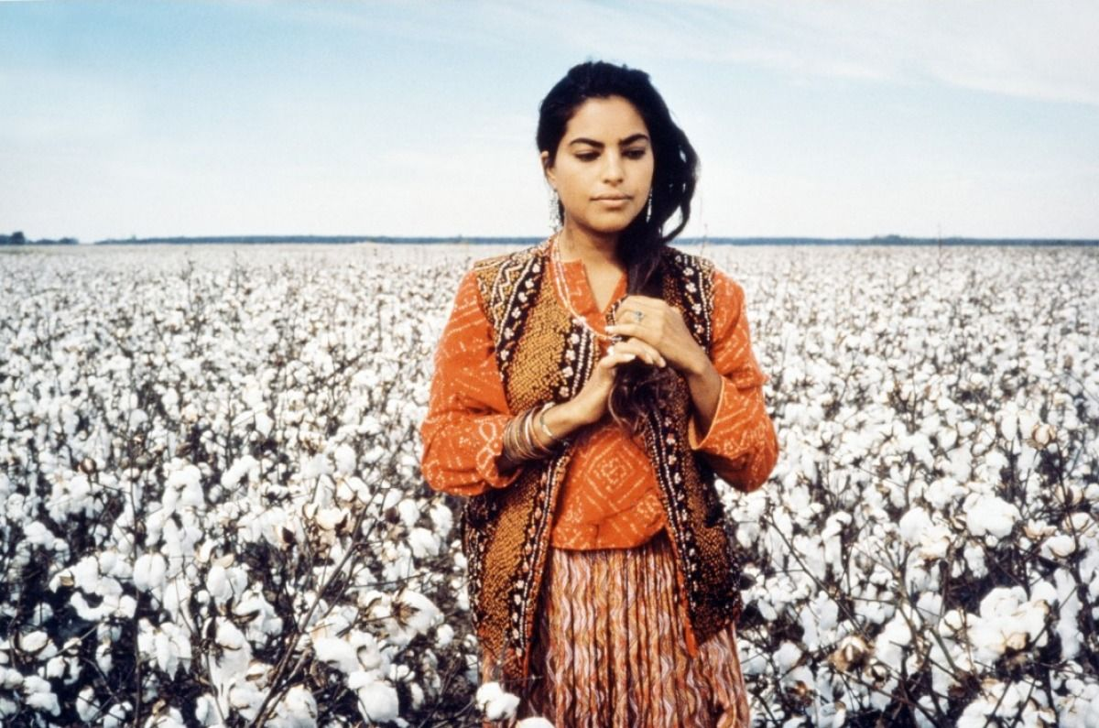

Slide 9
Mississippi Masala and other Asian American feature films from the 1980s and early ‘90s, including Dim Sum (1985) dir. Wayne Wang, Living on Tokyo Time (1987) dir. Steven Okazaki, The Wedding Banquet (1993) dir. Ang Lee, Joy Luck Club (1994) dir. Wang, Picture Bride (1994) dir. Kayo Hatta were made with commercial release and mass audiences in mind.
Nair, along with Lee, Wang, and other continues to make films today.

Slide 10
Discussion Questions:

Slide 11
Discussion Questions:
What is the representational politics of this film? For example, how are the Indians represented?

Slide 12
Discussion Questions:
What is the representational politics of this film? For example, how are the Indians represented?
What about its African American representation?

Slide 14
Discussion Questions:
How does the representation of interracial romance in this film compare to other examples we studied (e.g. Broken Blossoms) in this class?

Slide 15
Discussion Questions:
How does the representation of interracial romance in this film compare to other examples we studied (e.g. Broken Blossoms) in this class?
What about other aspects of interracial relationship depicted in the film?

Slide 17
Comparative Analysis: Mississippi Masala and Voices in the Morning (1992) dir. Meena Nanji

Slide 18
Comparative Analysis: Mississippi Masala and Voices in the Morning (1992) dir. Meena Nanji
What are the similarities and differences between these two media works (representation, formal language, issues)?

Slide 19
Comparative Analysis: Mississippi Masala and Voices in the Morning (1992) dir. Meena Nanji
What are the similarities and differences between these two media works (representation, formal language, issues)?
Compare the representation of South Asian women’s experiences in these two works.

Slide 20
Film Festival Assignment:
Shorts (program about parent/child relationships, immigrant experience)
ASWANG NEXT DOOR (2017) Dir. Bernard Badion
CURD (2019) Dir. Varun Chounal
FIRST GENERATION (2017) Dir. Jeannie Nguyen
ILY (2018) Dir. Jingyi Shao
LIQUOR STORE BABIES (2018) Dir. So Yun Um
INN (2017) Dir. Zion Chan
SISTER (2018) Dir. Siqi Song
SUNNY (2017) Dir. Sam Chung
YASAMIN (2017) Dir. Julia Elihu
Features
GOING BACK TO CHINA (2019) Dir. Emily Ting
LOVE BOAT: TAIWAN (2019) Dir. Valerie Soe
Festival event: date / time / venue?
Programming groups

Slide 21
Discussion Questions:

Slide 22
Discussion Questions:
Do you find any representation in the film stereotypical?

Slide 23
Discussion Questions:
Do you find any representation in the film stereotypical?
Discuss in relationship to the Mehta and Stam/Shohat readings?

Slide 24
Discussion Questions:
Do you find any representation in the film stereotypical?
Discuss in relationship to the Mehta and Stam/Shohat readings?
What are the limitations to stereotype analysis / critique?

