Slide 1
ASIAN AMERICANS IN MEDIA
Week 12: Contemporary Topics II
Asian Americans & Porn

Slide 2
Key Terms:
  Pornography
  On-scenity
  Porn classroom
  Asian male and female sexuality in North American porn
  Race-positive sexuality
  Unknowable subjectivity / unreliable representation / monstrous revolt

Slide 3
Why study porn?

Slide 4
Why study porn?
It’s a media genre like any other;

Slide 5
Why study porn?
It’s a media genre like any other;
All forms of popular culture has social value;

Slide 6
Why study porn?
It’s a media genre like any other;
All forms of popular culture has social value;
It is a big business;

Slide 7
Why study porn?
It’s a media genre like any other;
All forms of popular culture has social value;
It is a big business;
What it tells us about human sexuality and the human body;

Slide 8
Why study porn?
It’s a media genre like any other;
All forms of popular culture has social value;
It is a big business;
What it tells us about human sexuality and the human body;
New media technologies (video and internet);

Slide 9
Why study porn?
It’s a media genre like any other;
All forms of popular culture has social value;
It is a big business;
What it tells us about human sexuality and the human body;
New media technologies (video and internet);
Porn is a part of film history

Slide 10
Why study porn?
It’s a media genre like any other;
All forms of popular culture has social value;
It is a big business;
What it tells us about human sexuality and the human body;
New media technologies (video and internet);
Porn is a part of film history
On/scenity

Slide 11
“Hollywood makes approximately 400 films a year, porn industry makes 10,000-11,000… Porn revenues total between10 and 14 billion dollars annually… bigger than professional football, basketball, and baseball put together.” (Linda Williams, Introduction to Porn Studies)

Slide 12
The Porn Classroom

Slide 13
The Porn Classroom
Have you studied porn before in class?

Slide 14
The Porn Classroom
Have you studied porn before in class? If so, in what context?

Slide 15
The Porn Classroom
Have you studied porn before in class? If so, in what context?
Do we dare to ask: Is this turn me/you/us on? Is there a place for this kind of discussion in the porn classroom?

Slide 16
The Porn Classroom
Have you studied porn before in class? If so, in what context?
Do we dare to ask: Is this turn me/you/us on? Is there a place for this kind of discussion in the porn classroom? (Sexual harassment issues)

Slide 17
The Porn Classroom
Have you studied porn before in class? If so, in what context?
Do we dare to ask: Is this turn me/you/us on? Is there a place for this kind of discussion in the porn classroom? (Sexual harassment issues)
How do we define pornography?

Slide 18
The Porn Classroom
Have you studied porn before in class? If so, in what context?
Do we dare to ask: Is this turn me/you/us on? Is there a place for this kind of discussion in the porn classroom? (Sexual harassment issues)
How do we define pornography?
How do we study porn?

Slide 19
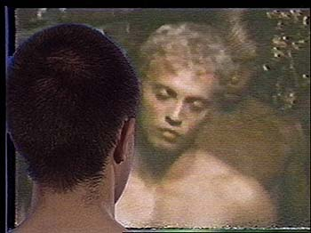
Chinese Characters (1986)
Dir. Richard Fung

Slide 20
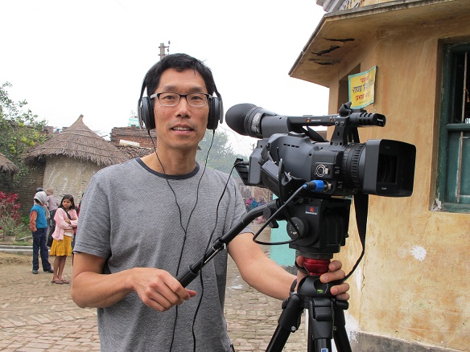
Richard Fung
Canadian Chinese-Trinidadian video artist and cultural theorist.
Born 1954 in Trinidad, based in Toronto. Professor at OCAD University
His video Orientations is one of the first media representations of North American

Slide 21
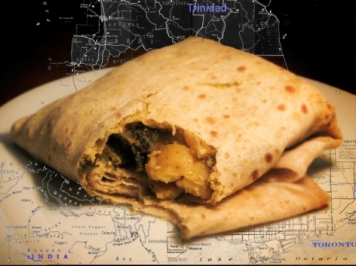
  gay and lesbian Asians
His other videos, including My Mother’s Place (1990), Steam
  Clean (1990), Dirty Laundry (1996), Sea in The Blood (1996) explore issues of race, colonialism, family, AIDS/HIV, sexuality, and diaspora. His most recent work is Dal Puri Diaspora (2012)

Slide 22
Discussion Questions:

Slide 23
Discussion Questions:
What are the different strategies used by Fung to de-stabilize the popular representation of Asian male sexuality in Chinese Characters?

Slide 24
Discussion Questions:
What are the different strategies used by Fung to de-stabilize the popular representation of Asian male sexuality in Chinese Characters?
How successful do you think his strategies were?

Slide 25
Discussion Questions:
What are the different strategies used by Fung to de-stablize the popular representation of Asian male sexuality in Chinese Characters?
How successful do you think his strategies were?
How does Chinese Characters relate to Looking for My Penis?

Slide 26
“As with the vast majority of North American tapes featuring Asians, the problem is not the representation of anal pleasure per se, but rather that the narratives privilege the penis while always assigning the Asian the role of bottom; Asian and anus are conflated.” (P.155)

Slide 27
“Whether we like it or not, mainstream gay porn is more available to most gay Asian men than any independent work you or I might produce. That is why pornography is a subject of such concern for me.” (P.168)

Slide 28
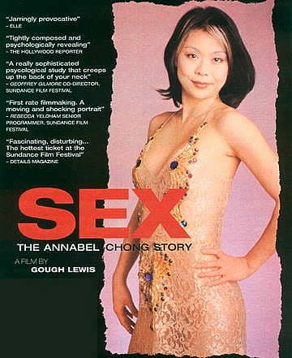
Sex: The Annabel Chong Story
(1999)
Dir. Gough Lewis

Slide 29
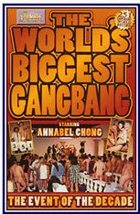
The World’s Biggest Gang Bang
(1995)
Dir. Greg Alves

Slide 30
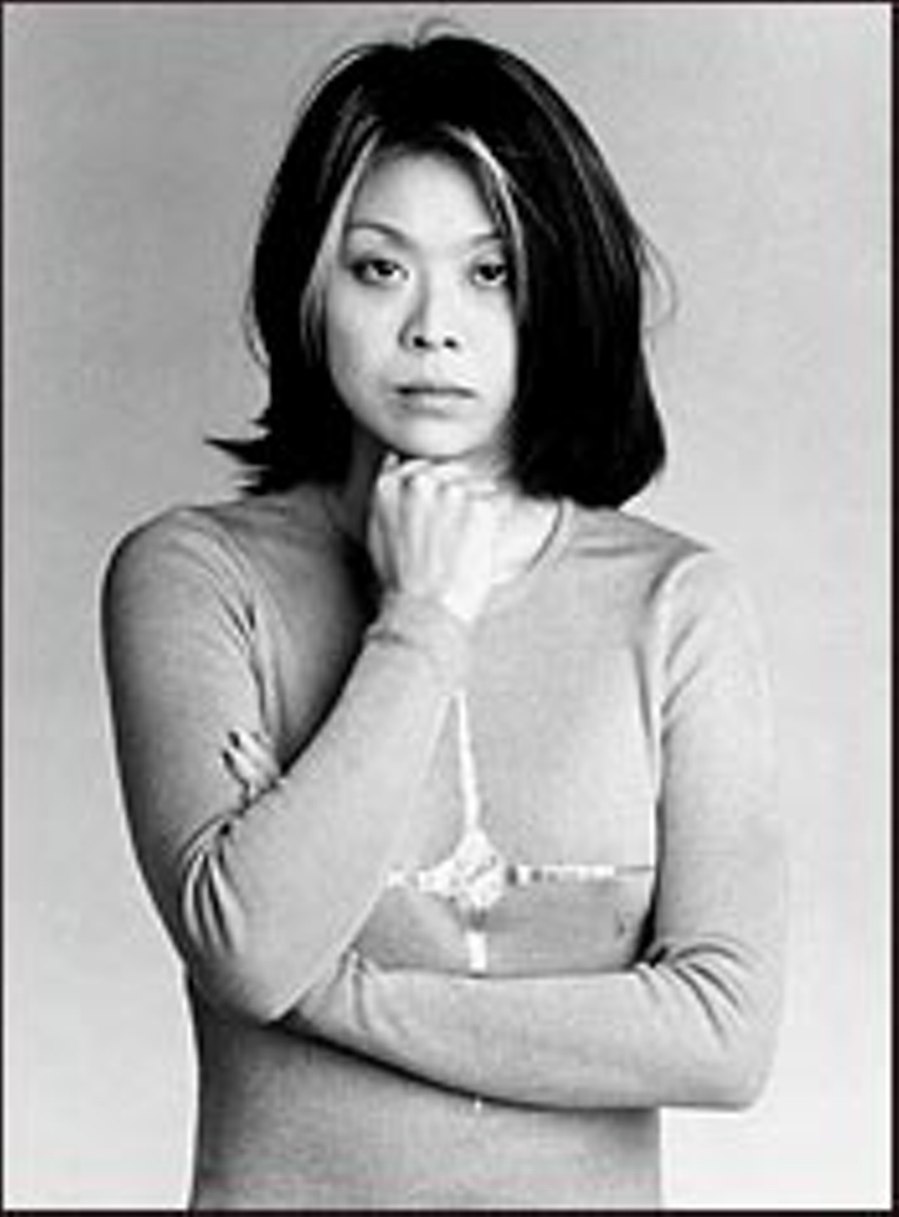
Annabel Chong
Grace Quek, born in Singapore in 1972
Chong acted in 51 films from 1994-2003, directed two films in 1998 and 2000.
In 1995, Chong had sex with 251 men in the porn video The World’s Biggest Gang Bang.

Slide 31
Released in 1999, the video is one of the highest grossing porn films ever. Chong was never paid the $10,000 she was promised.
Concurrent to her porn career, Chong/Quek was also a student at USC, studying art and gender studies.
Sex: The Annabel Chong Story was a documentary made by Gough Lewis, who was a film student when he met Chong and set out to produce a film about her.

Slide 32
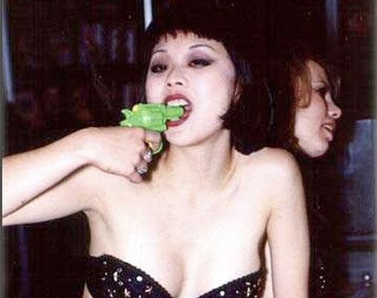
Parreñas Shimizu noted in her book that in recent years “Asian” becoming synonymous with anal
  sex and other extreme sexual activities, such as the special acrobatics of double and triple penetration and gangbangs in contemporary pornography.

Slide 33
Discussion Questions:

Slide 34
Discussion Questions:
Parreñas wrote that Chong took “the hypersexuality of Asian women to the extreme by embracing whoredom as a feminist practice rooted in her racial and cultural situation.” Do you see that in the media representations of her shown in class?

Slide 35
Discussion Questions:
Parreñas wrote that Chong took “the hypersexuality of Asian women to the extreme by embracing whoredom as a feminist practice rooted in her racial and cultural situation.” Do you see that in the media representations of her shown in class?
What do you think Parreñas means by Chong’s “unknowable subjectivity and unreliable representation”?

Slide 36
What about her “monstrous revolt”?

Slide 37
What about her “monstrous revolt”?
Is Chong a feminist artist, as she claims in the film?

Slide 38
What about her “monstrous revolt”?
Is Chong a feminist artist, as she claims in the film? Is she a model minority porn star?

Slide 39
What about her “monstrous revolt”?
Is Chong a feminist artist, as she claims in the film? Is she a model minority porn star?
“In various publications, she resists commodification by forwarding a deeply contradictory identity that negotiates not only the binds of pain and pleasure but good and bad. She does so in nicely spoken ways that seem to counter well her affinity for nasty sexual practices.” (P. 175)

Slide 40
Parreñas’s theory of race-positive sexuality:
“A formulation that brings together the concerns of black feminist theory regarding pornography and sex-positive discourse who present pleasure, pain, and trauma simultaneously in ways that embrace the liberating possibilities of sexuality while acknowledging the risk of reifying perversity and pathology traditionally ascribed to women of color in popular culture.” (P.144)

