Slide 1
ASIAN AMERICANS IN MEDIA
Week 3: The ‘Good’ Chinese —The Good Earth

Slide 2
Key Terms:
the Hollywood Chinese
Racial discrimination in Hollywood
Pre-WWII representational politics

Slide 3
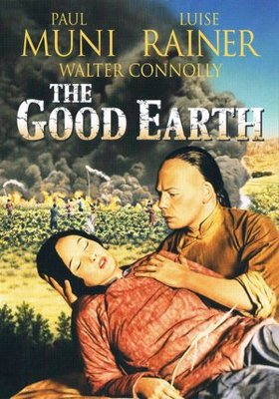
The Good Earth (1938)
Dir. Sidney Franklin
Starring Paul Muni, Louise Rainer, Keye Luke, Tilly Losch, & Philip Ahn

Slide 4
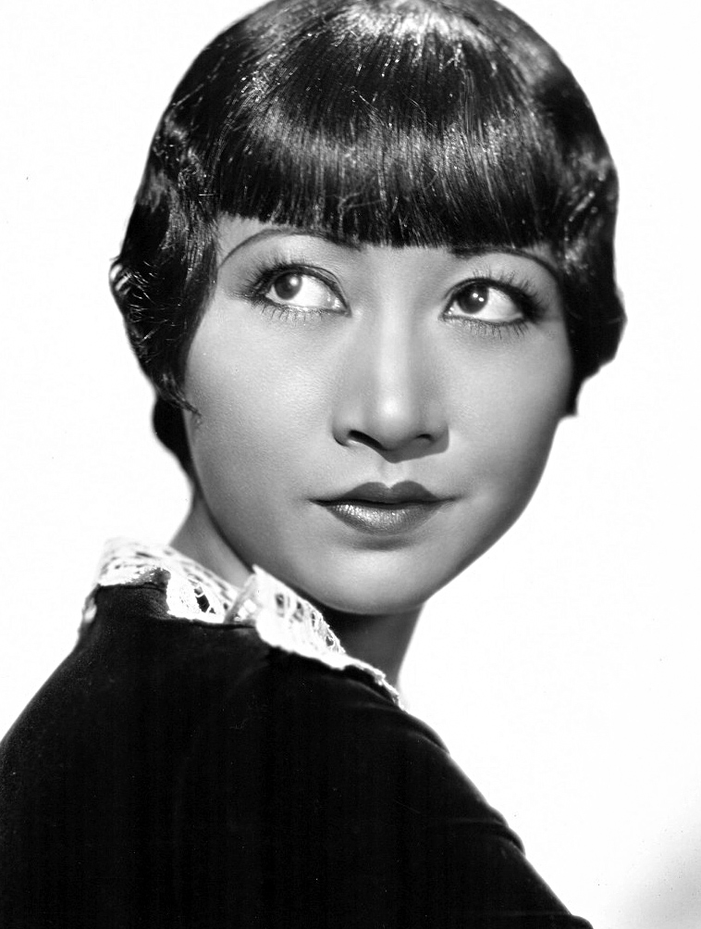
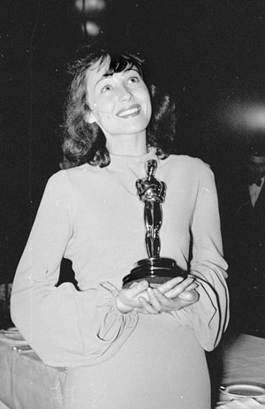
Anna May Wong lost the role of O-Lan to Luise Rainer, who won an Academy Award (Oscar) for Best Actress in 1938 for her portrayal of O-Lan.

Slide 5
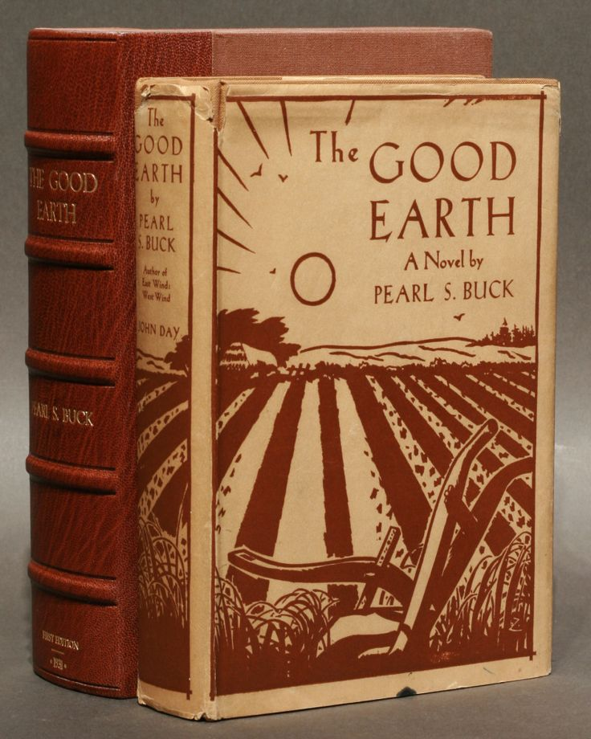
Based on a novel of the same title by Pearl S Buck, published in 1931.
The Good Earth was the best-selling fiction book in the U.S. in 1931 and 1932, and won the Pulitzer Prize in 1932.
In 1938, Buck was awarded the Nobel Prize in Literature “for her rich and truly epic descriptions of peasant life in China and for her biographical masterpieces.”

Slide 6
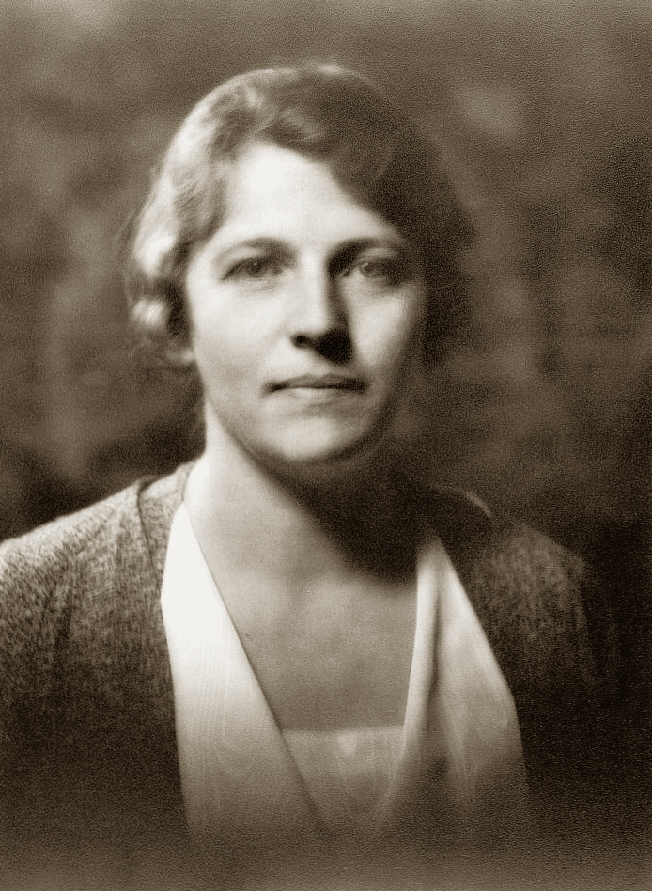
Pearl Sydenstricker Buck, also known by her Chinese name Sai Zhenzhu (賽珍珠) was born in the U.S. and raised in China, where her parents were missionaries. She was raised in a bilingual – English/Chinese - environment

Slide 7
She married John Lossing Buck in 1917 and they both taught in the University of Nanking from 1920-1933. In 1934, she left China and returned to the U.S.
She was the first American woman to win the Nobel Prize for Literature. In her speech to the Academy, she explained, ”I am an American by birth and by ancestry,” but “my earliest knowledge of story, of how to tell and write stories, came to me in China.”

Slide 8
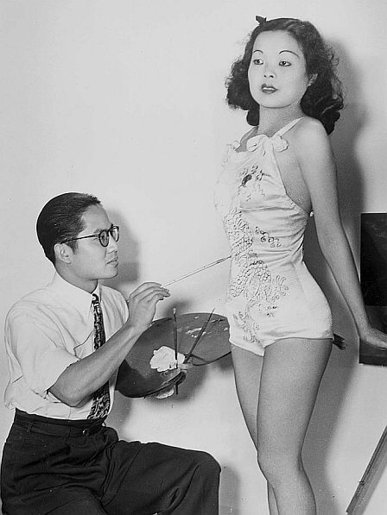
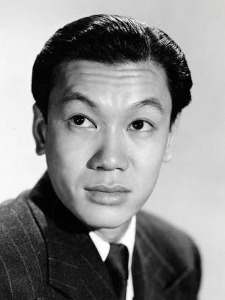
Asian Americas in 1930s Hollywood

Slide 9
The Hollywood Chinese
Charles Leong, a Chinese American extra in The Good Earth (We read from his first-hand account this week.)
“All Chinese look alike” - the Los Angeles Chinese American community that gathered around the production of a series of film productions about China in the late 1930s.
Young Chinese Americans having to learn to “play Chinese”.

Slide 10
A Chinese village re-constructed in Chatsworth, CA.
Tom Gubbins, the Irishman who controls the Chinese actors/prop market.
The relationship between White actors (who got all the main parts, playing in “yellowface”) and Chinese American extras
Other Asian American actors from this period including Philip Ahn (Chinese revolutionary officer) and his brother Philson

Slide 11
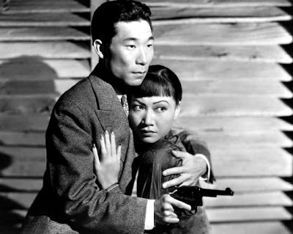
Ahn (Chinese famer talking about the locusts), Keye Luke (elder son), Ronald Lui (second son), Benson Fong, Luke Chan and others. They were, for the most part, un-credited in their film roles from this period.

Slide 12
“I was barefooted and hoeing a thin row of rice shoots. I felt the warmth of the soil. I was in China. And the back of me, a camera followed my every action.” (Charles Leong)
“the Hollywood Chinese is a paradox, an oriental mosaic in the cinematic pattern created through no effort of its own, and yet a most vital part of the whole design; that in this land of movies and madness, cuties and quixotism, your chop-suey waiter of today may perform tomorrow on the screen

Slide 13
as your favorite warlord; that an Irishman controls the Chinese actor’s market; that the only Chinese temple I ran across in Hollywood was Shirley Temple, when she spoke Mandarin in the picture Stowaway (1936); that where else and how else would I have a chance to play billiards with Gary Cooper?” (Charles Leong)

Slide 14
“a minor footnote to that humongously diverse cast of "Chinese peasants," la Hepburn was trailing her 50-thou, reported, mink through the dust and mud of the Calabasas outdoor sets. For me, it was a 17-week lark, at 175 a week, to bear witness to Hollywood patronizations of celestial proportions… And not a hell of a lot has changed, as witness the current teleblurb featuring "Chinese" emigres who "bow" like "Japanese." They still can't tell us apart, nor do they seem to care.” (Frank Eng, who was in Dragonseed, 1944, also based on a Pearl Buck novel)

Slide 15
Discussion Questions:

Slide 16
Discussion Questions:
How does the representation of the Chinese differ between this and the previous 2 films we watched in class?

Slide 17
Discussion Questions:
How does the representation of the Chinese differ between this and the previous 2 films we watched in class?
Can we speculate on some of the reasons for this change in the representation? (artistic, cultural, social, political)?

Slide 18
Discussion Questions:
How does the representation of the Chinese differ between this and the previous 2 films we watched in class?
Can we speculate on some of the reasons for this change in the representation? (artistic, cultural, social, political)?
What do you think Charles Leong meant when he wrote: “the Hollywood Chinese is a paradox”?

Slide 19
Describe the filmic language.

Slide 20
Describe the filmic language.
And consider this language in relationship to its representational politics (gender, race, class, etc.)

Slide 21
