Slide 1
ASIAN AMERICANS IN MEDIA
Week 9: Meanwhile, in Hollywood…Year Of The Dragon

Slide 2
Key Terms:
  Postmodernism
  Spectacle
  Interracial romance and sexuality
  The crisis in “grand narratives”
  The return of the Yellow Peril
  Yellow Perils meets Model Minority

Slide 3
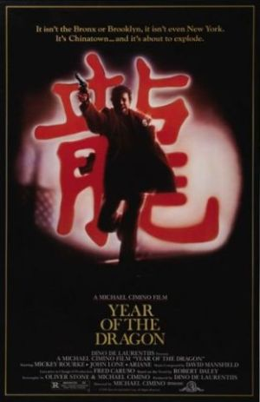
Year of The Dragon (1985)
Dir. Michael Cimino
Screenplay by Oliver Stone and Cimino
Produced by Dino De Laurentiis

Slide 4
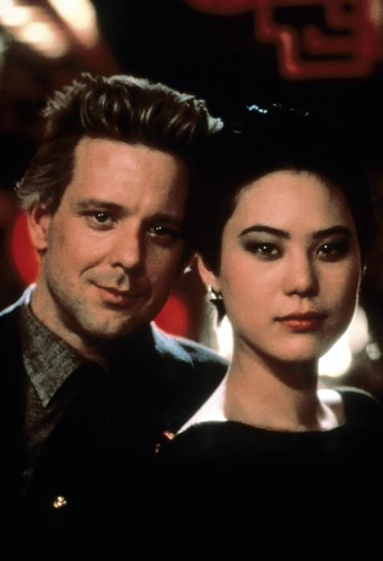
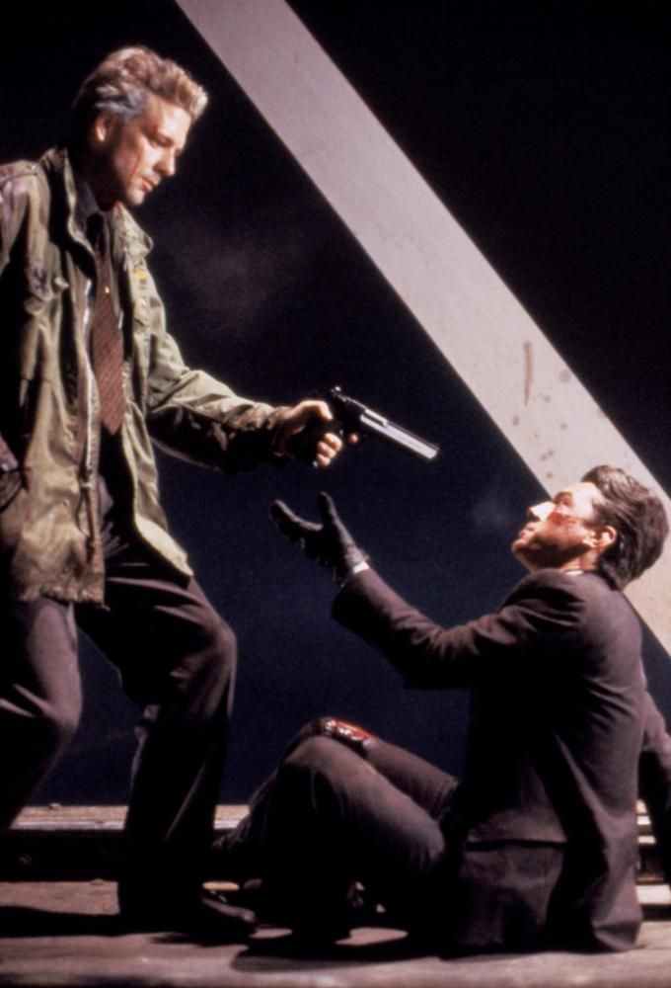
Starring Mickey Rourke, Jone Lone, & Ariane

Slide 5
A Hollywood studio production (MGM/UA), adapted from a novel by Robert Daley
Set in New York’s Chinatown
The film was protested by Chinese American and Asian American groups when it opened.
As a result, a disclaimer was attached to its opening credits: “

Slide 6
"This film does not intend to demean or to ignore the many positive features of Asian Americans and specifically Chinese American communities. Any similarity between the depiction in this film and any association, organization, individual or Chinatown that exists in real life is accidental."

Slide 7
Director Cimino responded to the controversy in an interview in Jeune cinéma: "The film was accused of racism, but they didn’t pay attention to what people say in the film. It’s a film which deals with racism, but it’s not a racist film…”

Slide 8
Discussion Questions:

Slide 9
Discussion Questions:
Based on the opening of the film, how would you characterize its depiction of the New York Chinatown as a community?

Slide 10
Discussion Questions:
Based on the opening of the film, how would you characterize its depiction of the New York Chinatown as a community?
Do you think the film is racist?

Slide 11
Discussion Questions:
Based on the opening of the film, how would you characterize its depiction of the New York Chinatown as a community?
Do you think the film is racist?
What has changed in the representation of Chinese Americans in Hollywood cinema since the 1970s?

Slide 12
Discussion Questions:
Based on the opening of the film, how would you characterize its depiction of the New York Chinatown as a community?
Do you think the film is racist?
What has changed in the representation of Chinese / Asian Americans in Hollywood cinema since the 1970s?

Slide 13
Discussion Questions:
Why should we care about these stereotypes?

Slide 14
Discussion Questions:
Why should we care about these stereotypes?
What are the possible effects of some of these images?

