Slide 1
FILM SOUND
Introduction: Sound, Sound Studies, Film Sound

Slide 2
What is sound?

Slide 3
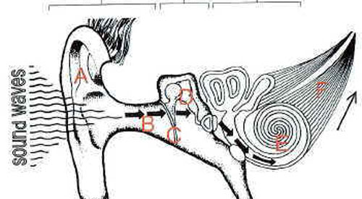

Slide 4
How do we study sound?

Slide 5
How do we study sound?
Audio and visual (the sensorium)

Slide 6
How do we study sound?
Audio and visual (the sensorium)
Hearing and listening

Slide 7
How do we study sound?
Audio and visual (the sensorium)
Hearing and listening
Sound and visual cultures

Slide 8
How do we study sound?
Audio and visual (the sensorium)
Hearing and listening
Sound and visual cultures
Sound studies

Slide 9
Film Sound

Slide 10
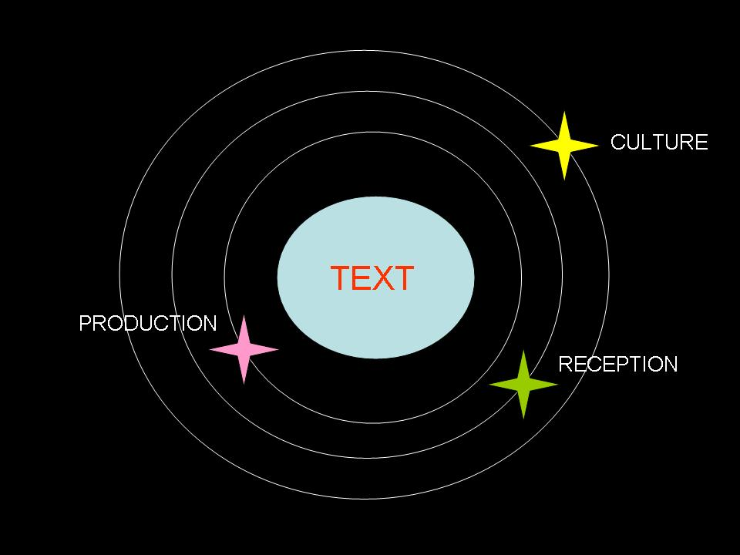
Cinema as Text (Traditional Film Studies)

Slide 11
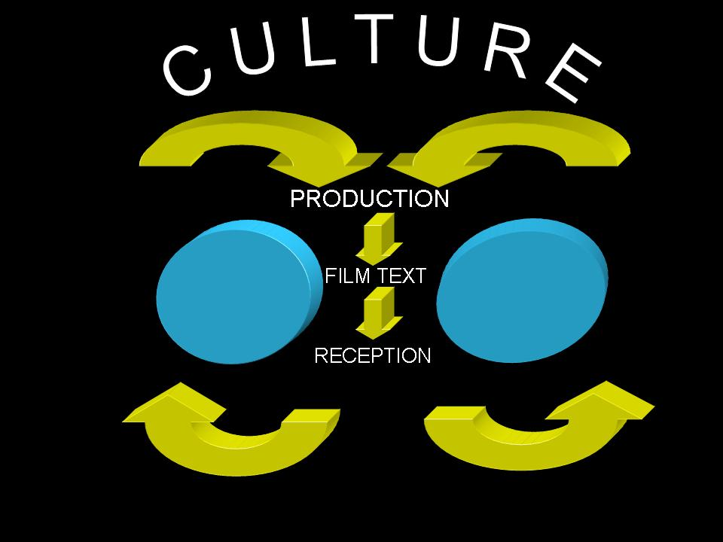
Cinema as Event (Altman’s Model)

Slide 12
CINEMA AS EVENT
From production to reception, and vice versa
Multiplicity
Three-Dimensionality
Materiality
Heterogeneity
Intersection
Performance
Mutli-Discursivity
Instability

Slide 13
Mediation
Choice
Diffusion
Interchange

Slide 14
Film Sound
Comparative discussion based on our observation of these ‘films’

Slide 15
Wochenende (The Weekend), 1930, Dir. Walter Ruttmann

Slide 16
L'arrivée d'un train en gare de La Ciotat (The Arrival of a Train at La Ciotat Station), 1895, Dir. Lumière brothers (Auguste and Louis)

Slide 17
SOUND THEORY SOUND PRACTICE
Sound Events:
The production of sound is a material event
Vibration, medium, changes in pressure
The composite nature of sound

Slide 18
“The production of sound is a material event, taking place in space and time, and involving the disruption of surrounding matter.” (p. 18)

Slide 19
SOUND THEORY SOUND PRACTICE
The Sound Narrative:
The naming of sounds
Sound, space, and time
”Our ears tell us.” (p. 22) What does Altman mean by this?

Slide 20
“Constantly delayed, dampened, reinforced, overlapped and recombined, sound provides us with much of the information we need to understand its origins and itineraries­­—but the existing terminology clearly does not.” (p. 23)

Slide 21
SOUND THEORY SOUND PRACTICE
Sound Record & Reproduction:
Every record = a particular hearing
“Recorded sound thus always carries some record of the recording process, superimposed on the sound event itself.” (p. 26)
“Recordings are thus always representations…” (p. 27)

Slide 22
SOUND THEORY SOUND PRACTICE
Sound Record & Reproduction:
Playback – device (comprehensibility), space (re-design of exhibition spaces)
Cocktail party effect

Slide 23
“Usually discussed as the most transparent of classical narratives, sound is in fact a Rashomon phenomenon, existing only in the separate stories of the various perceivers of the original event.” (p. 24)

Slide 24
“Usually discussed as the most transparent of classical narratives, sound is in fact a Rashomon phenomenon, existing only in the separate stories of the various perceivers of the original event.” (p. 24)

Slide 25
Fallacies In Film Sound Theory:
Historical

Slide 26
Fallacies In Film Sound Theory:
Historical
Ontological

Slide 27
Fallacies In Film Sound Theory:
Historical
Ontological
Reproduction

Slide 28
Fallacies In Film Sound Theory:
Historical
Ontological
Reproduction
Nominalism

Slide 29
Fallacies In Film Sound Theory:
Historical
Ontological
Reproduction
Nominalism
Cinema as index

Slide 30
“To study film sound is to take seriously the multiplicity of possible determinants of any given audience perception. As a complex representation of a complex sound event, cinema sound offers sound designers infinite possibilities for creation and obfuscation. As such, it also offers theoreticians and critics of cinema sound fascinating opportunities to recognized and analyze the techniques, conventions, codes, and ideological investments of the sound chain.”
(p. 31)

Slide 31
“To study film sound is to take seriously the multiplicity of possible determinants of any given audience perception. As a complex representation of a complex sound event, cinema sound offers sound designers infinite possibilities for creation and obfuscation. As such, it also offers theoreticians and critics of cinema sound fascinating opportunities to recognized and analyze the techniques, conventions, codes, and ideological investments of the sound chain.”
(p. 31)

