Slide 1
II. Film Sound Theories
2. Voice in Cinema

Slide 2
The Voice in Cinema
“This is neither a history nor an anthology, but rather an outline for a theory of the film as sound film” (Chion, ix)
This book is primarily concerned with the speaking voice
Published in 1982
A different intellectual milieu in France
3 prominent forces – all gave prominence to the voice in different ways
“the voice is in the air” (Chion)

Slide 3
Freudian and Lacanian psychoanalysis in literary and film studies;
French feminism and its investigation of the gendered structure in language;
The cinematic and narrative experiments of Marguerite Duras

Slide 4
Chion’s Key Statements and Questions:
“There is no sound track”: synchronized sound is “swallowed up” in the image’s false depth and fiction (Chion calls it “an instantaneous perceptual triage” p. 3)
Where do cinematic voices come from?
What is unique about voices in cinema?

Slide 5
Voco/verbocentrism
The Acousmêtre – what is it? Where does it come from? What are its characteristics?
De-acousmatization
The I-Voice

Slide 6
Corporeal Implication
The Anacousmêtre
Synchronism: nailing and rigging, dubbing / possession
Impossible embodiment

Slide 7
In French:
  Embodiment (mise-en-corps)
  Entombment (mise en bière)
  Interment (mise en terre)

Slide 8
Postmodern Acousmêtres

Slide 9
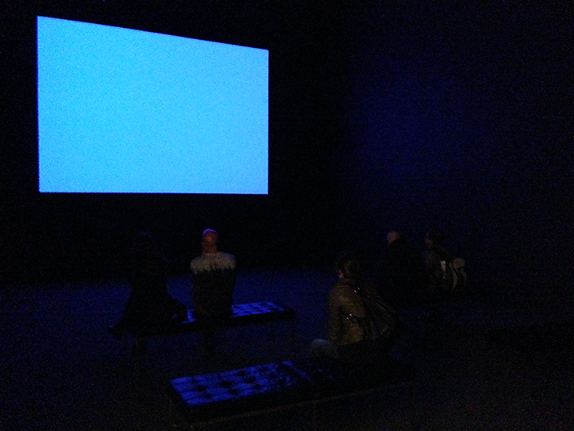
Blue (1993) Dir. Derek Jarman
Shown as an installation with DVD projection in MOMA’s Contemporary Galleries, 1980-Now; October 20, 2013

