Slide 1
II. Film Sound Theories
3. Feminist Film Theory

Slide 2
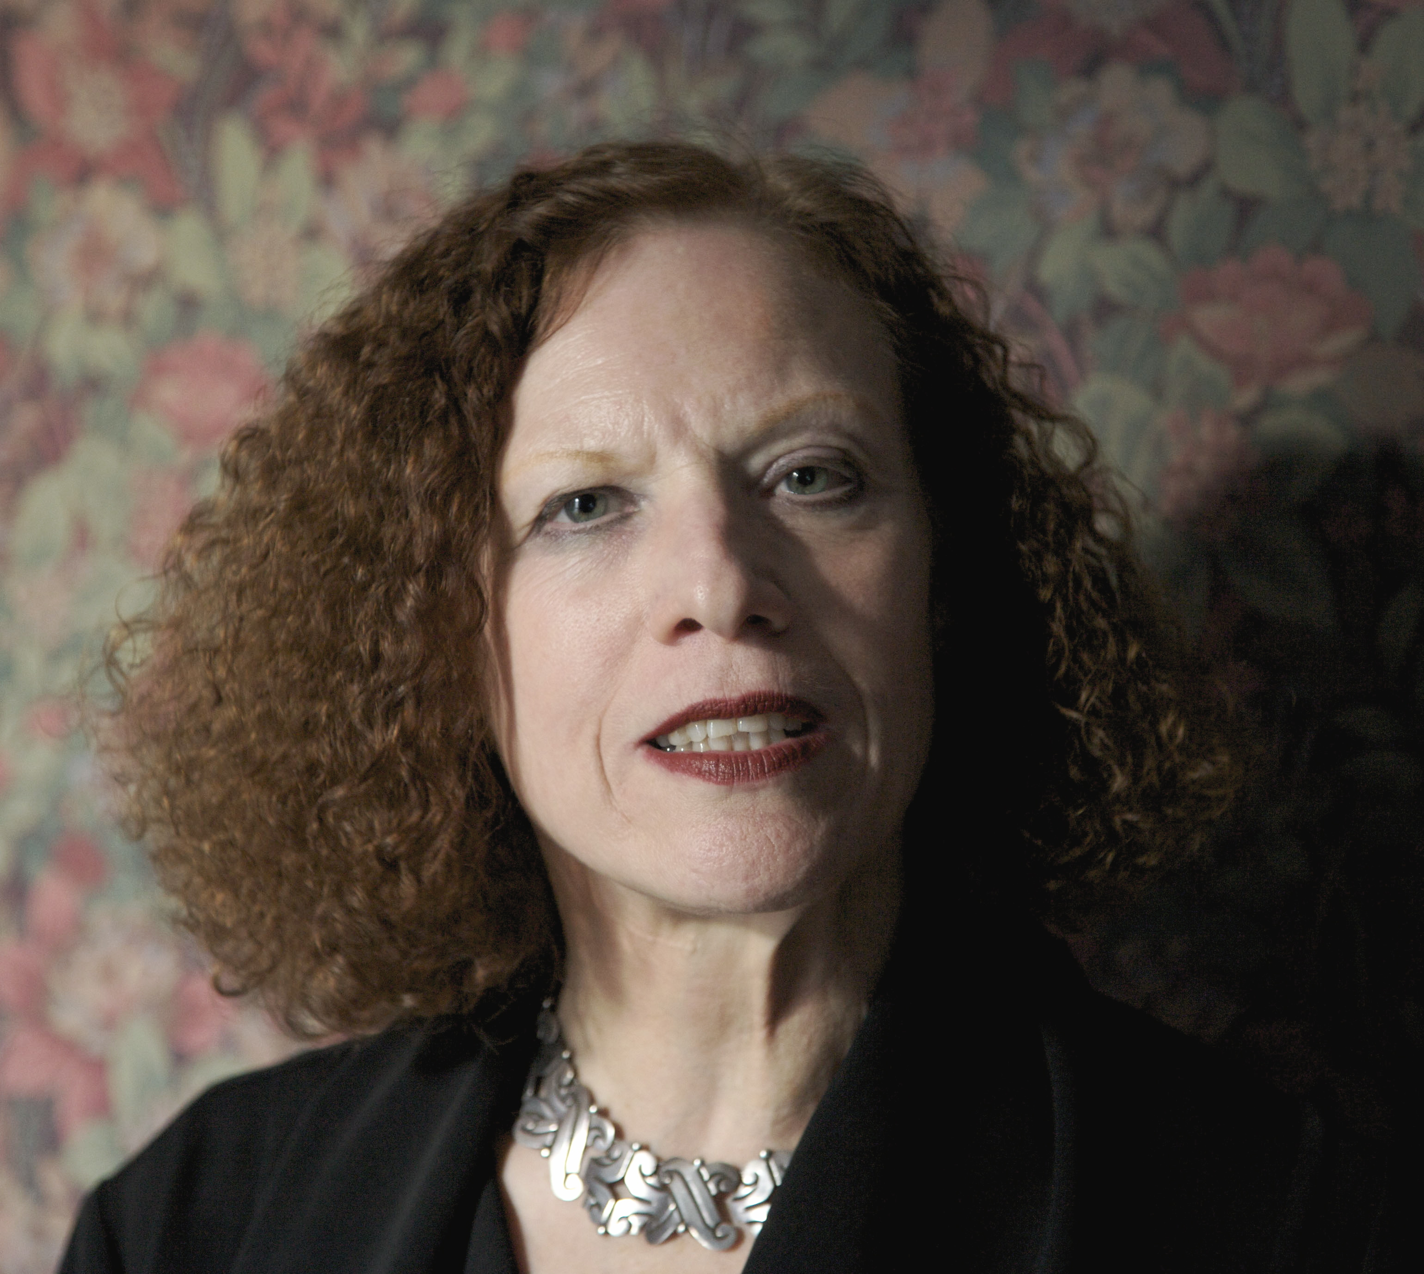
She is Keith and Kathy Sachs Professor of Art History of Art at the University of Pennsylvania
She is the author of nine books, including works that draw from psychoanalysis: The Acoustic Mirror and Male Subjectivity at the Margins. Her new book, The Miracle of Analogy, published in 2015, is the first volume in a two-volume reconceptualization of photography.
She writes and teaches on phenomenology, psychoanalysis, photography, cinema, painting, as well as feminist theory.
Kaja Silverman

Slide 3
The Acoustic Mirror
This book is concerned with the female voice in psychoanalysis and cinema
Published in 1988
The influence of post-structuralist theory, deconstruction, and Freudian and Lacanian psychoanalysis on feminist film theory in the late 1970s and 1980s

Slide 4
Why psychoanalysis?
How does Silverman use psychoanalysis to discuss the particular position of women’s voices in narrative cinema?

Slide 5
SINGIN’ IN THE RAIN:
Sonic vraisemblable
Dubbing and synchronization
Male and female subjectivity: exteriority and interiority
Invagination

Slide 6
Fantasies of The Mother’s Voice:
Subject formation: the mother’s voice as acoustic mirror, sonorous envelope
Dystopic fantasy / abject: web-like, entrapment, engulfment; Chion
Utopic fantasy / objet (a): plenitude and bliss, idyllic unity of mother and child; Rosolato and Kristeva

Slide 7
Chora: signifier for the moment prior to the Mirror Stage and the Symbolic, an image of unity between mother and child, associated with music and poetry
The mother speaks: Laura Mulvey’s “voice-off” in RIDDLES OF THE SPHINX

Slide 8
The Screaming / Crying Point:
The Screaming Point (Chion, pp.76-77)
The Point of the Cry (Silverman, p. 77)
Is the screaming / crying point always beyond meaning and subjectivity?

