Slide 1
I. ‘Silent’ to Sound Cinema
2. Silent Film Sound

Slide 2
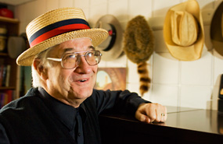
Rick Altman
Professor in Cinema and Comparative literature at University of Iowa
Also written books on the musical film genre, and edited a book on sound theory and practice that we will read from later this semester.

Slide 3
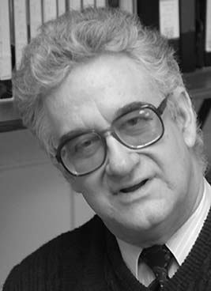

Slide 4
Silent Film Sound, the book:
Developing “a new history of American cinema reconfigured through sound”
This is an ambitious and extensively researched book – how to read it for class
“…rummage around at the bottom of the barrel”
Existing field of silent film sound
His methodology: Crisis Historiography

Slide 5
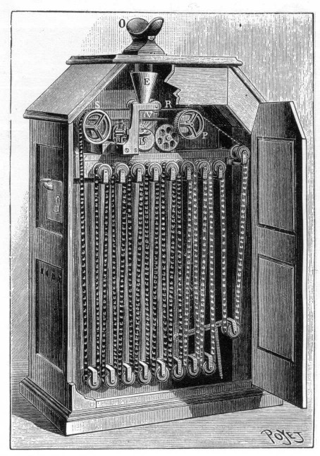
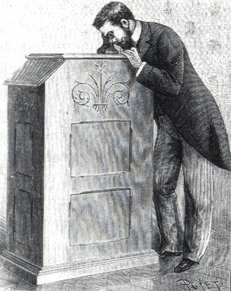
Kinetoscope

Slide 6
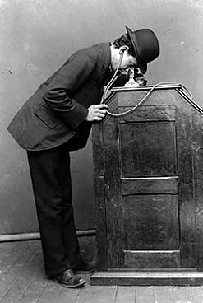
Kinetoscope with sound

Slide 7
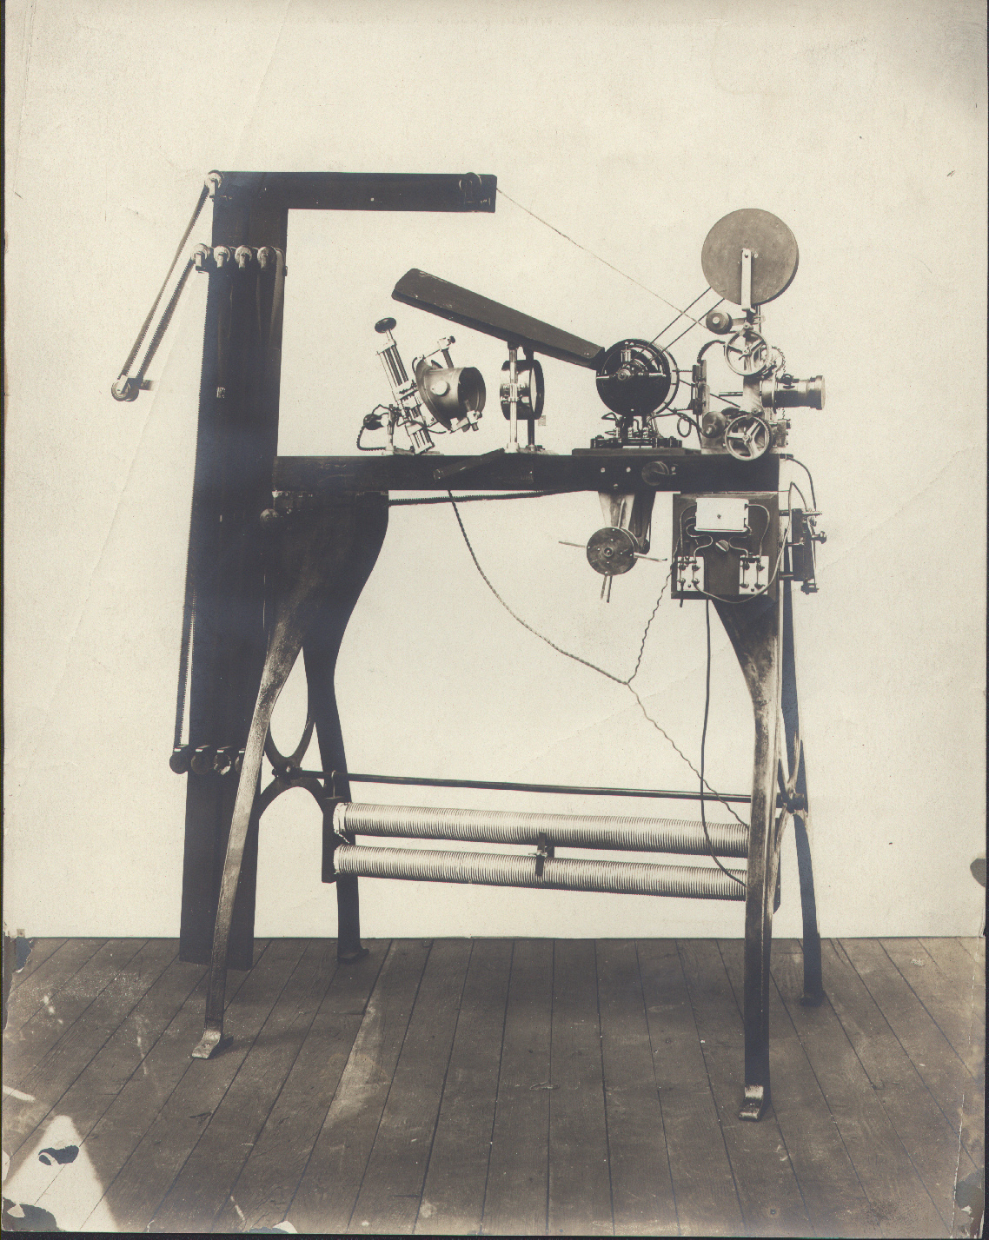
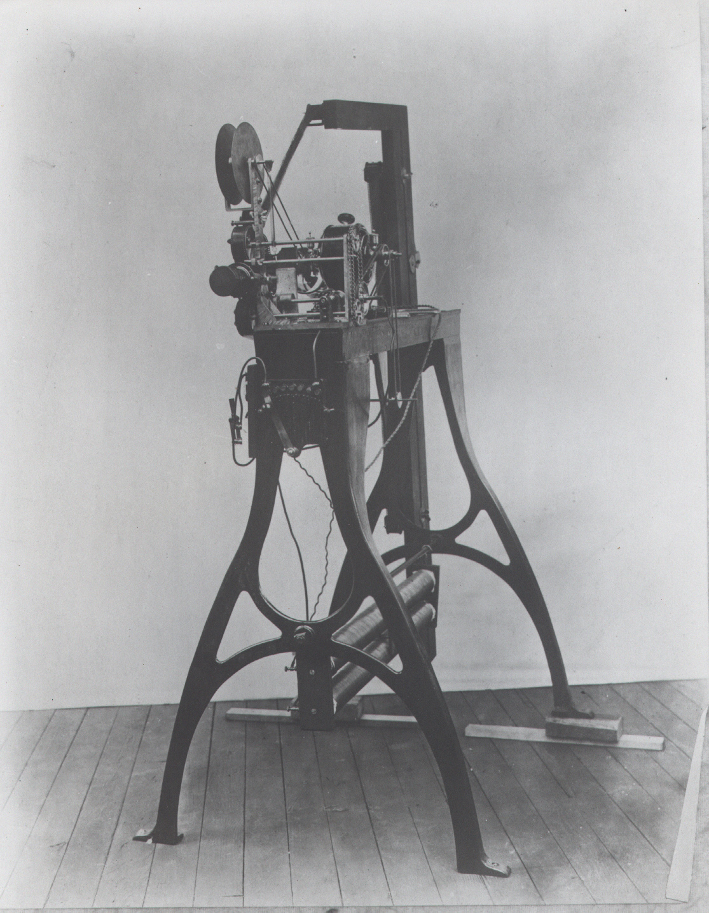
Edison Vitascope, 1896

Slide 8
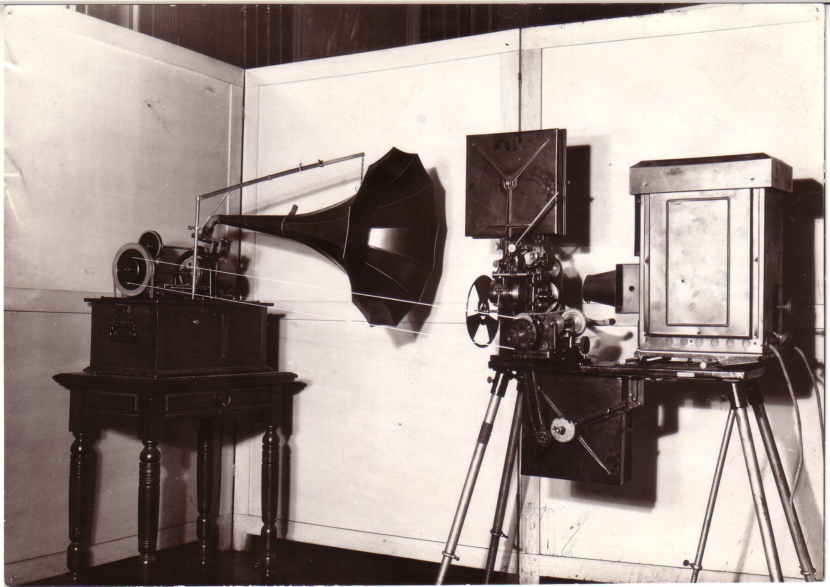
Edison Kinetophone

Slide 9
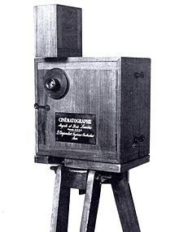
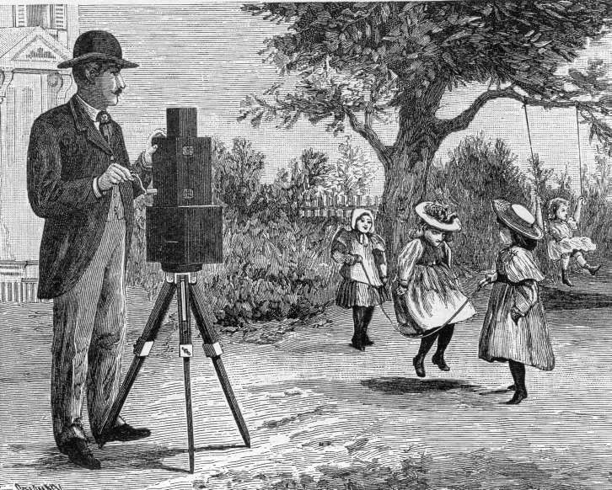
Cinematographe, as camera

Slide 10
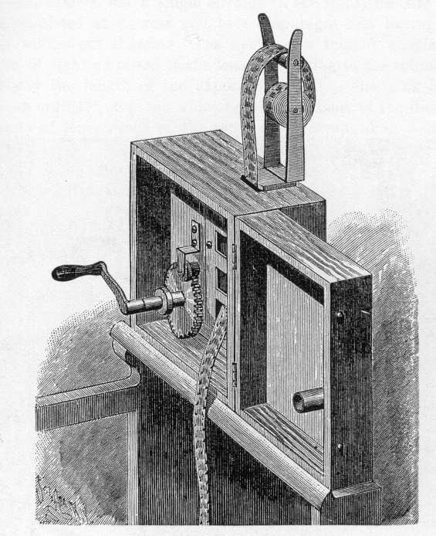
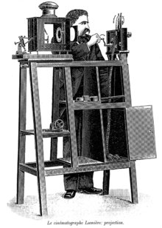
Cinematographe, as projector

Slide 11
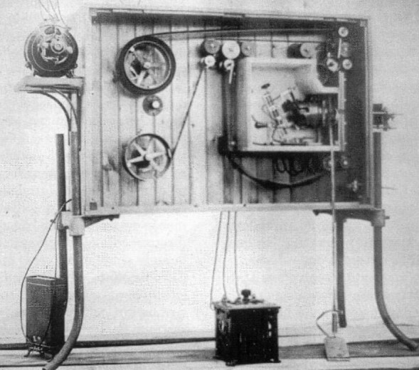
Biograph

Slide 12
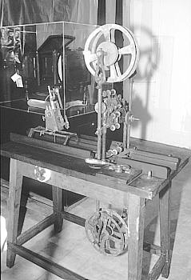
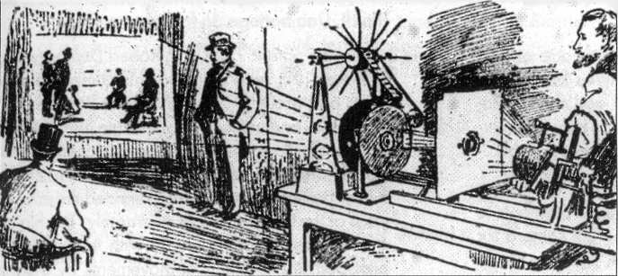
Eidoloscope and Panoptikon

Slide 13
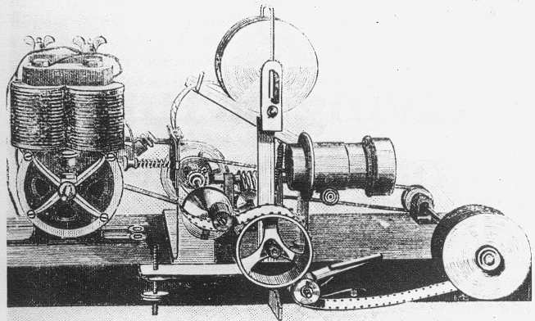
Phantoscope

Slide 14
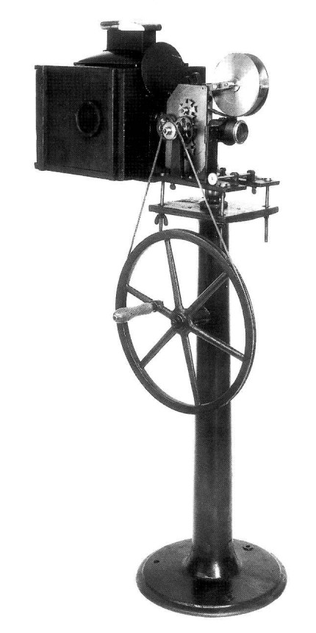
Theatrograph

Slide 15
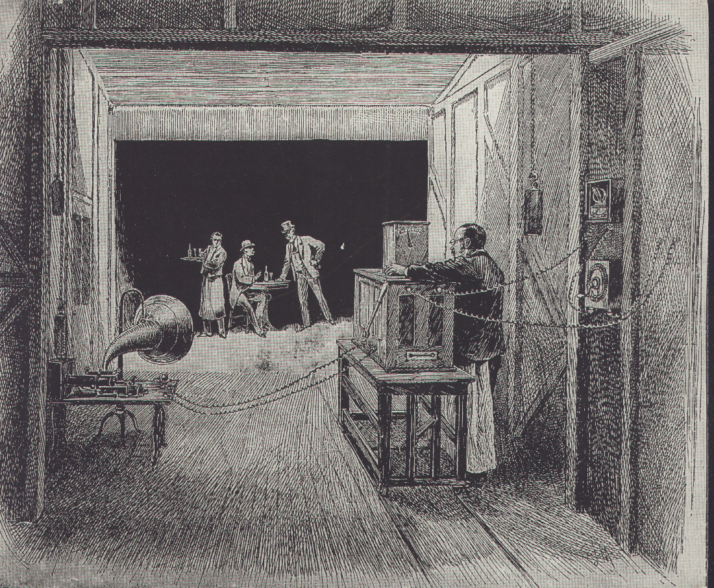
Kinetographic theatre

Slide 16
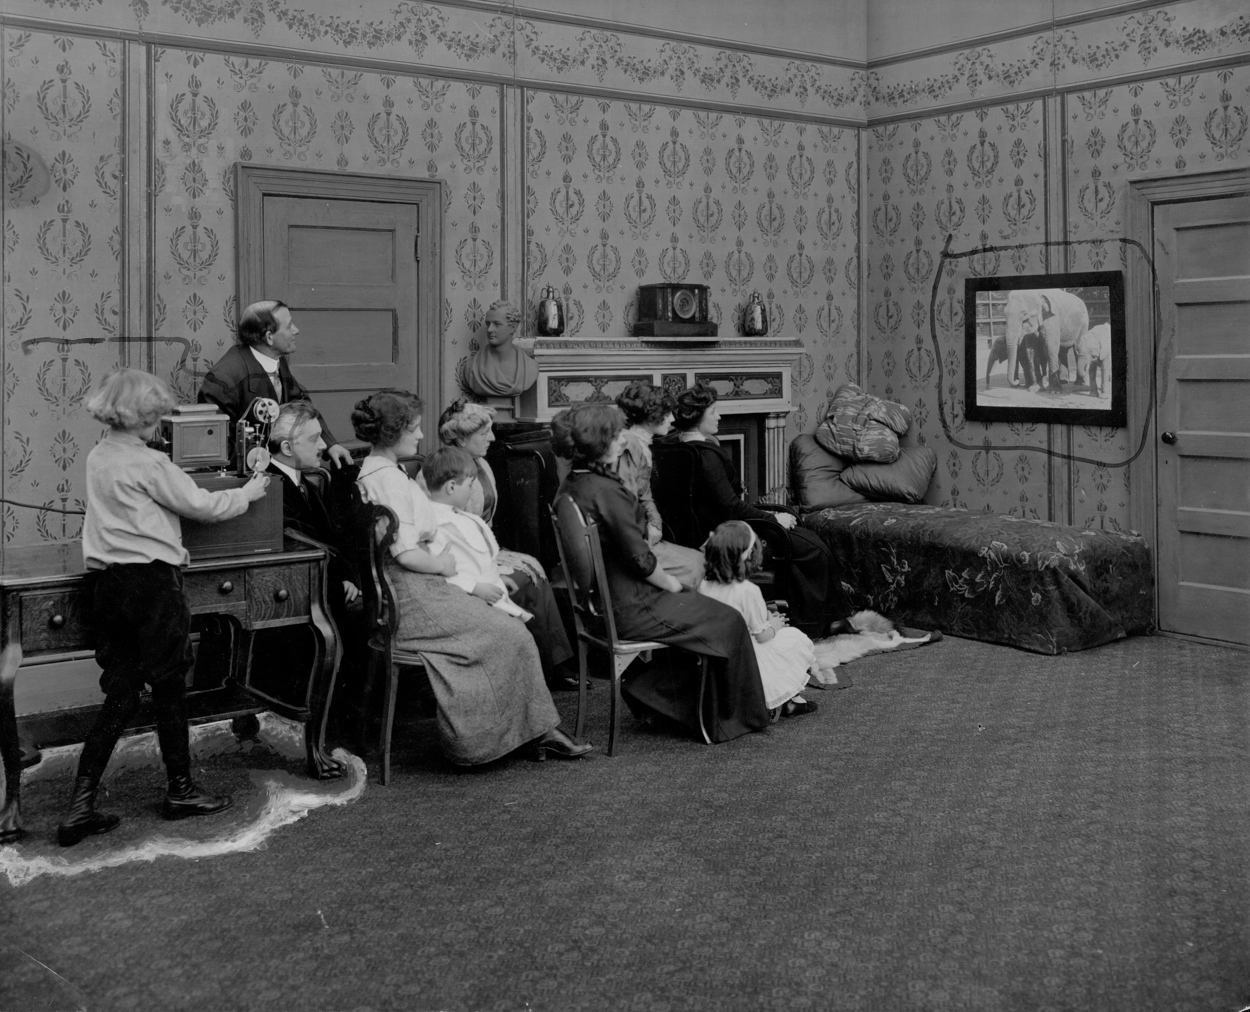
Home projecting Kinetoscope, Edison publicity shot, 1912

Slide 17
Sounds We Might Have Heard at Early Projection Films:
Music, sound effects, lectures
Orchestra vs. sound effects
Produced by live orchestra, stagehands, phonographic recordings, or human voice
Filmic accompaniment from dance music, marches, light classical selections, and popular songs
Audience
Silence
Projectors
Other forms of entertainment
Cue-sound aesthetic
Semi-synchronization
A lack of accepted/standardized vocabulary to talk about sound film

Slide 18
Films From/About This Period:
The Stenographer’s Friend
(1910 Edison film promoting the use of the phonograph as a tool for dictation)
Cinematographe (Institut Lumiere’s demonstration of the operation of the Cinematographe)
Lecture/Demonstration (1912 Edison film similar to the one mentioned by Altman)
Dickson Experimental Sound Film (1984-5 One of the first Edison experiments with live-recorded sound)

Slide 19
Silent Film Music
Early film scores - “special music” or “special cuts” created by the filmmaker/producers as a part of the film package
Arrangements for piano or small orchestra, to match filmic scenarios
Communicative value and audience education
Film programs before 1912 - several short films, illustrated songs, and vaudeville acts
Early teens (“golden era” of silent film music) – explosion of theater construction; picture palaces; blockbuster films of 1915-16 season

Slide 20
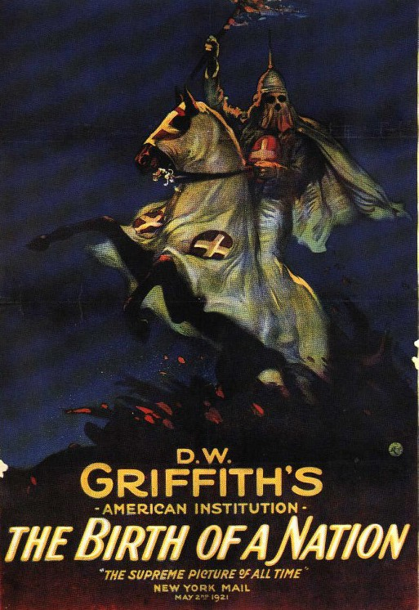
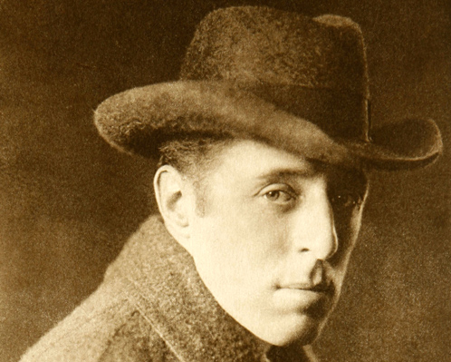
The Birth of A Nation (1915)
Directed by D.W. Griffith

Slide 21
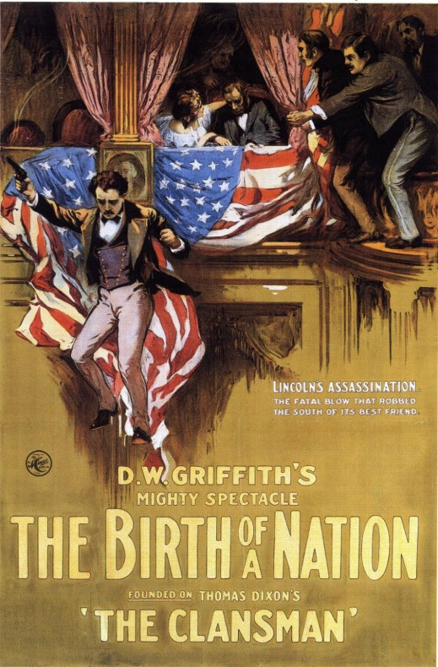
The Birth of A Nation – The Film
Opened as THE CLANSMAN in Los Angeles’ Clune Auditorium in Feb. 8, 1915 for a 22 week run
On March 8, open in NYC’s Liberty Theatre with a new title THE BIRTH OF A NATION
Screened at the Liberty till the end of 1915 – set a record – tickets cost $2
Boycotted by the NAACP

Slide 22
Film Music for The Birth of A Nation
The Clune orchestra featured 40 instrumentalists, several vocalists, and a chorus of 12
Score by Carli Elinor, with compositions by Mozart, Wagner, Rossini, Suppé, Bizet, Wagner, Massenet, Offenbach, and Beethoven
The Liberty orchestra featured 50 instrumentalist
New score by Joseph Carl Breil, incorporating compositions by Grieg, Wagner, Bellini, Suppé, Tchaikovsky, Wagner, Massenet, Offenbach, and Beethoven. Also folk favorites, including everything from “Auld Lang Syne” to “My Old Kentucky Home,” are joined by marches and patriotic numbers like “The Bonnie Blue Flag,” “Dixie,” Hail Columbia,” and “Marching Through Georgia,” as well as popular tunes including “Where Did You Get That Hat” and “Zip Coon.”

Slide 23
Film Music for The Birth of A Nation (cont.)
Bugle calls
Breil’s original composition – love theme for Elsie Stoneman and Ben Cameron “The Perfect Song,” the “Clan Call” of the KKK
“The Birth of A Nation proved that motion pictures could serve as prestige vehicles. In order to fulfill this promise, however, a film had to be accompanied by an orchestra of unprecedented size.” (p. 294)
1921 revival of the film at the Roxy featured a new score, played by a 90 piece orchestra

Slide 24
The Golden Age of Orchestral Film Music
1914-20: expected number of musicians went from 16 to over 70 concert-level musicians
By 1922: 500 theater orchestras of 30+ musicians out of about 15,000 theaters in the U.S. 30-50% of theaters employ an orchestra, most commonly 5-10 musicians
Emphasis on stringed instruments (cross-cueing practice)
Re-organization of theater personnel
Re-editing of films
Film music publishing industry – music as oral/aural practice to music as written form
“Wear” of a piece of music – constant renewal of film repertory

