Slide 1
I. ‘Silent’ to Sound Cinema
3. Sound Technology
& Early Cinema

Slide 2
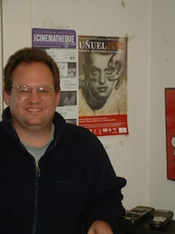
James Lastra
Professor in Cinema/Media Studies and English at University of Chicago
Student of Rick Altman. Published one book on sound in film in 2000

Slide 3
Sound Technology & The American Cinema
This book combines a history of modernity with a study of sound
Cinema as the prime symbol of modernity
2 basic claims: a) first that aurality has been the unthought in accounts of modernity and that, b) consequently, we have overestimated the hegemony of the visual.” (p. 4)
Thick epistemology: device, discourse, practice, and institution
1925-1934

Slide 4
Sound and Imaging Technologies in The Late 18th Century
Phonograph and the camera; writing and the reproduction of sensory experiences
Provide a model of Hollywood’s reaction to the possibility of recorded sound later
Apparatus theory
Performance and inscription: “…technological representation is never a case of simply seeing or hearing, but of looking and listening. We look and listen for things, for specific purposes, while the machine’s ‘more perfect’ eyes and ears simply absorb indiscriminately.” (p. 91)

Slide 5
How does Lastra approach the “coming of sound”?

Slide 6
How does Lastra approach the “coming of sound”?
What was “sound”?

Slide 7
How does Lastra approach the “coming of sound”?
What was “sound”?
What was “synchronization”?

Slide 8
How does Lastra approach the “coming of sound”?
What was “sound”?
What was “synchronization”?
What was understood as a “film”?

Slide 9
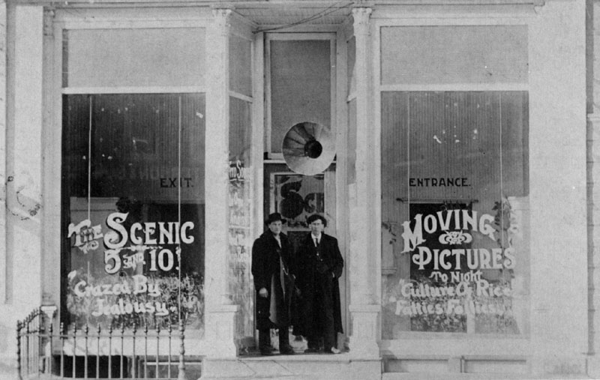
Nickelodeon in Iowa, early 1900s

Slide 10
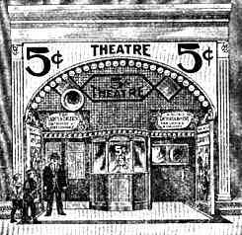
Nickelodeon in Sears Catalogue, 1908

Slide 11
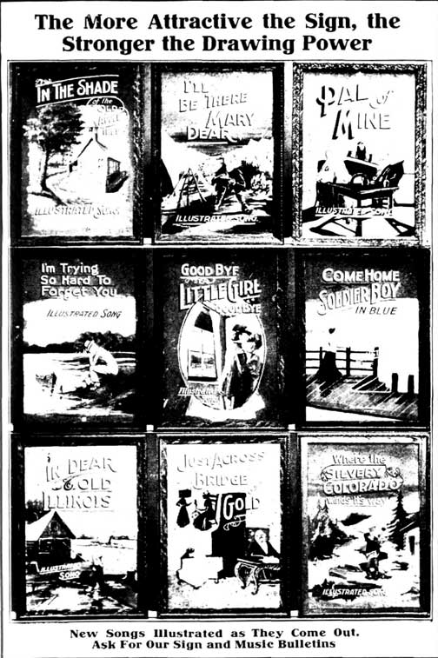
Illustrated Song Catalogue, 1906

Slide 12
Expanding the idea of synchronization – “any fixed or purposeful relationship between sound and image” (p. 94)
Sound’s direct address
Producer’s dilemma
Funning / articulation

Slide 13
Rebirth of A Nation (2005-8)
Live performance and DVD by Paul D. Miller (a.k.a. DJ Spooky – that subliminal kid)

Slide 14
Rebirth of A Nation (2005-8)
Live performance and DVD by Paul D. Miller (a.k.a. DJ Spooky – that subliminal kid)
As a contemporary example of funning?

Slide 15
Rebirth of A Nation (2005-8)
Live performance and DVD by Paul D. Miller (a.k.a. DJ Spooky – that subliminal kid)
As a contemporary example of funning?
In what ways does it correspond to pre-1910 film sound?

Slide 16
Rebirth of A Nation (2005-8)
Live performance and DVD by Paul D. Miller (a.k.a. DJ Spooky – that subliminal kid)
As a contemporary example of funning?
In what ways does it correspond to pre-1910 film sound?
In what ways does it not?

Slide 17
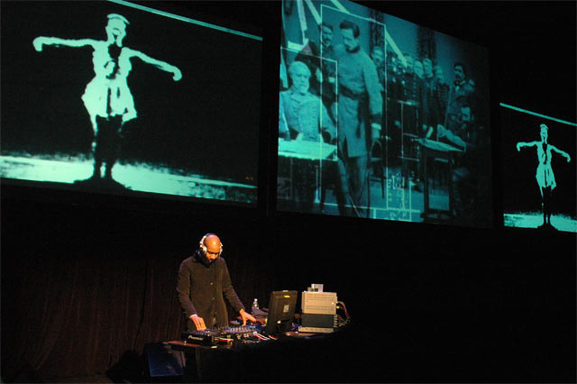
DJ Spooky performing Rebirth of a Nation at Chicago Museum of Contemporary Art November 2004

Slide 18
“Funning” – satirizes scenes or entire films through musical puns, comments on the picture through the title, lyrics, or melody of the accompanying music. (p. 112)
Catered to particular audiences and their prejudices
Drew attention to the musician’s cleverness/stupidity
Fractured the film’s uniformly coherent address
Provides meta/narrative pleasure and commentary for (ethnic) audiences

Slide 19
“The ‘performative’ tradition, allied to a more topographic and less narrative approach to the image, tended to treat the image as a pretext for the gratuitous production of sound. Deriving its impetus from vaudeville, it stressed comic accentuation and an intermittent, punctuated temporality, resulting in an antinarrative and antipsychological form of humorous attention grabbing. The later, and ever more dominant, tradition stressed a rigid hierarchy in providing sound effects, separating the image into zones of importance and unimportance.” (p. 110)

Slide 20
“The ‘performative’ tradition, allied to a more topographic and less narrative approach to the image, tended to treat the image as a pretext for the gratuitous production of sound. Deriving its impetus from vaudeville, it stressed comic accentuation and an intermittent, punctuated temporality, resulting in an antinarrative and antipsychological form of humorous attention grabbing. The later, and ever more dominant, tradition stressed a rigid hierarchy in providing sound effects, separating the image into zones of importance and unimportance.” (p. 110)

Slide 21
Summary: what became the dominant idea of sychronization in Hollywood?
Realism vs. performative tradition
“Articulation” – synchronization as performance (See p. 121)
Standardization – assumes the norms of a middle class, white spectatorship
A form that stresses absolute continuity of the music

Slide 22
Standards and Practices in Classical Hollywood ‘Sound’ Films
1926-34: the most extensive transformation in technology, personnel, formal conventions, and mode of production in the history of American cinema
Hollywood + phonography/telephony industries - conflict in two systems of representing sonic realism

Slide 23
Formal unity and narrative plausibility vs. perceptual realism
Realism: “prime site of cultural struggle and appropriation” (p. 158)
Workplace relations were worked out, in part, in the field of aesthetics

Slide 24
The Sound Engineer/Technician
Professionally under siege?
Joseph Maxfield, Harry Olson, Frank Massa – technicians/researchers from the phonography/telephony industries (e.g Bell Lab’s ERPI)
The “invisible auditor” (concert / phonography model)
Blamed for delays and inefficiencies on set: “the group of workers with less institutional power were required to expend a great deal of energy simply to avoid a loss of prestige and work place autonomy.” (p. 171)

Slide 25
Redefined their function as representation or construction rather than duplication
Primacy of dialogue intelligibility
A created realism: dialogue recorded separately and placed within an artificial, dubbed, continuous background (dissociation of camera and microphone narration from real perception)
The invisible auditor gave way to the ideal auditor.
Society of Sound Engineers formed in 1934

