Slide 1
SOUND, ART, & POWER
Prologue:
Film Without Images

Slide 2
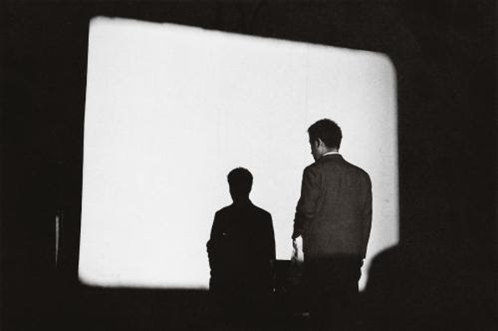
Nam June Paik, Zen for Film (1965)

Slide 3
Is Zen for Film a film?

Slide 4
Zen for Film:
Paik: avant-garde composer turned media and performance artists (“the grand/father of video art”)
His first work in film, made in 1965
16mm clear film leader
“… no script, no narrative, no sets, no actors, no sound, no camera, no montage” (Herman Asselberghs, quoted in TINST, p. xx)
Running time? Exhibition?

Slide 5
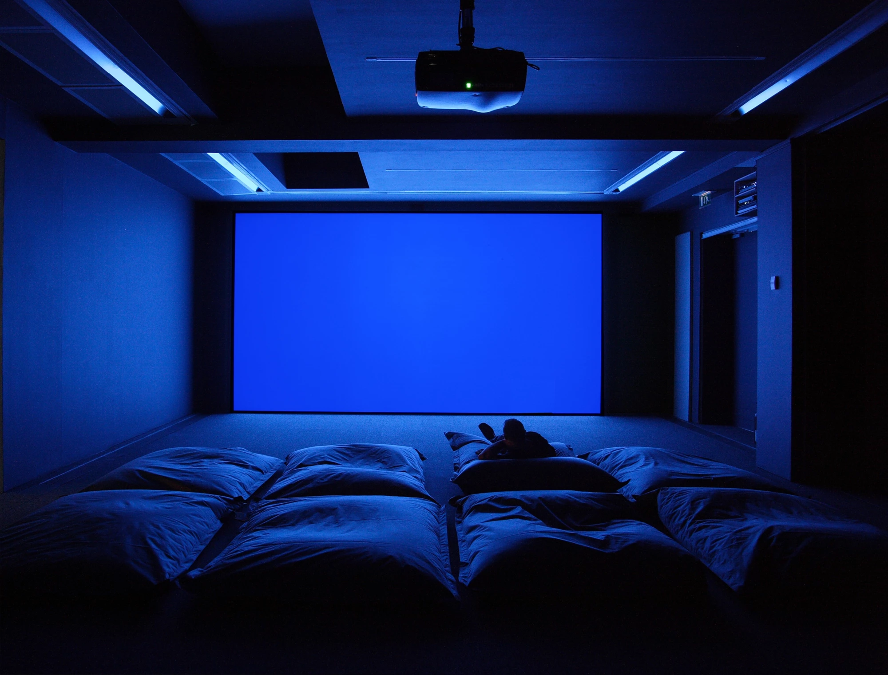
Derek Jarman, Blue (1993)
Installed at the Serpentine Gallery, London in 2008 as a part of the
Derek Jarman: Brutal Beauty exhibition

Slide 6
Blue:
Jarman: British queer experimental filmmaker
Blue is his last film, finished before he died in 1994 from AIDS-related complications, one of which caused him to go blind
35mm blue film leader, TRT: 79 mins.
Created and exhibited as a feature-length film, live performance, radio play, book, digital stream, and installation

Slide 7
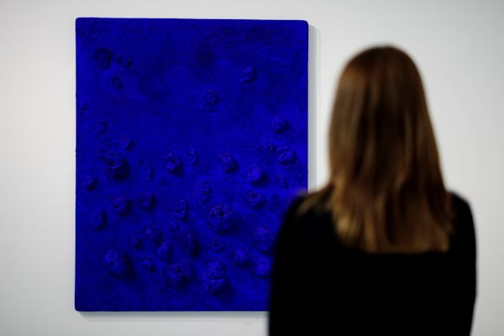
Yves Klein, Blue Sponge Relief
(Little Night Music), 1960
Tate Liverpool, 2017

Slide 8
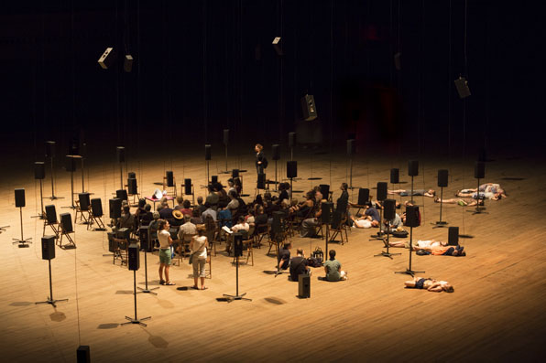
Janet Cardiff & George Bures Miller,
The Murder of Crows (2008)
Installed at Park Avenue Armory, New York in 2012

Slide 9
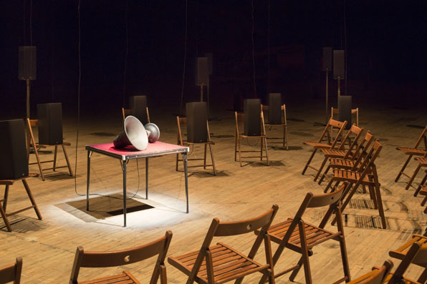
Janet Cardiff & George Bures Miller,
The Murder of Crows (2008)
Installed at Park Avenue Armory, New York in 2012

Slide 10
The Murder of Crows:
Cardiff Miller: Canadian sound art partnership
Created in 2008 and premiered at the Biennale of Sydney
Sound installation composed from about 800 digital audiotracks, broadcasted on 98-100 speakers.
A sonic realization of Francisco de Goya’s etching The Sleep of Reason Produces Monsters (1797-99)
“Physical cinema”, “scripting”, “narrative”

Slide 11
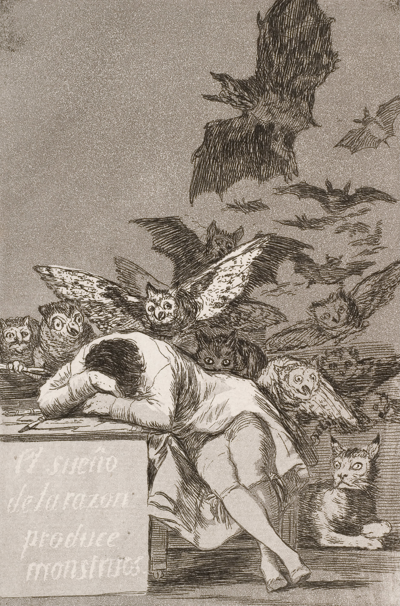
Francisco de Goya, The Sleep of Reason Produces Monsters (1797-99)

Slide 12
If film is understood to be an audio-visual medium, when there are no images in a film, is it still a film?

Slide 13
Some on-going ideas and issues to explore this semester:

Slide 14
Some on-going ideas and issues to explore this semester:
Contested media histories (film without images are nothing new, e.g. Walter Ruttmann’s The Weekend, 1930)

Slide 15
Some on-going ideas and issues to explore this semester:
Contested media histories (film without images are nothing new, e.g. Walter Ruttmann’s The Weekend, 1930)
“Plurality and refusal of closure” (p. xxix) the movement in between media and transforming media platforms

Slide 16
Some on-going ideas and issues to explore this semester:
Contested media histories (film without images are nothing new, e.g. Walter Ruttmann’s The Weekend, 1930)
“Plurality and refusal of closure” (p. xxix) the movement in between media and transforming media platforms
The criticality of sound? Studying sound also teaches us about visuality

