Slide 1
SOUND, ART, & POWER
Week 10: Media Soundscapes – History & Theory

Slide 2
“Upon entering almost any contemporary gallery space, we hear sound emanating from TV monitors, projection spaces, computers and in headphones alongside the daily sounds made by gallery staff, art patrons, the gallery bookshop and so on.” (Caleb Kelly, Gallery Sound, pp. 2-3)

Slide 3
“Unlike image, sound cannot be contained by a frame. Free to move around corners and through walls, it creates problems of confinement and curators have to find inventive ways to prevent the noise from one installation bleeding into other rooms.” (Holly Rogers, Sounding the Gallery, p. 123)

Slide 4
“Unlike image, sound cannot be contained by a frame. Free to move around corners and through walls, it creates problems of confinement and curators have to find inventive ways to prevent the noise from one installation bleeding into other rooms.” (Holly Rogers, Sounding the Gallery, p. 123)

Slide 5
“Sound is not easily contained. It naturally invades space, seeps under doors and through walls. This is why sound art is often kept out of exhibition spaces where it is heard to interfere with the act of viewing.

Slide 6
Or, when it is included, it is isolated from the resonating chamber of the ‘white cube’ and consigned to soundproofed cubicles or secondary architectural spaces. Sound artists routinely see their work relegated to the lobby, elevator, toilet, and basement, or simply put outdoors.

Slide 7
This desire to isolate ‘noise’ and reject interference reflects a lack of understanding for sound.” (Christian Marclay, Ensemble exhibition brochure, 2008)

Slide 8
Structure for this chapter:
  History and theory
  Empirical research
  Direct listening and observation
  3.5. Institutional practices

Slide 9
Structure for this chapter:
  History and theory
  Direct listening and observation
  Empirical research & institutional practices

Slide 10
1. History & Theory:

Slide 11
1. History & Theory:
  Crisis historiography

Slide 12
1. History & Theory:
  Crisis historiography
  Cinematic sound spaces

Slide 13
1. History & Theory:
  Crisis historiography
  Cinematic sound spaces
  Architectural acoustics

Slide 14
Crisis Historiography
Rick Altman argues that “the ‘reality’ which each new technology sets out to represent is in large part defined by preexistintent representational systems” (“Sound Space”, p. 46)
Crisis as in “identity crisis”: crisis historiography assumes that the definition of a representational technology is both historically and social contingent, and that “new technologies are always born nameless”. (TINST, p. 123)
Media installations as the “new cinema” (Michael Rush and Chrissie Iles)

Slide 15
Crisis Historiography
Rick Altman argues that “the ‘reality’ which each new technology sets out to represent is in large part defined by preexistintent representational systems” (“Sound Space”, p. 46)
Crisis as in “identity crisis”: crisis historiography assumes that the definition of a representational technology is both historically and social contingent, and that “new technologies are always born nameless”. (TINST, p. 123)
Media installations as the “new cinema” (Michael Rush and Chrissie Iles)

Slide 16
“During a crisis, a technology is understood in varying ways, resulting in modifications not only of the technology itself but also of terminology, exhibition spaces, and audience attitudes. These changes resist linear presentation precisely because they are generated not by a single social construction but by multiple competing approaches to the new technology.” (Altman, Silent Film Sound, p. 21)

Slide 17
“During a crisis, a technology is understood in varying ways, resulting in modifications not only of the technology itself but also of terminology, exhibition spaces, and audience attitudes. These changes resist linear presentation precisely because they are generated not by a single social construction but by multiple competing approaches to the new technology.” (Altman, Silent Film Sound, p. 21)

Slide 18
“Cinema itself has become an art of video… Cinema is now undeniably expanded; installation is prefiguring a new cinematic spectator/image relationship based on interaction.” (Michael Rush, “Installation and the New Cinematics”, p. 112-113)

Slide 19
The different ‘realities’ to consider for media installation and performance soundscapes:

Slide 20
The different ‘realities’ to consider for media installation and performance soundscapes:
  Representational reality

Slide 21
The different ‘realities’ to consider for media installation and performance soundscapes:
  Representational reality
  Technological reality

Slide 22
The different ‘realities’ to consider for media installation and performance soundscapes:
  Representational reality
  Technological reality
  Material reality

Slide 23
The different ‘realities’ to consider for media installation and performance soundscapes:
  Representational reality
  Technological reality
  Material reality
  Institutional reality

Slide 24
Pre-existing representational systems for media installations and performance:

Slide 25
Pre-existing representational systems for media installations and performance:
  Cinema

Slide 26
Pre-existing representational systems for media installations and performance:
  Cinema
  Music

Slide 27
Pre-existing representational systems for media installations and performance:
  Cinema
  Music
  Performance – art, musical, theatrical

Slide 28
Pre-existing representational systems for media installations and performance:
  Cinema
  Music
  Performance – art, musical, theatrical
  Modern sound reproduction technology

Slide 29
Cinematic Sound Spaces
Classical Hollywood code of realism
Construction of the auditor into filmic space

Slide 30
”We are asked not to hear, but to identify with someone who will hear for us. Instead of giving us the freedom to move about the film’s space at will, this technique locates us in a very specific place—the body of the character who hears for us.

Slide 31
Point-of-audition sound thus constitutes the perfect interpellation, for it inserts us into the narrative at the very intersection of two places, which the image alone is incapable of linking, thus giving us the sensation of controlling the relationship between those spaces.” (Altman, “Sound Space”, pp. 60-61)

Slide 32
”We are asked not to hear, but to identify with someone who will hear for us. Instead of giving us the freedom to move about the film’s space at will, this technique locates us in a very specific place—the body of the character who hears for us. Point-of-audition sound thus constitutes the perfect interpellation, for it inserts us into the narrative at the very intersection of two places, which the image alone is incapable of linking, thus giving us the sensation of controlling the relationship between those spaces.” (Altman, “Sound Space”, pp. 60-61)

Slide 33
Cinematic Sound Spaces
Classical Hollywood code of realism
Construction of the auditor into filmic space
Invisible auditor and ideal auditor

Slide 34
”Despite some momentary challenges to the classical norms of spatial construction… the overwhelming pressure for profitability and consistency of both modes of production and product mandated a system of practices which contradicted the most often explicitly voiced representational goals.” (James Lastra, Sound Technology and American Cinema, p. 215)

Slide 35

Case Study
Bill Fontana, White Sound – An Urban Seascape (2011)

Slide 36
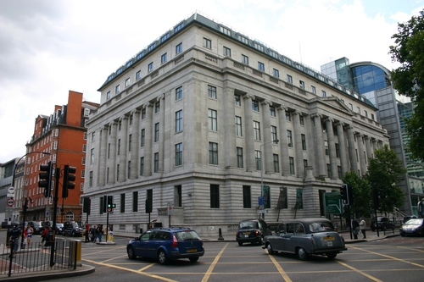
Case Study
Bill Fontana, White Sound – An Urban Seascape (2011)

Slide 37
Acoustic Architecture
The cinema as a modern soundscape
Modern sound(scape)

Slide 38
Acoustic Architecture
The cinema as a modern soundscape
Modern sound(scape)
  Clear, focused, and transmitted directly to the auditor

Slide 39
Acoustic Architecture
The cinema as a modern soundscape
Modern sound(scape)
  Clear, focused, and transmitted directly to the auditor
  Non-reverberant acoustic spaces

Slide 40
Acoustic Architecture
The cinema as a modern soundscape
Modern sound(scape)
  Clear, focused, and transmitted directly to the auditor
  Non-reverberant acoustic spaces
  The sense of space in modern sound is produced through studio production

Slide 41
“From the soundproofed offices of the PSFS Building to the pronounced directional flow of sound at the Eastman Theatre and the Hollywood Bowl, to the electroacoustic offerings at Radio City Music Hall, this kind of sound was everywhere.

Slide 42
In its commodified nature, in its direct and nonreverberant quality, in its emphasis on the signal and its freedom from noise, and in its ability to transcend traditional constraints of time and space, the sound of the sound track was just another constituent of the modern soundscape. Indeed, the sound track epitomized the sound of modern America.” (Emily Thompson, The Soundscape of Modernity, p. 284)

Slide 43
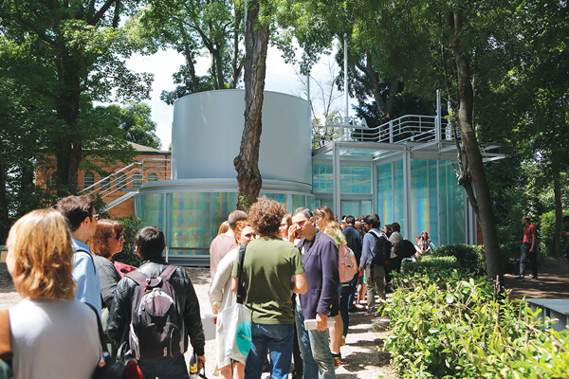
Case Study
Kimsooja, To Breathe: Bottari (2013)
The Korean Pavilion, Venice

Slide 44
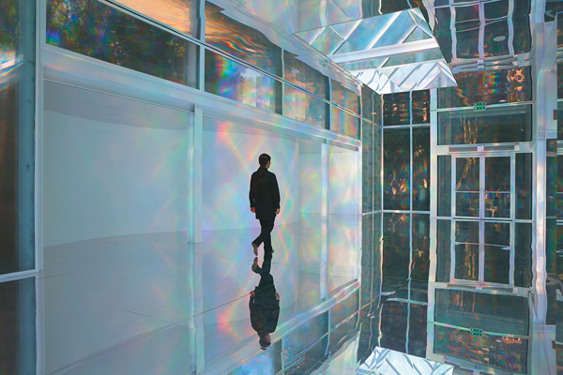
Case Study
Kimsooja, To Breathe: Bottari (2013)
The Korean Pavilion, Venice

Slide 45
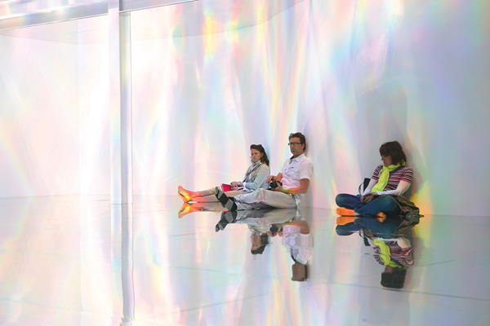
Case Study
Kimsooja, To Breathe: Bottari (2013)
The Korean Pavilion, Venice

Slide 46
Case Study
Kimsooja, To Breathe: Blackout (2013)
The Korean Pavilion, Venice

Slide 47
“The contemporary cinema was created for viewing moving images and listening to highly produced audio, while the gallery space was created for viewing visual art. The cinema attempts to lull us into forgetting our physical presence in the theatre, while the art gallery constantly alerts us to the fact that we are looking at art and that we are present.” (Caleb Kelly, Gallery Sound, p. 3)

Slide 48
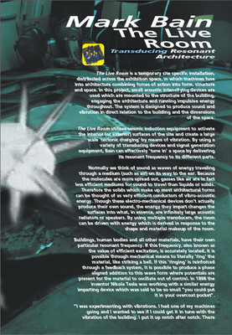
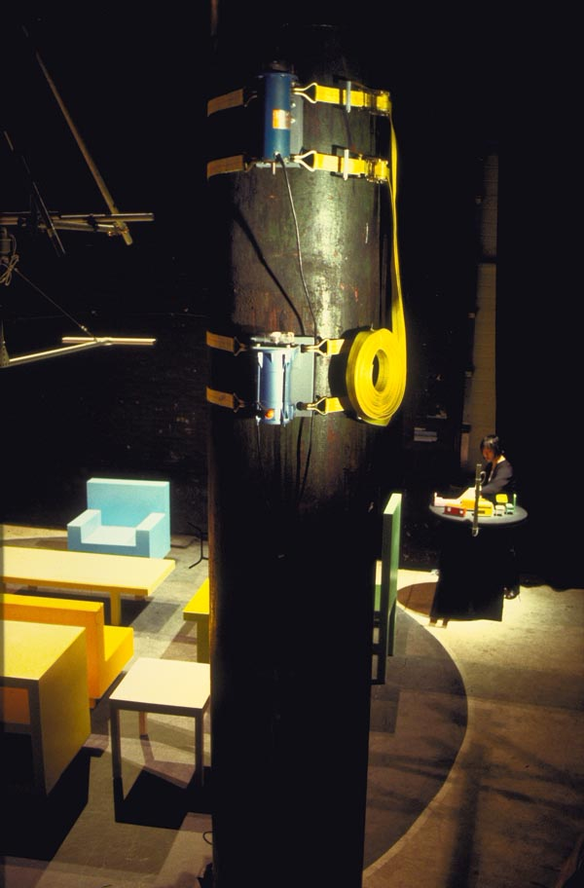
Case Study: Mark Bain, Live Room (1998)

