Slide 1
SOUND, ART, & POWER
Week 5: Performing Autoethnography

Slide 2
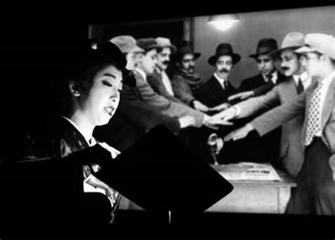
Benshi Performance
(弁士: Japanese montreur d’images)

Slide 3
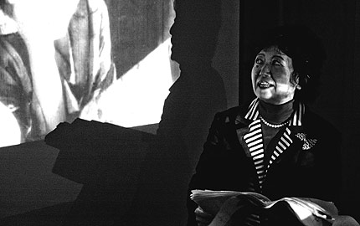
Sawato Midori (澤登 翠) famous benshi who was honored “the Master of Sound” by Japan Audio Society in 2010.

Slide 4
Race and Vocal Embodiment
Race, gender, speech/language, voice (Trinh)
“Rasp” as a vocal signifier of blackness (Smith)
Rap – “post-literate orality” + sound reproduction technology (Rose, Ong)
Race and the posthuman voice (Weheliye)

Slide 5
Race and Vocal (Dis)embodiment
Race, gender, speech/language, voice (Trinh)
“Rasp” as a vocal signifier of blackness (Smith)
Rap – “post-literate orality” + sound reproduction technology (Rose, Ong)
Race and the posthuman voice (Weheliye)

Slide 6
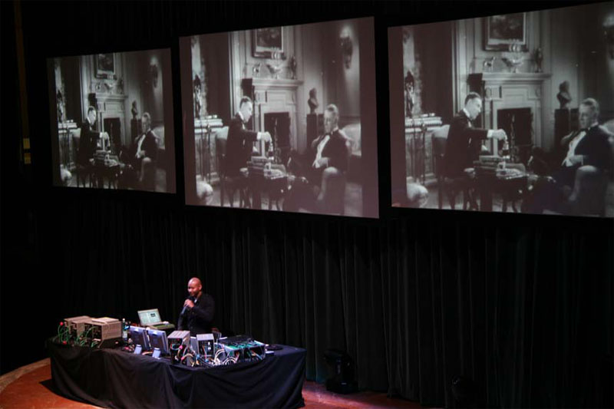
Paul D. Miller (DJ Spooky-That Subliminal Kid) performing Rebirth of A Nation at the Institute of Contemporary Art, Virginia Commonwealth University in 2019

Slide 7
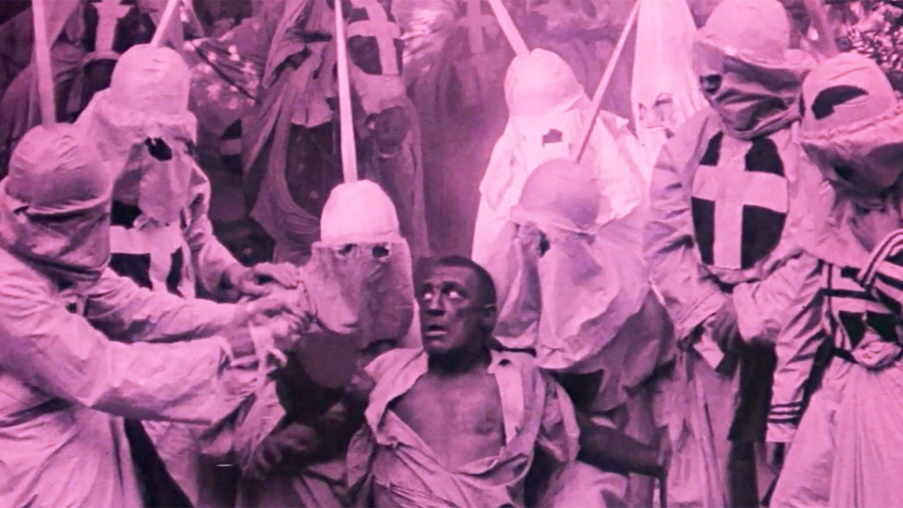
The Birth of A Nation (1915)
Dir. D.W. Griffith

Slide 8
Discussion:
Considering what are essentially the same scenes from The Birth of A Nation (1915) and Rebirth of A Nation (2004-present)
What are their audio-visual relationships? More specifically, how does the music and images interact in these works?
The human voice is disembodied as intertitles and voiceover in these works. Does “orality” still plays a role (or more) in them? How does sound technology “stage the body of information and technology as opposed to the lack thereof”?

Slide 9
Discussion:
Considering what are essentially the same scenes from The Birth of A Nation (1915) and Rebirth of A Nation (2004-present)
What are the differences between the live performance, single-channel video, and sound-only versions of Miller’s work?

Slide 10
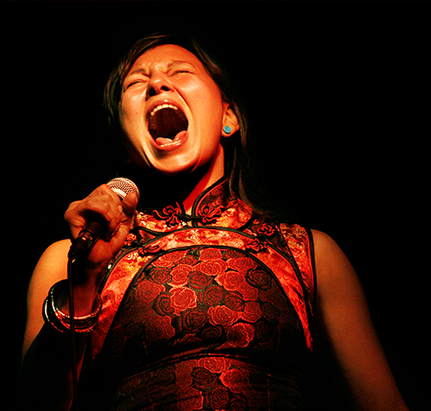
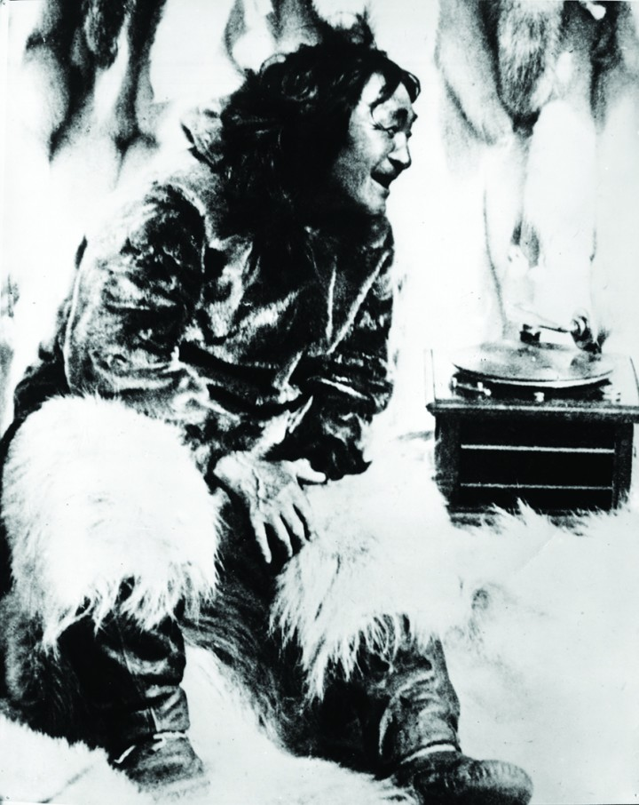
Tanya Tagaq rescoring
Nanook of the North (1922) Dir. Robert Flaherty

Slide 11
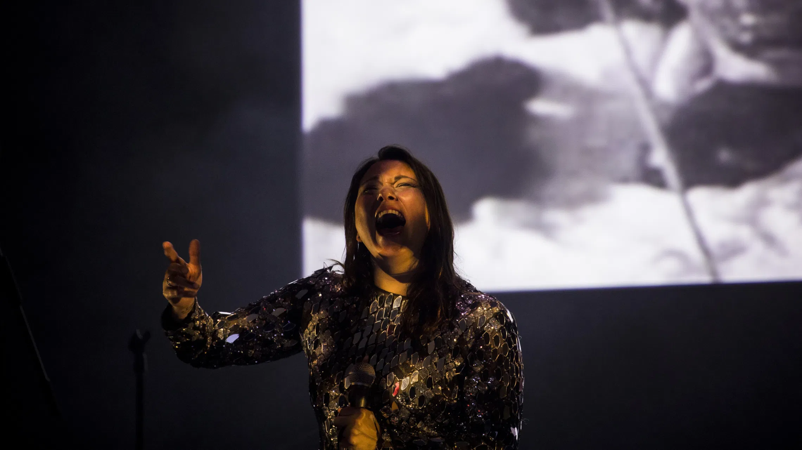
Performance at Dark Mofo 2018
Hobart, Australia

Slide 12
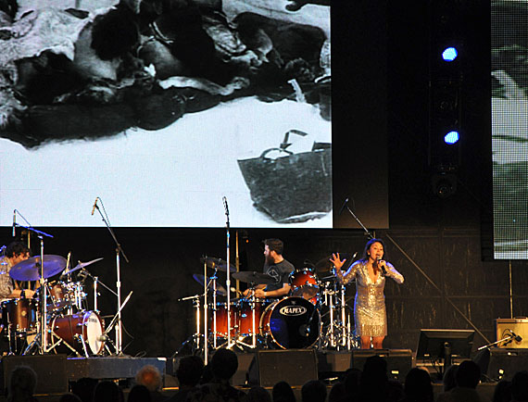
Performance in Toronto, Canada
in 2014

Slide 13
Discussion:
Building on our discussion on voice, orality, and sound technology, consider the ethnographic representations in Nanook of the North and Tagaq’s experimental voice-over and re-scoring of the film through the following terms:
Native I
Vocal re-embodiment
Relationality

Slide 14
Concluding thoughts on voice and “radical otherness”:
The return of the voice to the body
  Whose bodies?
  Vocal re-embodiment
Voice and music as vibrational energy (Nina Sun Eidsheim)
An ontology of vocal uniqueness (Adriana Cavarero)

Slide 15
“A voice means this: there is a living person, throat, chest, feelings, who sends into the air this voice, different from all other voices…” (Italo Calvino, “A King Listens”)

Slide 16
“The play between vocal emission and acoustic perception necessarily involves the internal organs. It implicates a correspondence with the fleshy cavity that alludes to the deep body, the most bodily part of the body. The impalpability of sonorous vibrations, which is colorless as the air, comes out of a wet mouth and arises from the red of the flesh. This is also why, as Calvino suggests, the voice is the equivalent of what the unique person has that is most hidden and most genuine.” (Adriana Cavarero, For More Than One Voice, p. 4)

Slide 17
“The play between vocal emission and acoustic perception necessarily involves the internal organs. It implicates a correspondence with the fleshy cavity that alludes to the deep body, the most bodily part of the body. The impalpability of sonorous vibrations, which is colorless as the air, comes out of a wet mouth and arises from the red of the flesh. This is also why, as Calvino suggests, the voice is the equivalent of what the unique person has that is most hidden and most genuine.” (Adriana Cavarero, For More Than One Voice, p. 4)

Slide 18
”Precisely because speech is sonorous, to speak to one another is to communicate oneself to others in the plurality of voices. In other words, the act of speaking is relational: what it communicates first and foremost, beyond the specific content that the words communicate, is the acoustic, empirical, material relationality of singular voices.” (Cavarero, p. 13)

Slide 19
“Precisely because speech is sonorous, to speak to one another is to communicate oneself to others in the plurality of voices. In other words, the act of speaking is relational: what it communicates first and foremost, beyond the specific content that the words communicate, is the acoustic, empirical, material relationality of singular voices.” (Cavarero, p. 13)

