Slide 1
SOUND, ART, & POWER
Week 8: Noises of Protest

Slide 2
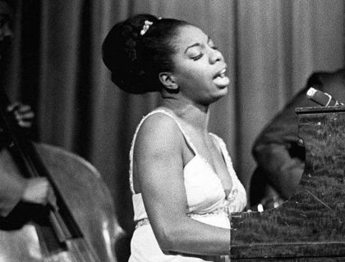
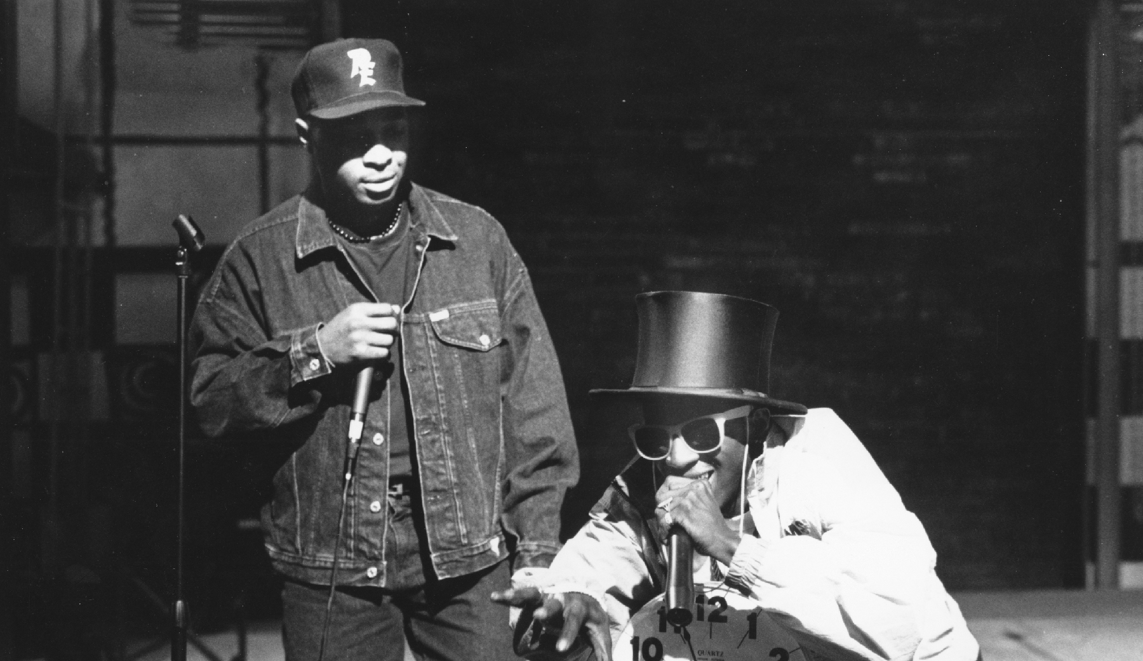
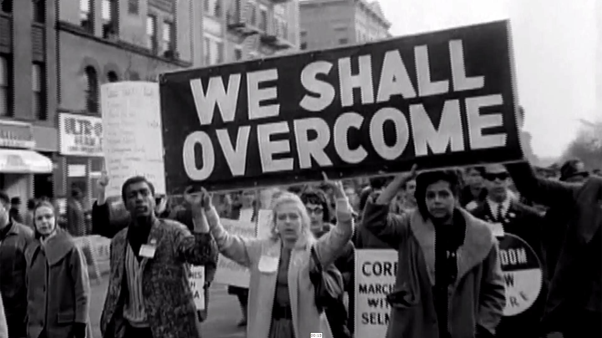
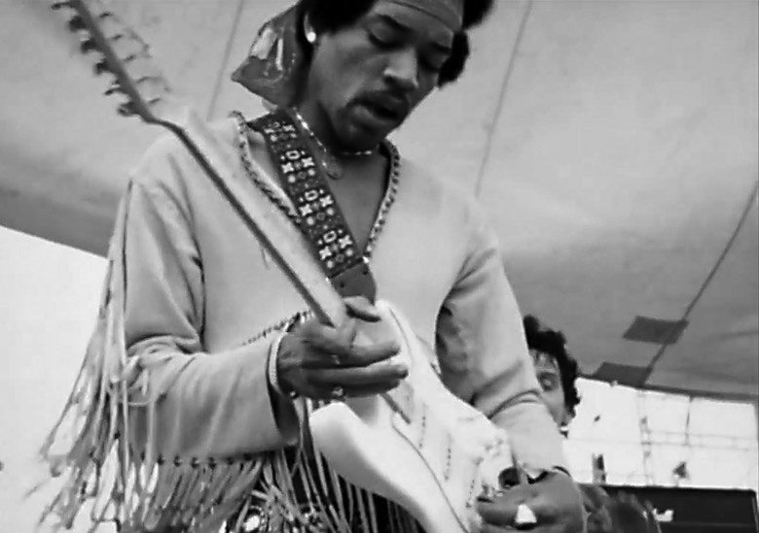

Slide 3
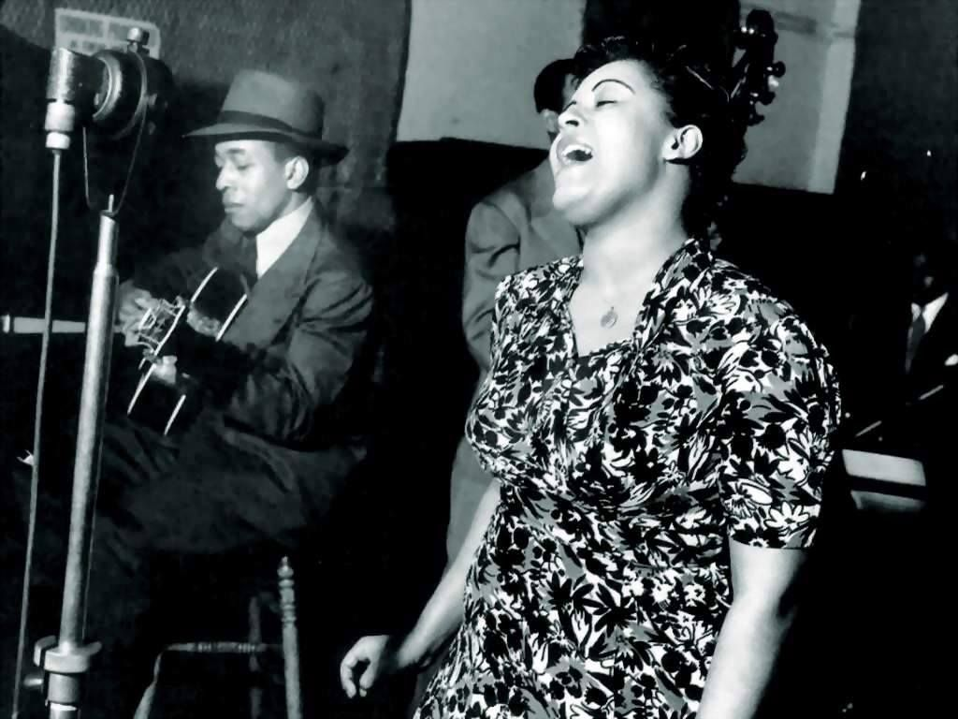
Billie Holiday at the recording session, New York City, 1939

Slide 4
Listening to Strange Fruit:
According to Holiday, the song “has a way of separating the straight people from the squares and cripples” (quoted in TINST, p. 89)
It “brought previously unexplored dimensions of race, violence, and, implicitly, sexuality into the nightclub and concert hall…” “prick the collective conscience of her listeners.” (Davis quoted in TINST, p. 89)
The “grain” (Barthes) of Holiday’s voice, her performance of the song

Slide 5
Noise

Slide 6
Noise / Music

Slide 7
Noise Music

Slide 8
Noise:
“The Art of Noises: A Futurist Manifesto” (Luigi Russolo)
Noise: The Political Economy of Music (Jacques Attali)

Slide 9
Noise:
Noise music and the intonarumori
Attali: “the political organization of the twentieth century is rooted in the political thought of the nineteenth, the latter is almost entirely present in embryonic form in the music of the eighteenth century.” (Noise, p. 4)

Slide 10
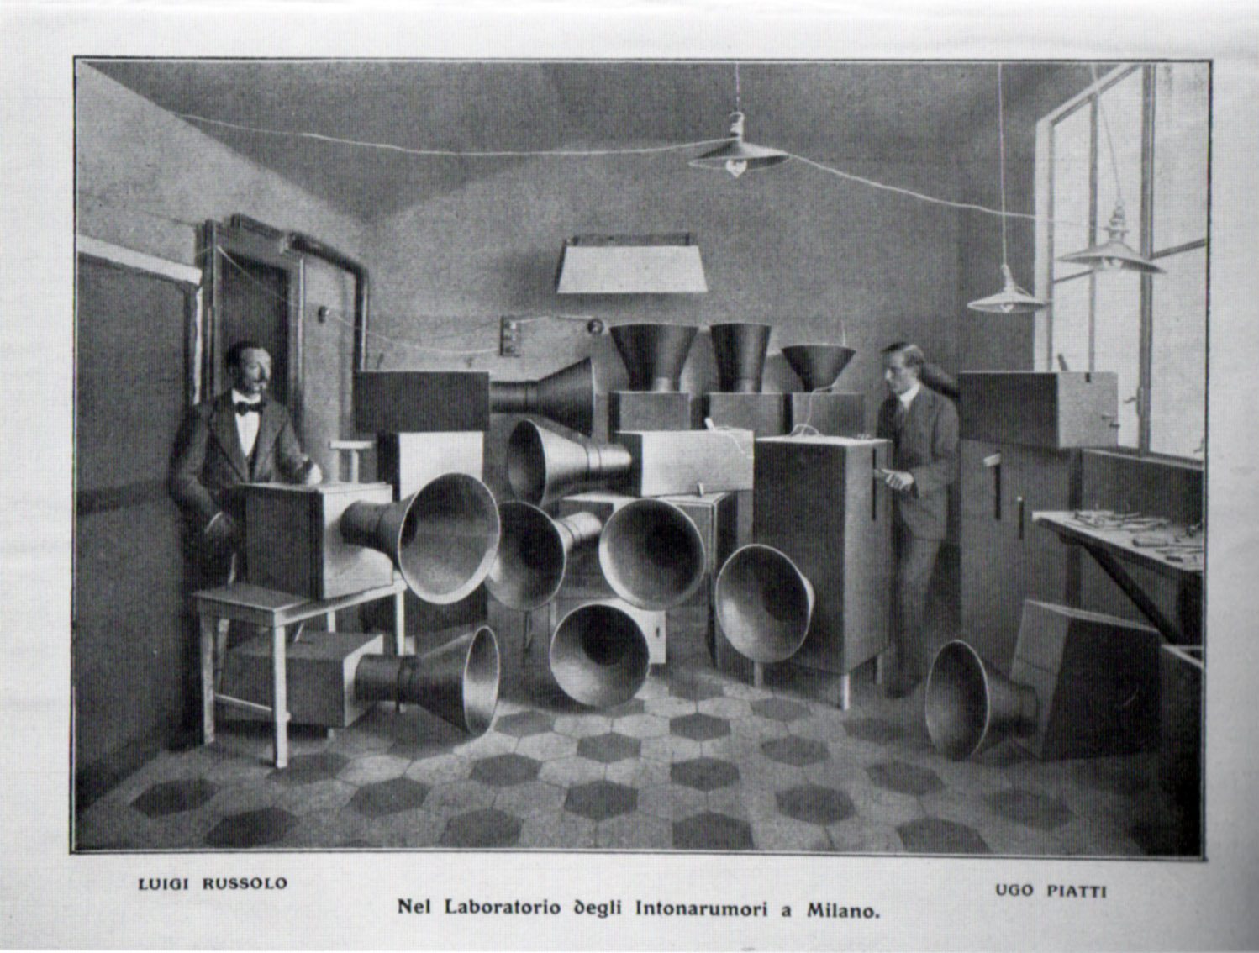
Russolo and his assistant Ugo Piatti with the intonarumori, 1913

Slide 11
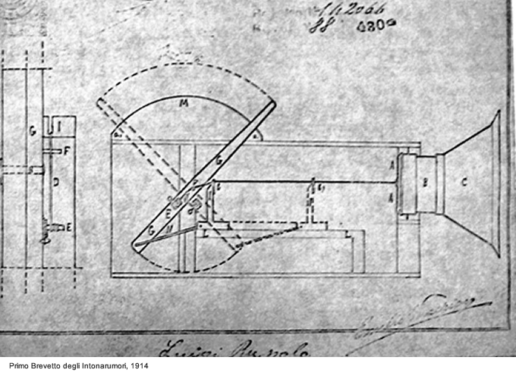
Diagram for one of Russolo’s noise instruments called the Scoppiatore

Slide 12
Noise:
“…the art of war in the art of noise” (Steve Goodman on Russolo)
Attali: “…noise is violence: it disturbs. To make noise is to interrupt a transmission, to disconnect, to kill. It is a simulacrum of murder… [And] music is a channelization of noise, and therefore a simulacrum of the sacrifice. It is thus a sublimation, an exacerbation of the imaginary, at the same time as the creation of social order and political integration. ” (Noise, p. 26)

Slide 13
Noise:
“…the art of war in the art of noise” (Steve Goodman on Russolo)
Attali: “…noise is violence: it disturbs. To make noise is to interrupt a transmission, to disconnect, to kill. It is a simulacrum of murder… [And] music is a channelization of noise, and therefore a simulacrum of the sacrifice. It is thus a sublimation, an exacerbation of the imaginary, at the same time as the creation of social order and political integration. ” (Noise, p. 26)

Slide 14
Noise:
Noise as matter: resistance, subsistence, co-existence, persistence, and obsistance (Greg Hainge)
”Universal opposite” (David Novak)
“… the relationship between noise, error and innovation is frequently gendered as well as racialized.” (Marie Thompson)

Slide 15
“Noise is both obvious and evasive. It is something that many of us regularly encounter and yet, as is often claimed, remains stubbornly resistant to theorization. Noise slips between different disciplinary fields: it carries through the walls that separate science, acoustics, economics, politics, art, information theory and law. And what constitutes noise can vary considerably between these fields. It could be said, then, that noise is a ‘noisy’ concept: it is messy, complex, fleeting, fuzzy-edged and at times, infuriating.”
(Marie Thompson, Beyond Unwanted Sound, pp. 1-2)

Slide 16
“Noise is both obvious and evasive. It is something that many of us regularly encounter and yet, as is often claimed, remains stubbornly resistant to theorization. Noise slips between different disciplinary fields: it carries through the walls that separate science, acoustics, economics, politics, art, information theory and law. And what constitutes noise can vary considerably between these fields. It could be said, then, that noise is a ‘noisy’ concept: it is messy, complex, fleeting, fuzzy-edged and at times, infuriating.”
(Marie Thompson, Beyond Unwanted Sound, pp. 1-2)

Slide 17
Noise in American History:
Colonial America: Africans and Native Americans
Antebellum South: slave and masters’ relationship to noise and silence
Postbellum (Reconstruction): KKK, terrorism, “militaristic use of sound” (Mark Smith, Listening to Nineteenth-Century America, p. 224)

Slide 18
“In a culture preoccupied with noise and efficiency, reverberation became just another form of noise, an unnecessary sound that was inefficient and best eliminated.” (Emily Thompson, quoted in TINST, p. 94)

Slide 19
Discussion:
Listen to excerpts from Billie Holiday’s 1959 performance of Strange Fruit and the soundtrack of Guitar Drag
What kinds of noise(s) do these works produce?
In what ways are these works themselves a form of noise?
You are encouraged to think this through in a “noisy” critical framework!

Slide 20
“Extending the scope of Davis’s point, I further argue that neither Strange Fruit nor Guitar Drag should be considered anomalies within Holiday and Marclay’s respective oeuvres. Rather, like sound resonators that take subsonic vibrations and amplify them into a more audible volume, these works magnify cultural and racial politics in order for them to be heard in new ways. Intentionally or unintentionally, these works resound the issues of race, sexuality, politics, and social justice, bringing them to the forefront of Holiday and Marclay’s oeuvres.” (TINST, p. 90)

Slide 21
“Extending the scope of Davis’s point, I further argue that neither Strange Fruit nor Guitar Drag should be considered anomalies within Holiday and Marclay’s respective oeuvres. Rather, like sound resonators that take subsonic vibrations and amplify them into a more audible volume, these works magnify cultural and racial politics in order for them to be heard in new ways. Intentionally or unintentionally, these works resound the issues of race, sexuality, politics, and social justice, bringing them to the forefront of Holiday and Marclay’s oeuvres.” (TINST, p. 90)

