Slide 1
SOUND, ART, & POWER
Week 9: A Distanced Brutality

Slide 2
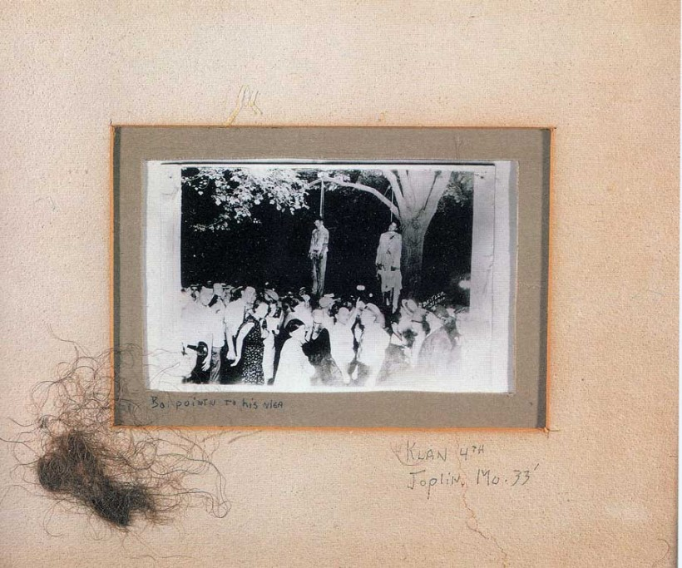
The Lawrence Beitler photograph, framed with victim’s hair

Slide 3
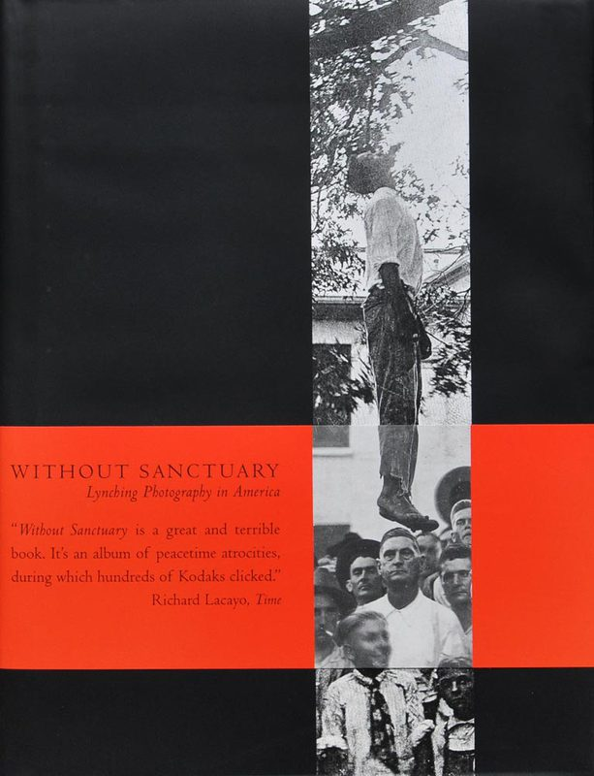
Without Sanctuary: Photographs and Postcards of Lynching in America
Exhibition and book in 2000
A visual history of racialized violence in America – there is an observable lineage in the performance of such violent acts
The murder of Byrd is a continuation of this history

Slide 4
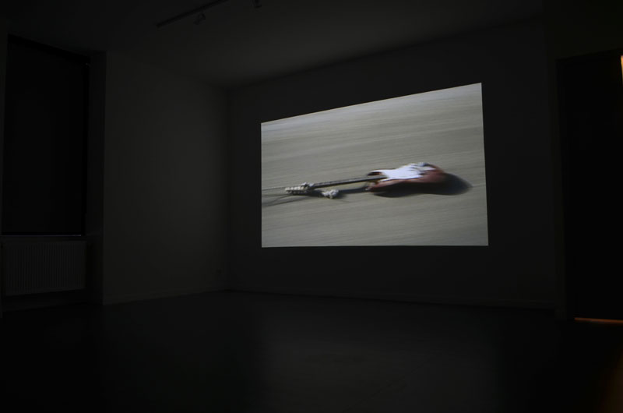
Christian Marclay, Guitar Drag, 2000
installation view

Slide 5
Another History:
Historical reverberations amplified in Marclay’s installation performance, and are driven by a larger cultural force that courses through the histories of racialized violence, sound technology, and medicine, causing them to vibrate in unison.

Slide 6
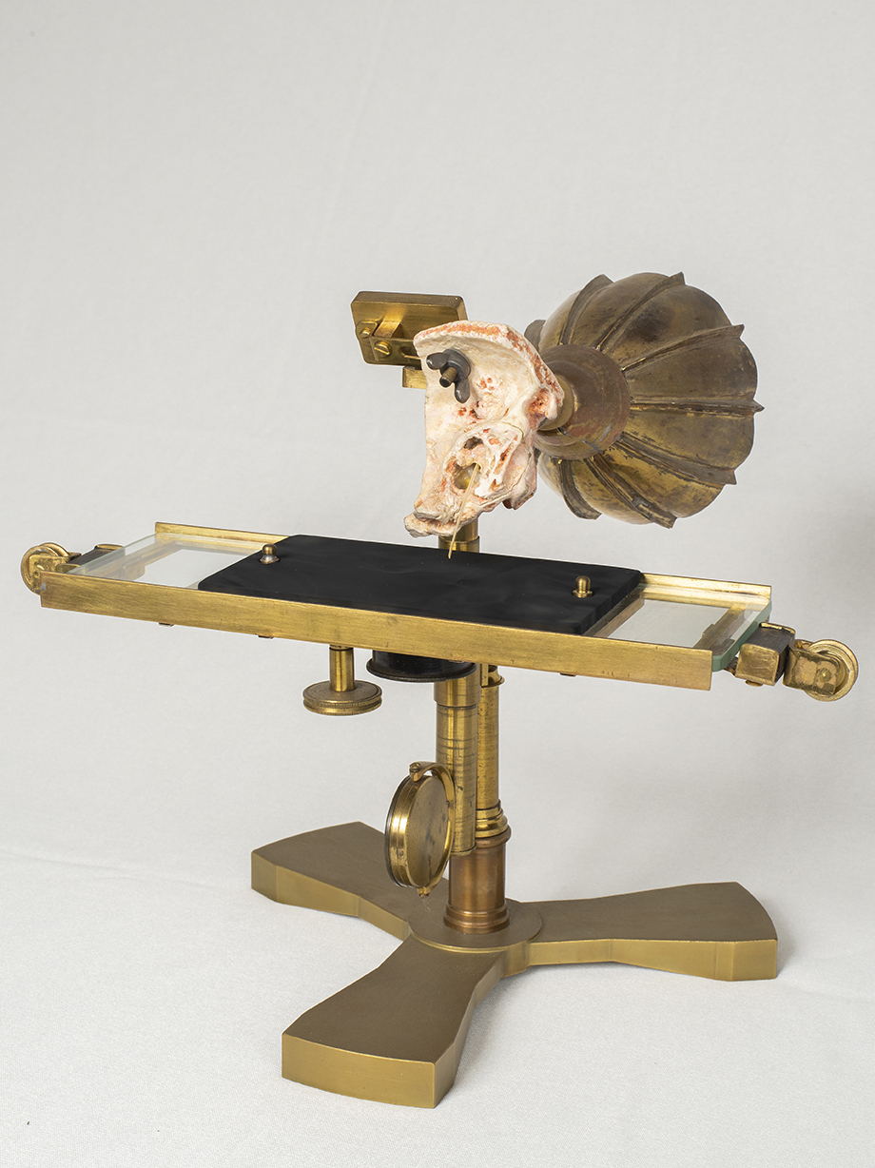
The Ear Phonautograph, created by Alexander Graham Bell and Clarence Blake in 1874. Reconstructed at the Canada Science and Technology Museum in 2017. (Image on right)

Slide 7
“Reducing the complex humanity of black men and women to a collection of fleshy parts has a long genealogy back to slavery and the racial discourse enabling and under girding it. Whites exerted power over black bodies by discursively fragmenting them and objectifying various parts as useful but ultimately fungible.” (Jennifer Stoever, The Sonic Color Line, p. 198)

Slide 8
“Reducing the complex humanity of black men and women to a collection of fleshy parts has a long genealogy back to slavery and the racial discourse enabling and under girding it. Whites exerted power over black bodies by discursively fragmenting them and objectifying various parts as useful but ultimately fungible.” (Jennifer Stoever, The Sonic Color Line, p. 198)

Slide 9
History of Dissection & Medicine:
Blake obtained the cadaver ears he and Bell used in the Ear Phonautograph from the Harvard Medical School
Anatomy acts in the U.S. and U.K. were legislative attempts to control and regulate the sourcing of human bodies.
Grave robbing, body snatching, resurrectionists

Slide 10
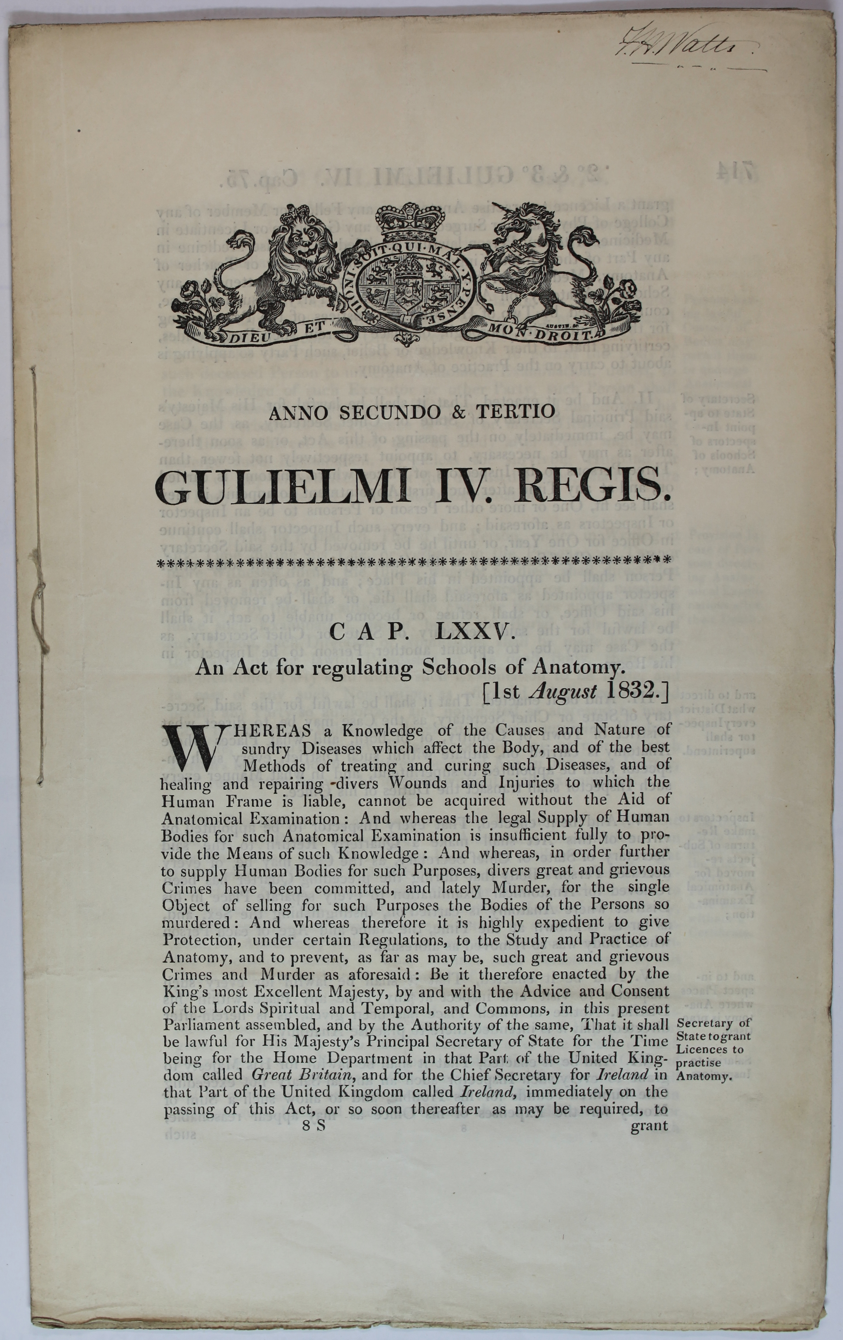
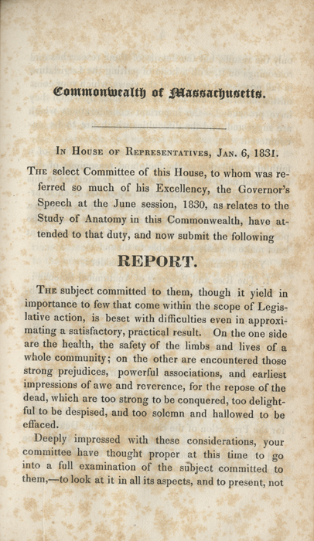
The British and Massachusetts Anatomy Acts, passed in early 1830s

Slide 11
History of Dissection & Medicine:
Anatomy riots
Race and sex in medicine and dissection

Slide 12
“The performance of dissection and grave robberies asserted and reinforced professional identity and solidarity, but also privileged other social identities, in this case whiteness.

Slide 13
In robbing graves and dissecting their subjects, medical students asserted a ghastly seigneurial privilege: they freely transgressed the funerary customs and honor of working men and women, blacks, Indians, convicted criminals, and immigrants.

Slide 14
Complicating this was the erotic potential of the cadaver, which was identified, via anatomical discourse and illustration, with the ‘animal economy’, the site from which desire emerged, and also as the object of desire. For both dissector and dissected, body snatching figured as a rape of the grave, while dissection was a public undressing, a rape of the dead body.” (Michael Sappol, A Traffic of Dead Bodies, p. 87)

Slide 15
History of Dissection & Medicine:
Connection to lynching, torture, and racialized violence
Fragmentation and objectification of (the raced and sexualized) body

Slide 16
“We need great volumes of human material to supply medical schools with cadavers so that the future doctors have a solid understanding of human anatomy. Adoption agencies send thousands of children from the third world to the first to fill the gaps in the American family unit. Pharmaceutical companies need live people to test the next generation of superdrugs, and the beauty industry process millions of pounds of human hair every year to quench a ceaseless demand for new hairstyles. Forget the days of grass-skirt-wearing cannibals on tropical islands, our appetite for human flesh is higher now than at any other time in history.” (Scott Carney, The Red Market, p. 3)

Slide 17
“We need great volumes of human material to supply medical schools with cadavers so that the future doctors have a solid understanding of human anatomy. Adoption agencies send thousands of children from the third world to the first to fill the gaps in the American family unit. Pharmaceutical companies need live people to test the next generation of superdrugs, and the beauty industry process millions of pounds of human hair every year to quench a ceaseless demand for new hairstyles. Forget the days of grass-skirt-wearing cannibals on tropical islands, our appetite for human flesh is higher now than at any other time in history.” (Scott Carney, The Red Market, p. 3)

Slide 18
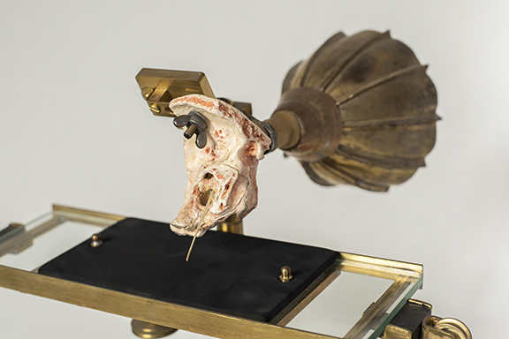

Slide 19
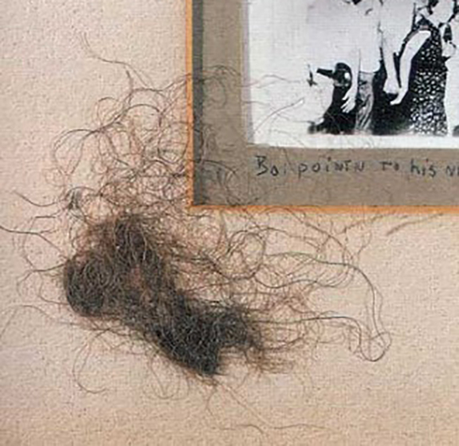

Slide 20
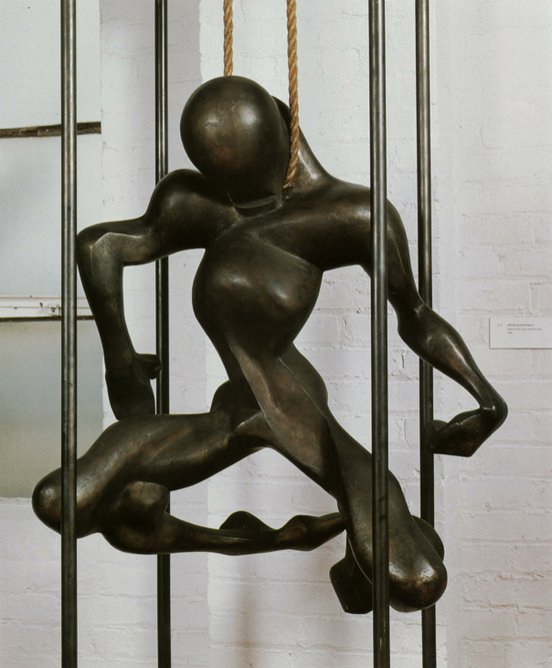

Slide 21
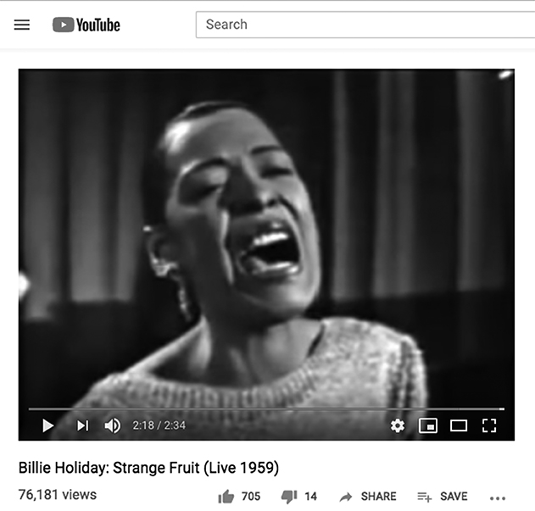

Slide 22
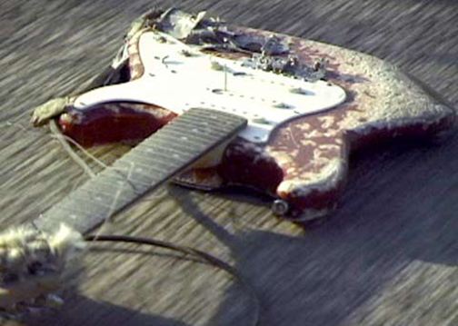

Slide 23
‘Resonance has always fascinated humans. It seems to combine two fundamental dimensions: first, the potential for power that sounds possess, and second, the capacity to act at a distance using sound as an intermediary. In a way, resonance is a myth of strength, symbolized by the power of sound’. (Augoyard and Torgue, Sonic Experience, p. 108)

Slide 24
‘Resonance has always fascinated humans. It seems to combine two fundamental dimensions: first, the potential for power that sounds possess, and second, the capacity to act at a distance using sound as an intermediary. In a way, resonance is a myth of strength, symbolized by the power of sound’. (Augoyard and Torgue, Sonic Experience, p. 108)

Slide 25
Discussion:
Other examples of resonating bodies that are raced and sexed within histories of media technology, medicine, or science

Slide 26
Discussion:
Other examples of resonating bodies that are raced and sexed within histories of media technology, medicine, or science
Does auditory frameworks (e.g. reverberation) prompt you to think differently about racialized violence?

