Slide 1
Sound Theories
3. Voices

Slide 2
Voice is:

Slide 3
Voice is:
Self-expression

Slide 4
Voice is:
Self-expression
Subjective

Slide 5
Voice is:
Self-expression
Subjective
Spirit

Slide 6
Voice is:
Self-expression
Subjective
Spirit
Consciousness

Slide 7
Voice is:
Self-expression
Subjective
Spirit
Consciousness
Language

Slide 8
Voice is:
Self-expression
Subjective
Spirit
Consciousness
Language
Speech

Slide 9
Voice is:
Self-expression
Subjective
Spirit
Consciousness
Language
Speech
Power

Slide 10
Voice is:
Self-expression
Subjective
Spirit
Consciousness
Language
Speech
Power
Presence

Slide 11
Voice is:
Self-expression
Subjective
Spirit
Consciousness
Language
Speech
Power
Presence
Unique

Slide 12
Voice is:
Self-expression
Subjective
Spirit
Consciousness
Language
Speech
Power
Presence
Unique
Plural

Slide 13
A Theory of the Voice:
The grain of the voice (Barthes)

Slide 14
Voice in:
Music, singing, technology (Weheliye)
Philosophy (Cavarero)
Media and emotion (Smith)

Slide 15
1. The Grain of the Voice
(Roland Barthes)
“The ‘grain’ is the body in the voice as it sings, the hand as it writes, the limb as it performs… listen to my relation with the body of the man or woman singing or playing and that relation is erotic – but in no way ‘subjective’.” (p. 509)
Dual production of language (text) and music – history of music vs. theory of the text

Slide 16
Pheno-text and geno-text (from Kristeva)
The pheno-song: “covers all phenomena, all the features which belongs to the structure of the language being sung, the rules of the genre… in short, everything in the performance that is in the service of communication, representation, expression…” (p. 506)

Slide 17
The geno-song: “is the volume of the singing and speaking voice, the space where signification germinate ‘from within the language and in its very materiality’… It is, in very simple word but which must be taken seriously, the diction of the language.” (p. 506)

Slide 18
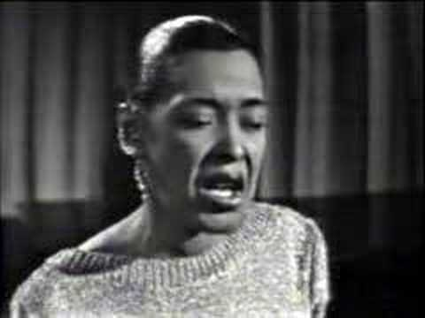
Listening exercise: listen to different versions of Strange Fruit (1937), analyze / play using Barthes’ theory.

Slide 19
2. Voice in Black Popular Music
(Alexander Weheliye)
The use of sound technologies in popular R&B music (“cell-phone” effect): “voice distortion devices as both technological and ‘expressive extensions of the performing body.’” (p. 512)
“In the move from the vocoder to the vocoder effect, the centrality of the human voice dissipates throughout the desiring machine that is R&B.” (p. 515)

Slide 20
Making race central to theories of posthumanism. (p. 516)

Slide 21
For Thursday: Look for versions of Strange Fruit that evoke one or more of the key concepts from the reading you chose:
          Uniqueness (Cavarero)
          Uncanny (Smith)
Post on Sakai along with your discussion questions by 10PM Wednesday. You can see examples posted by past students on the MS52 class blog.

Slide 23
“Voice is sound, not speech. But speech constitutes its essential destination. What is therefore at stake in any inquiry into the ontology of the voice—where uniqueness and relationality come to the fore—is a rethinking, without metaphysical prejudices, of this destination.” (Cavarero, p. 529)

Slide 24
“For Freud, the uncanny is particularly tied to the involuntary return to the same situation, something of particular pertinence to the experiences of the laugh track because of its nature as a tape loop: we hear the same laughs again and again. Indeed, the laugh track apparatus is an unlikely precursor to the tape-loop performances in modern avant-garde and popular music, even a kind of proto-sampler.” (Smith, p. 535)

