Slide 1
II. Histories of Sound

Slide 2
Listening to History / Histories of Listening
Histories of Sound and Technology
Acoustic Archives

Slide 3
Why are historians now beginning to listen to the past?

Slide 4
Why are historians now beginning to listen to the past?
    Listening to History

Slide 5
Why are historians now beginning to listen to the past?
    Listening to History
    Aural history

Slide 6
Why are historians now beginning to listen to the past?
    Listening to History
    Aural history
And how are they listening?

Slide 7
Why are historians now beginning to listen to the past?
    Listening to History
    Aural history
And how are they listening?
        Histories of Listening

Slide 8
Why are historians now beginning to listen to the past?
    Listening to History
    Aural history
And how are they listening?
        Histories of Listening
        History of aurality

Slide 9
Listening to History / Histories of Listening:
Bells, identity, 19th Century French village (Corbin)
Feminist historiography of electronic music (Rodgers + Sisters with Transistors, 2020, Dir. Lisa Rovner)

Slide 10
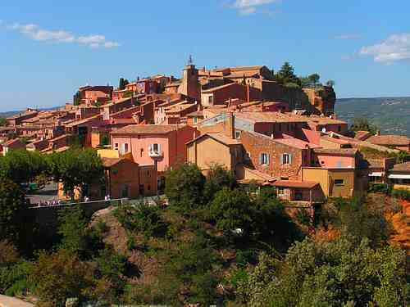
1. Identity, Bells, and the 19th Century French Village

Slide 11
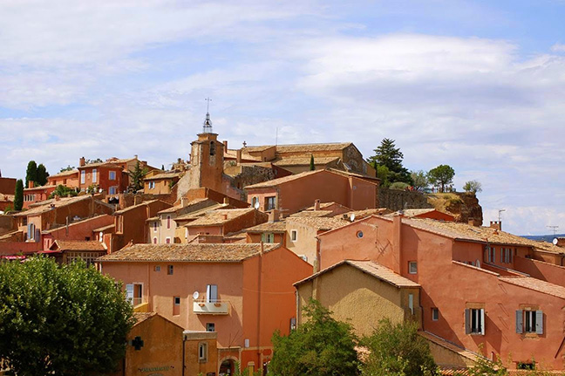
The Village of Roussillon, Provence, France

Slide 12
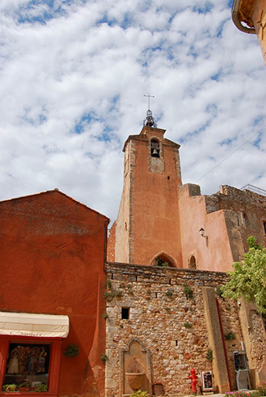
“In the nineteenth century, at least in the countryside, bell ringing defined a space within which only fragmented discontinuous noises were heard, none of which could really vie with the bell tower.”
(p. 185)

Slide 13
The functions of bells in the 19th century French countryside:

Slide 14
The functions of bells in the 19th century French countryside:
Marking territorial identity

Slide 15
The functions of bells in the 19th century French countryside:
Marking territorial identity
“Sacral recharging of the surrounding space” (p. 185)

Slide 16
The functions of bells in the 19th century French countryside:
Marking territorial identity
“Sacral recharging of the surrounding space” (p. 185)
Orientation

Slide 17
The functions of bells in the 19th century French countryside:
Marking territorial identity
“Sacral recharging of the surrounding space” (p. 185)
Orientation
Prophylactic virtue

Slide 18
The functions of bells in the 19th century French countryside:
Marking territorial identity
“Sacral recharging of the surrounding space” (p. 185)
Orientation
Prophylactic virtue
To ‘rarefy’ the air (p. 189)

Slide 19
The functions of bells in the 19th century French countryside:
Marking territorial identity
“Sacral recharging of the surrounding space” (p. 185)
Orientation
Prophylactic virtue
To ‘rarefy’ the air (p. 189)
Temporal marker

Slide 20
What language and names are inscribed on these bronze bells?

Slide 21
What language and names are inscribed on these bronze bells?
Who has bells rung in their honor?

Slide 22
“Through bells an individual was better able to apprehend the identity of the group to which he belonged. They helped him locate himself in space and time. They audibly proclaimed to him the order of the society within which his life unfolded, and made manifest the power of the constituted authorities” (p. 200)

Slide 23
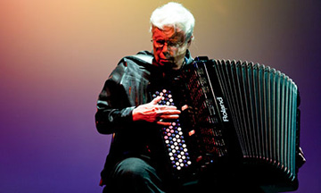
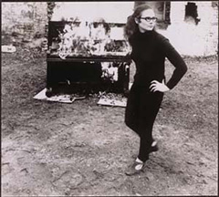
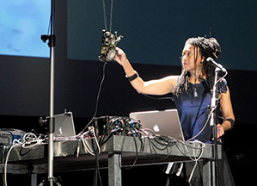
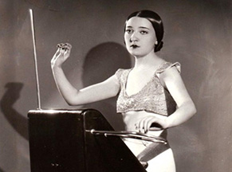

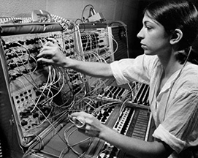
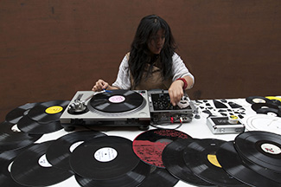
2. Towards A Feminist Historiography of Electronic Music

Slide 24
Rodger’s historiography:

Slide 25
Rodger’s historiography:
    Origins stories (e.g. Russolo’s Art of Noises) tend to normalize hegemonic cultural practices

Slide 26
Rodger’s historiography:
    Origins stories (e.g. Russolo’s Art of Noises) tend to normalize hegemonic cultural practices
    The tools for making electronic music are not innocent

Slide 27
Rodger’s historiography:
    Origins stories (e.g. Russolo’s Art of Noises) tend to normalize hegemonic cultural practices
    The tools for making electronic music are not innocent
    Cagian silence

Slide 28
Rodger’s historiography:
    Origins stories (e.g. Russolo’s Art of Noises) tend to normalize hegemonic cultural practices
    The tools for making electronic music are not innocent
    Cagian silence
    The logic of reproduction

Slide 29
Rodger’s historiography:
    Origins stories (e.g. Russolo’s Art of Noises) tend to normalize hegemonic cultural practices
    The tools for making electronic music are not innocent
    Cagian silence
    The logic of reproduction
    Works by women electronic musicians suggest different, more imaginative ways to navigate this history

Slide 30
Let’s go listen and watch!

Slide 31
Discussion:
Link the listening practice, acoustic experience, or sound object you are writing about in your first essay to one of the historiographies we are studying this week
Discuss + share with your partner, then with the class.

