Slide 1
II. Histories of Sound
3. Acoustic Archives

Slide 2
Sound recording as archival medium (Sterne)
Two films on sound archives
  Phantom of the Operator (Martel)
  Tailenders (Horne)
Sonification (Sterne and Akiyama)

Slide 3
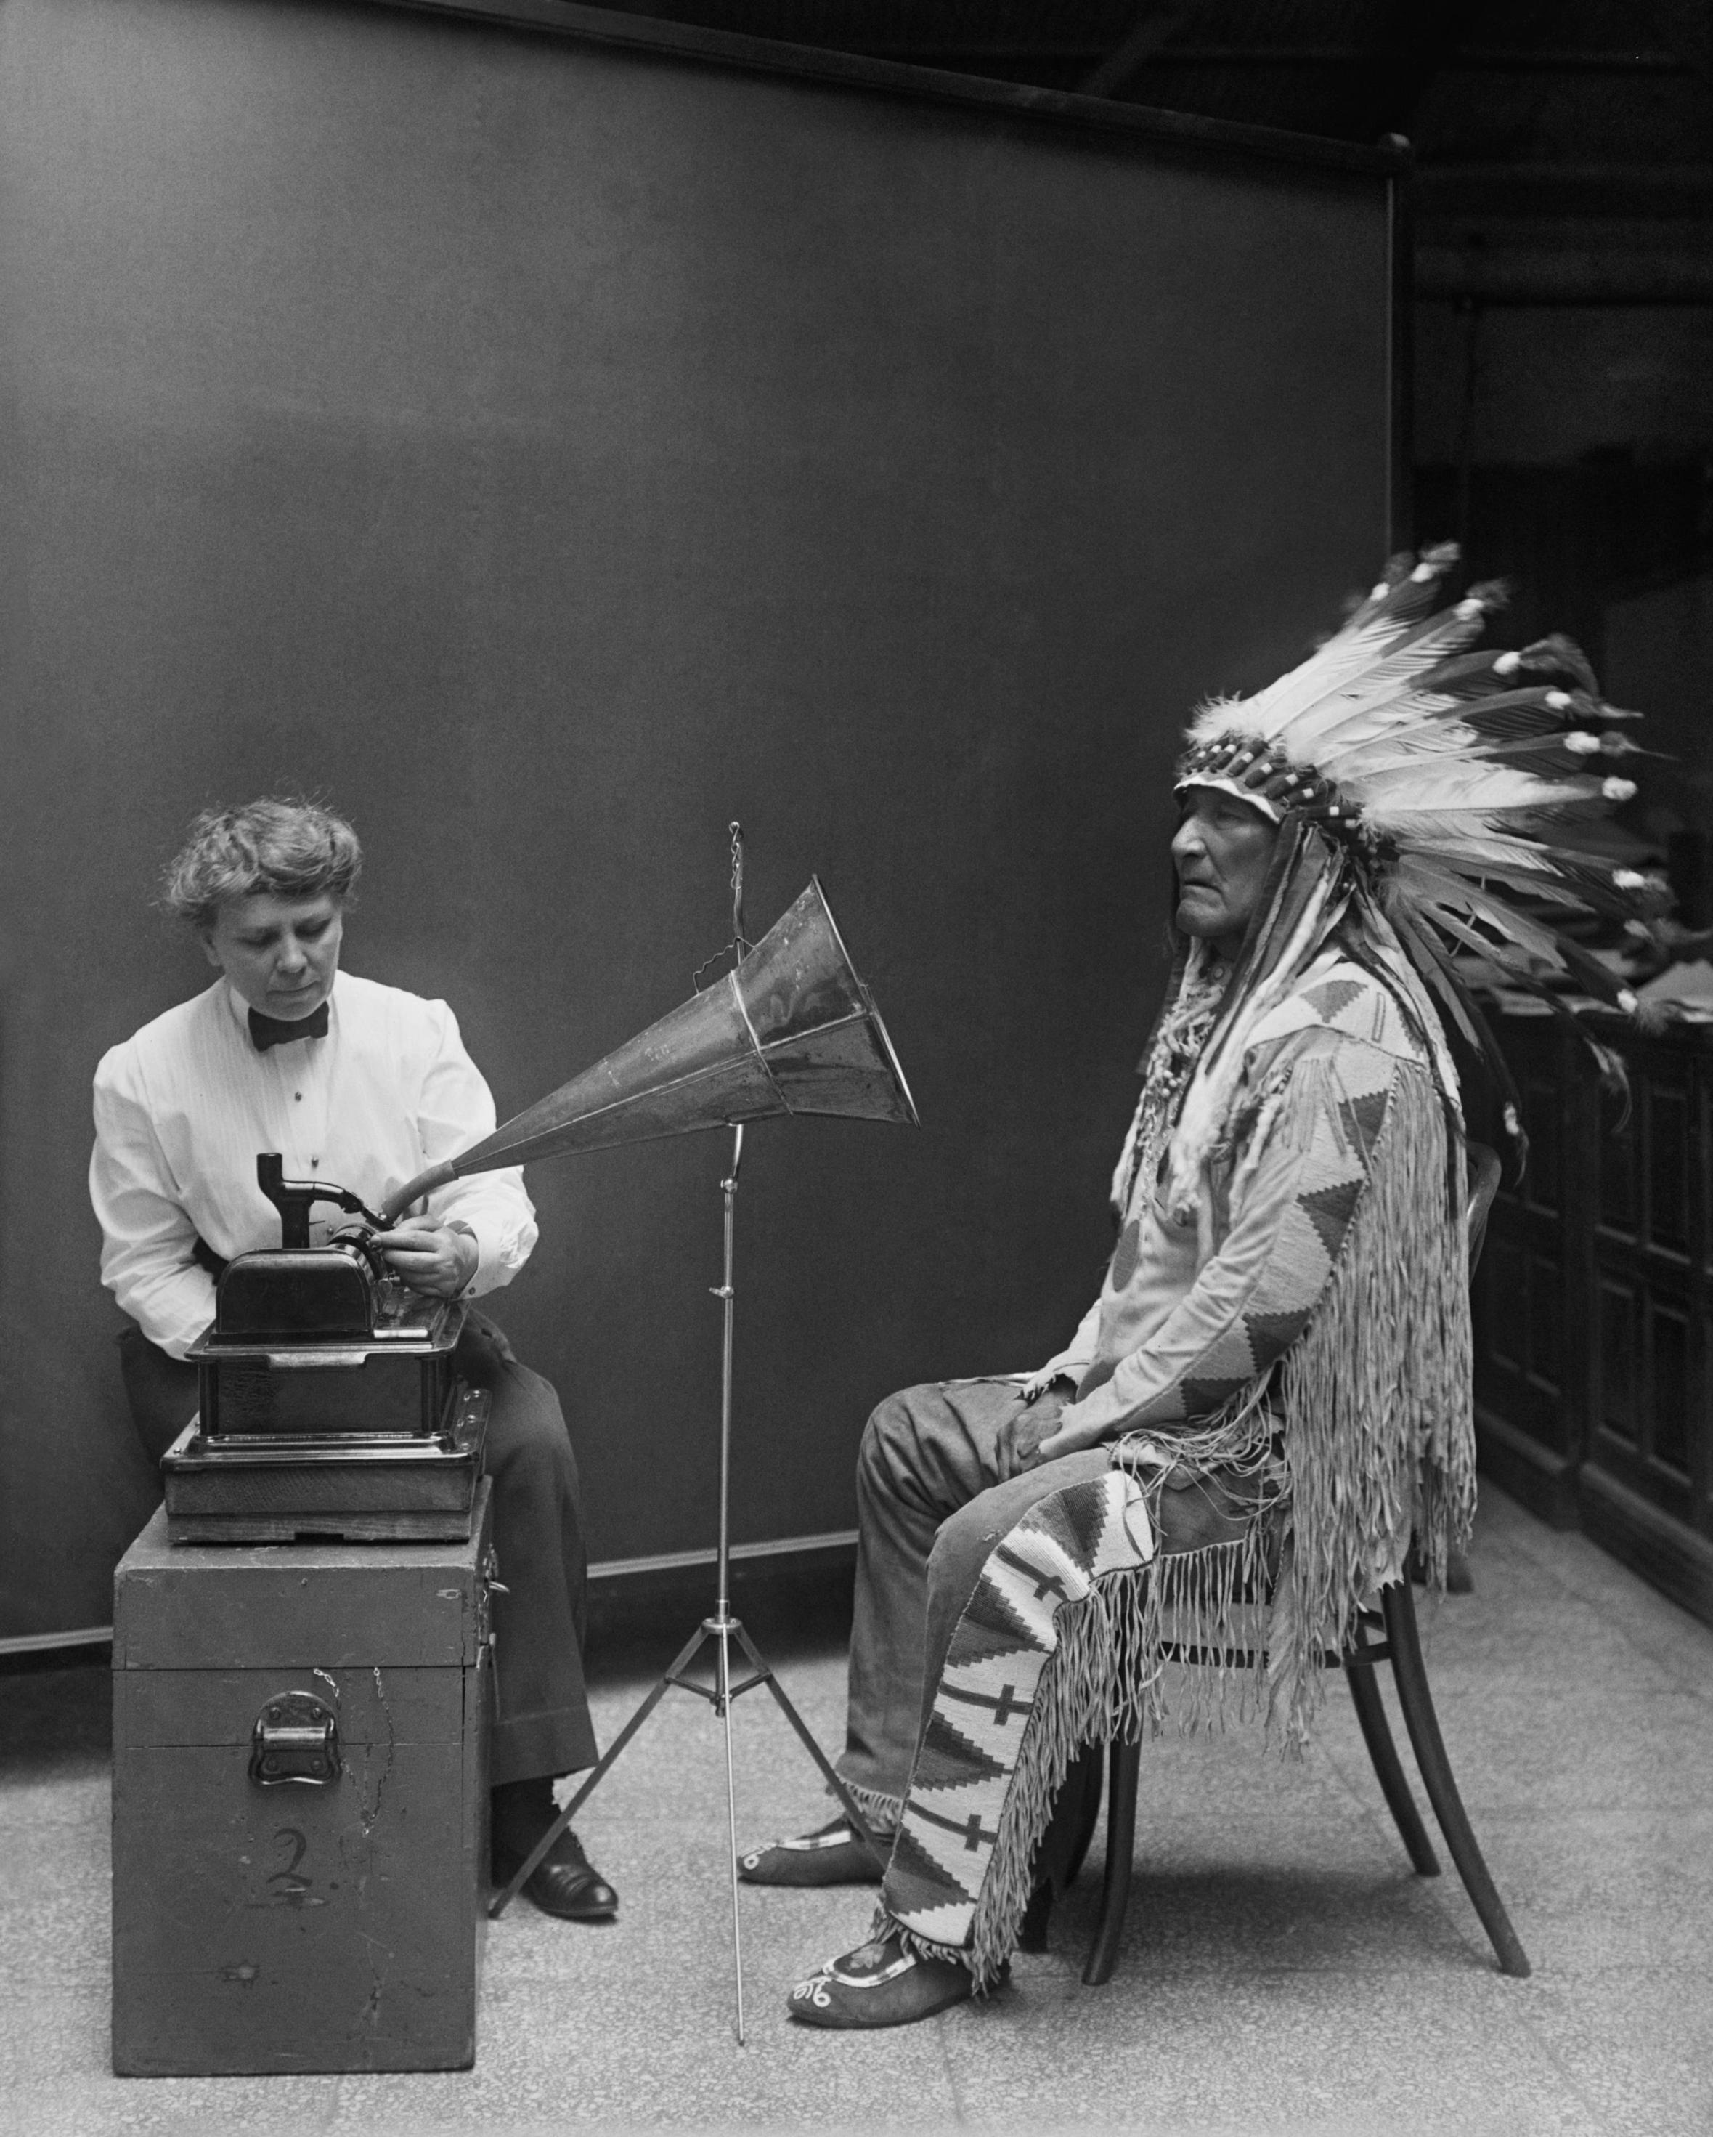
Preserving Sound in Modern America
(Sterne)

Slide 4
“From the moment of its public introduction, sound recording was understood to have great possibilities as an archival medium.” (p. 295)

Slide 5
Sound recording as an archival medium :

Slide 6
Sound recording as an archival medium :
Preserving the voices of the dead

Slide 7
Sound recording as an archival medium :
Preserving the voices of the dead
Ephemerality of the records

Slide 8
Sound recording as an archival medium :
Preserving the voices of the dead
Ephemerality of the records
Abstracted from one’s body / a figure of exteriority

Slide 9
Sound recording as an archival medium :
Preserving the voices of the dead
Ephemerality of the records
Abstracted from one’s body / a figure of exteriority
Victorian culture and death

Slide 10
Sound recording as an archival medium :
Preserving the voices of the dead
Ephemerality of the records
Abstracted from one’s body / a figure of exteriority
Victorian culture and death
Bourgeois modernity

Slide 11
Sound recording as an archival medium :
Preserving the voices of the dead
Ephemerality of the records
Abstracted from one’s body / a figure of exteriority
Victorian culture and death
Bourgeois modernity
“The ethos of preservation described and prescribed the cultural and technical possibilities of sound recording.” (p. 298)

Slide 12
Sound recording as an archival medium :
Preserving the voices of the dead
Ephemerality of the records
Abstracted from one’s body / a figure of exteriority
Victorian culture and death
Bourgeois modernity
“The ethos of preservation described and prescribed the cultural and technical possibilities of sound recording.” (p. 298)

Slide 13
“Permanence became a wish and a program for sound recording, not simply a fate realized.” (p. 303)

Slide 14
A Resonant tomb:
Canning technology (1850s-1880s)
Embalming
His Master’s Voice (1899)
Phonographical messages to the future
Audio ethnography

Slide 15
A Resonant tomb:
Canning technology (1850s-1880s)
Embalming
His Master’s Voice (1899)
Phonographical messages to the future
Audio ethnography

Slide 16
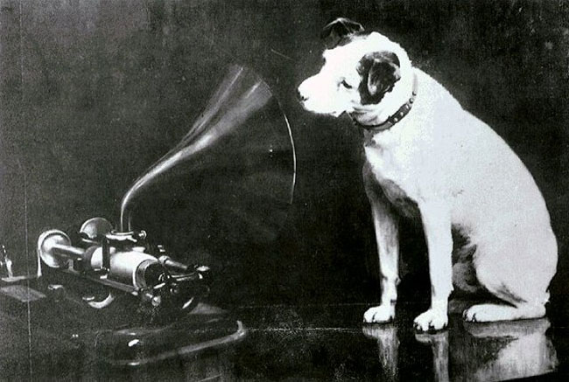
Francis Barraud’s painting of Nipper, dog of his deceased brother Mark Henry, painted around 1893. Barraud titled it Dog looking at and listening to a Phonograph

Slide 17
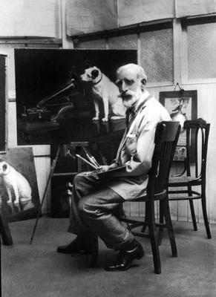
Barraud copying his painting for William Barry Owens (Emile Berliner’s manager) who bought the rights to it in 1899.

Slide 18
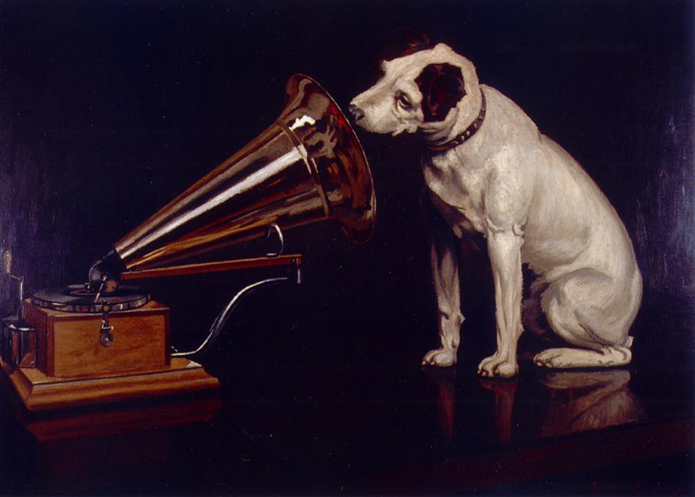
Burraud’s revised painting His Master’s Voice

Slide 19
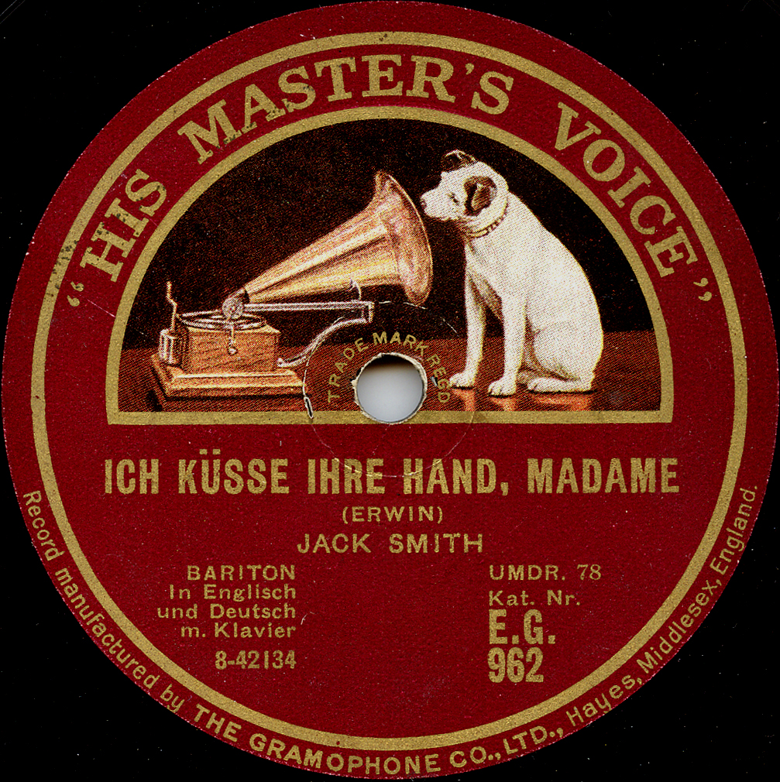

The His Master’s Voice trademark was granted to Emile Berliner in 1900

Slide 20
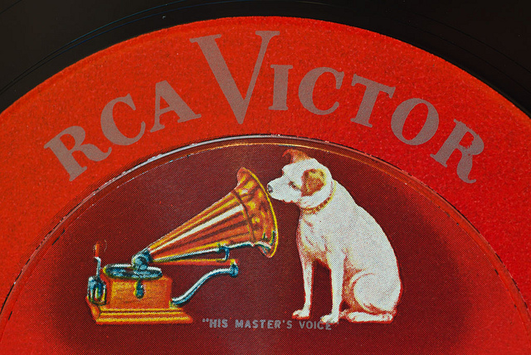
Nipper became known as the “RCA dog”

Slide 21
Frances Densmore recording Blackfoot chief Mountain Chief on a cylinder phonograph for the Bureau of American Ethology in 1916

Slide 22
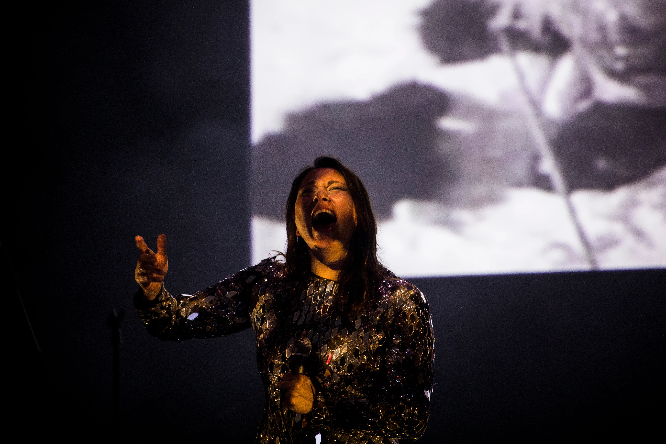
Tanya Tagaq performing a new soundtrack to Robert Flaherty’s Nanook of the North (1922) at Dark Mofo Festival, Hobart, Australia, 2018

Slide 23
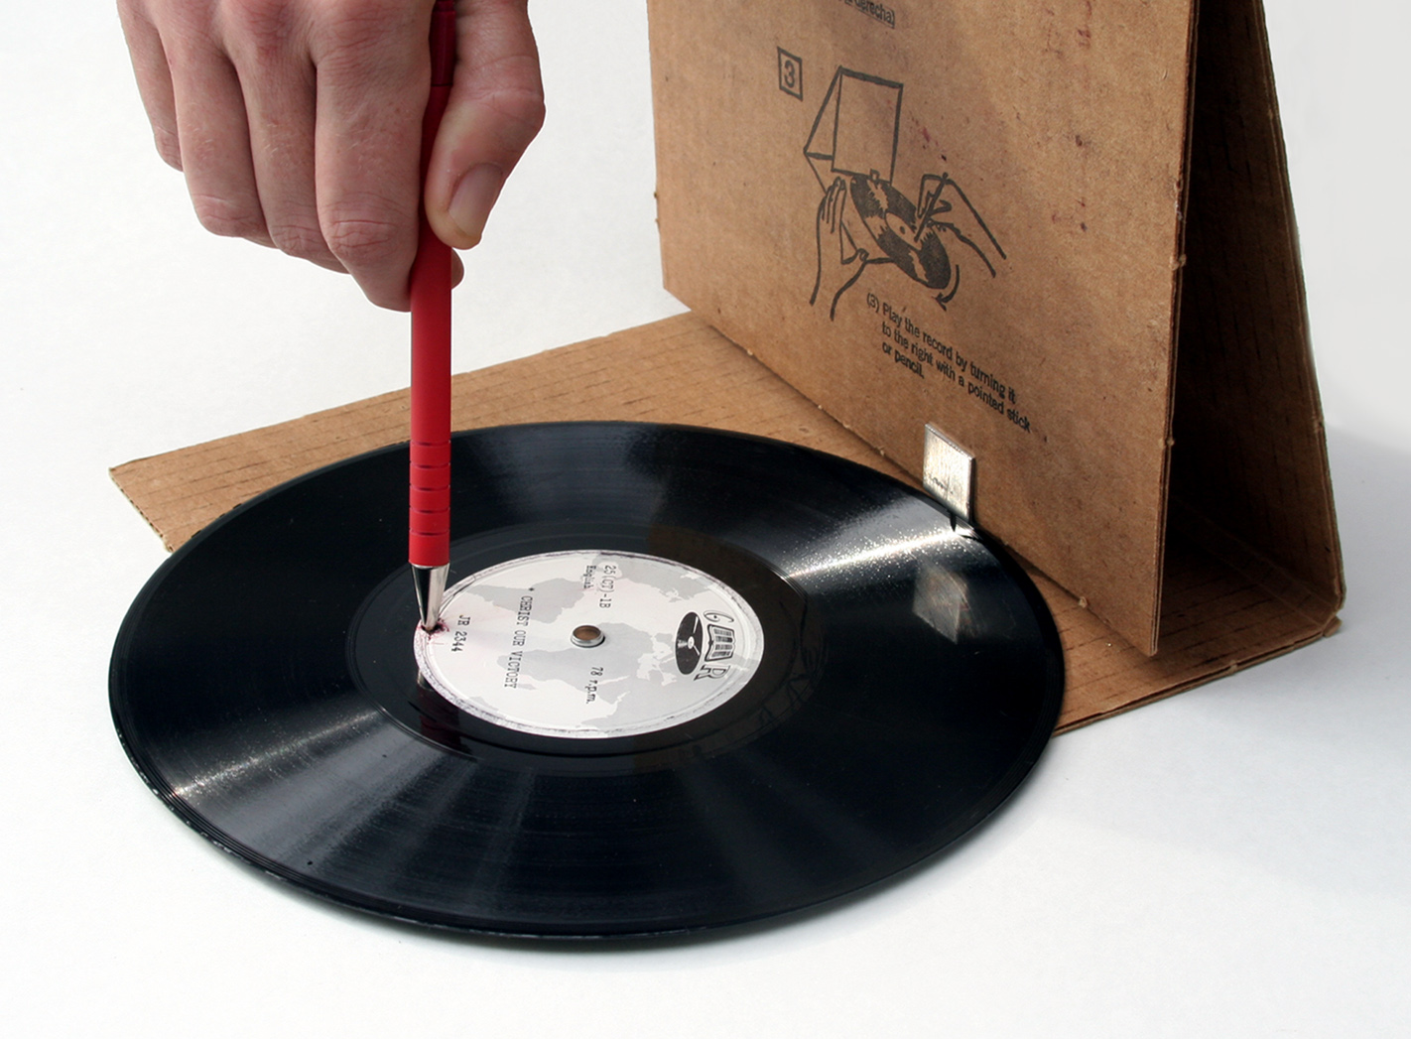
Global Recordings Network, founded in Los Angeles,1939, in the documentary Tailenders (2006) Dir. Adele Horne

Slide 24
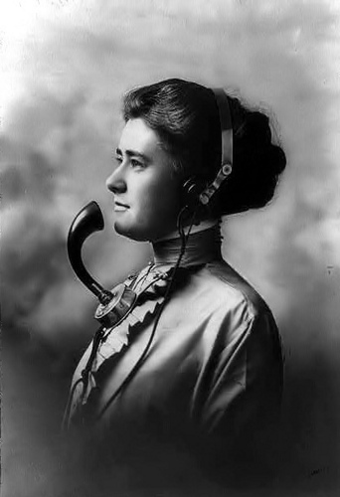
Phantom of The Operator (Canada, 2004) Dir. Caroline Martel

Slide 25
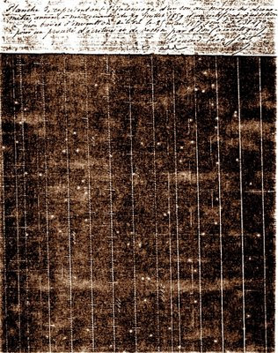
THINKING ABOUT SONIFICATION: SCOTT’S PHONAUTOGRAM

Slide 26
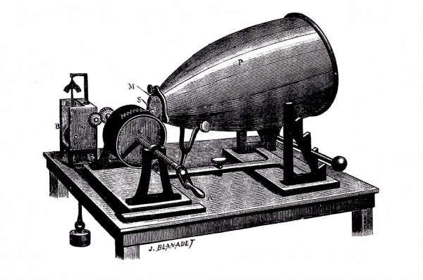
Édouard-Léon Scott de Martinville’s Phonautograph, 1857

Slide 27
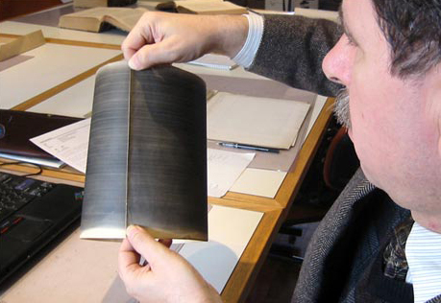

Slide 28
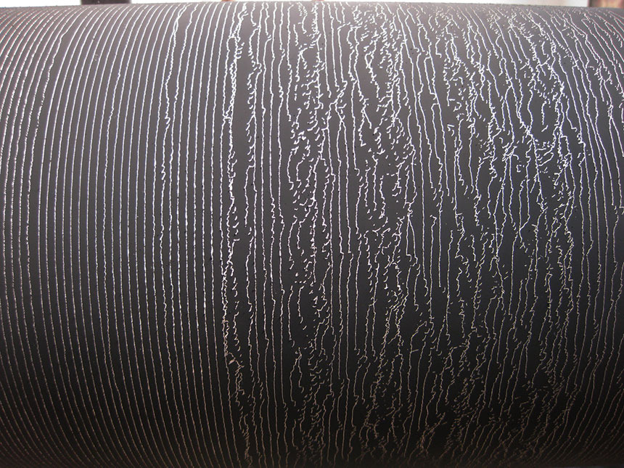

Slide 29
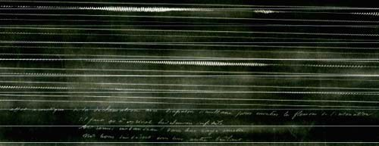
A phonautogram scanned from one of Scott’s originals in the archive of the Institut de France and published by First Sounds

Slide 30
What does it mean to play back sound recordings that were never meant for playback?

Slide 31
What does it mean to play back sound recordings that were never meant for playback?
What implications does the practice of sonification have on sound studies as a field?

Slide 32
For Thursday: Based on the film (Horne or Martell) you chose to watch, consider the acoustic archive depicted in them in relation to Sterne and Akiyama’s discussions, and what they can offer an aural historian.
Formulate your discussion question around these considerations.

Slide 33
Thursday Discussion
Divide into two groups based on the film you watched;
Share you discussion questions with each other;

Slide 34
Thursday Discussion
Working as a group, select an (up to 5 mins.) excerpt of the film your group watched and write a thesis statement about it and the film based on your group’s discussion.
Present the film clip to the class with your thesis statement, accompanied by 2-3 supporting questions for discussion

