Slide 1
III. Sound as Media
2. Film Sound

Slide 2
Film sound theories
  Audio-Vision (Chion)
  4.5 Fallacies (Altman)

Slide 3
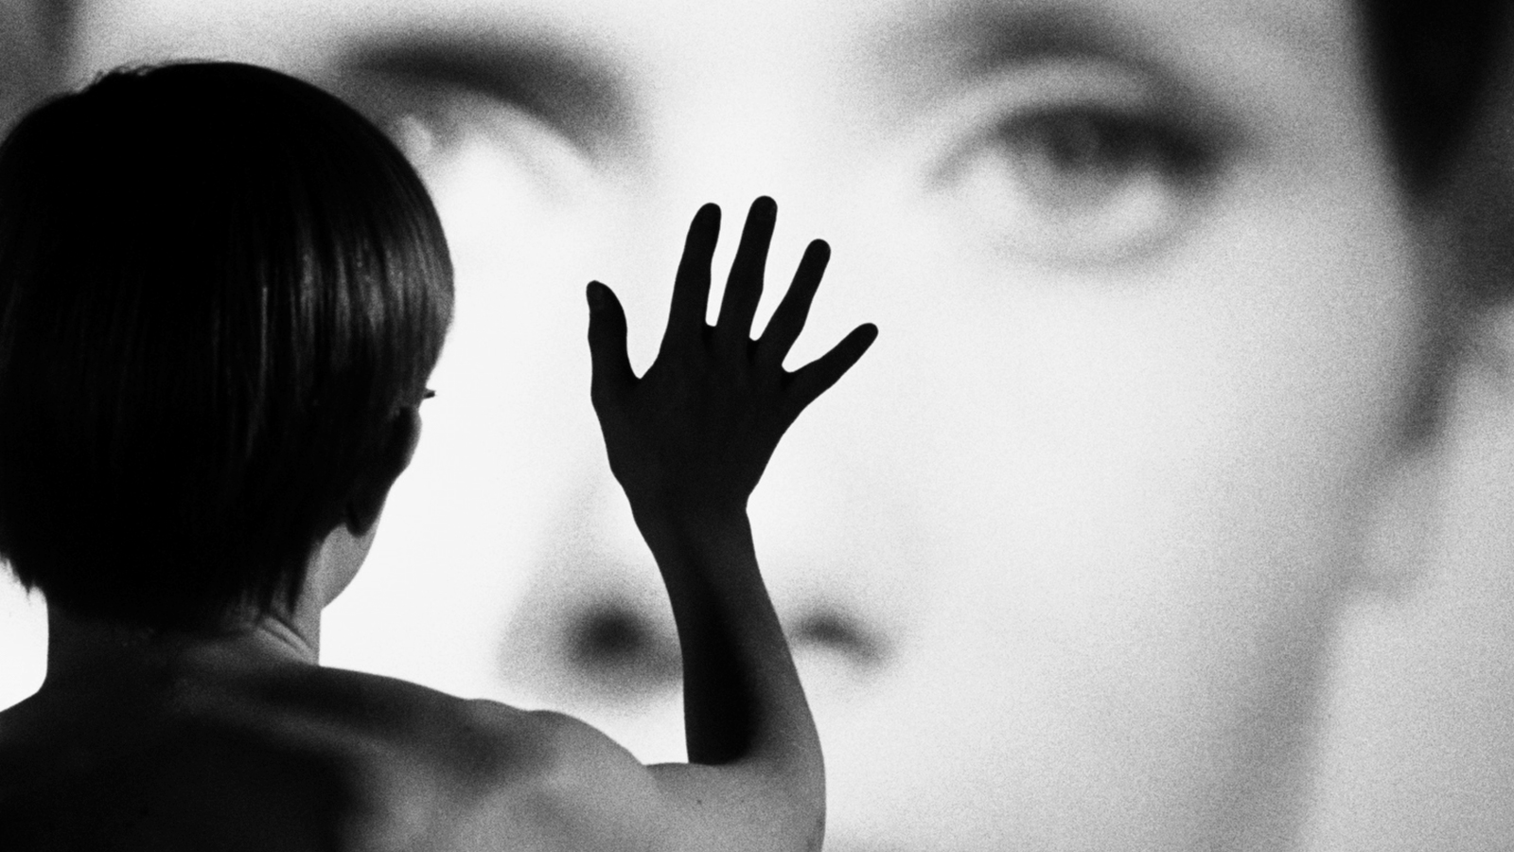
Persona (1966) Dir. Ingmar Bergman

Slide 4
Chion’s Key Concepts:
Added Value
Synchresis
Vococentrism
Verbocentrism
Music: empathetic / anempathetic
Spotting

Slide 5
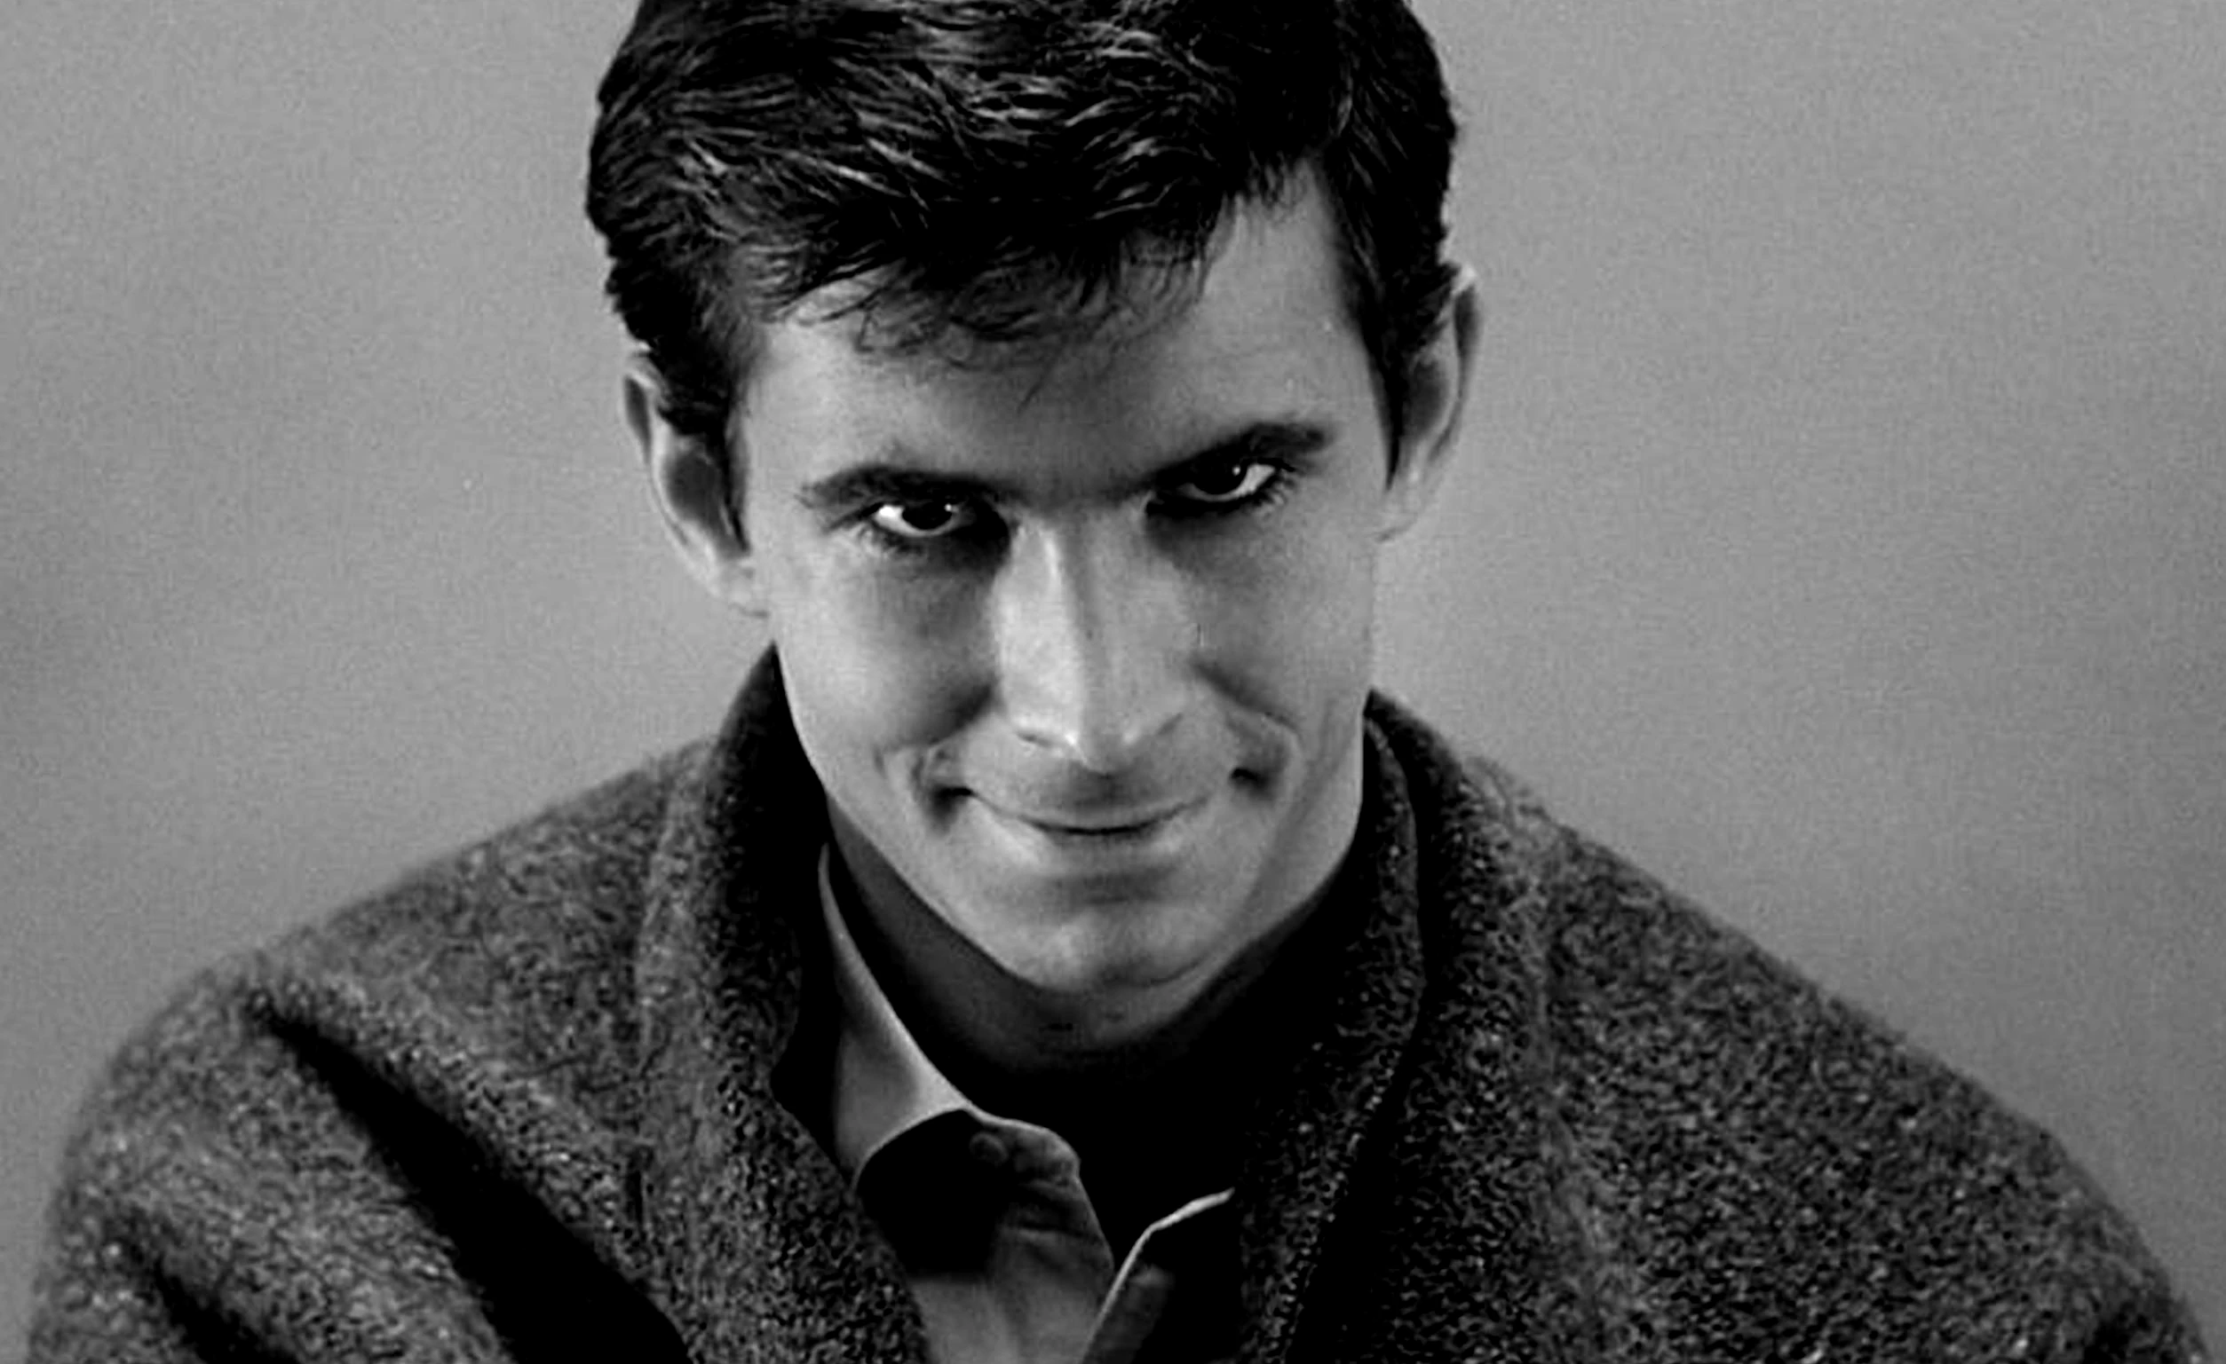
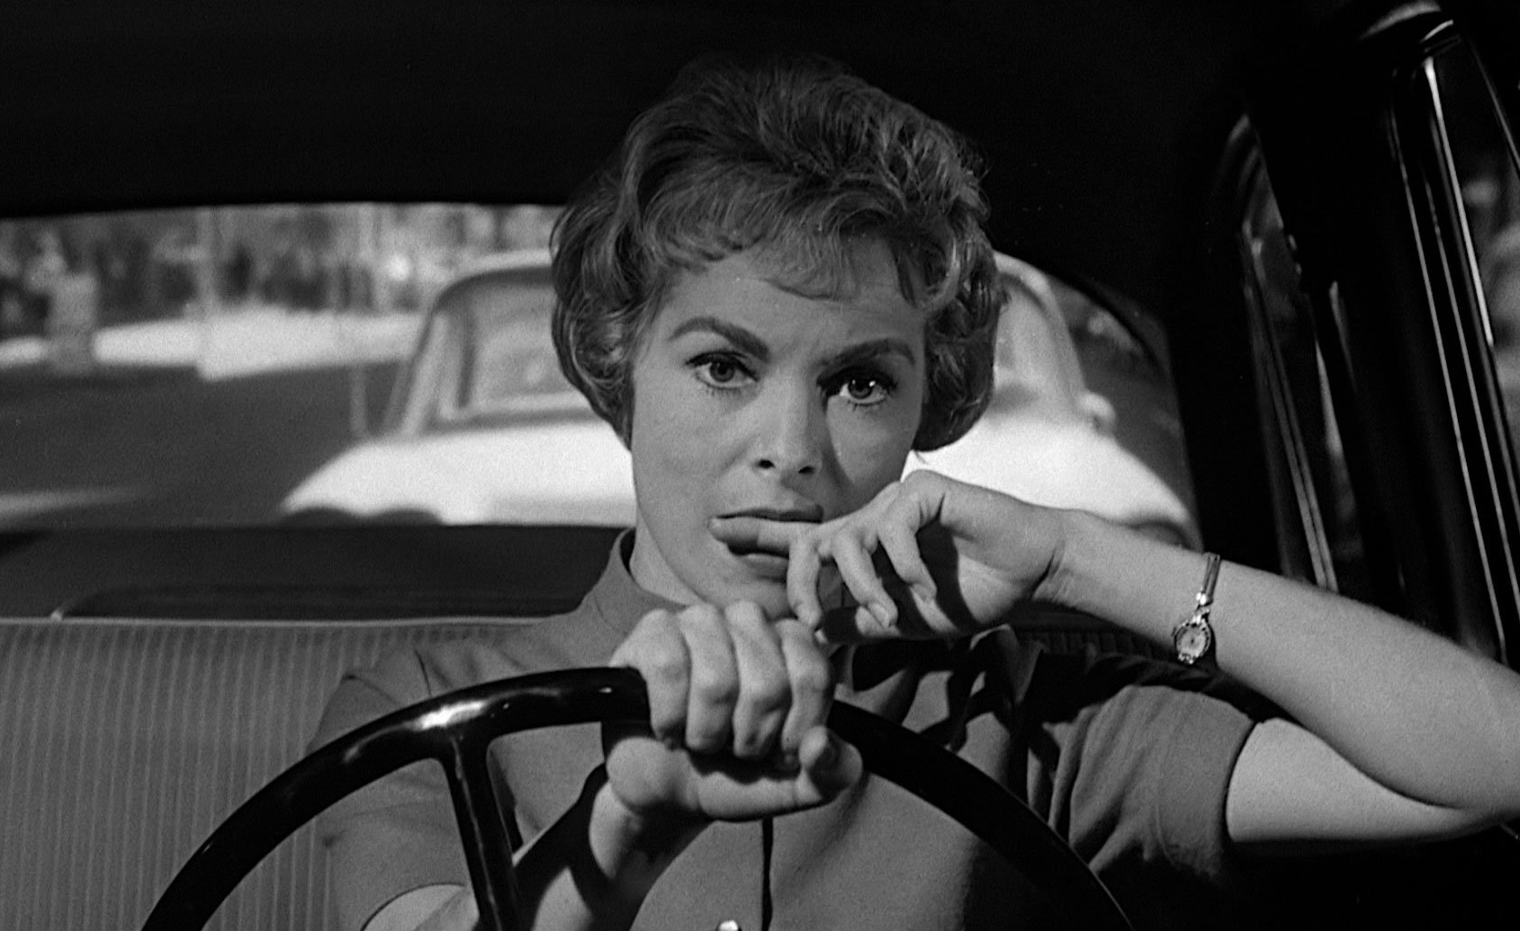
Psycho (1960)
Dir. Alfred Hitchcock

Slide 6
Fallacies In Film Sound Theory:

Slide 7
Fallacies In Film Sound Theory:
Historical

Slide 8
Fallacies In Film Sound Theory:
Historical
Ontological

Slide 9
Fallacies In Film Sound Theory:
Historical
Ontological
Reproduction

Slide 10
Fallacies In Film Sound Theory:
Historical
Ontological
Reproduction
Nominalism

Slide 11
Fallacies In Film Sound Theory:
Historical
Ontological
Reproduction
Nominalism
4.5 Cinema as index

