Slide 1
IV. Sound Space
2. Acoustemology & Representation

Slide 2
Anthropology of sound:

Slide 3
Anthropology of sound:
What role does anthropological inquiry have in shaping the discourse of acoustic ecology and soundscape studies?

Slide 4
Anthropology of sound:
And how does acoustic phenomena and technological mediation shape and influence these inquiries?

Slide 5
Anthropology of sound:
How might anthropology/ethnography help us imagine auditory culture(s) as historical formations of distinct sensibilities, as sonic geographies of difference?

Slide 6
Anthropology of sound:
  Rainforest Acoustemology (Feld)
  An Anthropologist Underwater (Helmreich)

Slide 7
Feld: “Deep down the hope is that by giving marginalized voices places to speak and shout and sing from, anthropology can in some measure counter the long-standing arrogance of colonial and imperial authority, of history written in one language, in one voice, as one narrative.” (p. 223)

Slide 8
Feld: “Deep down the hope is that by giving marginalized voices places to speak and shout and sing from, anthropology can in some measure counter the long-standing arrogance of colonial and imperial authority, of history written in one language, in one voice, as one narrative.” (p. 223)

Slide 9
Feld: “Deep down the hope is that by giving marginalized voices places to speak and shout and sing from, anthropology can in some measure counter the long-standing arrogance of colonial and imperial authority, of history written in one language, in one voice, as one narrative.” (p. 223)

Slide 10
Helmreich: “...inquiry motivated not by the visual rhetoric of self-examination and self-correcting perspectivalism but by auditorily inspired, lateral attention to the modulating relations that produce insides and outsides, subjects and objects, sensation and sense data...” (p. 169)

Slide 11
Helmreich: “...inquiry motivated not by the visual rhetoric of self-examination and self-correcting perspectivalism but by auditorily inspired, lateral attention to the modulating relations that produce insides and outsides, subjects and objects, sensation and sense data...” (p. 169)

Slide 12
Helmreich: “...inquiry motivated not by the visual rhetoric of self-examination and self-correcting perspectivalism but by auditorily inspired, lateral attention to the modulating relations that produce insides and outsides, subjects and objects, sensation and sense data...” (p. 169)

Slide 13
“Rather than seeing from a point of view, I suggest tuning in to surroundings and to circumstances that allow resonance, reverberation, echo—senses of presence and distance, at scales ranging from individual to collective.”

Slide 14
“Rather than seeing from a point of view, I suggest tuning in to surroundings and to circumstances that allow resonance, reverberation, echo—senses of presence and distance, at scales ranging from individual to collective.”

Slide 15
“Rather than seeing from a point of view, I suggest tuning in to surroundings and to circumstances that allow resonance, reverberation, echo—senses of presence and distance, at scales ranging from individual to collective.”
“a model of anthropologists as transducers in circuits of social relations.”(all p. 169-170)

Slide 16
“Rather than seeing from a point of view, I suggest tuning in to surroundings and to circumstances that allow resonance, reverberation, echo—senses of presence and distance, at scales ranging from individual to collective.”
“a model of anthropologists as transducers in circuits of social relations.”(all p. 169-170)

Slide 17
Some Useful Theoretical Terms and Concepts:

Slide 18
Some Useful Theoretical Terms and Concepts:
Acoustemology

Slide 19
Some Useful Theoretical Terms and Concepts:
Acoustemology
Poetic cartography:
      Lift-up-over-sounding” (dulugu ganalan)
      “flowing” (a:ba:lan)

Slide 20
Some Useful Theoretical Terms and Concepts:
Acoustemology
Poetic cartography:
      Lift-up-over-sounding” (dulugu ganalan)
      “flowing” (a:ba:lan)
Sound worlds as embodied histories (histories lived musically)

Slide 21
Some Useful Theoretical Terms and Concepts:
Transductive ethnography

Slide 22
Some Useful Theoretical Terms and Concepts:
Transductive ethnography
Immersion

Slide 23
Comparative Analysis Between the Sound World of the Kaluli and Alvin

Slide 24
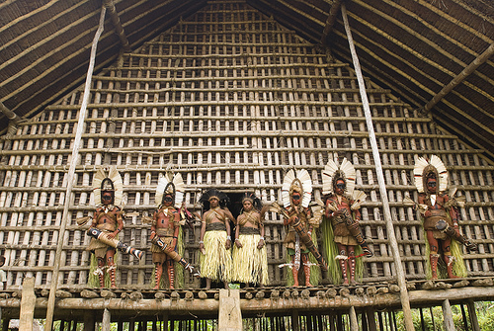
Visual World of the Kaluli, Papua New Guinea

Slide 25
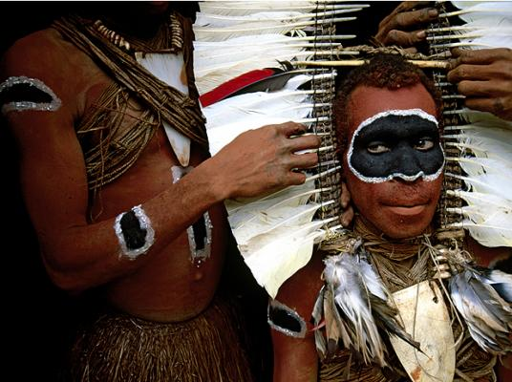

Slide 26


Slide 27
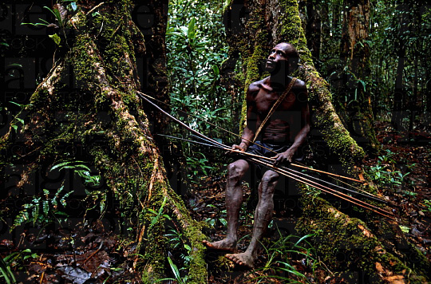

Slide 28


Slide 29
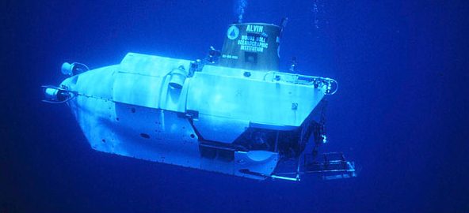
Visual World of Alvin (DVS-2)

Slide 30
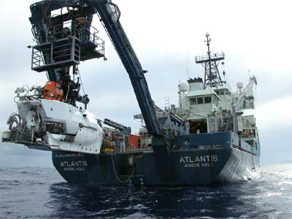
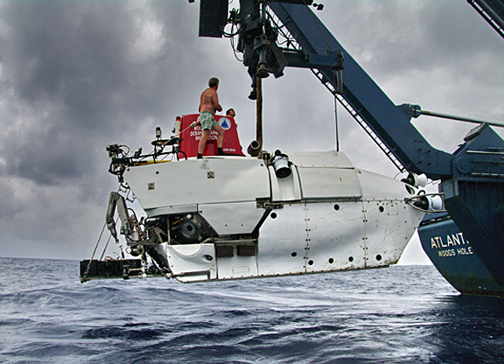

Slide 31
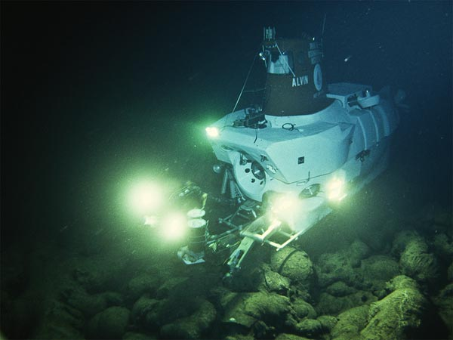

Slide 32
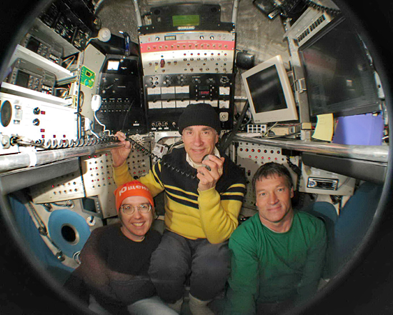

Slide 33
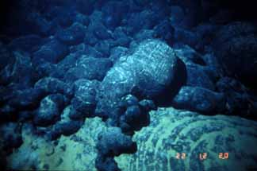
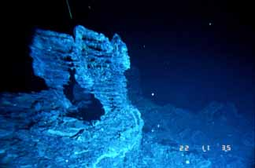

Slide 34
How are the soundscapes of the Kaluli and deep sea environments similar and different from ours?

Slide 35
How are the soundscapes of the Kaluli and deep sea environments similar and different from ours?
How are these soundscapes similar and different from each other?

Slide 36

Soundscape Discussion: 3 Case Studies
Francisco López , La Selva, 1998

Slide 37
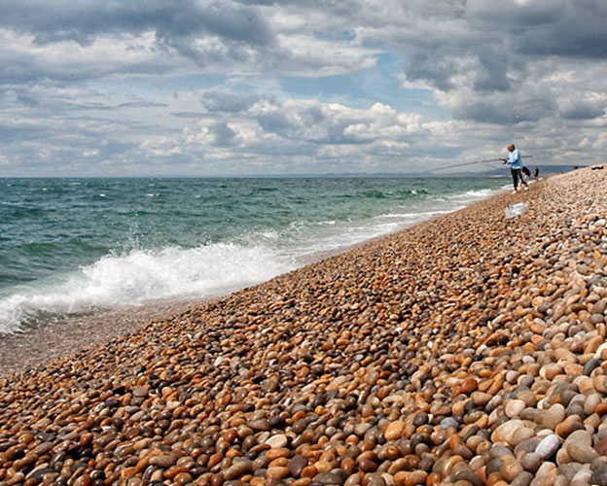
Soundscape Discussion: 3 Case Studies
Bill Fontana, White Sound – An Urban Seascape, 2011

Slide 38
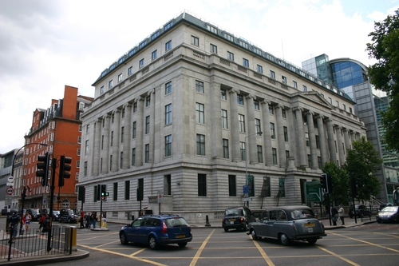
Soundscape Discussion: 3 Case Studies
Bill Fontana, White Sound – An Urban Seascape, 2011

Slide 39
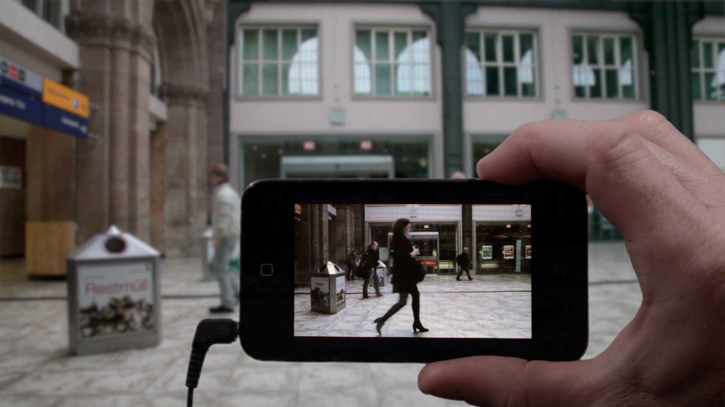
Soundscape Discussion: 3 Case Studies
Janet Cardiff & George Bures Miller,
Alter Bahnhof Video Walk, 2012

