Slide 1
V. Open Topic Class
(More) Film Sound

Slide 2
Review:
  Audio-Vision (Chion)
  4.5 Fallacies (Altman)

Slide 3
Review:
  Audio-Vision (Chion)
    Added Value
    Synchresis
    Vococentrism
    Verbocentrism
    Music: empathetic / anempathetic
    Spotting
  4.5 Fallacies (Altman)

Slide 4
Review:
  Audio-Vision (Chion)
    Added Value
    Synchresis
    Vococentrism
    Verbocentrism
    Music: empathetic / anempathetic
    Spotting
  4.5 Fallacies (Altman)
    Historical
    Ontological
    Reproduction
    Nominalism
    Cinema as index

Slide 5
The Voice in the Cinema:

Slide 6
The Voice in the Cinema:
The body in cinema is a fantasmatic body, it offers up a support and point of identification for the subject. (unity and presence)

Slide 7
The Voice in the Cinema:
The body in cinema is a fantasmatic body, it offers up a support and point of identification for the subject. (unity and presence)
The “addition” of sound (synchronous dialogue) offers the opportunity of representing a fuller and more organically unified body

Slide 8
The Voice in the Cinema:
“Just as voice must be anchored by a given body, and the body must be anchored in a given space” (p. 164)

Slide 9
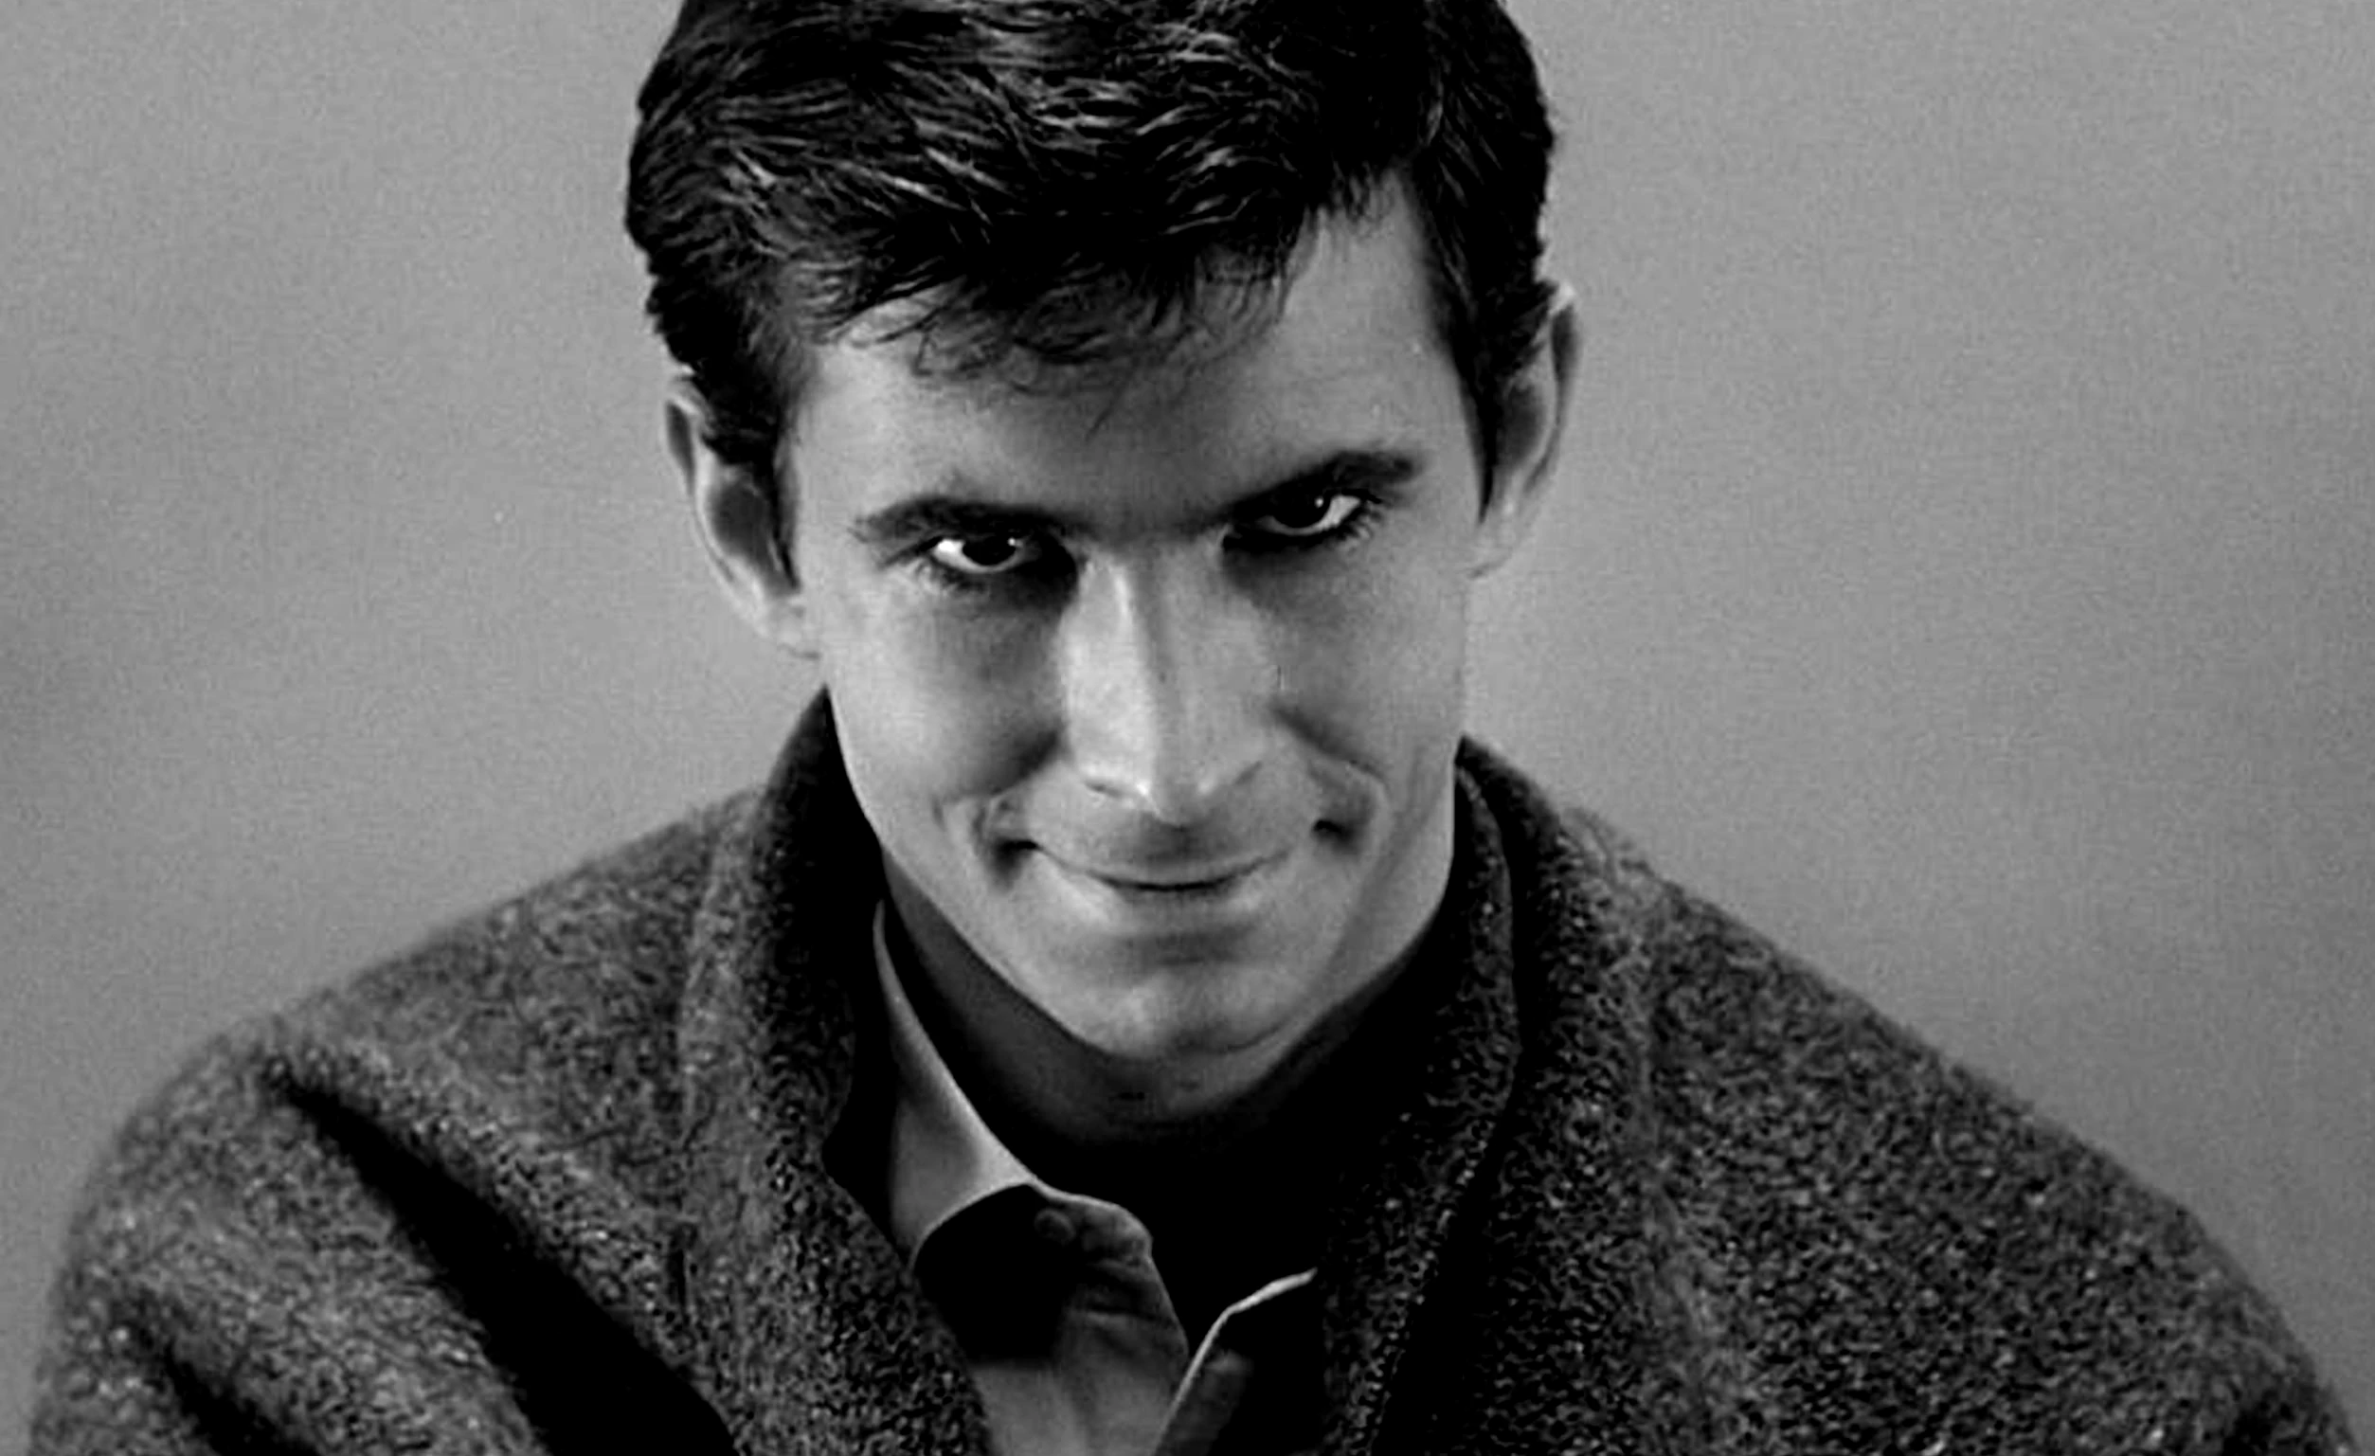
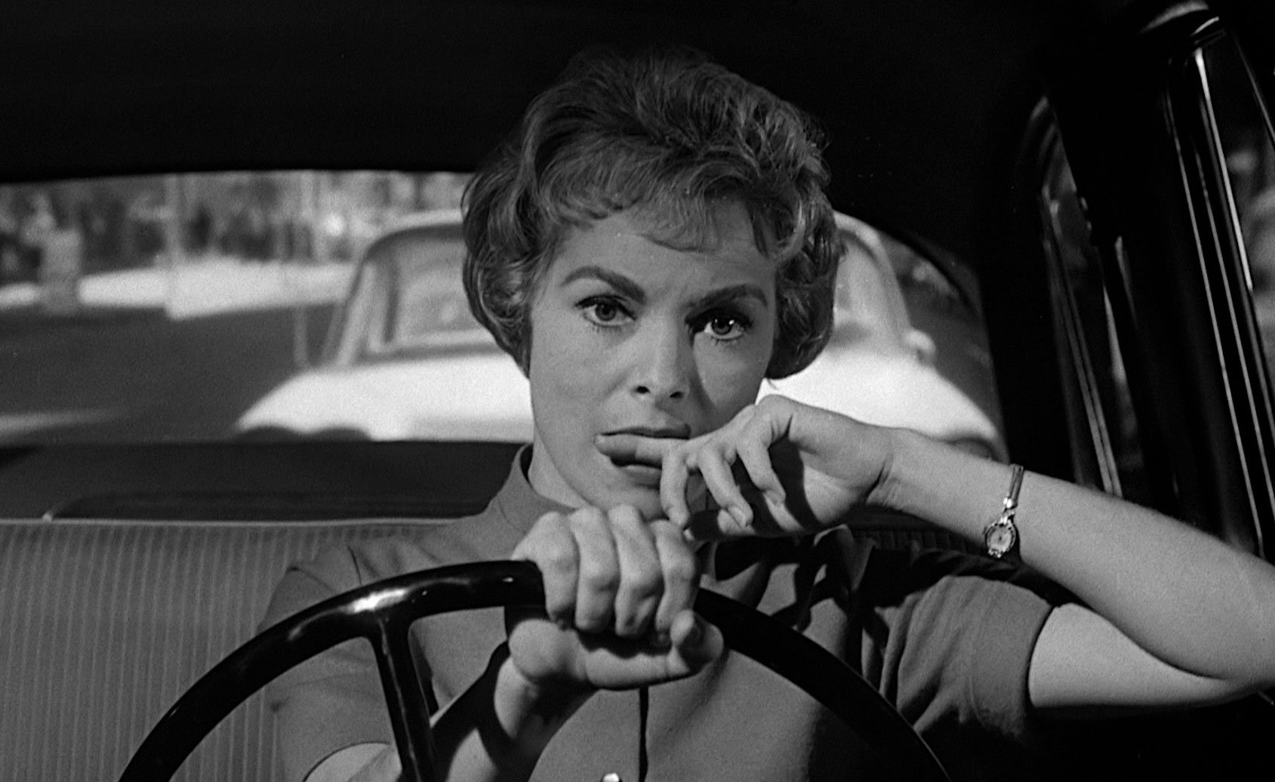
Psycho (1960)
Dir. Alfred Hitchcock

Slide 10
Doane’s main points in her discussion of cinematic voice and space :
Voice-off and Voiceover
      Visibility and audibility
      Cinematic spaces: 3 types
      Silence
      Uncanny
      Power
Pleasure of hearing
      Overhearing and voyeurism
      Psychoanalytic theories of unity and separation
      The “sonorous envelope”

Slide 11
Politics of the voice
      Feminism
      Voice of the mother in psychoanalysis
      Voice of the patriarchal order
      Voice as other

Slide 12
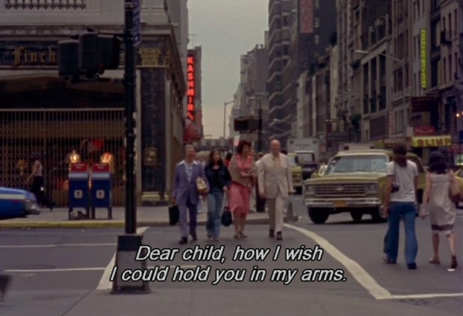
News from Home (1976)
Dir. Chantal Akerman

Slide 13
“Radical otherness”

Slide 14
“Radical otherness”
“As soon as the sound is detached from its source, no longer anchored by a represented body, its potential work as a signifier is revealed. There is always something uncanny about a voice which emanates from a source outside the frame.” (p. 166)

Slide 15
“Radical otherness”
“As soon as the sound is detached from its source, no longer anchored by a represented body, its potential work as a signifier is revealed. There is always something uncanny about a voice which emanates from a source outside the frame.” (p. 166)

Slide 16
“Radical otherness”
“It is its radical otherness with respect to the diegesis which endows this voice with a certain authority.” (p. 168)

Slide 17
“Radical otherness”
“It is its radical otherness with respect to the diegesis which endows this voice with a certain authority.” (p. 168)

Slide 18
“Radical otherness”
“As a form of direct address, it speaks without mediation to the audience, bypassing the ‘characters’ and establishing a complicity between itself and the spectator—together they understand and thus place the image.”

Slide 19
“Radical otherness”
“Disembodied, lacking any specification in space or time, the voiceover is, as Bonitzer points out, beyond criticism—it censors the questions ‘Who is speaking?’, ‘Where?’, ‘In what time?’, and ‘For Whom?’” (p. 168)

Slide 20
“Radical otherness”
“Disembodied, lacking any specification in space or time, the voiceover is, as Bonitzer points out, beyond criticism—it censors the questions ‘Who is speaking?’, ‘Where?’, ‘In what time?’, and ‘For Whom?’” (p. 168)

Slide 21
“Radical otherness”
“Because it rises from the field of the Other, the voice-off is assumed to know: this is the essence of its power… The power of the voice is a stolen power, a usurpation.” (Bonitzer, quoted in Doane, p. 168)

Slide 22
“Radical otherness”
“Because it rises from the field of the Other, the voice-off is assumed to know: this is the essence of its power… The power of the voice is a stolen power, a usurpation.” (Bonitzer, quoted in Doane, p. 168)

Slide 23
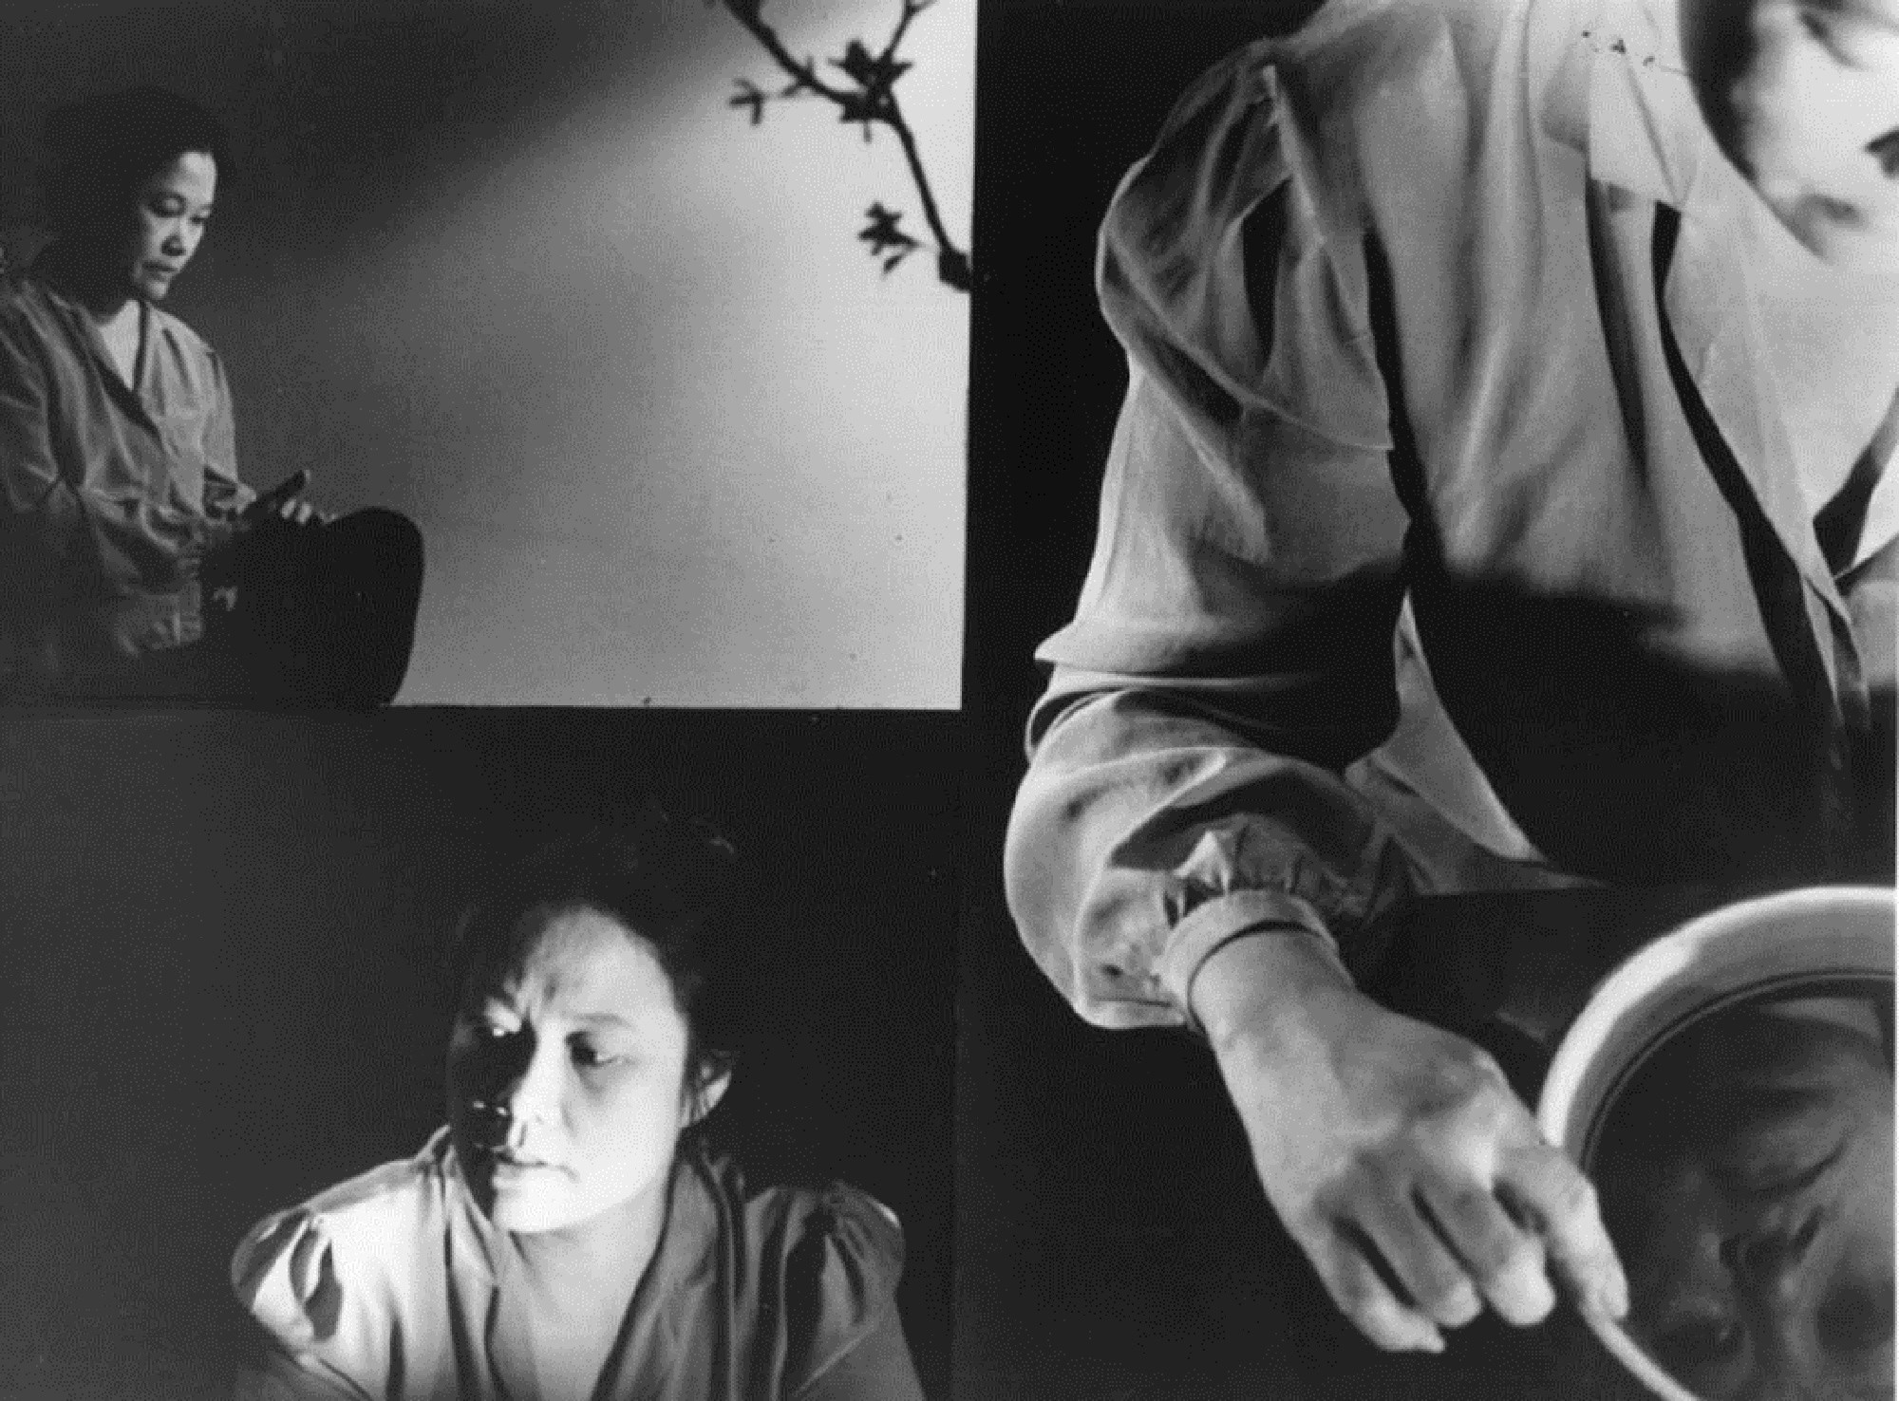
Surname Viet Given Name Nam
(1989) Dir. Trinh T. Minh-ha

