Slide 1
INTRODUCTION TO SOUND STUDIES
Class Topic: Sound and Sound Studies

Slide 2
What is sound?

Slide 3
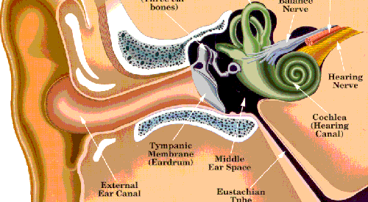

Slide 4
What is sound?

Slide 5
What is sound?
What are the differences between hearing and listening?

Slide 6
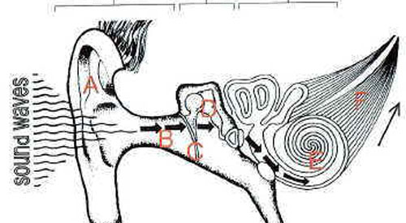

Slide 7
What are the differences between hearing and vision?

Slide 8
What are the differences between hearing and vision?
What are the similarities?

Slide 9
How do we study sound?

Slide 10
Can you define a culture of sound?

Slide 11
Can you define a culture of sound?
If so, how does your definition of sound culture compare to your definition of visual culture?

Slide 12
Key Concepts from Sterne:
Hearing requires positionality (p.4)
The study of sound is an emerging field
Sound studies is interdisciplinary, reflexive, aware of its own historicity, and critical
Sonic imagination (p.5)
Sound students (p.3)

Slide 13
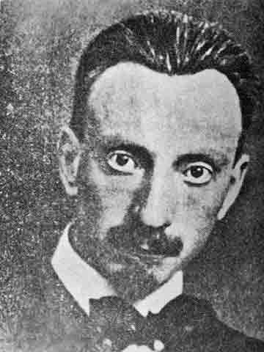
Luigi Russolo: “The Art of Noises”

