Slide 1
II. Histories of Sound
2. Histories of Sound and Technology

Slide 2
Listening tech(nique)ology in 19th century medicine (Nicolson)
The Soundscape of Modernity (Thompson)
Music in the era of electronic reproduction (Mowitt)

Slide 3
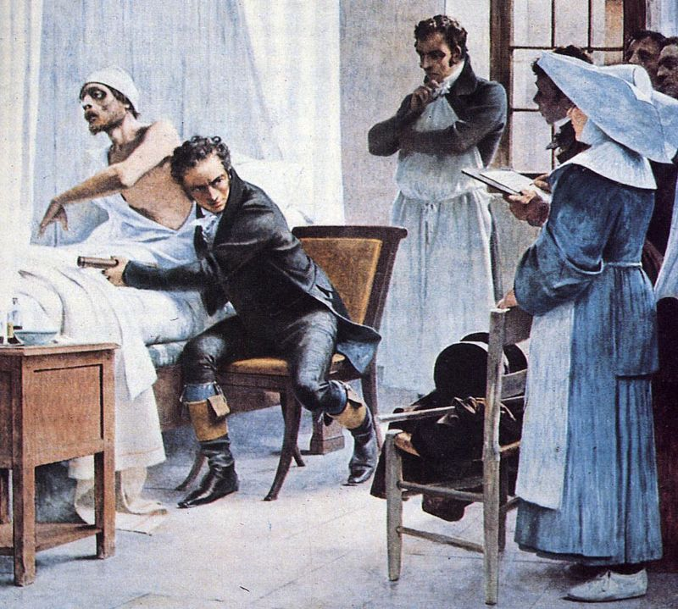
1. Having the Doctor’s Ear in 19th Century Edinburgh

Slide 4
Auscultation (based on the Latin verb auscultare "to listen") is the term for listening to the internal sounds of the body, usually using a stethoscope.
Auscultation is performed for the purposes of examining the circulatory system and respiratory system (heart sounds and breath sounds), as well as the gastrointestinal system (bowel sounds).

Slide 5
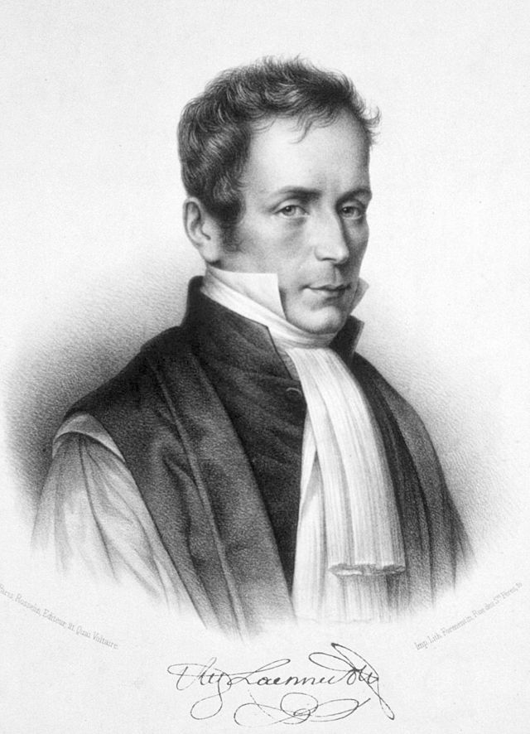
René-Théophile-Hyacinthe Laennec

Slide 6
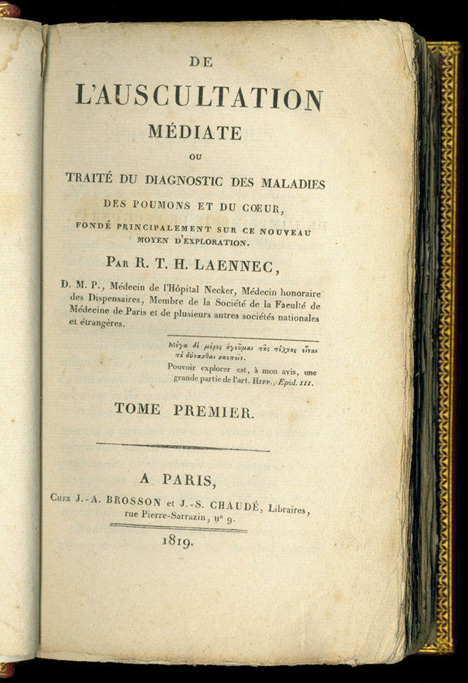
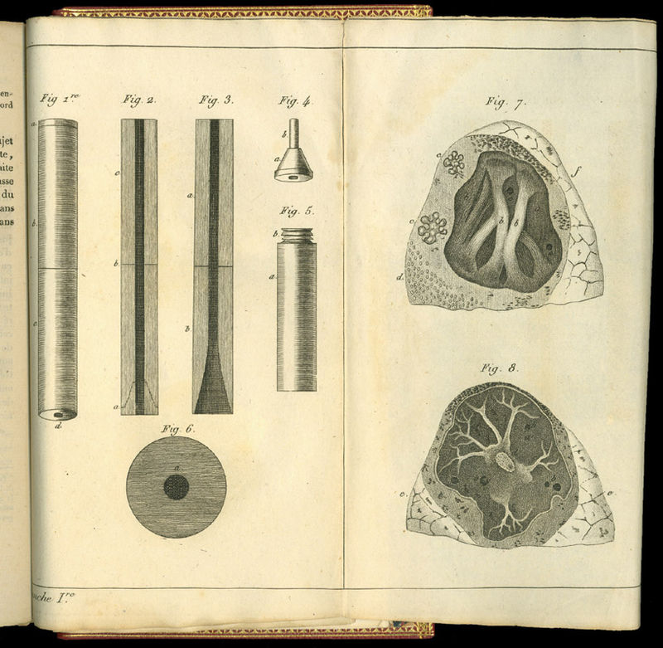
Pages from De l’auscultation mediate (published in 1819) showing Laennec’s stethoscope design

Slide 7
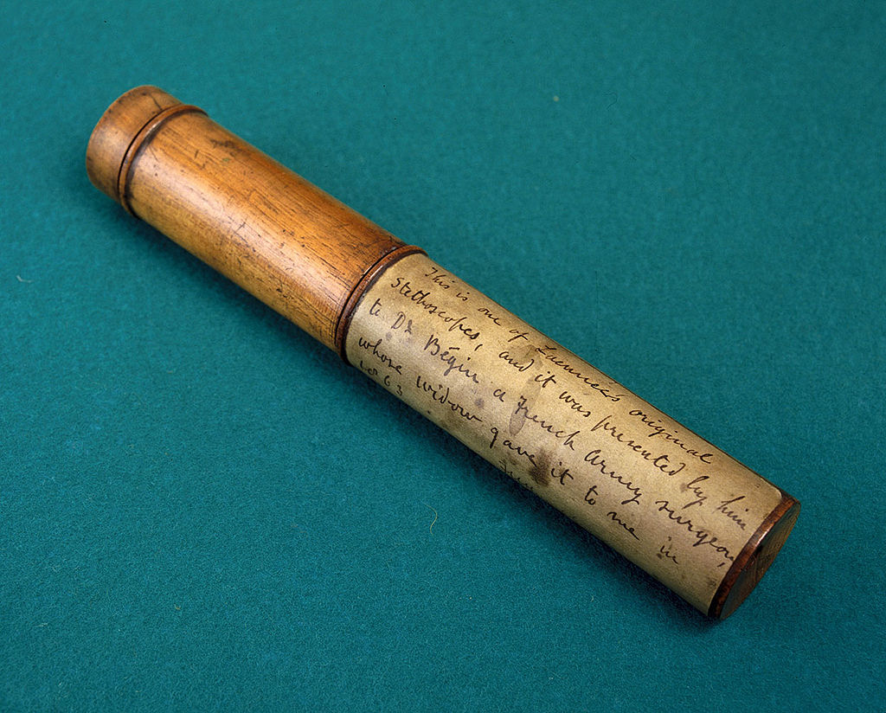

Laennec’s stethoscope (lf.) compared to a contemporary design (rt.) – see discussion of N.P. Comins’s development of a flexible model (p. 160-161)

Slide 8
Was the introduction of auscultation in Britain a contested process?

Slide 9
Paris: Laënnec’s invention of the stethoscope in 1816, and published De l’auscultation mediate in 1819
Edinburgh: Andrew Duncan and other’s review of De l’auscultation mediate:
    More a text on pathological anatomy than one on diagnostics;
    Difference between academic and practical knowledge of the techniques of physical examination

Slide 10
Impact of trained stethoscopists like Andrew Cullen and John Crauford Gregory
From 1825 onwards, new theories developed independent of the French source by James Hope, John William Turner and others (p. 159)
Improvements on the instrument: N.P. Comins
By 1828-9 stethoscope use was taught in medical textbooks

Slide 11
By 1831: innovation of stethoscopy transferred from Paris to Edinburgh
Why Edinburgh?

Slide 12
“… one of the major advantages of mediate auscultation over other techniques of physical diagnosis was that it offered physicians a means to undertake examinations without compromising their professional dignity. The fact that stethoscopy did not involve direct bodily contact was considered to be very helpful, both when one’s clientele were the unwashed poor of the hospital or dispensary and when one was consulted by modest ladies in one’s private practice. In other words, the stethoscope respected the social niceties of the practice of elite physic.” (p. 164)

Slide 13
“… one of the major advantages of mediate auscultation over other techniques of physical diagnosis was that it offered physicians a means to undertake examinations without compromising their professional dignity. The fact that stethoscopy did not involve direct bodily contact was considered to be very helpful, both when one’s clientele were the unwashed poor of the hospital or dispensary and when one was consulted by modest ladies in one’s private practice. In other words, the stethoscope respected the social niceties of the practice of elite physic.” (p. 164)

Slide 14
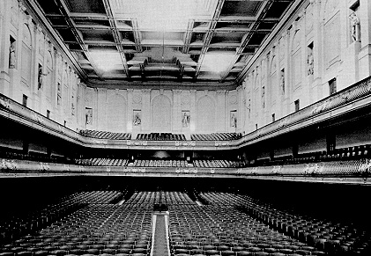
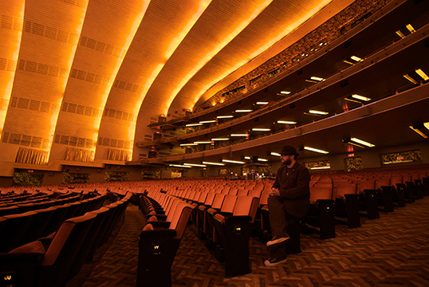
2. The Soundscape of Modernity

Slide 15
Thompson’s definition of soundscape:
“I define the soundscape as an auditory or aural landscape. Like a landscape, a soundscape is simultaneously a physical environment and a way of perceiving the environment; it is both a world and a culture constructed to make sense of the world. The physical aspect of a soundscape consists not only of the sounds themselves, the waves of acoustical energy permeating the atmosphere in which people live, but also the material objects that create, and sometimes destroy, those sounds."
(p. 116)

Slide 16
Thompson’s definition of soundscape:
“I define the soundscape as an auditory or aural landscape. Like a landscape, a soundscape is simultaneously a physical environment and a way of perceiving the environment; it is both a world and a culture constructed to make sense of the world. The physical aspect of a soundscape consists not only of the sounds themselves, the waves of acoustical energy permeating the atmosphere in which people live, but also the material objects that create, and sometimes destroy, those sounds."
(p. 116)

Slide 17
The Soundscape of Modernity:
The American soundscape underwent a particularly dramatic transformation in the years between 1900-1933
Sounds became signals - a new criterion by which the evaluate them - located in the new electrical technologies
The opening of Symphony Hall in Boston (1900) and the opening of Radio City Music Hall in New York (1932) frames the period covered by the book

Slide 18
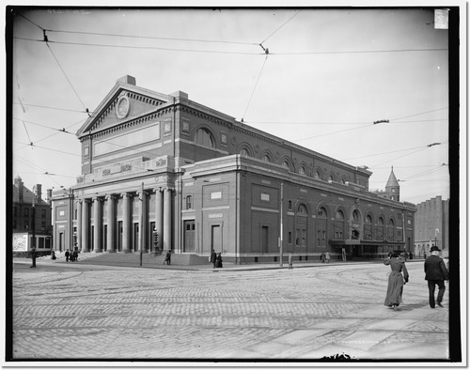
The Symphony Hall in Boston,1904

Slide 19
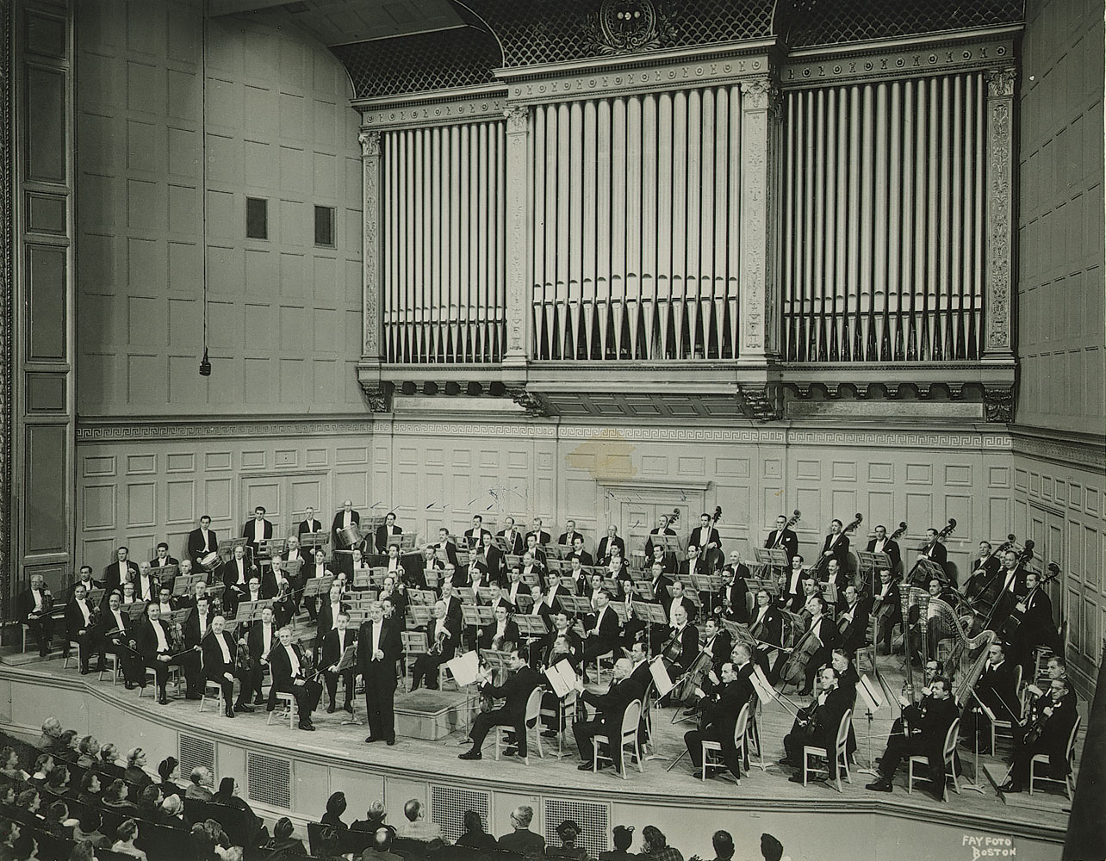

Slide 20
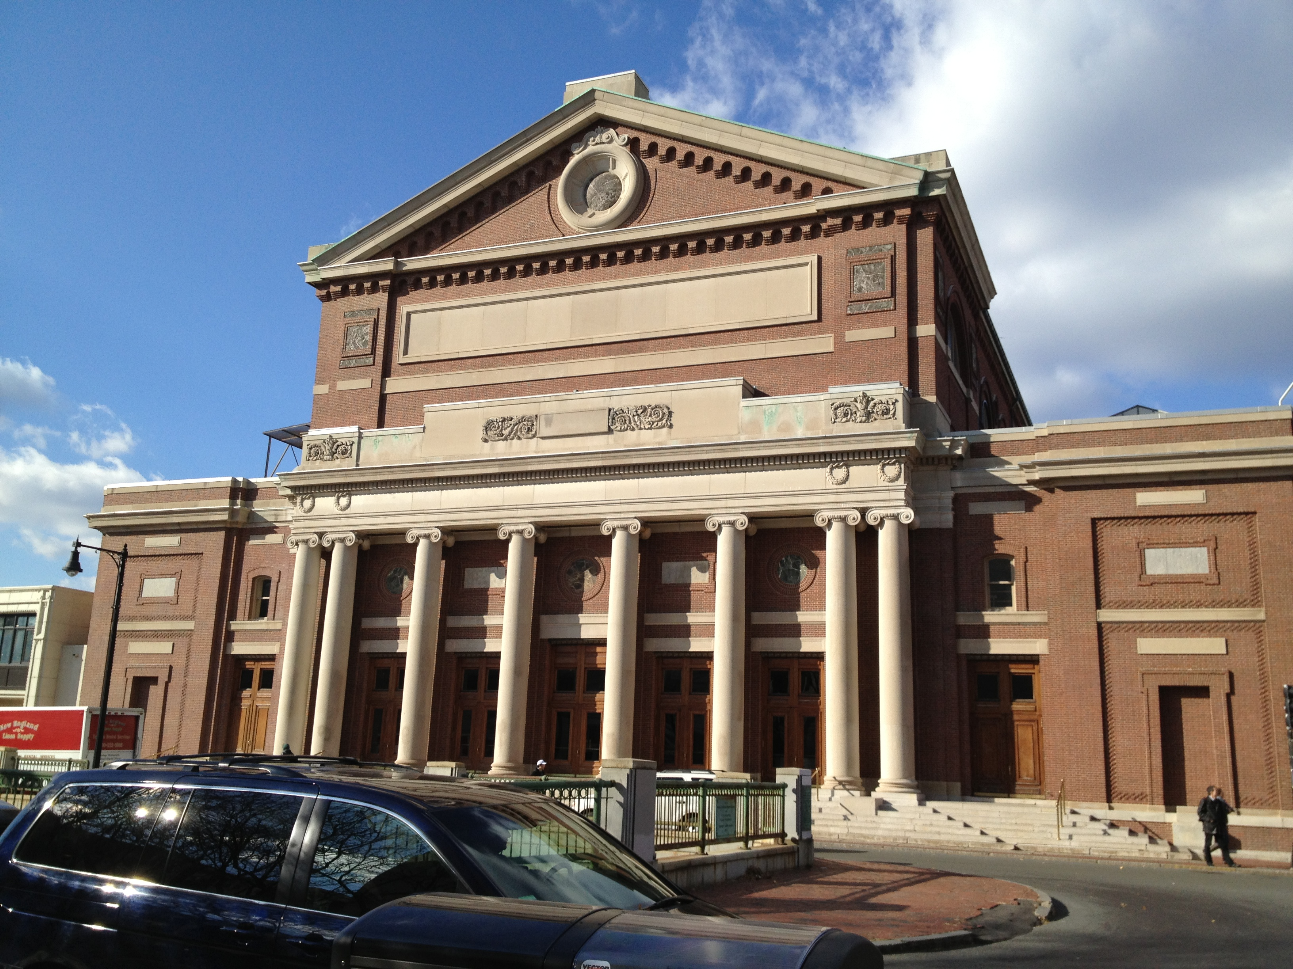
The Symphony Hall today

Slide 21
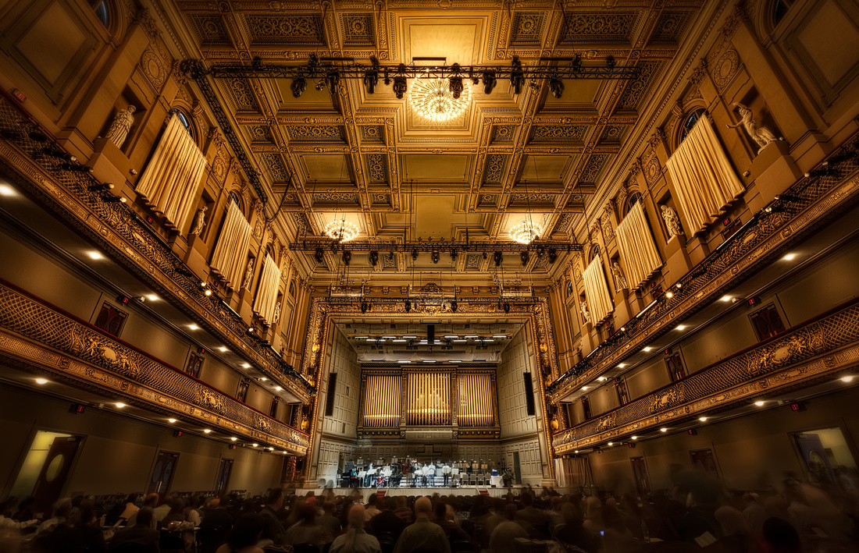

Slide 22
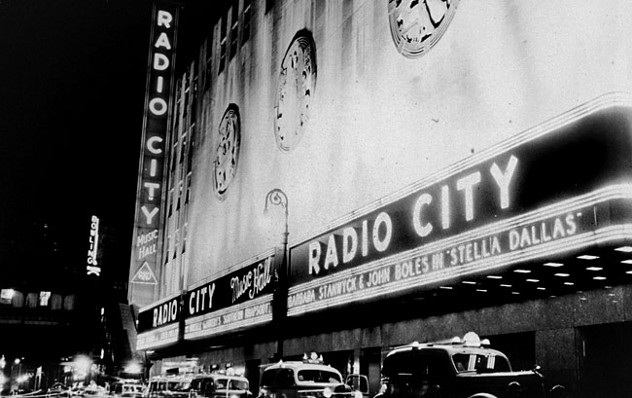
The Radio City Music Hall in New York,1937

Slide 23
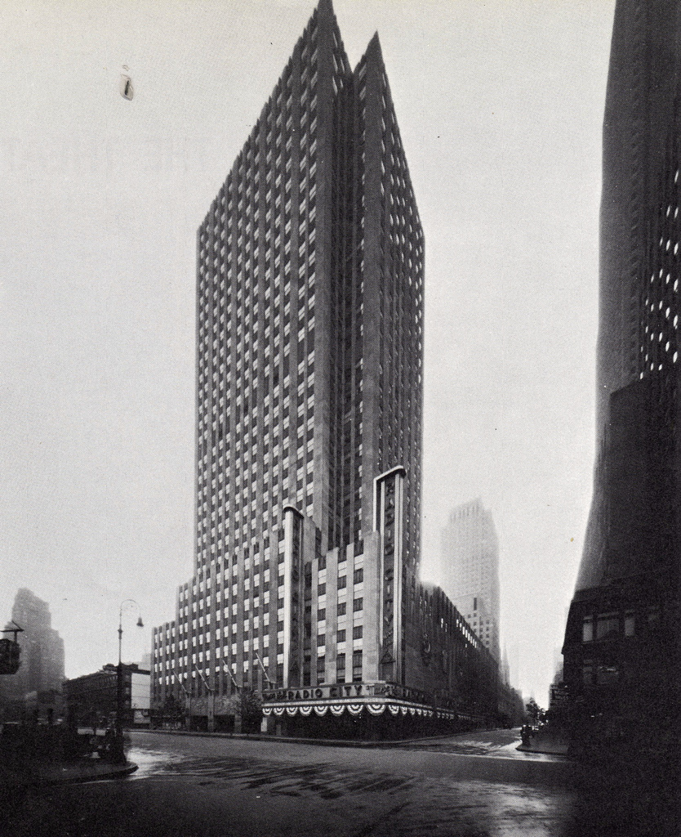

Slide 24
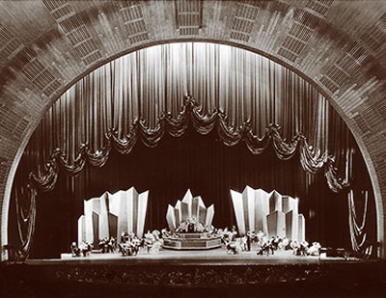

Slide 25
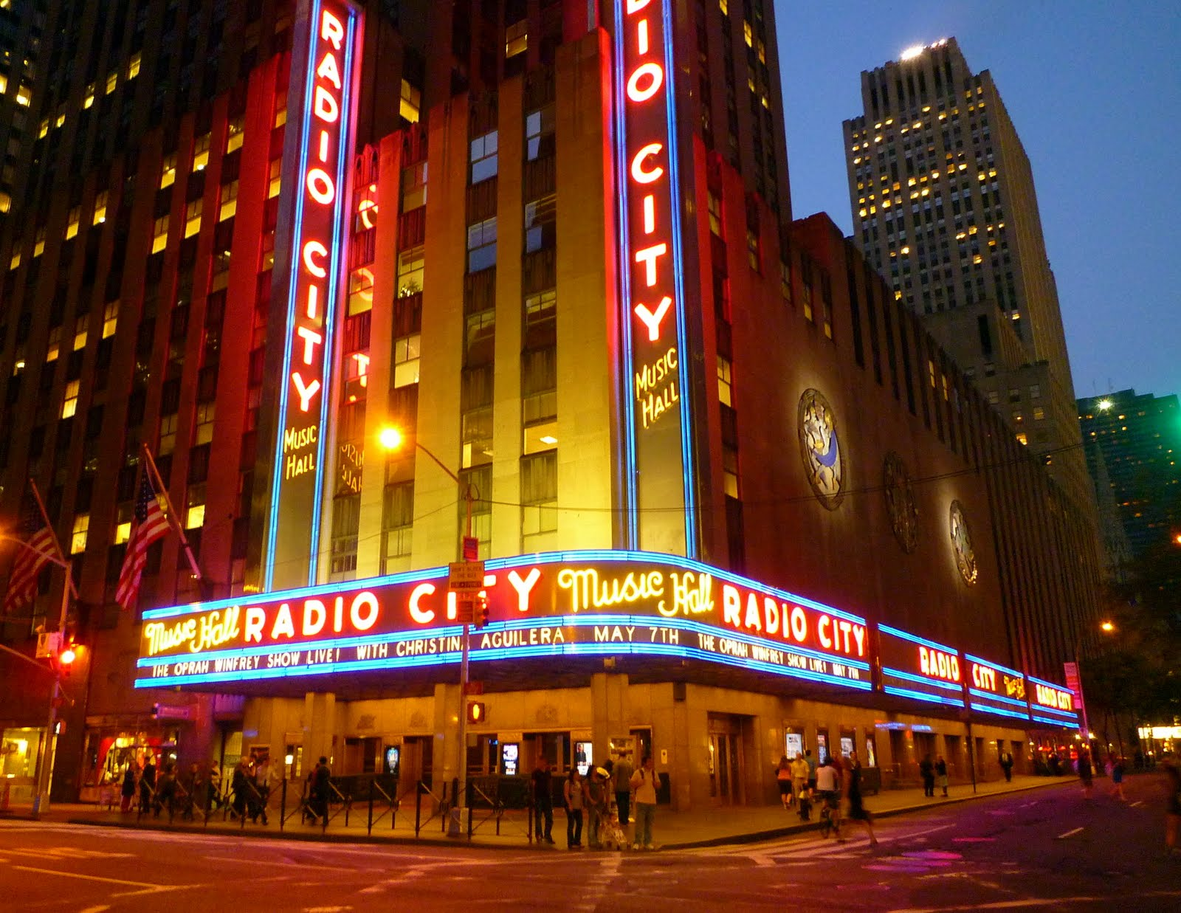
Radio City Music Hall today

Slide 26
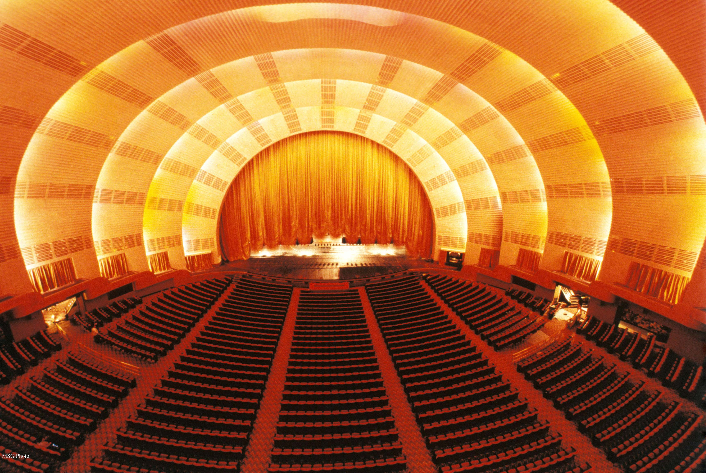

Slide 27
Thompson describes the emergence of a new, modernist sound. Define it:

Slide 28
Thompson describes the emergence of a new, modernist sound. Define it:
    An object of scientific scrutiny

Slide 29
Thompson describes the emergence of a new, modernist sound. Define it:
    An object of scientific scrutiny
    Controlled (a "good sound”)

Slide 30
Thompson describes the emergence of a new, modernist sound. Define it:
    An object of scientific scrutiny
    Controlled (a "good sound”)
    Non-reverberant

Slide 31
Thompson describes the emergence of a new, modernist sound. Define it:
    An object of scientific scrutiny
    Controlled (a "good sound”)
    Non-reverberant
    Many different places begin to sound alike

Slide 32
Thompson describes the emergence of a new, modernist sound. Define it:
    An object of scientific scrutiny
    Controlled (a "good sound”)
    Non-reverberant
    Many different places begin to sound alike
    Easy to understand

Slide 33
Thompson describes the emergence of a new, modernist sound. Define it:
    An object of scientific scrutiny
    Controlled (a "good sound”)
    Non-reverberant
    Many different places begin to sound alike
    Easy to understand
    Efficient

Slide 34
Thompson describes the emergence of a new, modernist sound. Define it:
    An object of scientific scrutiny
    Controlled (a "good sound”)
    Non-reverberant
    Many different places begin to sound alike
    Easy to understand
    Efficient
    Had little to say about the places in which it was produced and consumed

Slide 35
"...if most of sounds of the past are gone for good, they have nonetheless left behind a rich record of their existence in the artifacts, the people, and the cultures that once brought them forth.

Slide 36
"...if most of sounds of the past are gone for good, they have nonetheless left behind a rich record of their existence in the artifacts, the people, and the cultures that once brought them forth. By starting here, with the solidity of technological objects and material practices of those who designed, built, and used them, we can begin to recover the sounds that have long since melted into air.

Slide 37
"...if most of sounds of the past are gone for good, they have nonetheless left behind a rich record of their existence in the artifacts, the people, and the cultures that once brought them forth. By starting here, with the solidity of technological objects and material practices of those who designed, built, and used them, we can begin to recover the sounds that have long since melted into air. Along with those sounds, we can recover more fully our past." (p. 125-126)

Slide 38
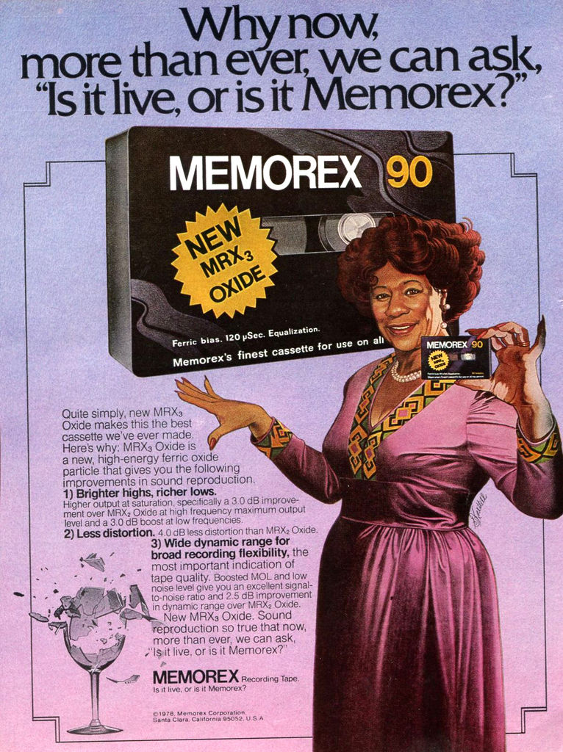
3. Sound of Music in Era of Electronic Reproduction

Slide 39
“Is it live, or is it Memorex?” Memory and Electronic (sound) Reproduction:
Mowitt argues that contemporary listening conditions are characterized by repetition, reproducibility, and recognition
The social construction of listening
Listening = interpretation

Slide 40
“If Memorex is as good as it claims to be, then what good is the original? The original becomes necessary and therefore valuable solely as a means of notarizing the copy.”

Slide 41
“If Memorex is as good as it claims to be, then what good is the original? The original becomes necessary and therefore valuable solely as a means of notarizing the copy.”
“The recording studio had become an instrument with its own particular musical idiom – an instrument that was also its own means of reproduction.” (both p. 217)

Slide 42
Modernist ocularcentrism? (Thinking through Adorno, Benjamin, and Attali)

Slide 43
Modernist ocularcentrism? (Thinking through Adorno, Benjamin, and Attali)
Oskar Negt and Alexander Kluge “identified a distinctive element of post-industrial capitalism the fact that it has become impossible to separate the subject from the technologies of cultural reception.” (p. 219)

Slide 44
Modernist ocularcentrism? (Thinking through Adorno, Benjamin, and Attali)
“At a time when the aestheticization of theory is becoming increasingly prevalent, music has responded by sensualizing cultural politics.” (p. 223)

Slide 45
Modernist ocularcentrism? (Thinking through Adorno, Benjamin, and Attali)
Reik’s notion of the third ear (p. 223)

Slide 46
Modernist ocularcentrism? (Thinking through Adorno, Benjamin, and Attali)
Reik’s notion of the third ear (p. 223)
  “A location where listening took place, registering what the speaker has forgotten”

Slide 47
Modernist ocularcentrism? (Thinking through Adorno, Benjamin, and Attali)
Reik’s notion of the third ear (p. 223)
  “A location where listening took place, registering what the speaker has forgotten”
  “where it was, I shall become” (Freud)

Slide 48
Modernist ocularcentrism? (Thinking through Adorno, Benjamin, and Attali)
Reik’s notion of the third ear (p. 223)
  “A location where listening took place, registering what the speaker has forgotten”
  “where it was, I shall become” (Freud)
  Collective interdependence

Slide 49
Modernist ocularcentrism? (Thinking through Adorno, Benjamin, and Attali)
Reik’s notion of the third ear (p. 223)
  “A location where listening took place, registering what the speaker has forgotten”;
  “where it was, I shall become” (Freud)
  Collective interdependence
Think about this when reading Sterne for next week

Slide 50
For Thursday: Choose a sound technology and do research on the historical developments and factors that shaped its present form, then compare that history to one that we studied this week. Use this comparative analysis to frame your discussion question.

