Slide 1
III. Sound as Media
2. Film Sound

Slide 2
Film sound theories (Chion & Altman)
Voice in cinema (Doane)
Sound in new media (Whittington)

Slide 3
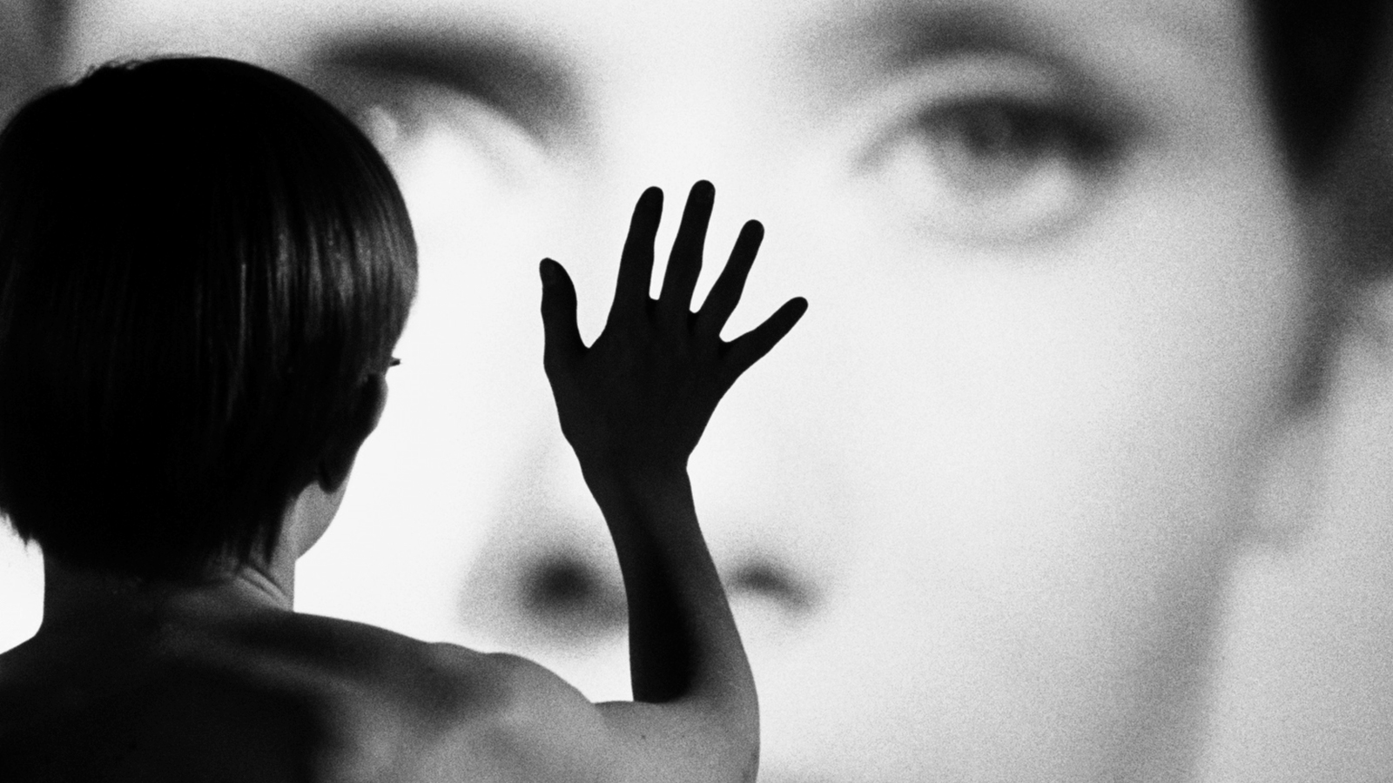
Persona (1966) Dir. Ingmar Bergman

Slide 4
Chion’s Key Concepts:
Added Value
Synchresis
Vococentrism
Verbocentrism
Music: empathetic / anempathetic
Spotting

Slide 5
Fallacies In Film Sound Theory:

Slide 6
Fallacies In Film Sound Theory:
Historical

Slide 7
Fallacies In Film Sound Theory:
Historical
Ontological

Slide 8
Fallacies In Film Sound Theory:
Historical
Ontological
Reproduction

Slide 9
Fallacies In Film Sound Theory:
Historical
Ontological
Reproduction
Nominalism

Slide 10
Fallacies In Film Sound Theory:
Historical
Ontological
Reproduction
Nominalism
4.5 Cinema as index

Slide 11
The Voice in the Cinema:

Slide 12
The Voice in the Cinema:
The body in cinema is a fantasmatic body, it offers up a support and point of identification for the subject. (unity and presence)

Slide 13
The Voice in the Cinema:
The body in cinema is a fantasmatic body, it offers up a support and point of identification for the subject. (unity and presence)
The “addition” of sound (synchronous dialogue) offers the opportunity of representing a fuller and more organically unified body

Slide 14
The Voice in the Cinema:
“Just as voice must be anchored by a given body, and the body must be anchored in a given space” (p. 164)

Slide 15
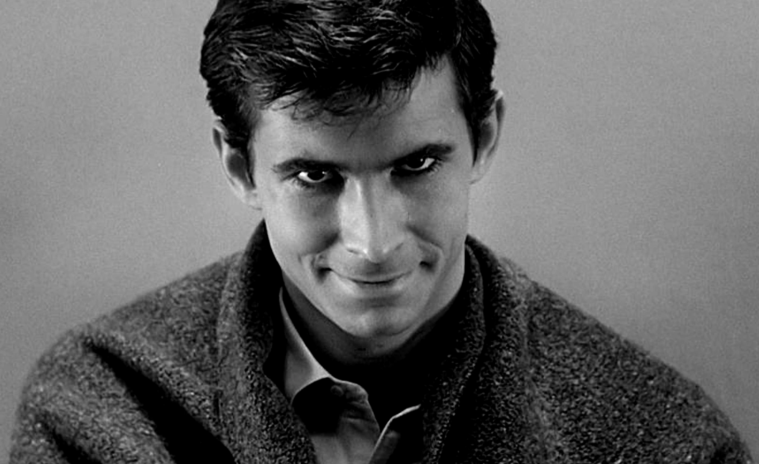
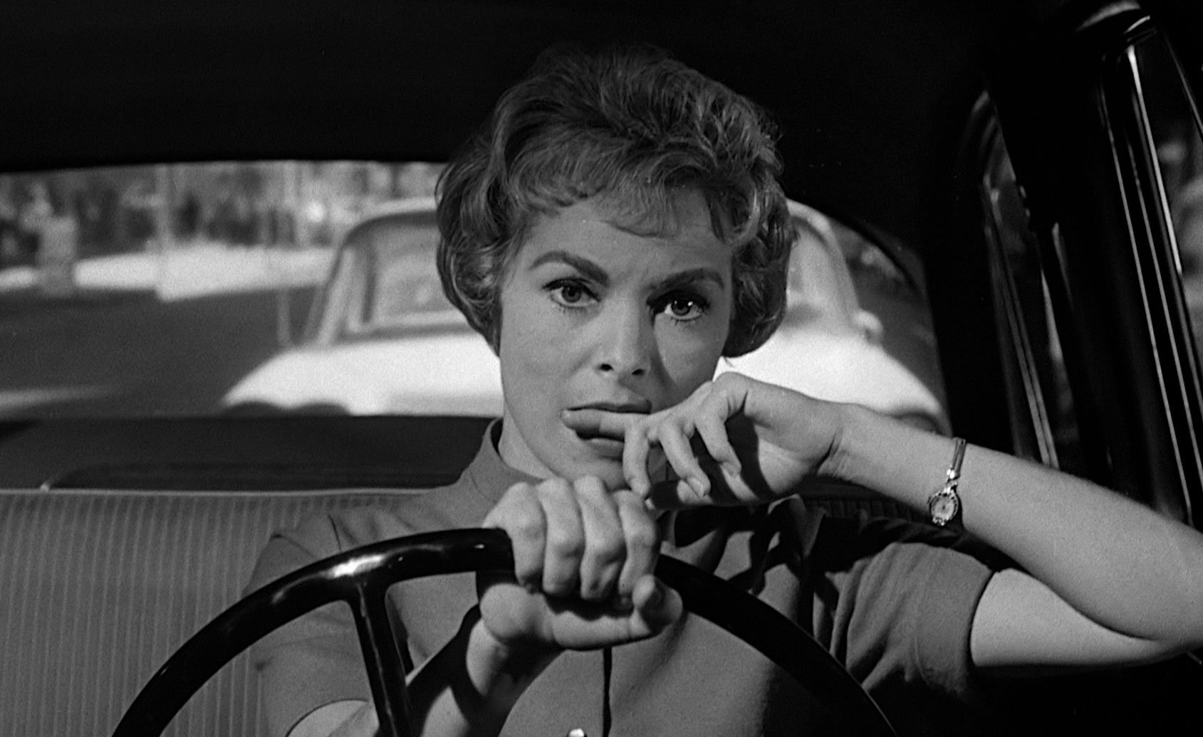
Psycho (1960)
Dir. Alfred Hitchcock

Slide 16
Doane’s main points in her discussion of cinematic voice and space :
Voice-off and Voiceover
      Visibility and audibility
      Cinematic spaces: 3 types
      Silence
      Uncanny
      Power
Pleasure of hearing
      Overhearing and voyeurism
      Psychoanalytic theories of unity and separation
      The “sonorous envelope”

Slide 17
Politics of the voice
      Feminism
      Voice of the mother in psychoanalysis
      Voice of the patriarchal order
      Voice as other

Slide 18
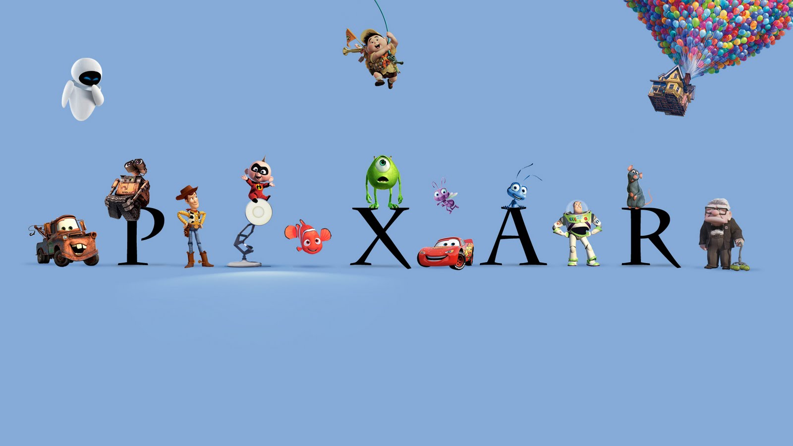
Sound Design and Technology in Pixar’s Animation

Slide 19
Founded by engineers working with George Lucas
New technology – Pixar Image Computer
Transformed from computer company to leading studio in 3-D computer-generated animation
Sound design became an integral aspect of Pixar’s new mode of storytelling

Slide 20
Pixar sound designers: Ben Burtt, Gary Rydstrom, Tom Meyers
Borrowed from live action sound, portable recording devices for collecting sound effects, sound samplers such as Synclavier, ProTools created multichannel formats
Pixar’s short films set the aesthetic and production patterns for the later successful features
New studio style + form of filmmaking: shifted industrial practices

Slide 21
Comparative Discussion:
Plane Crazy (1928) Walt Disney Animation
Luxor Jr. (1986) Pixar Animation Studios

Slide 22
Comparative Discussion:
Plane Crazy (1928) Walt Disney Animation
Luxor Jr. (1986) Pixar Animation Studios
Compare the sound design in these two animated shorts

Slide 23
Comparative Discussion:
What do you hear in these shorts? Do they sound different or similar?

Slide 24
Comparative Discussion:
What do you hear in these shorts? Do they sound different or similar?
What are the relationships between sound and image in these shorts?

Slide 25
Comparative Discussion:
What do you hear in these shorts? Do they sound different or similar?
What are the relationships between sound and image in these shorts?
Based on your understanding of Pixar’s history, contextualize these differences – technological, aesthetic, and narrative.

Slide 26
“It is historically important to note that sound design leads the way in theory and practice in this era of visual culture.” (p. 376)

