Slide 1
V. Student Chosen Topic
Psycho: Film Sound, Audio-Visual Analysis, Voice in Cinema

Slide 2
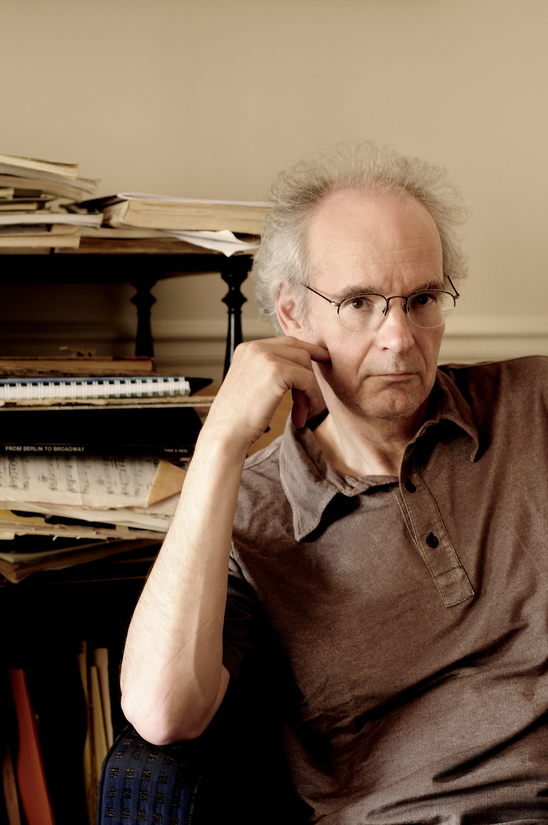
Michel Chion
He’s French (see 2nd pic) Trained as a composer under Pierre Schaeffer and Pierre Henry
Associate Professor at the University of Paris III: Sorbonne Nouvelle, where he is a theoretician and teacher of audio-visual relationships
He wrote at least six books on film sound, as well as monographs on filmmakers including Stanley Kubrick, Jacques Tati and David Lynch, and on films including EYES WIDE SHUT and THE THIN RED LINE

Slide 3
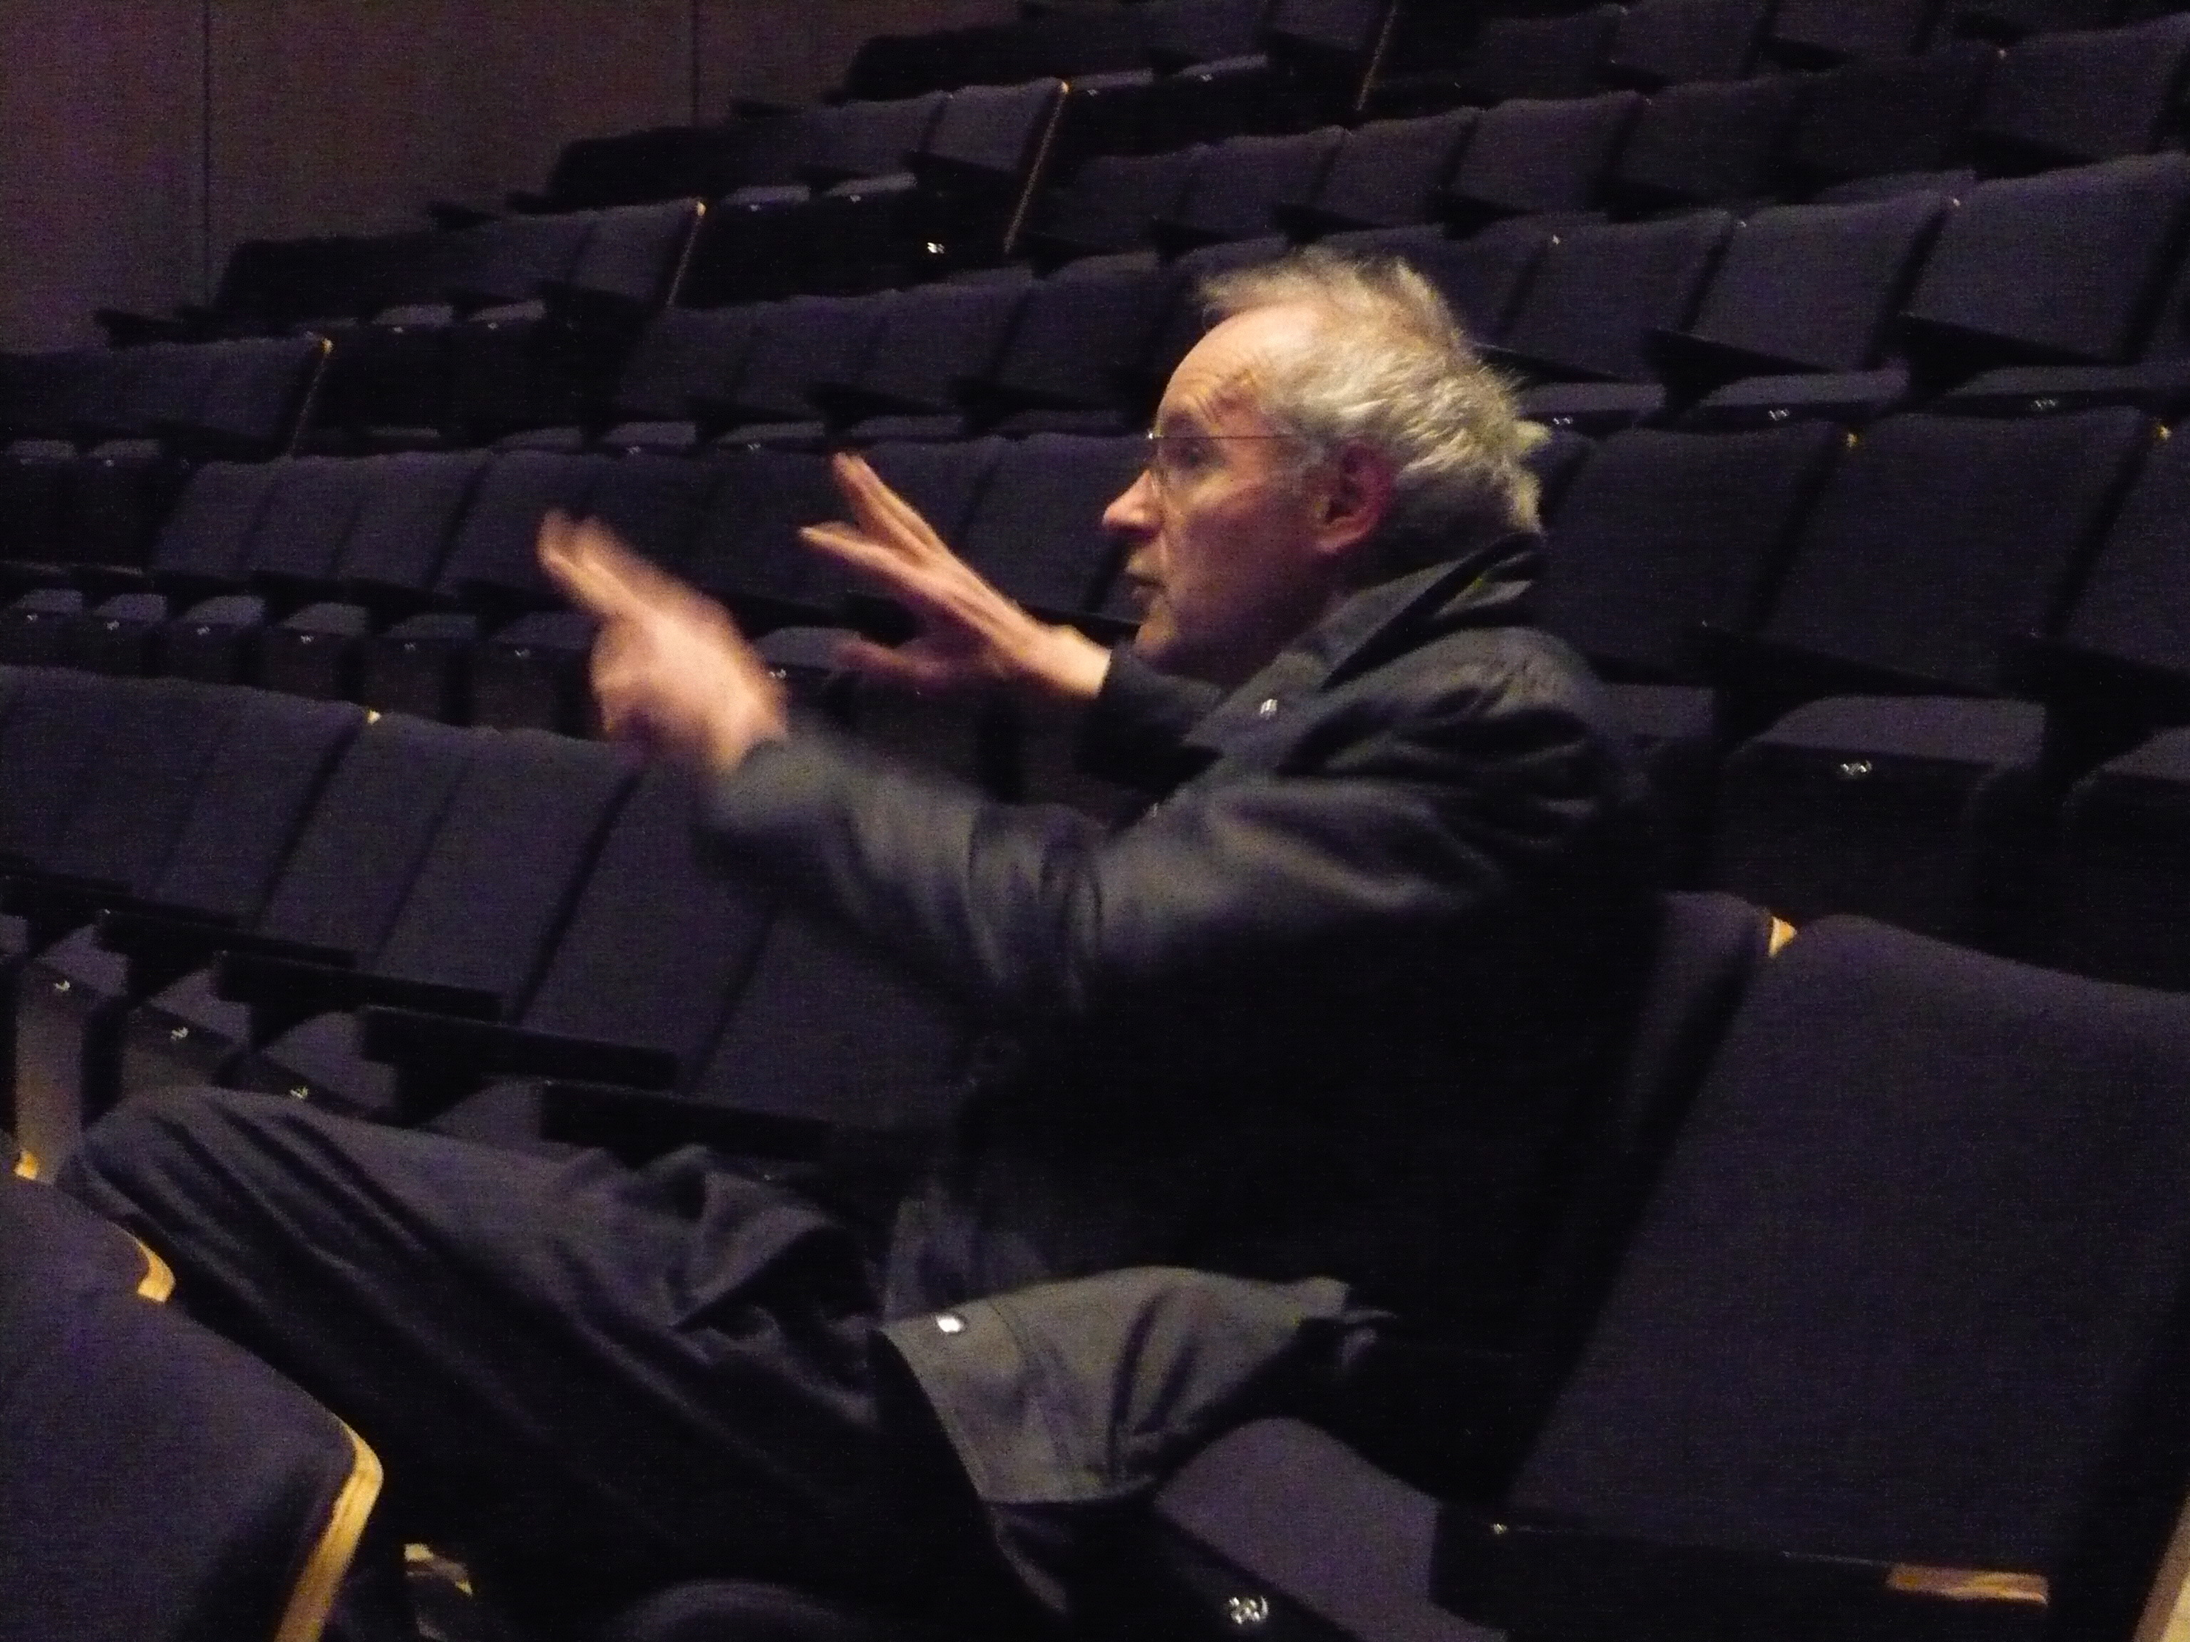

Slide 4
Audio-Vision: Sound on Screen
This book is concerned with audio-visual relationships (he calls it a contract) which can alter/expand our perception
In the book, Chion outlines a methodology for observing and analyzing these relationships (audio-visual analysis)

Slide 5
It is a summary of ideas Chion developed in his three earlier books
In the book, he writes predominantly about American and European feature-length narrative films in the book, but also touches on TV, video art, and music videos

Slide 6
Review Chion’s Key Concepts:
Added Value
Synchresis
Vococentrism
Verbocentrism
Music: empathetic / anempathetic
Spotting

Slide 7
Chion’s Methodology of Audio-Visual Analysis:
    Masking
    Forced marriage

Slide 8
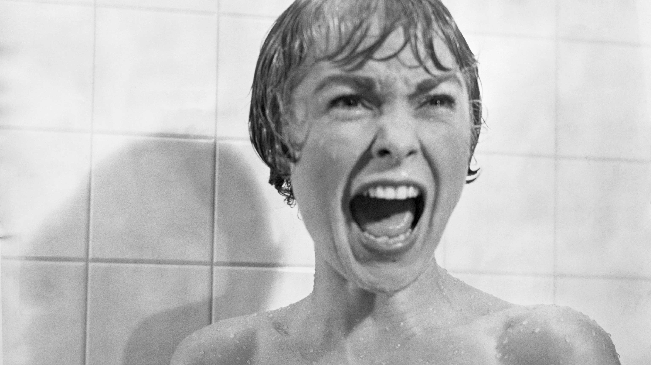
Psycho (1960)
Dir. Alfred Hitchcock

Slide 9
The Voice in Cinema
“This is neither a history nor an anthology, but rather an outline for a theory of the film as sound film” (Chion, ix)
This book is primarily concerned with the speaking voice
Published in 1982
A different intellectual milieu in France
3 prominent forces – all gave prominence to the voice in different ways
“the voice is in the air” (Chion)

Slide 10
Freudian and Lacanian psychoanalysis in literary and film studies;
French feminism and its investigation of the gendered structure in language;
The cinematic and narrative experiments of Marguerite Duras

Slide 11
Chion’s Key Statements and Questions:
“There is no sound track”: synchronized sound is “swallowed up” in the image’s false depth and fiction (Chion calls it “an instantaneous perceptual triage” p. 3)
Where do cinematic voices come from?
What is unique about voices in cinema?

Slide 12
The Acousmêtre – what is it? Where does it come from? What are its characteristics?
De-acousmatization
The I-Voice
Corporeal Implication
Impossible embodiment

Slide 13
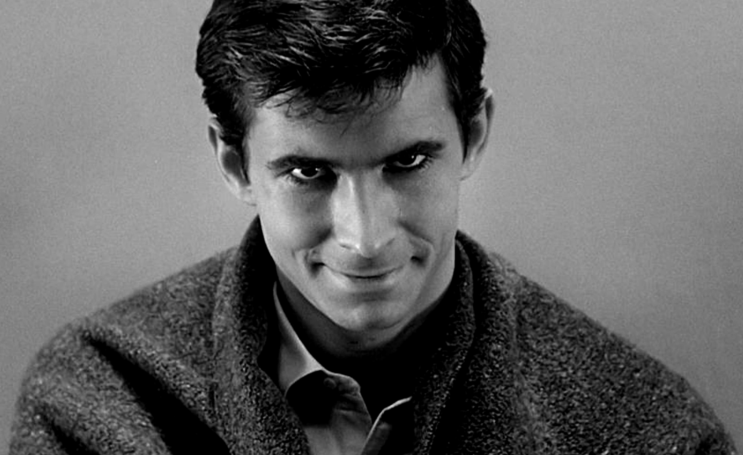
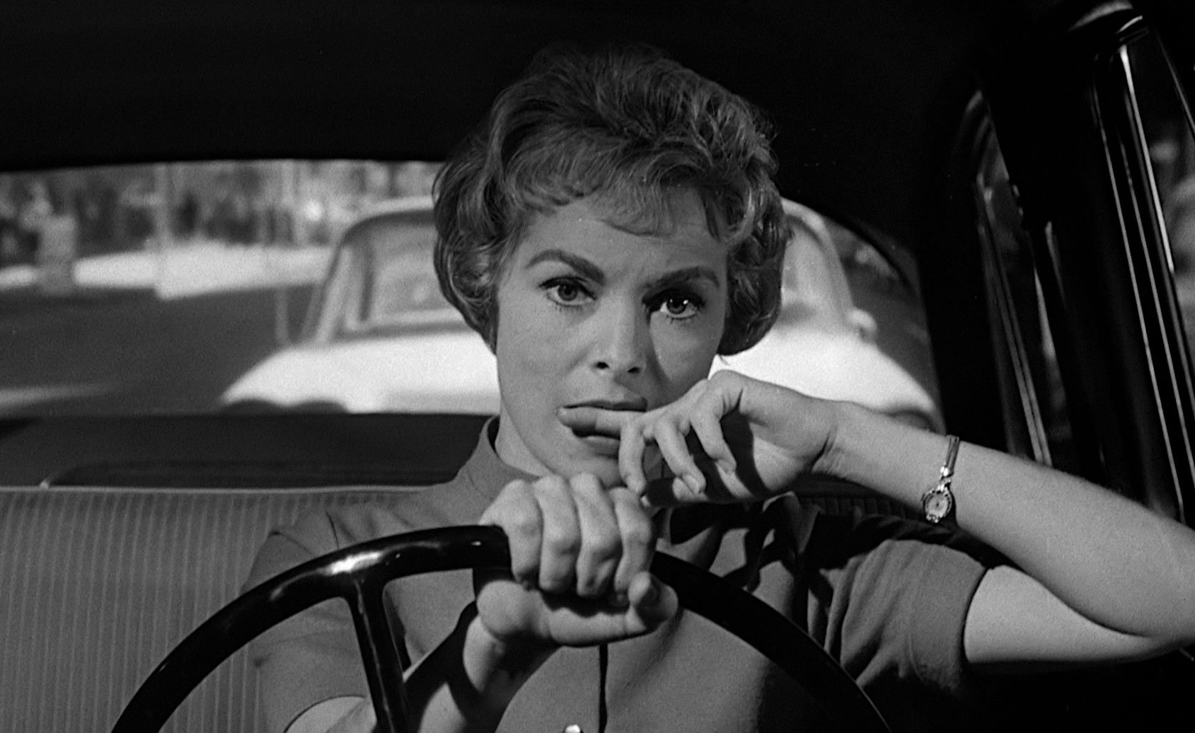
Psycho (1960)
Dir. Alfred Hitchcock

Slide 14
In French:
  Embodiment (mise-en-corps)
  Entombment (mise en bière)
  Interment (mise en terre)

