Slide 1
VIDEO & DIVERSITY
Week 11:
Multiple Identities, Queer Nation?

Slide 2
“Understanding marginality as position and place of resistance is crucial for oppressed, exploited, colonized people.”
- bell hooks (p. 342)

Slide 3
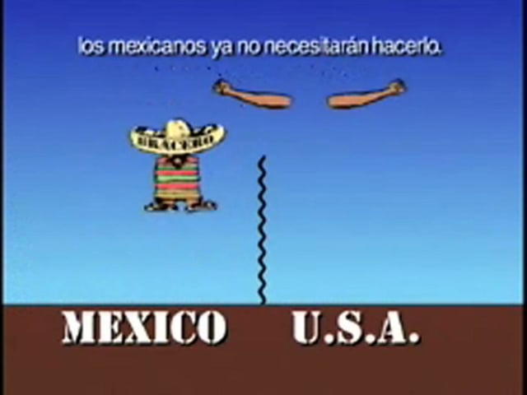
Animaquiladora (1997)
Dir. Alex Rivera & Lalo Lopez

Slide 4
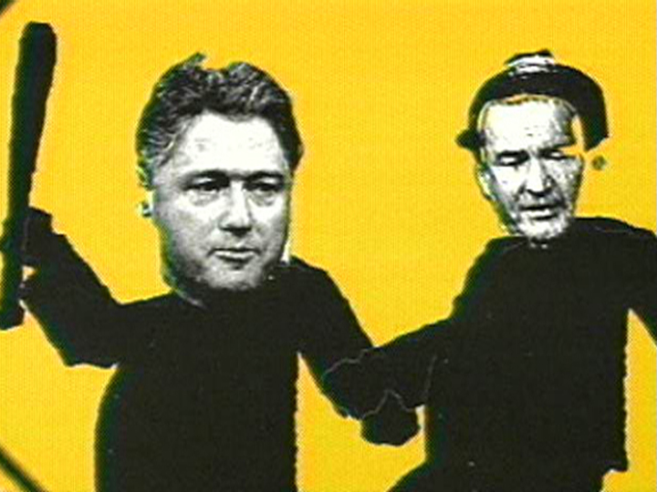
Connect one of the segments in the video to an idea or quote from the Fusco reading. Post on Zoom Chat.

Slide 5
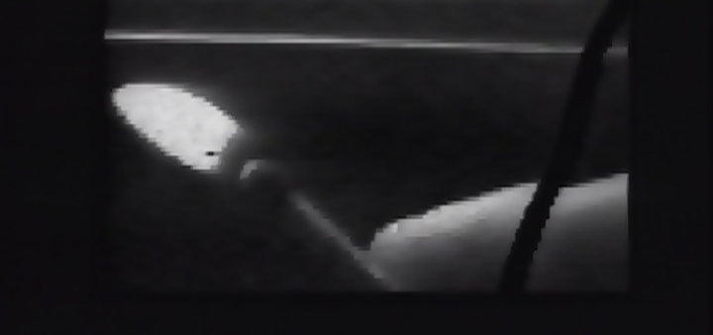
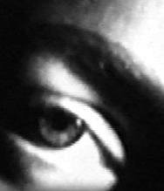
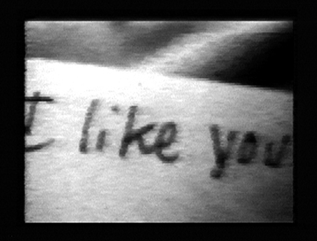
Me & Ruby Fruit (1989) Dir. Sadie Benning

Slide 6
Free Write Exercise

Slide 7
Free Write Exercise
How would you describe Benning’s video aesthetic? (since it is quite short, you have time to watch it again)

Slide 8
Free Write Exercise
How would you describe Benning’s video aesthetic? (since it is quite short, you have time to watch it again)
How does her video make you feel?

Slide 9
Free Write Exercise
How would you describe Benning’s video aesthetic? (since it is quite short, you have time to watch it again)
How does her video make you feel?
Does this video remind you of something you watched recently? Describe.

Slide 10
Group Work
How did some of the videomakers we have been watching recently (e.g. Valerie Soe, Marlon Riggs, Cheryl Dunye, Alex Rivera, Sadie Benning) and writers including bell hooks, Coco Fusco, Liz Highleyman, as well as the different writers in the RDSJ collection address the issue of multiple identities in their work?

Slide 11
Group Work
How does their identities influence the message in their work, and the kinds of videos they choose to make?

Slide 12
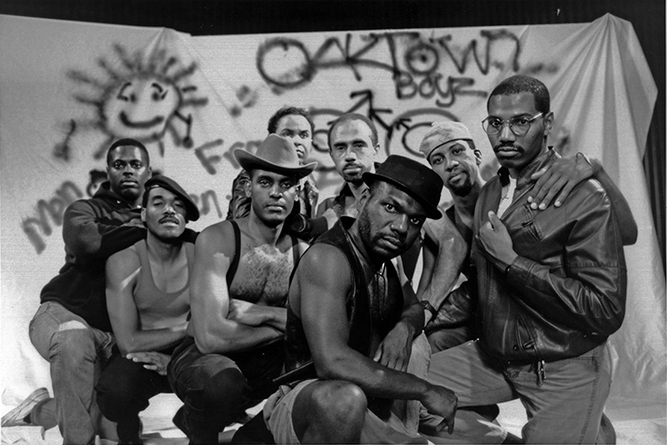
Tongues Untied (1989) Dir. Marlon Riggs

Slide 13
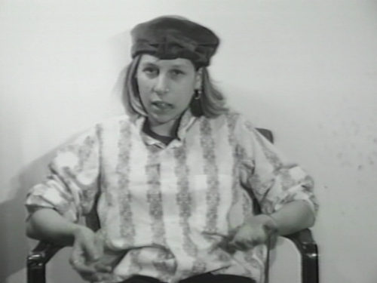
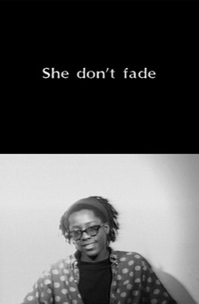
She Don’t Fade (1991) Dir. Cheryl Dunye

Slide 14
Group Work
Select a scene (up to 5 mins.) from Tongues Untied and She Don’t Fade that can support your argument. You can also reference the other videos we watched, as well as specific ideas and quotes from the class reading.

Slide 15
Group Work
Select a scene (up to 5 mins.) from Tongues Untied and She Don’t Fade that can support your argument. You can also reference the other videos we watched, as well as specific ideas and quotes from the class reading.
Put together a presentation integrating your argument and the media excerpt to present to the class (approx. 15 mins., including the excerpt)

Slide 16
“Our survival depended on an ongoing public awareness of the separation between margin and center and an ongoing private acknowledgement that we were a necessary, vital part of that whole.”
- bell hooks (p. 341)

