Slide 1
VIDEO & DIVERSITY
Week 12:
Appropriation, Fair Use, & Culture Jamming

Slide 2
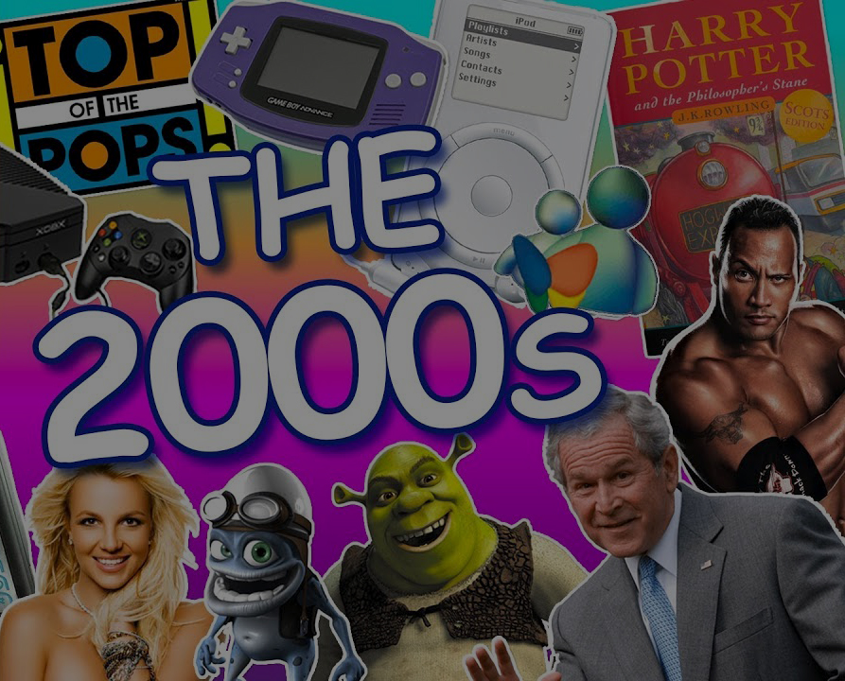
2000s Historical Perspective

Slide 3
Iraq Campaign 1991 (1992)
Dir. Phil Patiris

Slide 4
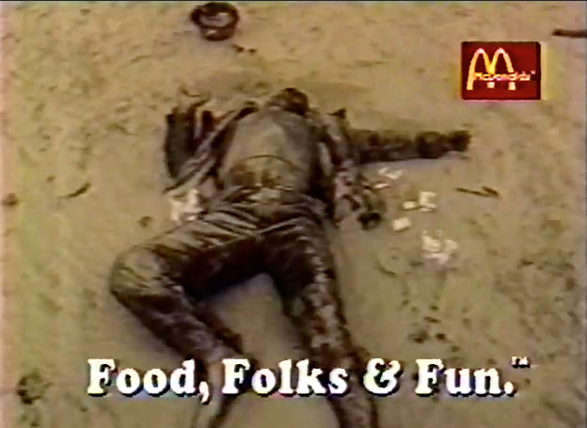
Iraq Campaign 1991 (1992)
Dir. Phil Patiris

Slide 5
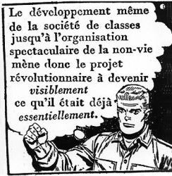
What is Detournement?

Slide 6
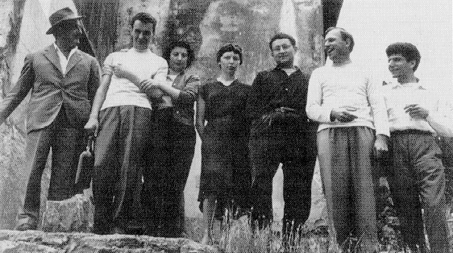
Situationist International
Founders of the Situationist International at Cosio d'Arroscia, Italy, April 1957. From left to right: Guiseppe Pinot Gallizio, Piero Simondo, Elena Verrone, Michele Bernstein, Guy Debord, Asger Jorn, and Walter Olmo.

Slide 7
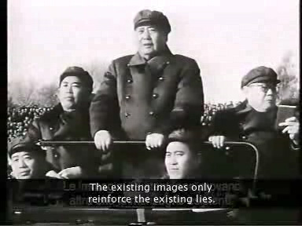
Still from In Girum Imus Nocte et Consumimur Igni, 1978, by Guy Debord

Slide 8
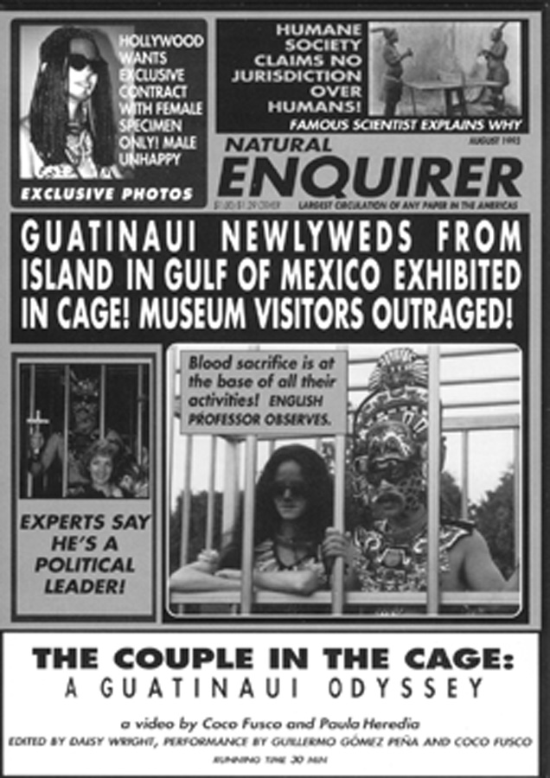
Forms of Appropriation

Slide 9
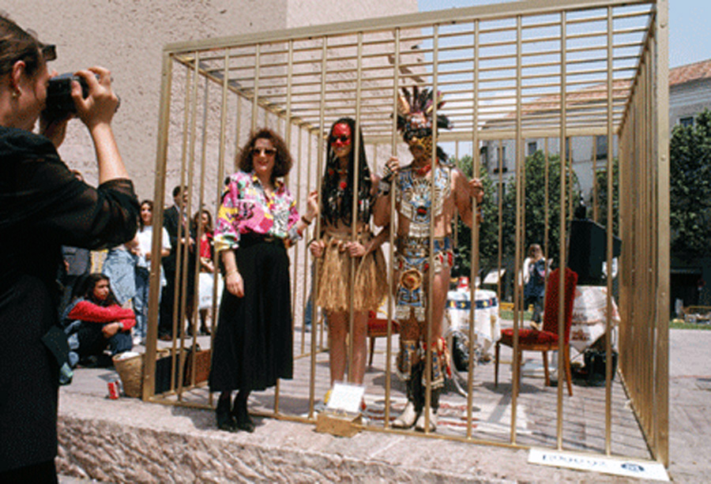
Couple in The Cage (1997)
Dir. Paula Heredia & Coco Fusco
Performance by Coco Fusco &
Guillermo Gómez-Peña

Slide 10
Cultural Appropriation
“the liberal notion of cultural appropriation as an act of ’free will,’ and the post-structuralist approaches that abstract individual acts of appropriation from the social systems that imbue them with specific meanings” (p.68)

Slide 11
Cultural Appropriation
“The more Eurocentric versions of this school of thought distinguish between dominant cultural acts of appropriation as creative transformation, and the subaltern manipulation of imposed forms as ‘derivative’ activity that distance them from a preferably natural state.” (p.70)

Slide 12
Cultural Appropriation
“Cultural appropriation is as much a political act as it is a formal operation or linguistic game. It involves taking something, often from someone, and it is rarely an isolated gesture.” (p.71)

Slide 13
Cultural Appropriation
“Cultural appropriation is as much a political act as it is a formal operation or linguistic game. It involves taking something, often from someone, and it is rarely an isolated gesture.” (p.71)

Slide 14
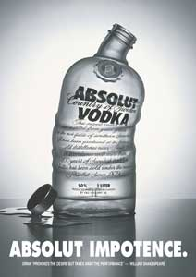
Culture Jamming
www.adbusters.org

Slide 15
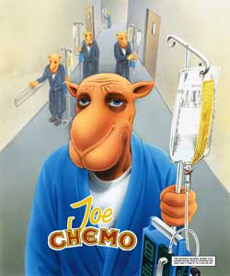
Culture Jamming
www.adbusters.org

Slide 16
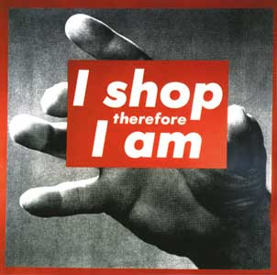
Culture Jamming
www.adbusters.org

Slide 17
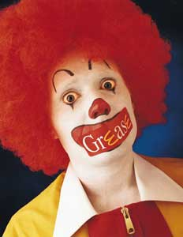
Culture Jamming
www.adbusters.org

Slide 18
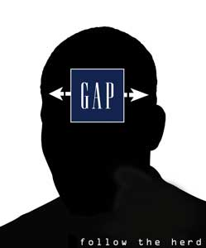
Culture Jamming
www.adbusters.org

Slide 19
Culture Jamming
According to Lasn, what is a meme?

Slide 20
Culture Jamming
According to Lasn, what is a meme?
A unit of information

Slide 21
Culture Jamming
According to Lasn, what are meme wars?

Slide 22
Culture Jamming
According to Lasn, what are meme wars?
Guerrilla information wars

Slide 23
Culture Jamming
According to Lasn, what are some strategies for culture jamming?

Slide 24
Culture Jamming
According to Lasn, what are some strategies for culture jamming?
Finding a leverage point

Slide 25
Culture Jamming
According to Lasn, what are some strategies for culture jamming?
Finding a leverage point
Detournement

Slide 26
Culture Jamming
According to Lasn, what are some strategies for culture jamming?
Finding a leverage point
Detournement
Cyberjamming

Slide 27
Culture Jamming
According to Lasn, what are some strategies for culture jamming?
Finding a leverage point
Detournement
Cyberjamming
TV jamming

Slide 28
Culture Jamming
According to Lasn, what are some strategies for culture jamming?
Finding a leverage point
Detournement
Cyberjamming – petitions, virtual protests, sit-ins, gripe sites
TV jamming
The pincer strategy

Slide 29
Culture Jamming
Do you think these strategies are relevant to our mediascape today?

Slide 30
Culture Jamming
Do you think these strategies are relevant to our mediascape today?
Let’s discuss in relation to a case study:

Slide 31
BLO (Barbie Liberation Organization) https://www.youtube.com/watch?v=eMHMf9y-27w
RTMark https://en.wikipedia.org/wiki/RTMark
The Yes Men https://theyesmen.org/

Slide 32
Culture Jamming
Does your DGA group’s action or campaign relate to culture jamming? If yes, how so? And if no, why not?

Slide 33

2010s Historical Perspective
(Basically the last decade…)

