Slide 1
VIDEO & DIVERSITY
Week 4: The 1960s

Slide 2
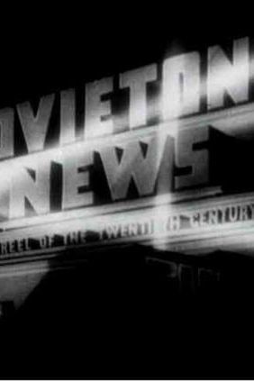
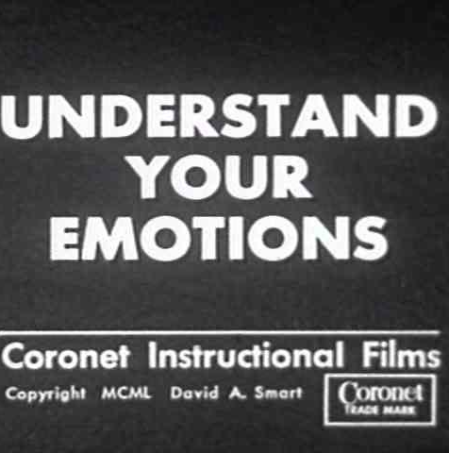
Newsreels, Educational & Instructional Films

Slide 3
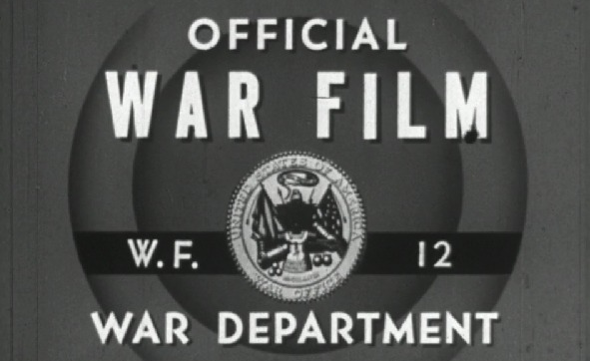


Who is in control of the message?

Slide 4
Who is in control of the message?
Who has access to production and distribution?

Slide 5
Who is in control of the message?
Who has access to production and distribution?
Who is the audience?

Slide 6
Who is in control of the message?
Who has access to production and distribution?
Who is the audience?
What is their purpose?

Slide 7
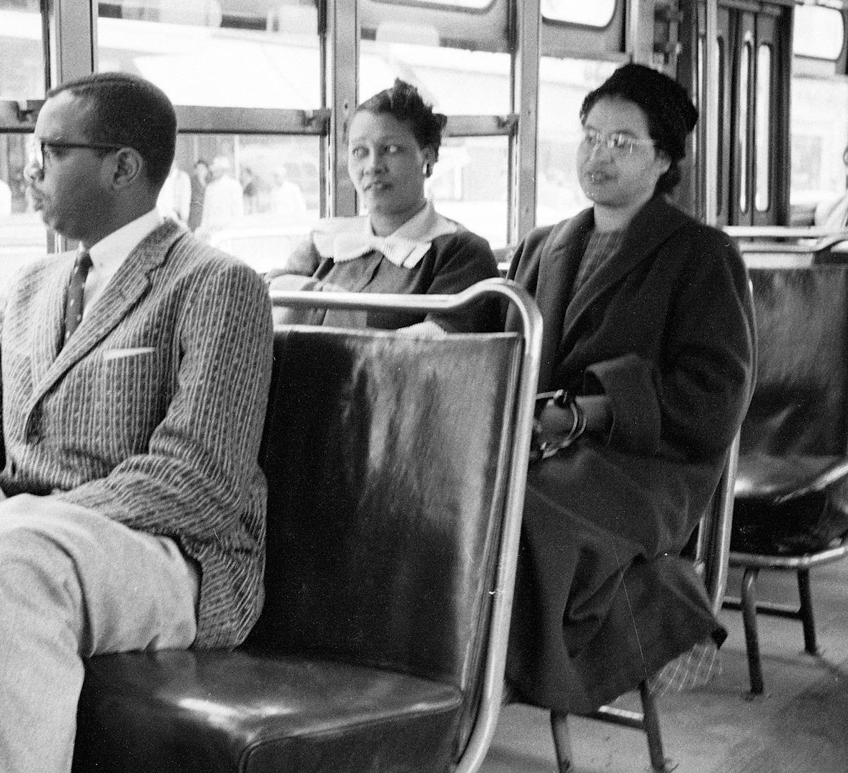
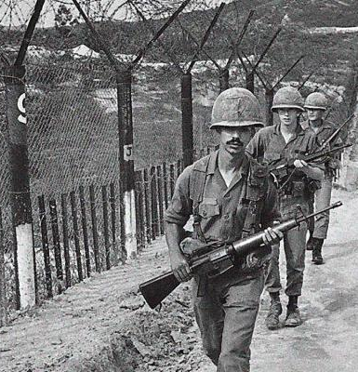
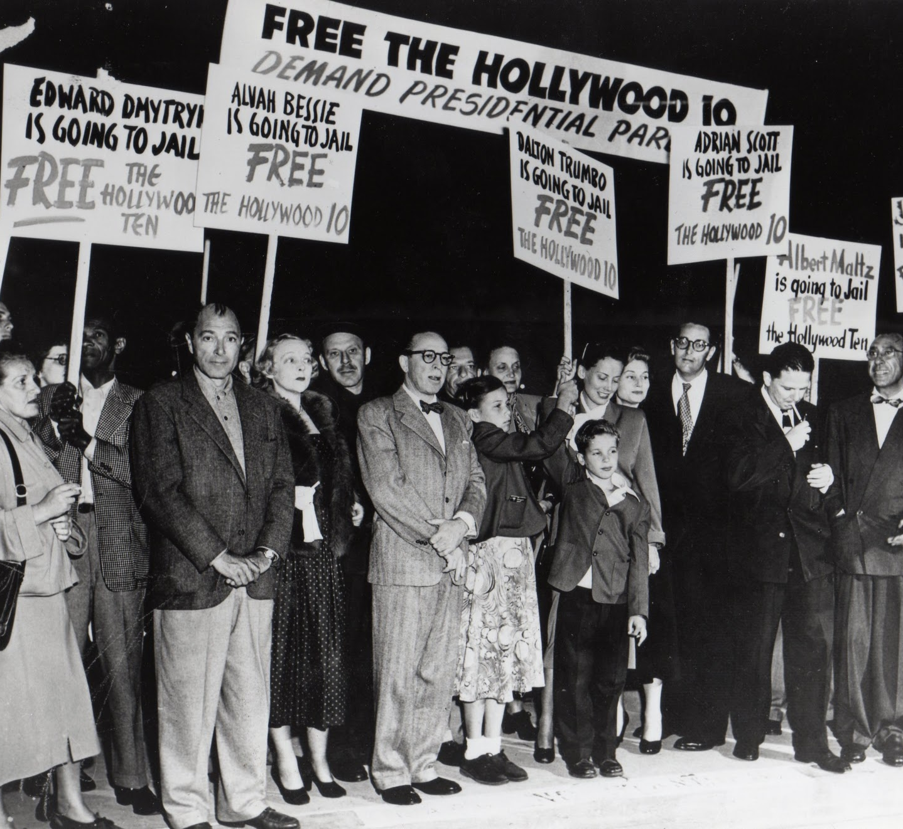
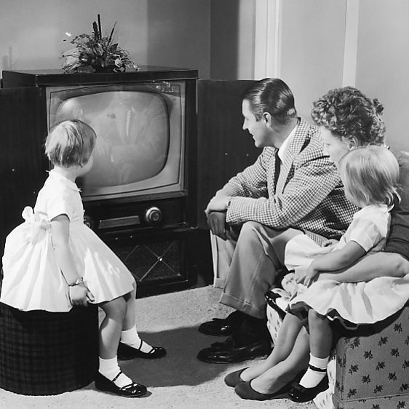

The 1950s –
The Cold War
Nuclear arms race
Korean War
Red scare / HUAC
Hollywood 10
1951-53 Julius & Ethel Rosenberg trial
Civil Rights – Rosa Parks, Emmett Till
Post-WWII baby boom & rise of consumerist culture
Television became the dominant media

Slide 8
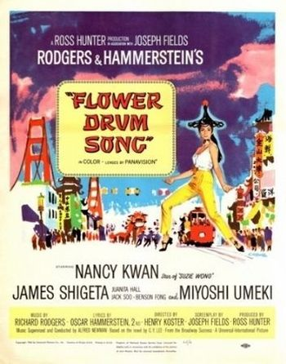
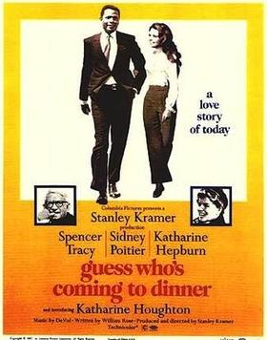
Comparative Analysis:
Flower Drum Song (1961)
Dir. Henry Koster
Guess Who’s Coming to Dinner (1967) Dir. Stanley Kramer

Slide 9
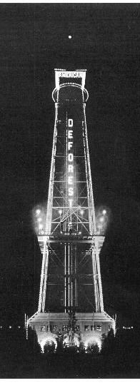
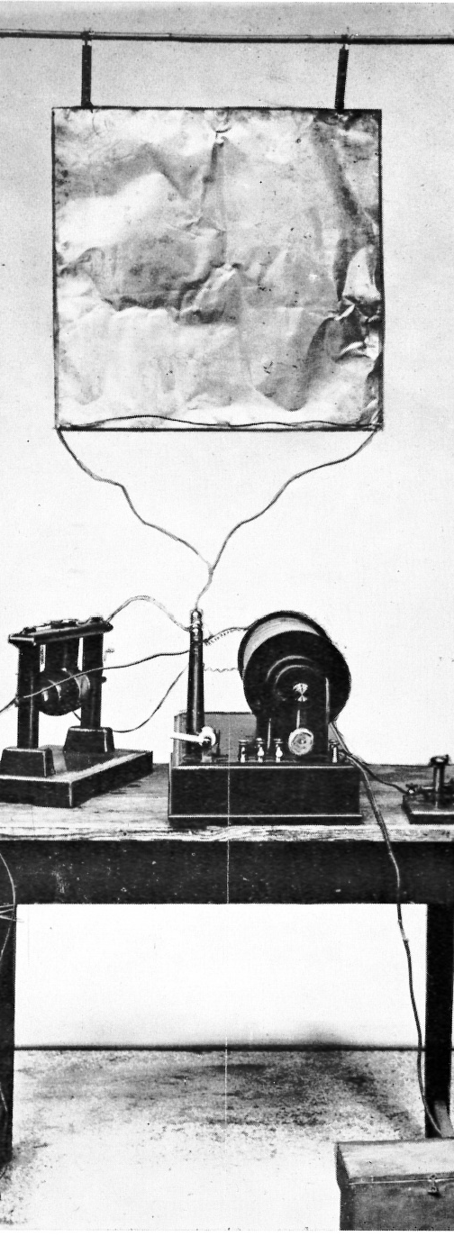
An Abbreviated History
of Broadcast Media
Late 1800s – WWI
Henrich Hertz (Germany) discovers electromagnetic waves, (1886-1889) an essential technology for future wireless communications. Hertz (Hz), the unit in measuring frequency, was named in his honor.
Guglielmo Marconi (Italy) developed the first wireless radio. (1901-1902)
Ambrose Fleming (UK) designed a radio transmitter with which the first transatlantic radio transmission was made in 1901.
Lee de Forest (US) made further inventions in radio technology.
Marconi and de Forest both formed transmission technology-based media companies.

Slide 10
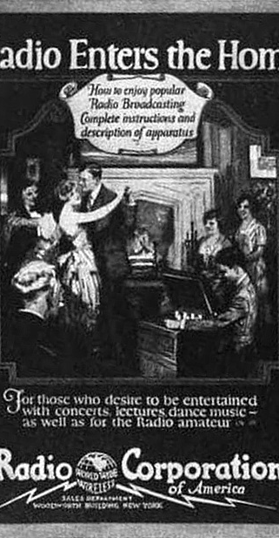
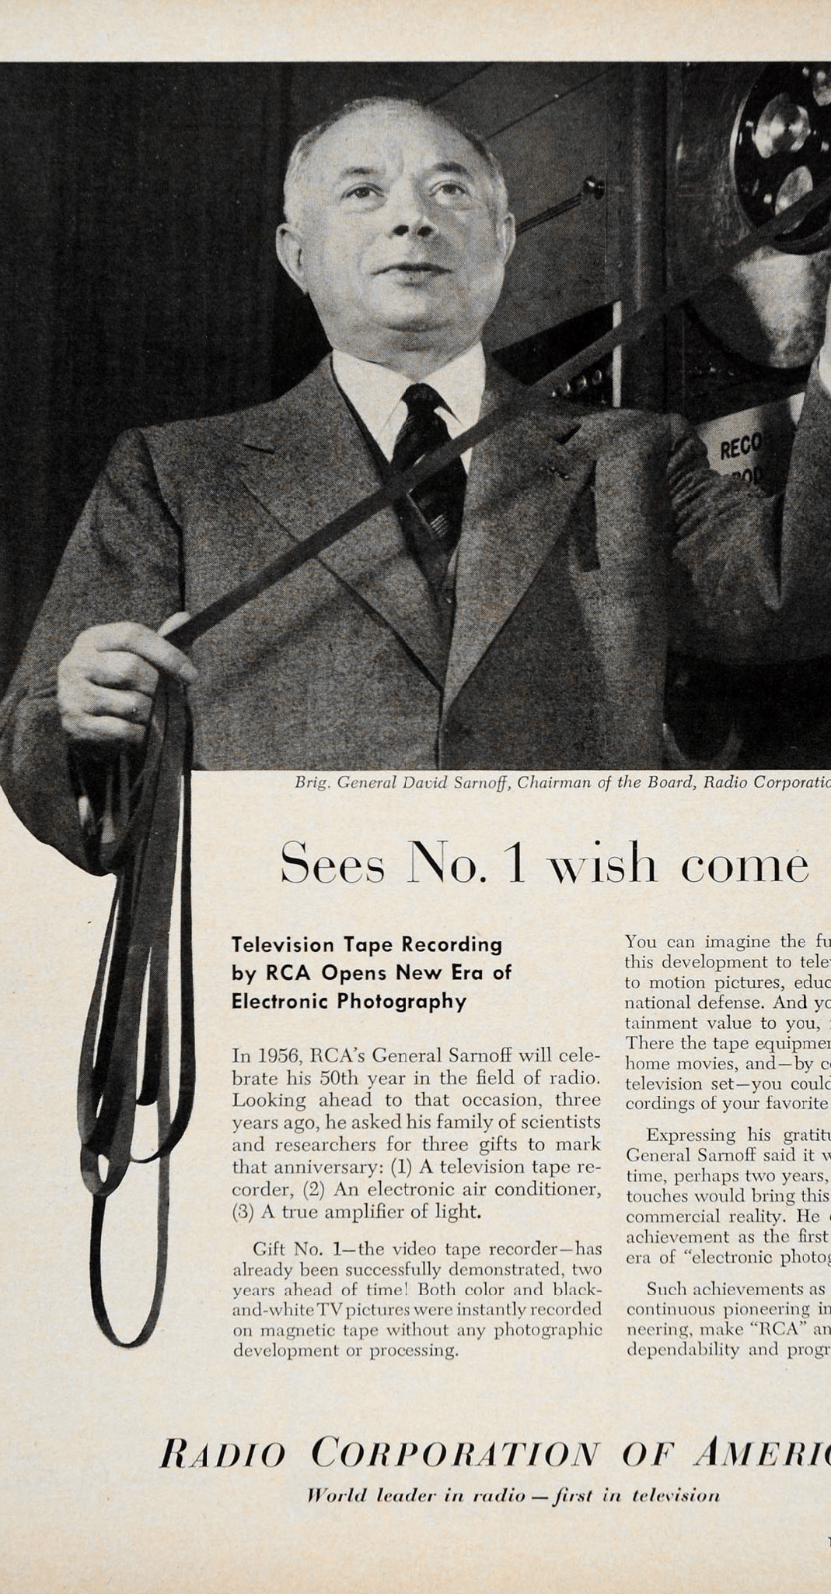
The Golden Age of Radio: early 1920s – 1950s
During WWI, the U.S. Government took over all radio holdings. Many technological advances were made, and the military backed the idea of a standardized monopoly.
Scientific American coined the term “Television” in 1907.
Radio Corporation of America (RCA) formed in 1919. RCA’s first year in selling radios, in 1922, earned $11,000,000. The second year earned $50,000,000.
The founder of RCA, David Sarnoff, also created the first television network, National Broadcasting Company, (NBC) in 1940.

Slide 11
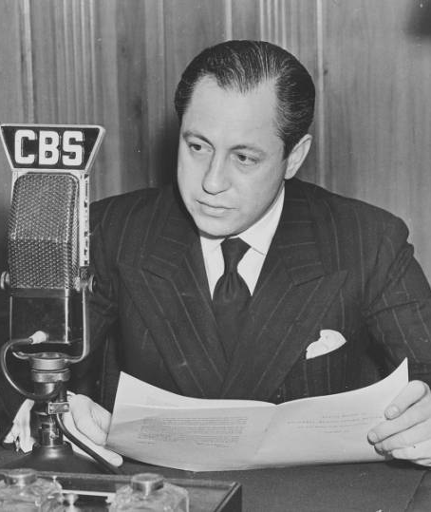
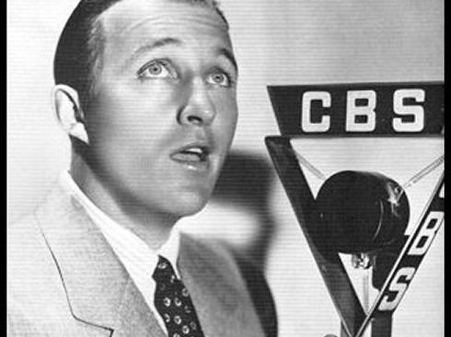
1940s
Columbia Broadcast System, (CBS) a media corporation competing with RCA, was led by William S. Paley from 1928 into the 1980s. CBS was initially focused on radio, moving into television in the 1940s.
In 1940, Peter Goldmark, the head of CBS Laboratories, invented a new television color system which rivals RCA’s system. FCC (Federal Communications Commission) sided with RCA in the subsequent dispute.
FCC ordered NBC to divest itself of one of its networks, which was sold for $8 million to Edward S. Noble, manufacturer of Life Savers candies, in 1943. Noble renamed the network American Broadcasting Company (ABC)
Both Paley and Sarnoff served in WWII. (1941-45) The war also led to refinement in video technology.
In 1946, 10,000 TV sets were sold, which is 0.02% of U.S. households. 200,000 sets were sold the following year, and by 1950, TV sets are in 9% of households, and 78% by 1955.

Slide 12
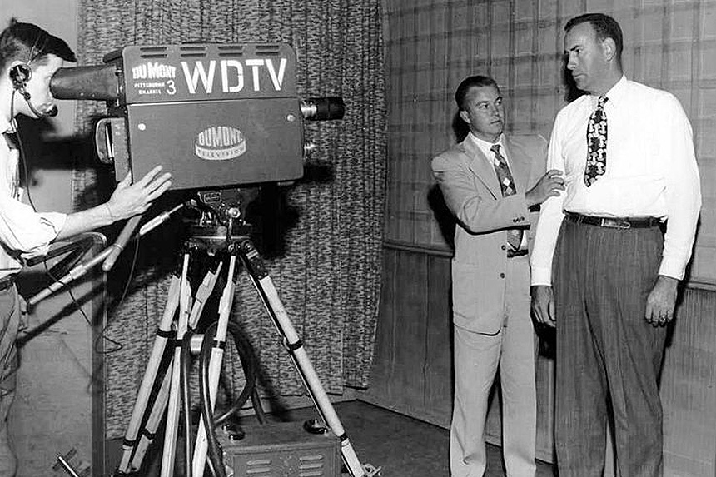
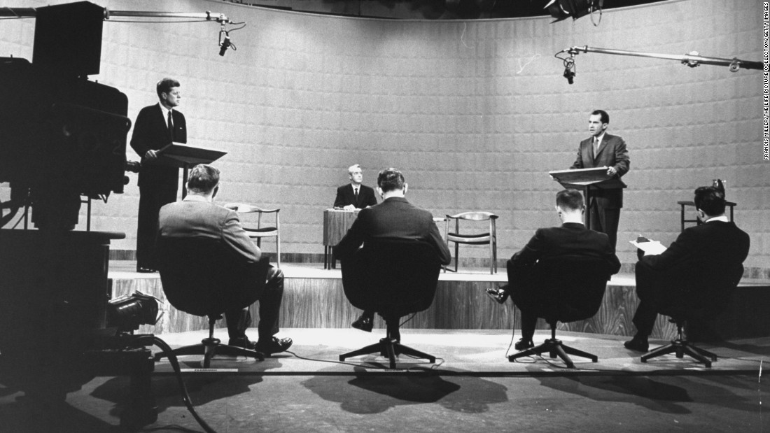
1950s & ‘60s
The birth of the videotape by Bing Crosby Enterprises (1951)
Late 1940s to the early ‘50s is considered the golden age of live television, (e.g. Ernie Kovacs) when production was centered in NYC.
TV stations in the 1950s: ABC, CBS, NBC (the Big Three); DMN (DuMont – the “forgotten network”).
Videotape technology was first developed with television stations such as CBS (1953-57).
The Nixon-Kennedy presidential debates in 1960 show the differing media representations, between radio and television.
Sony Corporation in Japan produced the first portable video reel-to-reel deck in 1965, and the first color video recorder in 1969.
CBS introduced the first video cassette in 1968.

Slide 13
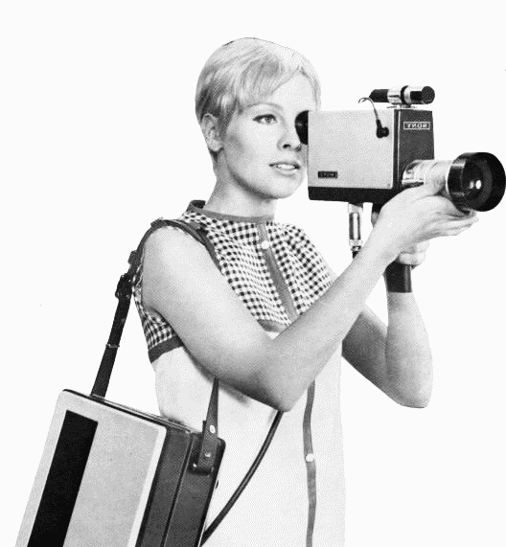
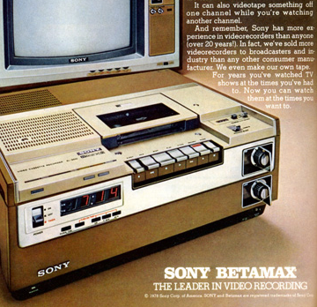
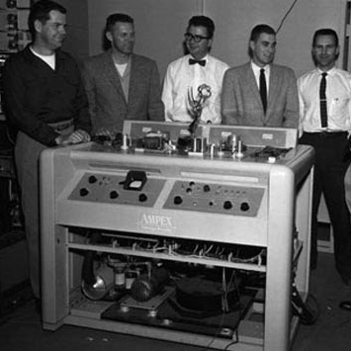
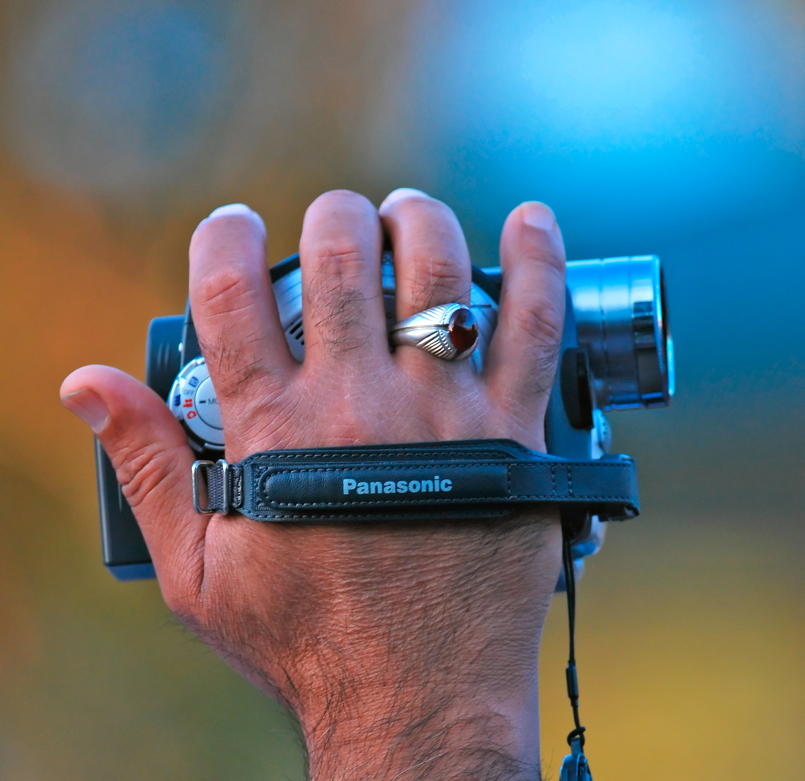
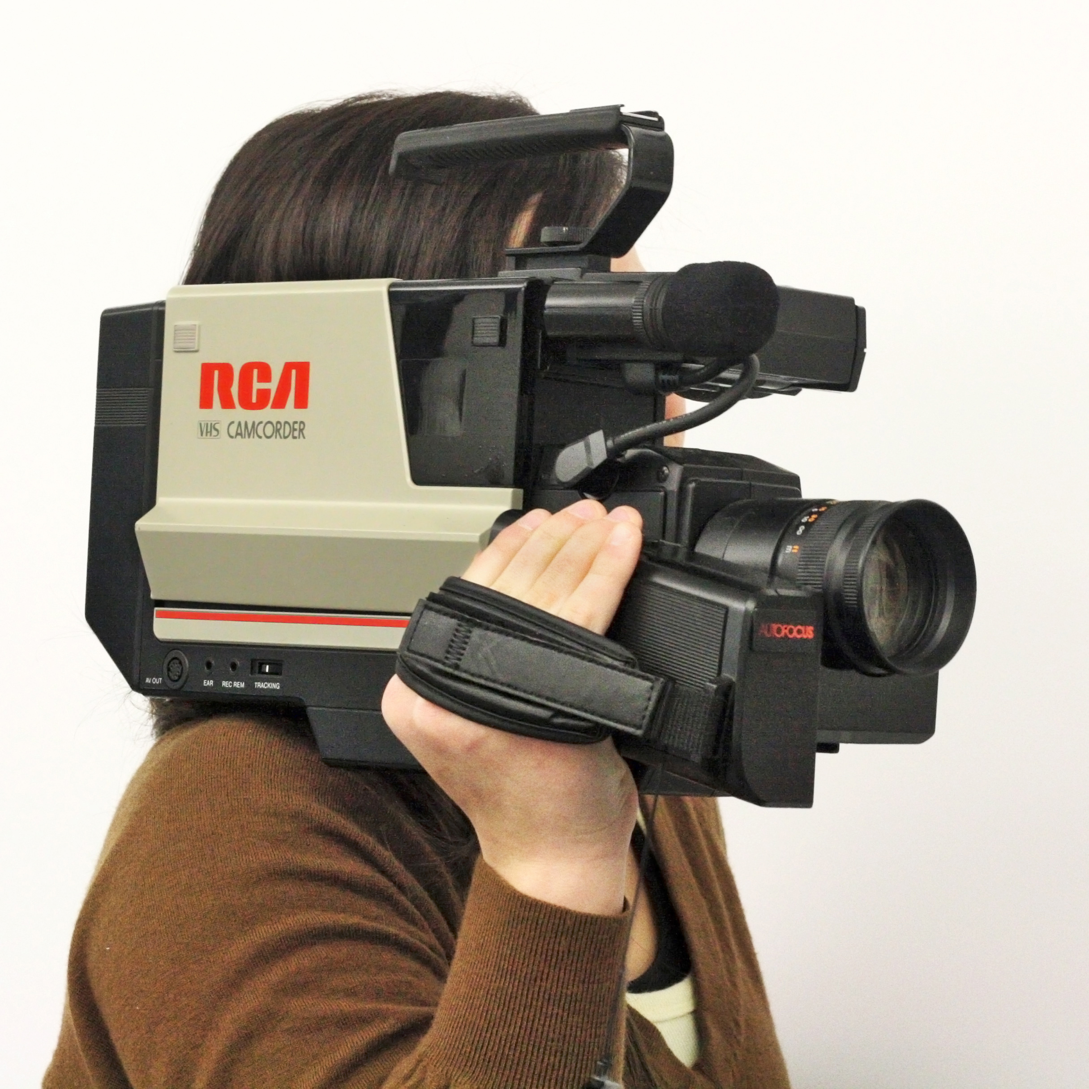
1970s & ‘80s
Sarnoff retired from RCA in 1970 and died in ‘71.
Paley waived CBS’s mandatory retirement in 1966 and remained chairman of the board till 1983. He returned in 1987 and died in 1990.
The rise of ABC and the youth demographic for advertisers in the 1970s.
The advent of cable, satellite, and videotape rental markets in the 1980s.

Slide 14
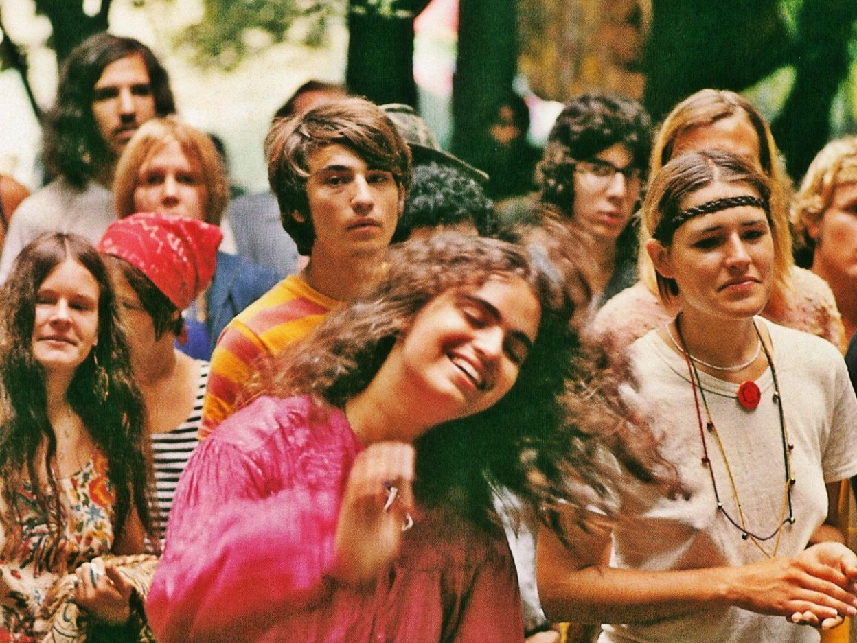
The 1960s -
Protest & Counterculture

Slide 15
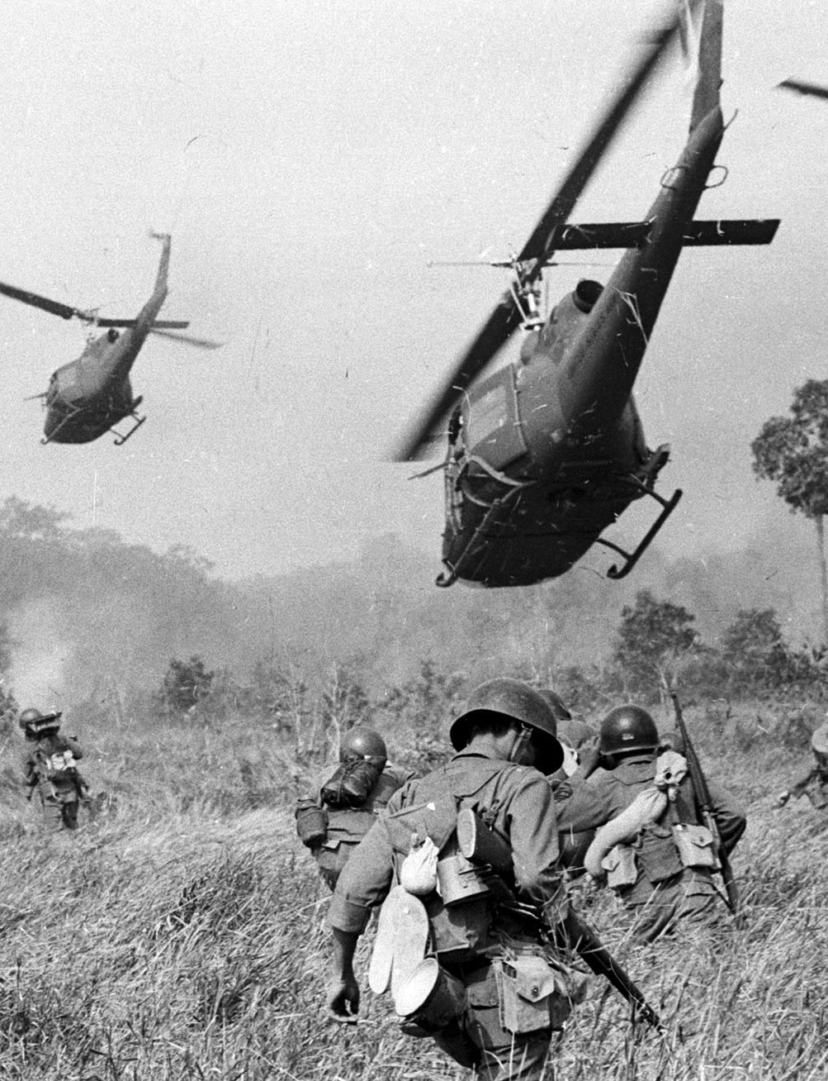
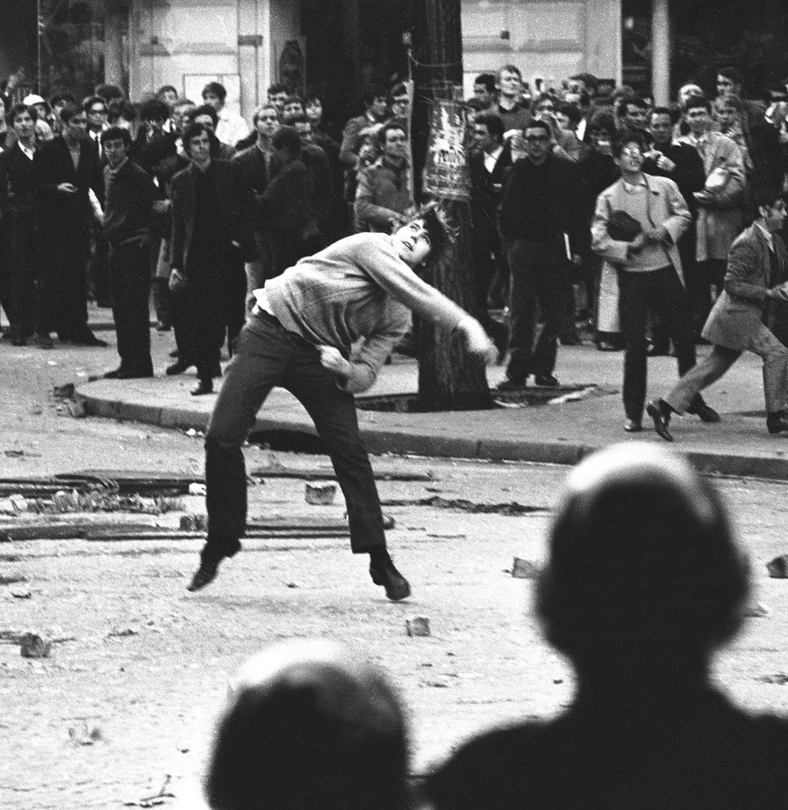
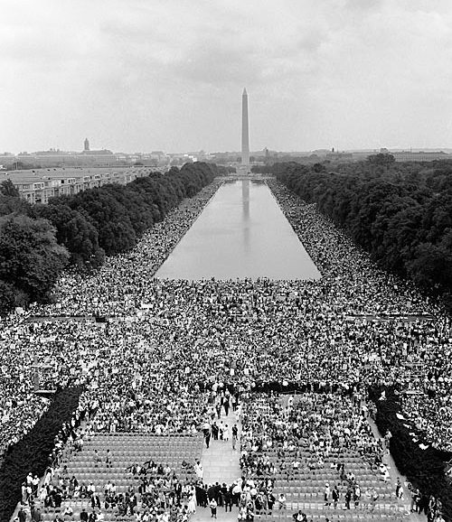
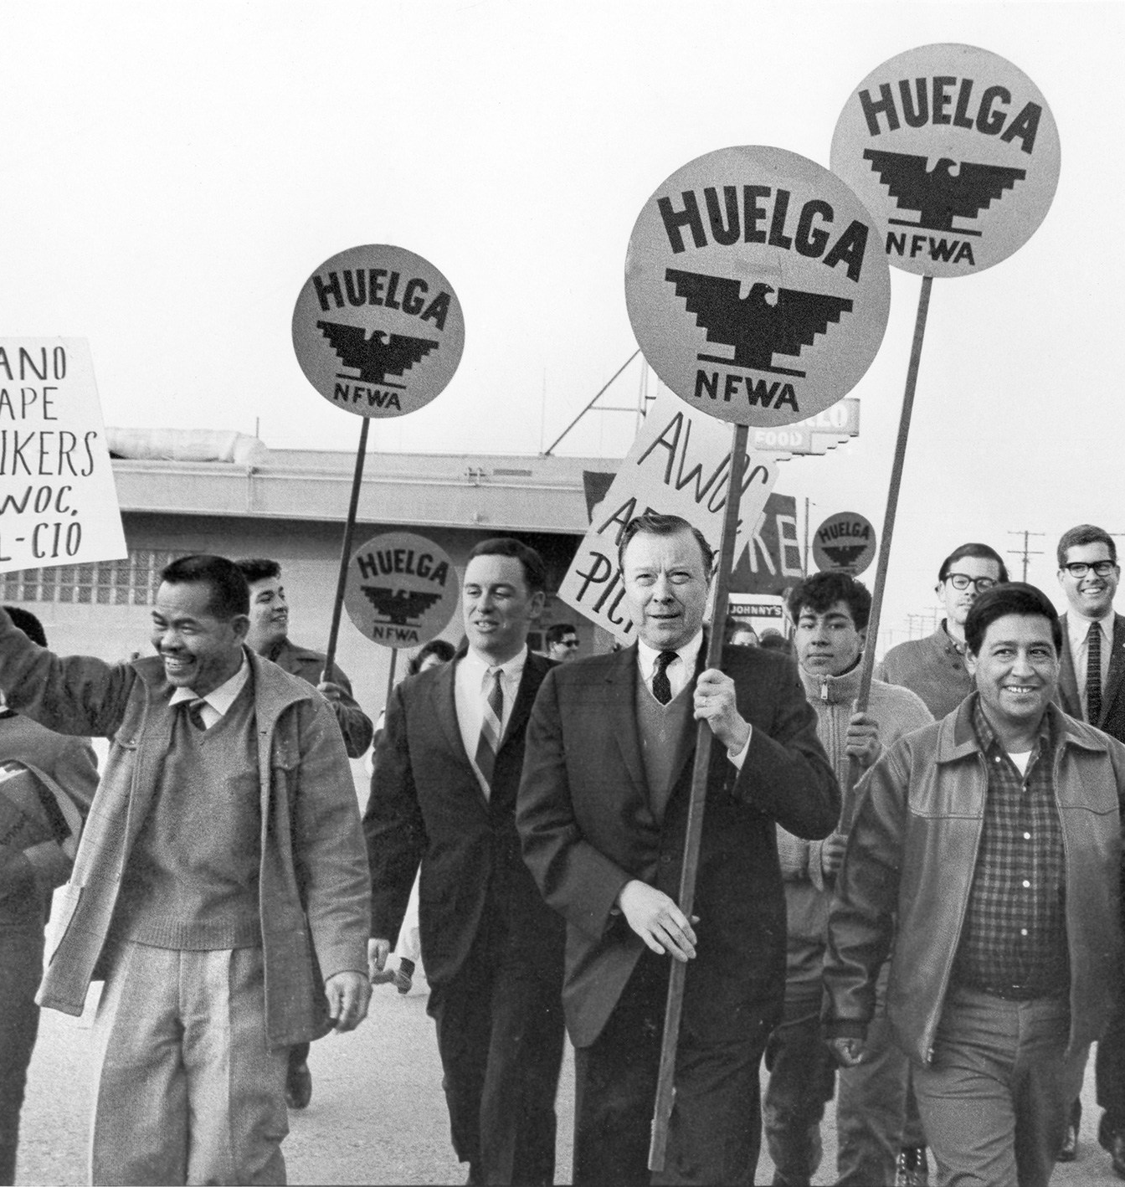
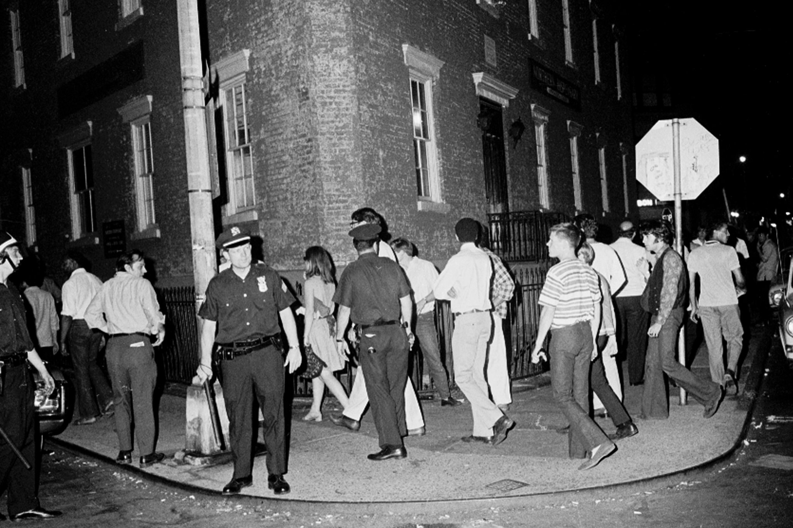
Vietnam War & the anti-war movement (e.g. Berkeley in the Sixties)
Civil Rights Movement – MLK, Malcolm X, the Black Panthers, 1963 March on Washington
The Delano Grape Strike & Boycott – Cesar Chavez, Larry Itliong / United Farm Workers (1965-70)
May 68 (Paris, France)
Stonewall Rebellion / Gay Liberation Front (1969)
Haight-Ashbury - hippies!
Pop art
Woodstock (1969) Joan Baez, Creedence Clearwater Revival, Country Joe & the Fish, Grateful Dead, Jefferson Airplane, Jimi Hendrix, Janis Joplin, Santana, Sly & the Family Stone, The Who, and more!

Slide 16

Gender & Representation:
“One is not born, but rather becomes, a woman.” (Simone de Beauvoir)
Carolee Schneemann, Eye Body: 36 Transformative Actions for Camera, 1963

Slide 17
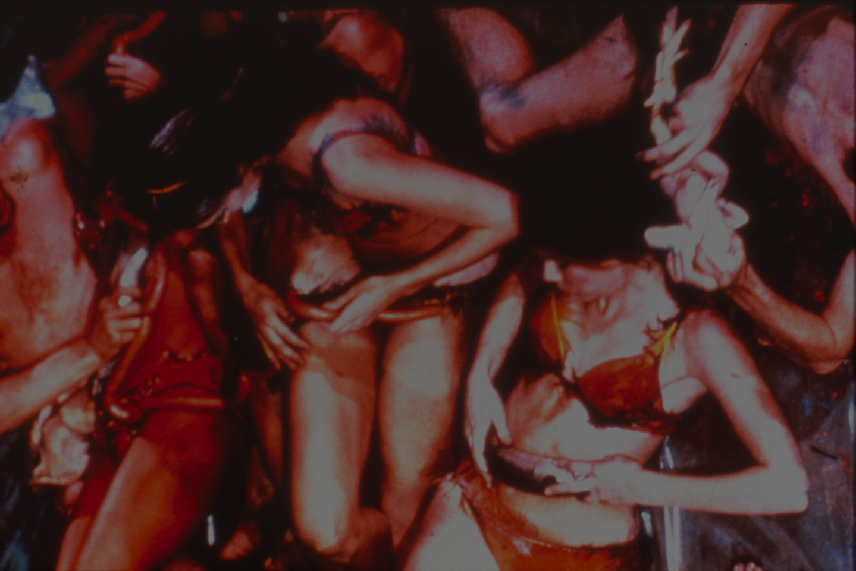
Gender & Representation:
What is the cause of female inequality?
Carolee Schneemann, Meat Joy, 1964

Slide 18
Gender & Representation:
What is the cause of female inequality?
What is the best strategy for ending female inequality?
Carolee Schneemann, Meat Joy, 1964

Slide 19
Gender & Representation:
What is the cause of female inequality?
What is the best strategy for ending female inequality?
What is the meaning, or definition, of female inequality (Bem)
Carolee Schneemann, Meat Joy, 1964

Slide 20
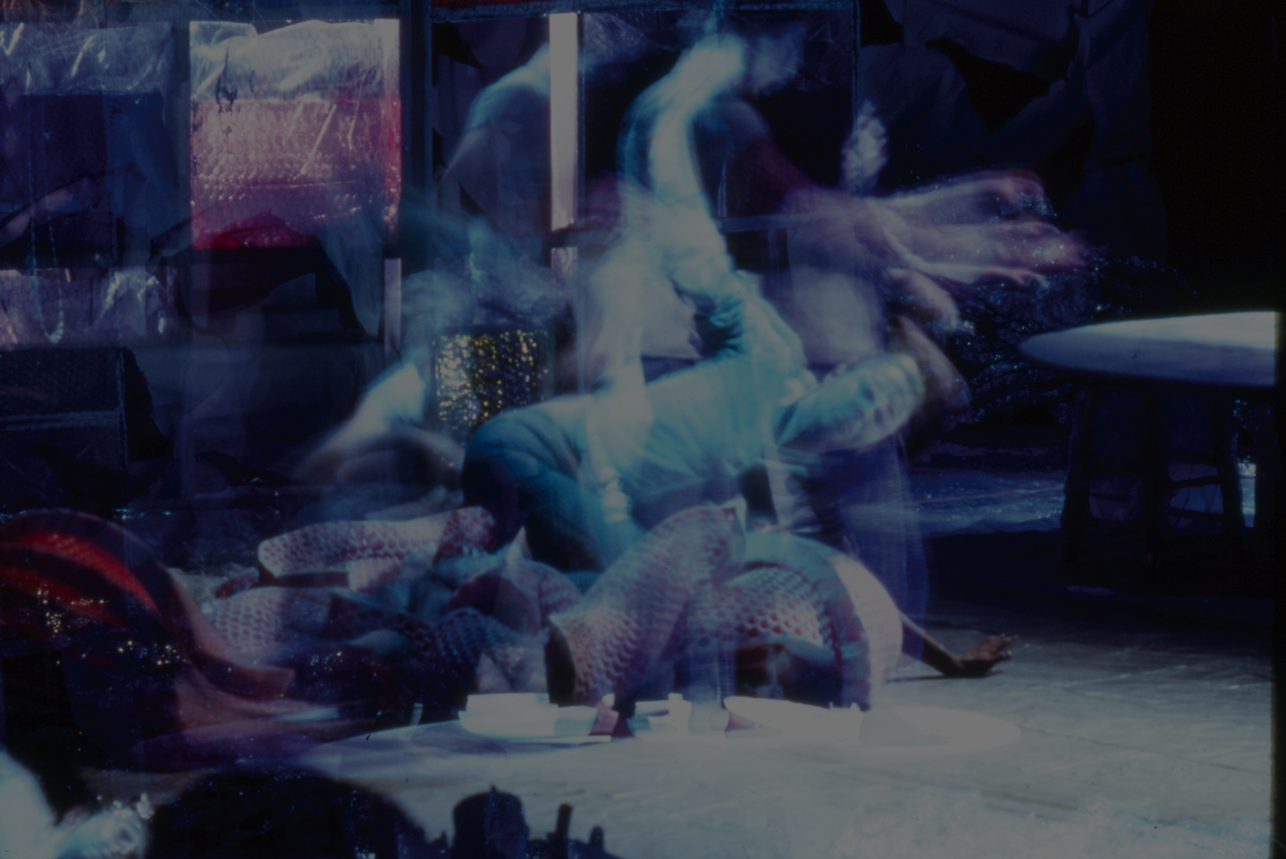
Gender & Representation:
“Gender boundaries are breachable, and individual and socially organized shifts from one gender to another call attention to ‘cultural, social, or aesthetic dissonances.’” (Judith Lorber, quote from Majorie Garber)
Carolee Schneemann, Snows, 1967

Slide 21
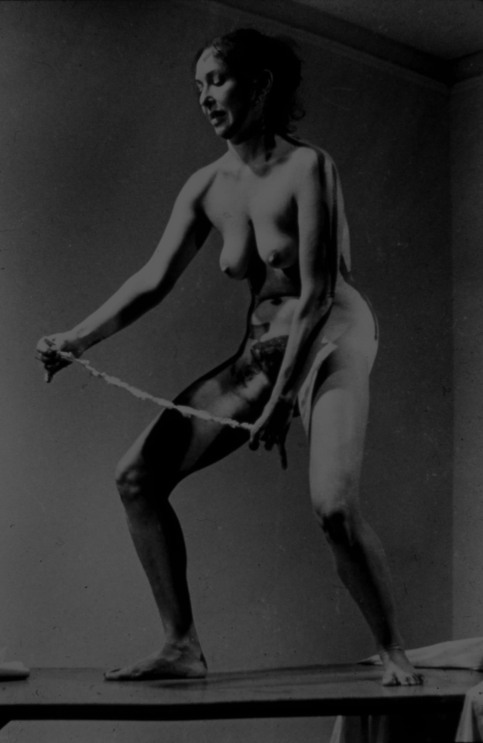
Gender & Representation:
“Why have there been no great women artists?” (Linda Nochlin)
Carolee Schneemann, Interior Scroll, 1975

Slide 22
Discussion & Collaborative Writing Exercise:
The class will break into groups of 2-3 students.
First, discuss your reactions watching Fuses (1964-67) by Carolee Schneemann and the educational film The Trouble with Women (1959) Have a conversation within your group, and take notes on the members’ different (or similar) reactions.

Slide 23
Discussion & Collaborative Writing Exercise:
When the main points emerge from your group’s discussion, move on to talk about how they connect to the class reading. Please focus on the Nochlin reading in this exercise, while referencing other readings. (e.g. the Schneemann interview)

Slide 24
Discussion & Collaborative Writing Exercise:
Write a short paragraph (250-300 words) as a group to summarize your discussion. Be specific in your description of the films - write about identifiable scenes, shots, images, sounds, and other elements as well as ideas from the reading – use specific quotes and references.

Slide 25
If you are unclear on how to engage with Nochlin’s essay, here are some questions you may want to consider:
Nochlin answers the question in the title of her essay implicitly by identifying institutions and education as the main causes that prevent women artists from “greatness”. How does that apply to the films you watched?

Slide 26
If you are unclear on how to engage with Nochlin’s essay, here are some questions you may want to consider:
Are there ideas, images, or stories in these films (and the other class reading connected to the films) that echo Nochlin’s thesis and main arguments in the essay?

Slide 27
If you are unclear on how to engage with Nochlin’s essay, here are some questions you may want to consider:
Are there aspects and elements in these films that challenge Nochlin’s thesis and main arguments?

Slide 28
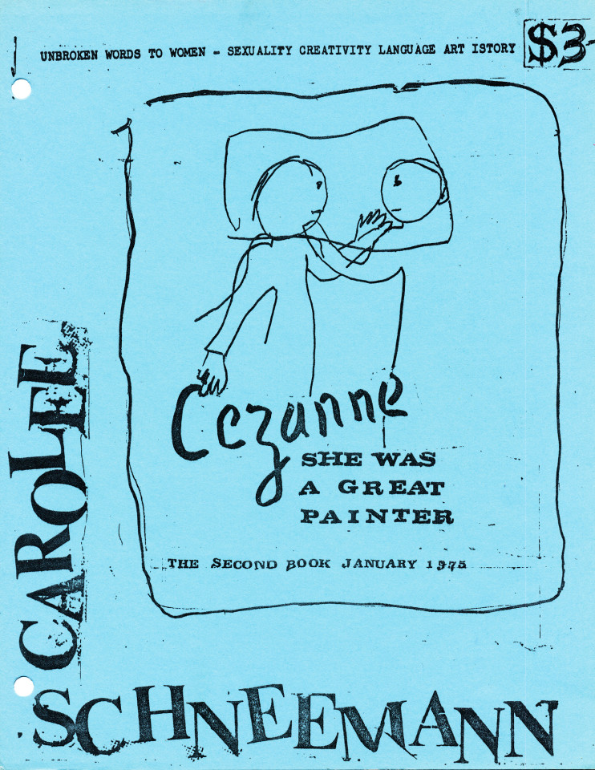
Carolee Schneemann, Cezanne She Was a Great Painter: The Second Book, January 1975, Unbroken Words to Women, Sexuality Creativity Language Art Istory

