Slide 1
VIDEO & DIVERSITY
Week 7: The 1970s
TV Culture & Early Video Art

Slide 2
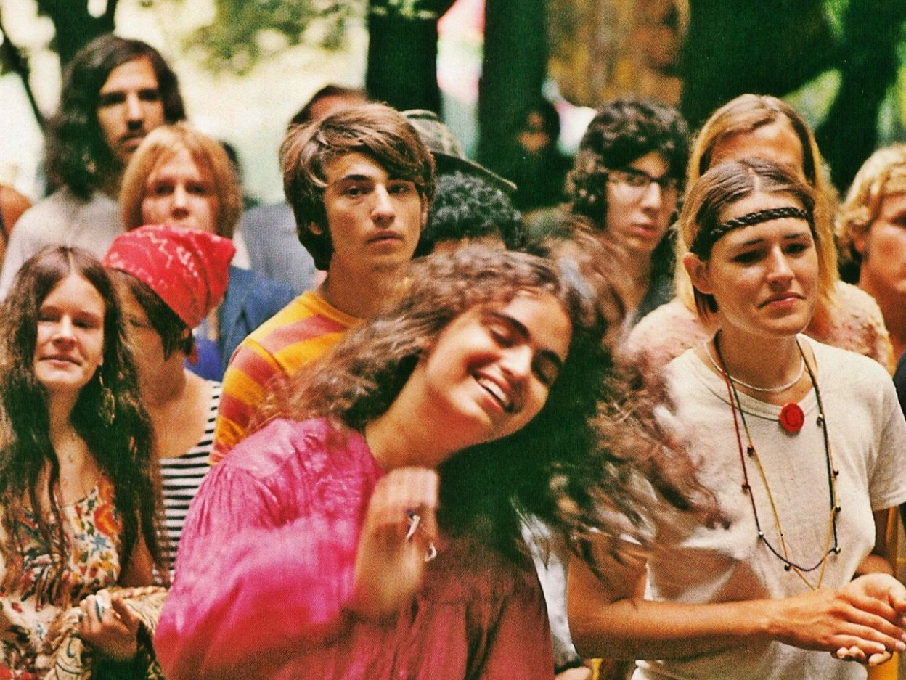

The 1960s -
Protest & Counterculture

Slide 3
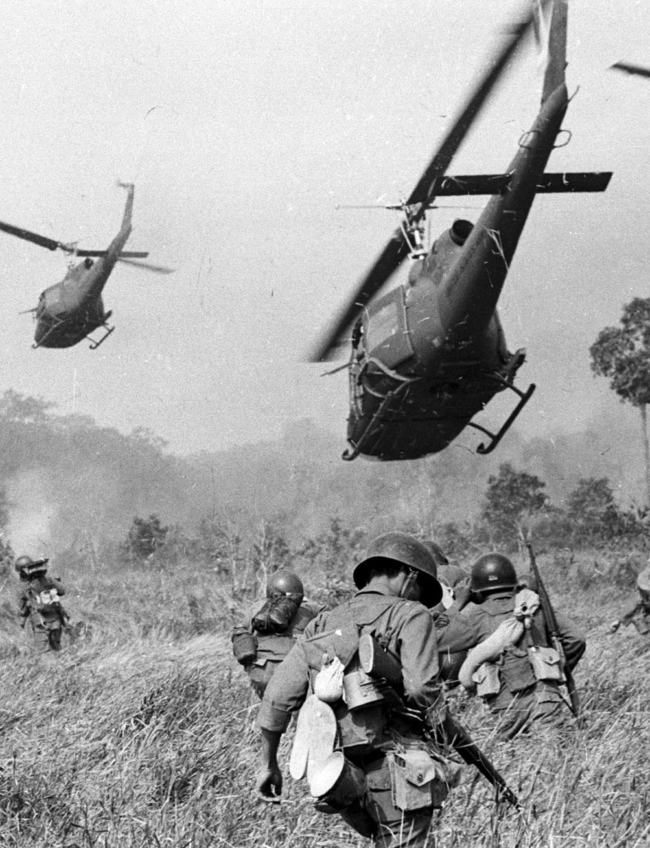
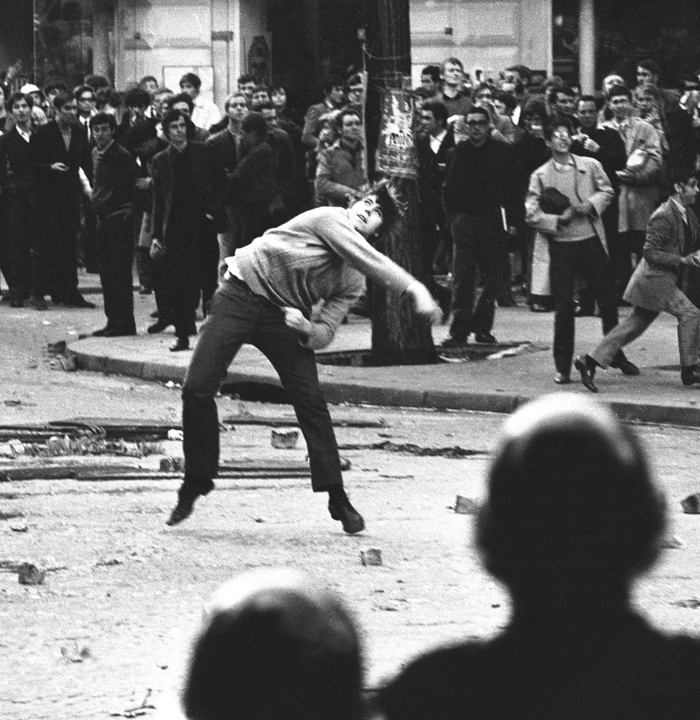
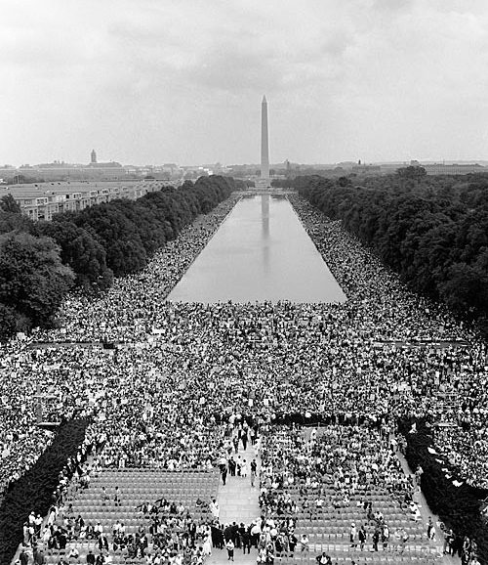
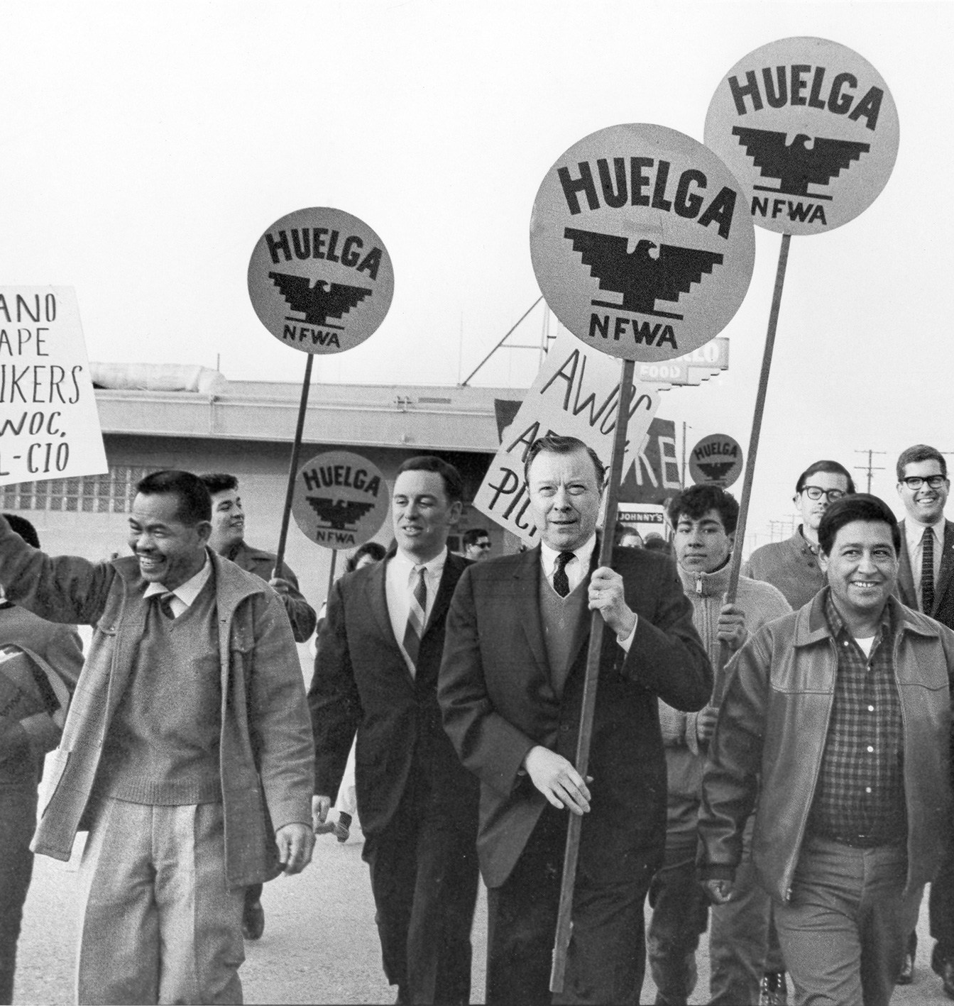
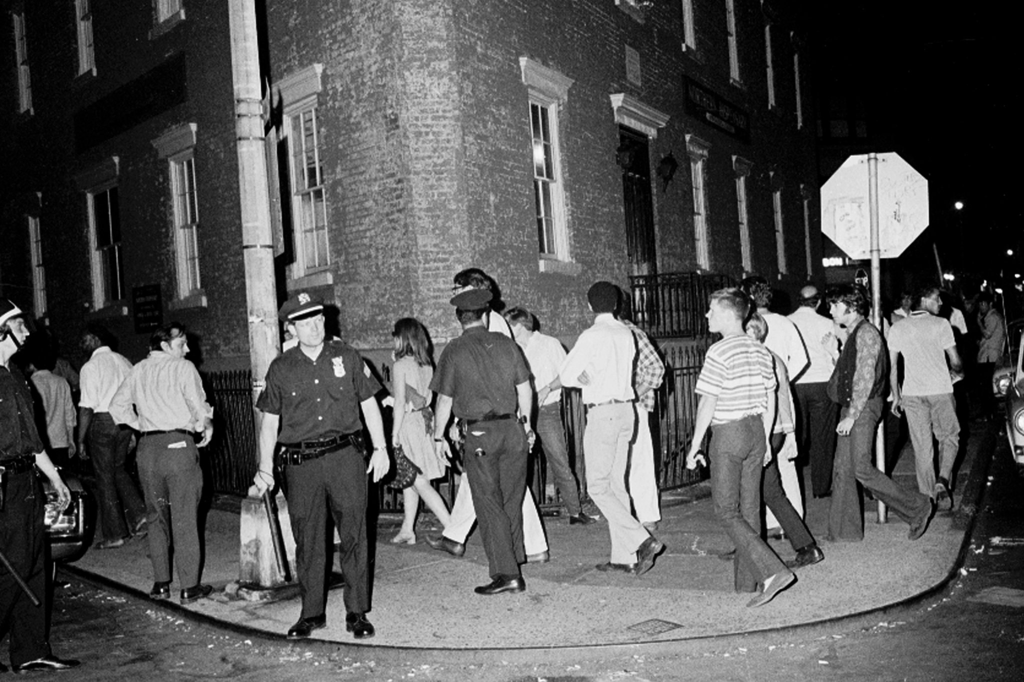
Vietnam War & the anti-war movement (e.g. Berkeley in the Sixties)
Civil Rights Movement – MLK, Malcolm X, the Black Panthers, 1963 March on Washington
The Delano Grape Strike & Boycott – Cesar Chavez, Larry Itliong / United Farm Workers (1965-70)
May 68 (Paris, France)
Stonewall Rebellion / Gay Liberation Front (1969)
Haight-Ashbury - hippies!
Pop art
Woodstock (1969) Joan Baez, Creedence Clearwater Revival, Country Joe & the Fish, Grateful Dead, Jefferson Airplane, Jimi Hendrix, Janis Joplin, Santana, Sly & the Family Stone, The Who, and more!

Slide 4
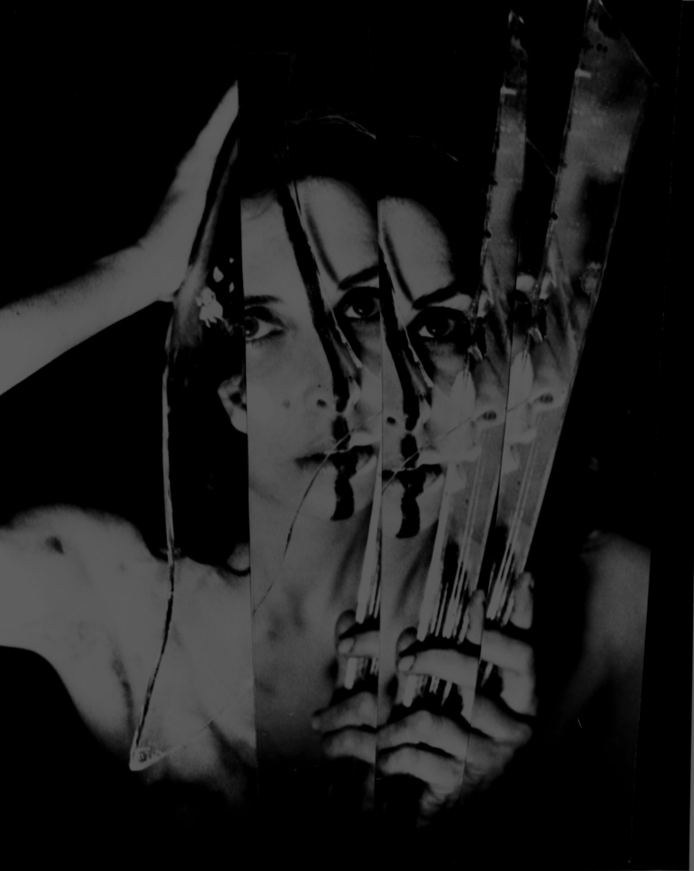
Gender & Representation:
“One is not born, but rather becomes, a woman.” (Simone de Beauvoir)
Carolee Schneemann, Eye Body: 36 Transformative Actions for Camera, 1963

Slide 5
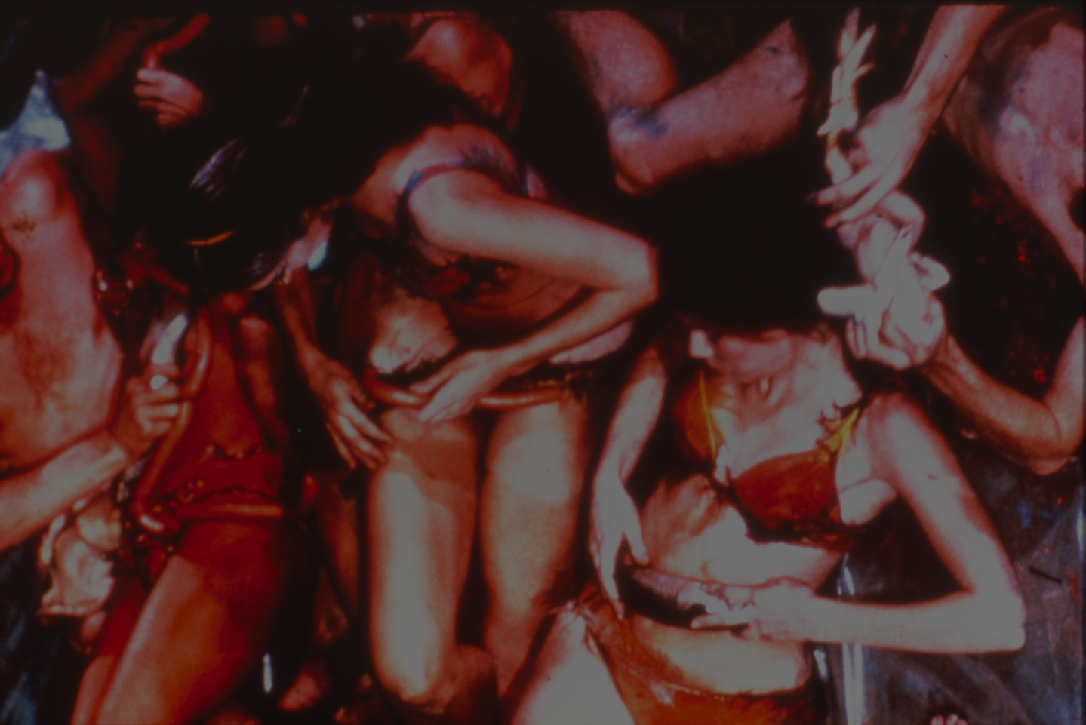
Gender & Representation:
What is the cause of female inequality?
Carolee Schneemann, Meat Joy, 1964

Slide 6
Gender & Representation:
What is the cause of female inequality?
What is the best strategy for ending female inequality?
Carolee Schneemann, Meat Joy, 1964

Slide 7
Gender & Representation:
What is the cause of female inequality?
What is the best strategy for ending female inequality?
What is the meaning, or definition, of female inequality (Bem)
Carolee Schneemann, Meat Joy, 1964

Slide 8
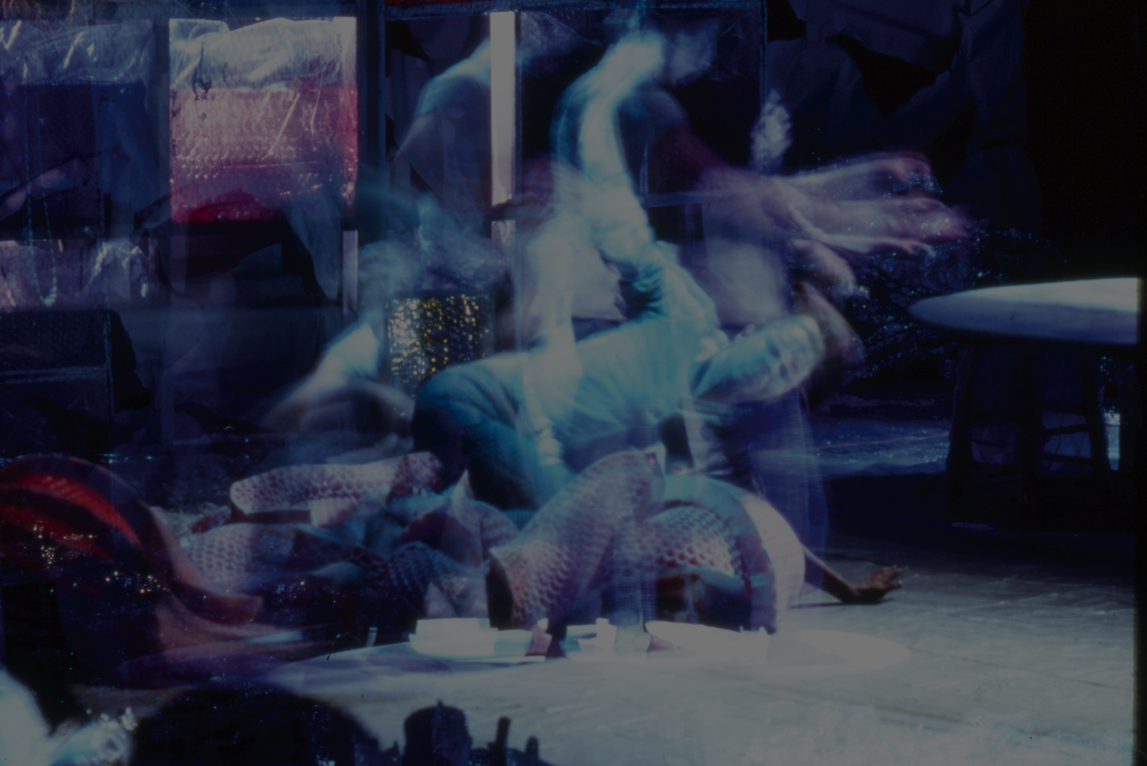
Gender & Representation:
“Gender boundaries are breachable, and individual and socially organized shifts from one gender to another call attention to ‘cultural, social, or aesthetic dissonances.’” (Judith Lorber, quote from Marjorie Garber)
Carolee Schneemann, Snows, 1967

Slide 9
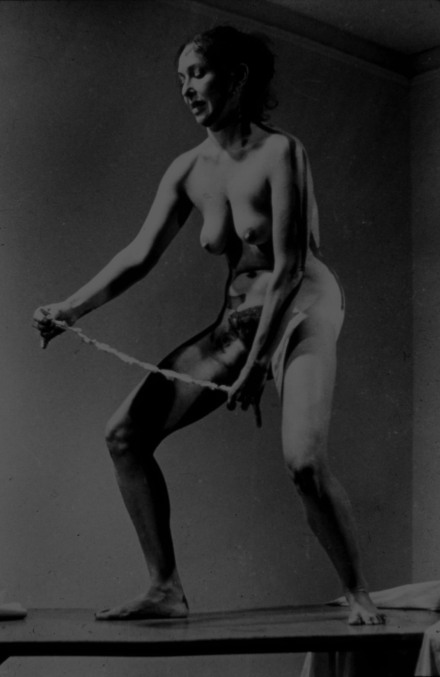
Gender & Representation:
“Why have there been no great women artists?” (Linda Nochlin)
Carolee Schneemann, Interior Scroll, 1975

Slide 10
Discussion:
We will be focusing on the Nochlin reading in this discussion, and using Carolee Schneemann as a case study.
Also by comparing Schneemann’s Fuses (1964-67) to the educational film The Trouble with Women (1959) consider the following questions.

Slide 11
1. Nochlin answers the question in the title of her essay implicitly by identifying institutions and education as the main causes that prevent women artists from “greatness”. How does that apply to the films you watched?

Slide 12
2. Are there ideas, images, or stories in these films (and the other class reading connected to the films) that echo Nochlin’s thesis and main arguments in the essay?

Slide 13
3. Are there aspects and elements in these films that challenge Nochlin’s thesis and main arguments?

Slide 14
4. How about observations and reactions from these films that are not discussed by Nochlin, but are related to discussions and debates on gender, sexuality, and media representation?

Slide 15
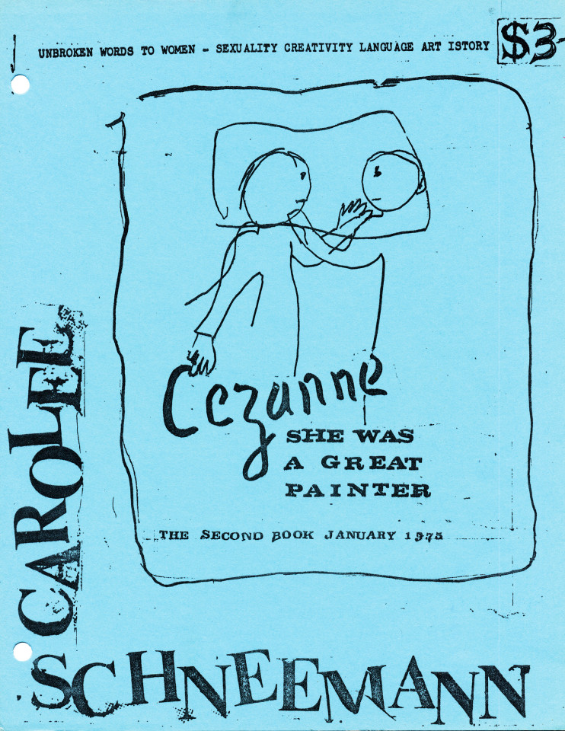
Carolee Schneemann, Cezanne She Was a Great Painter: The Second Book, January 1975, Unbroken Words to Women, Sexuality Creativity Language Art Istory

Slide 16
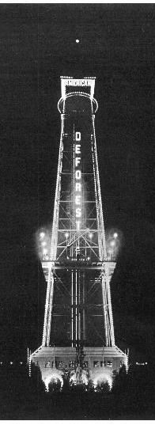
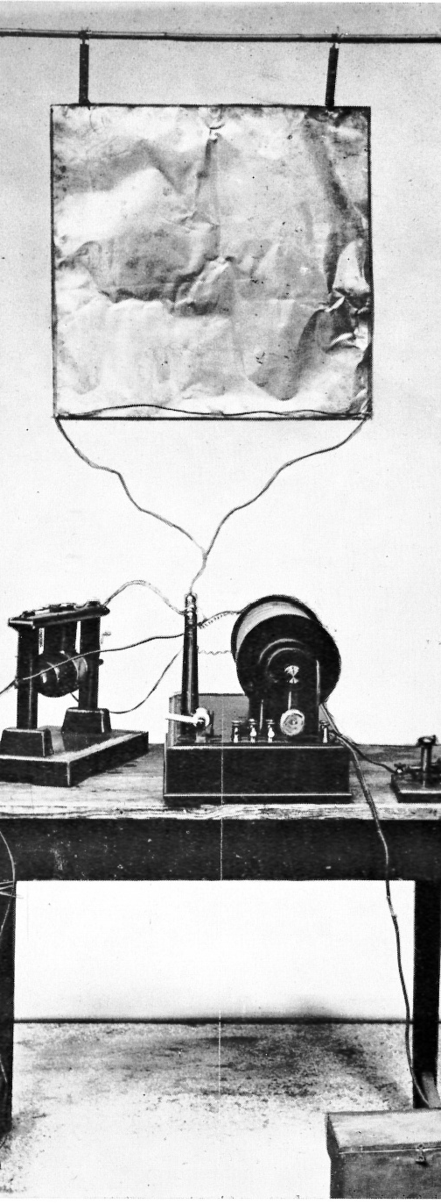
An Abbreviated History
of Broadcast Media
Late 1800s – WWI
Henrich Hertz (Germany) discovers electromagnetic waves, (1886-1889) an essential technology for future wireless communications. Hertz (Hz), the unit in measuring frequency, was named in his honor.
Guglielmo Marconi (Italy) developed the first wireless radio. (1901-1902)
Ambrose Fleming (UK) designed a radio transmitter with which the first transatlantic radio transmission was made in 1901.
Lee de Forest (US) made further inventions in radio technology.
Marconi and de Forest both formed transmission technology-based media companies.

Slide 17
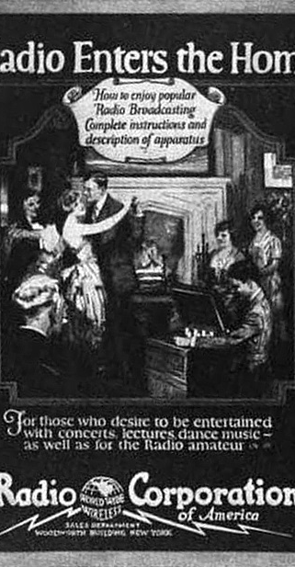
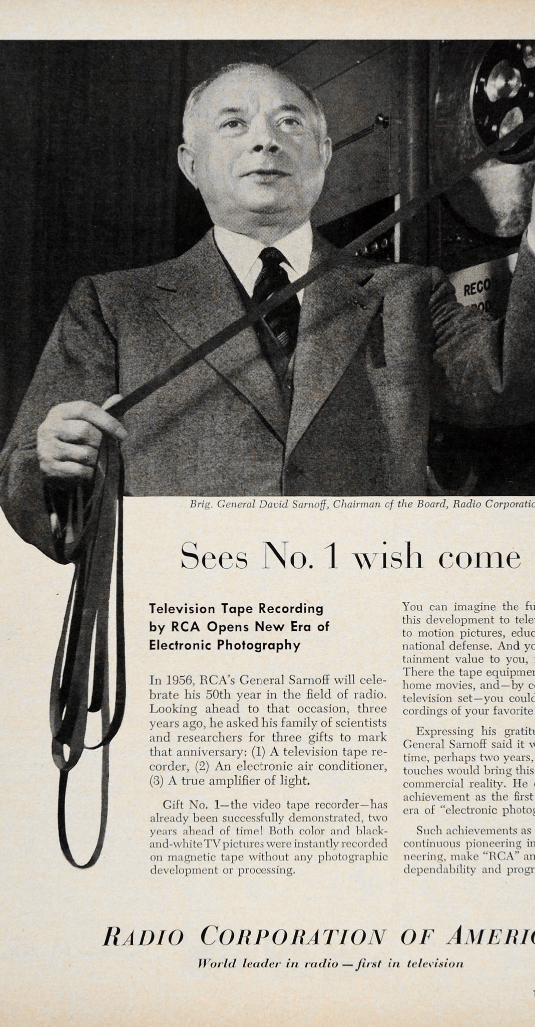
The Golden Age of Radio: early 1920s – 1950s
During WWI, the U.S. Government took over all radio holdings. Many technological advances were made, and the military backed the idea of a standardized monopoly.
Scientific American coined the term “Television” in 1907.
Radio Corporation of America (RCA) formed in 1919. RCA’s first year in selling radios, in 1922, earned $11,000,000. The second year earned $50,000,000.
The founder of RCA, David Sarnoff, also created the first television network, National Broadcasting Company, (NBC) in 1940.

Slide 18
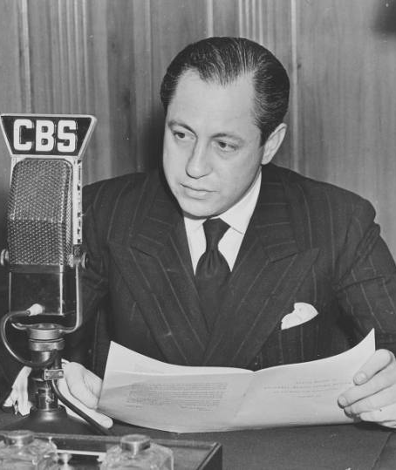
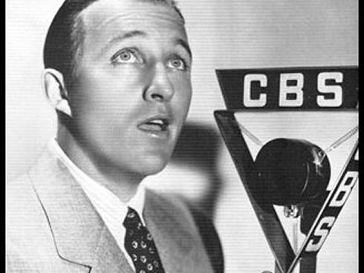
1940s
Columbia Broadcast System, (CBS) a media corporation competing with RCA, was led by William S. Paley from 1928 into the 1980s. CBS was initially focused on radio, moving into television in the 1940s.
In 1940, Peter Goldmark, the head of CBS Laboratories, invented a new television color system which rivals RCA’s system. FCC (Federal Communications Commission) sided with RCA in the subsequent dispute.
FCC ordered NBC to divest itself of one of its networks, which was sold for $8 million to Edward S. Noble, manufacturer of Life Savers candies, in 1943. Noble renamed the network American Broadcasting Company (ABC)
Both Paley and Sarnoff served in WWII. (1941-45) The war also led to refinement in video technology.
In 1946, 10,000 TV sets were sold, which is 0.02% of U.S. households. 200,000 sets were sold the following year, and by 1950, TV sets are in 9% of households, and 78% by 1955.

Slide 19
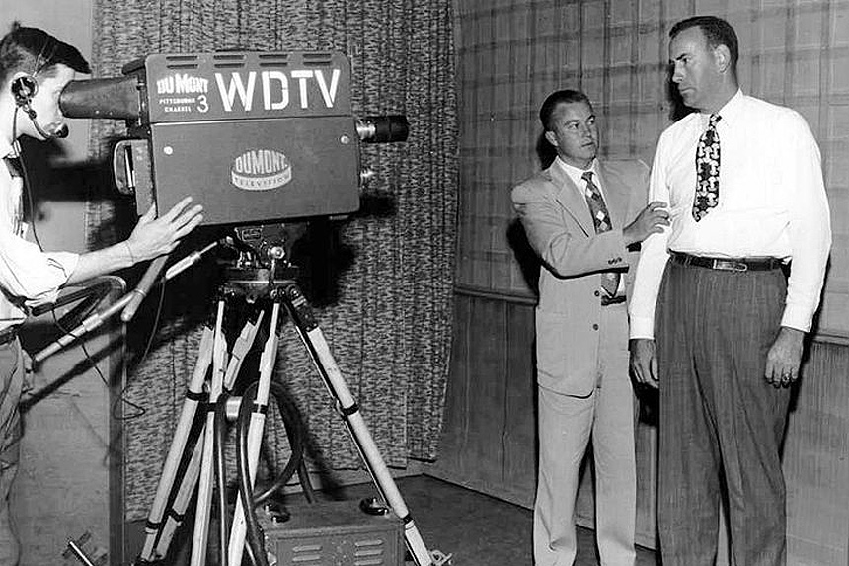
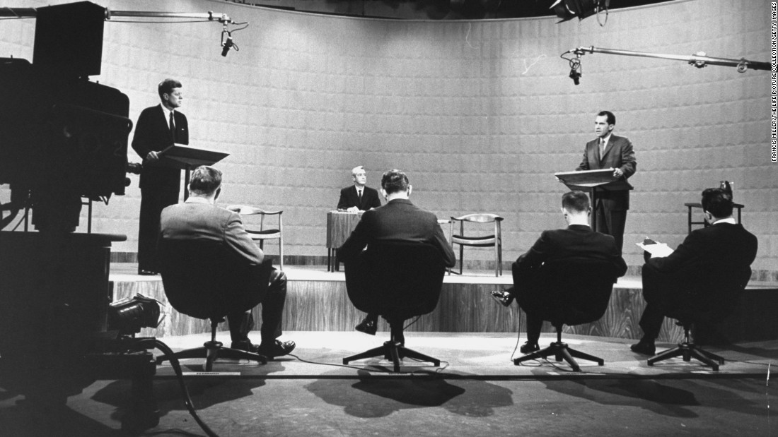
1950s & ‘60s
The birth of the videotape by Bing Crosby Enterprises (1951)
Late 1940s to the early ‘50s is considered the golden age of live television, (e.g. Ernie Kovacs) when production was centered in NYC.
TV stations in the 1950s: ABC, CBS, NBC (the Big Three); DMN (DuMont – the “forgotten network”).
Videotape technology was first developed with television stations such as CBS (1953-57).
The Nixon-Kennedy presidential debates in 1960 show the differing media representations, between radio and television.
Sony Corporation in Japan produced the first portable video reel-to-reel deck in 1965, and the first color video recorder in 1969.
CBS introduced the first video cassette in 1968.

Slide 20
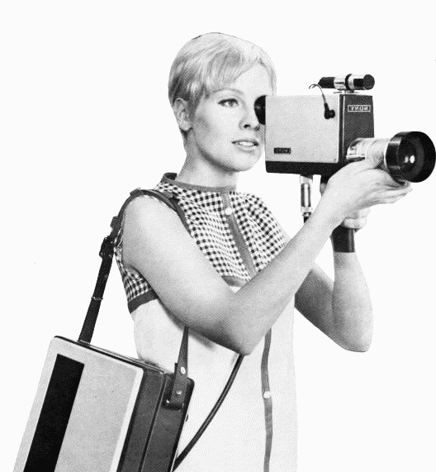
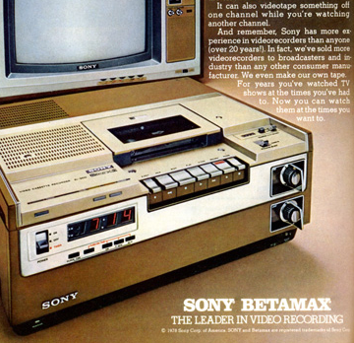
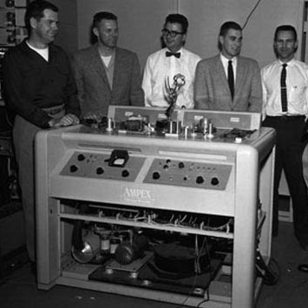
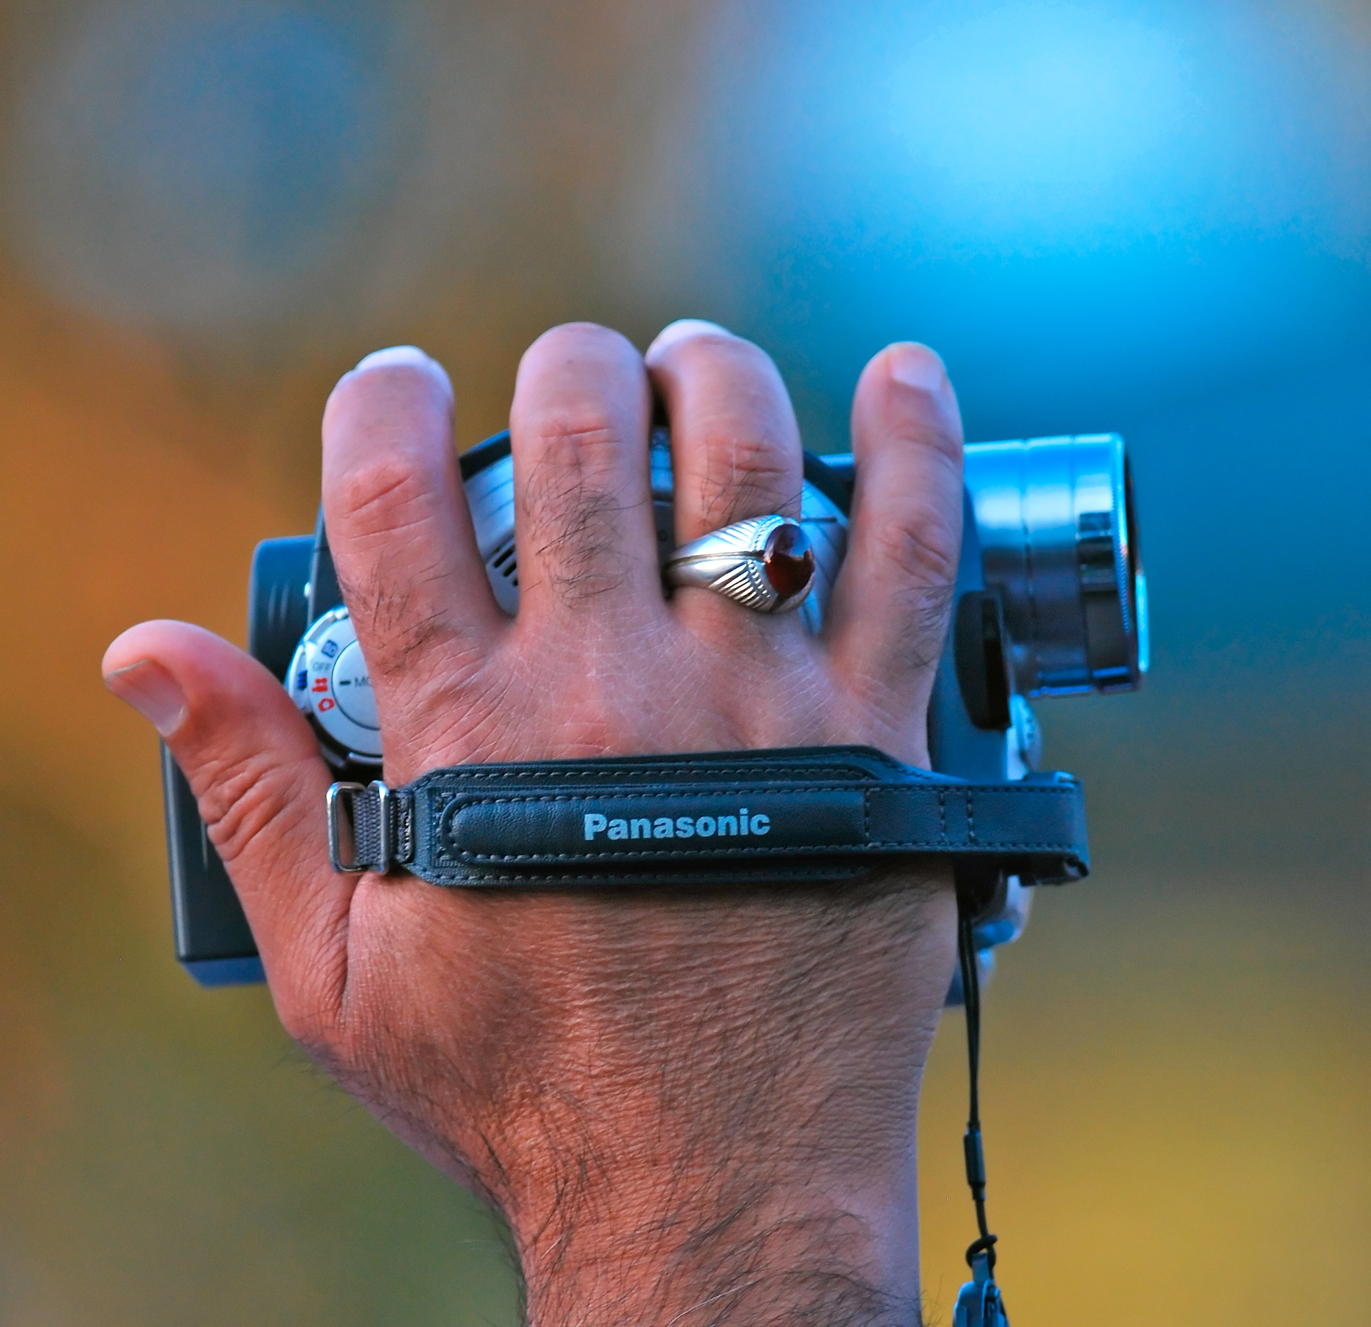
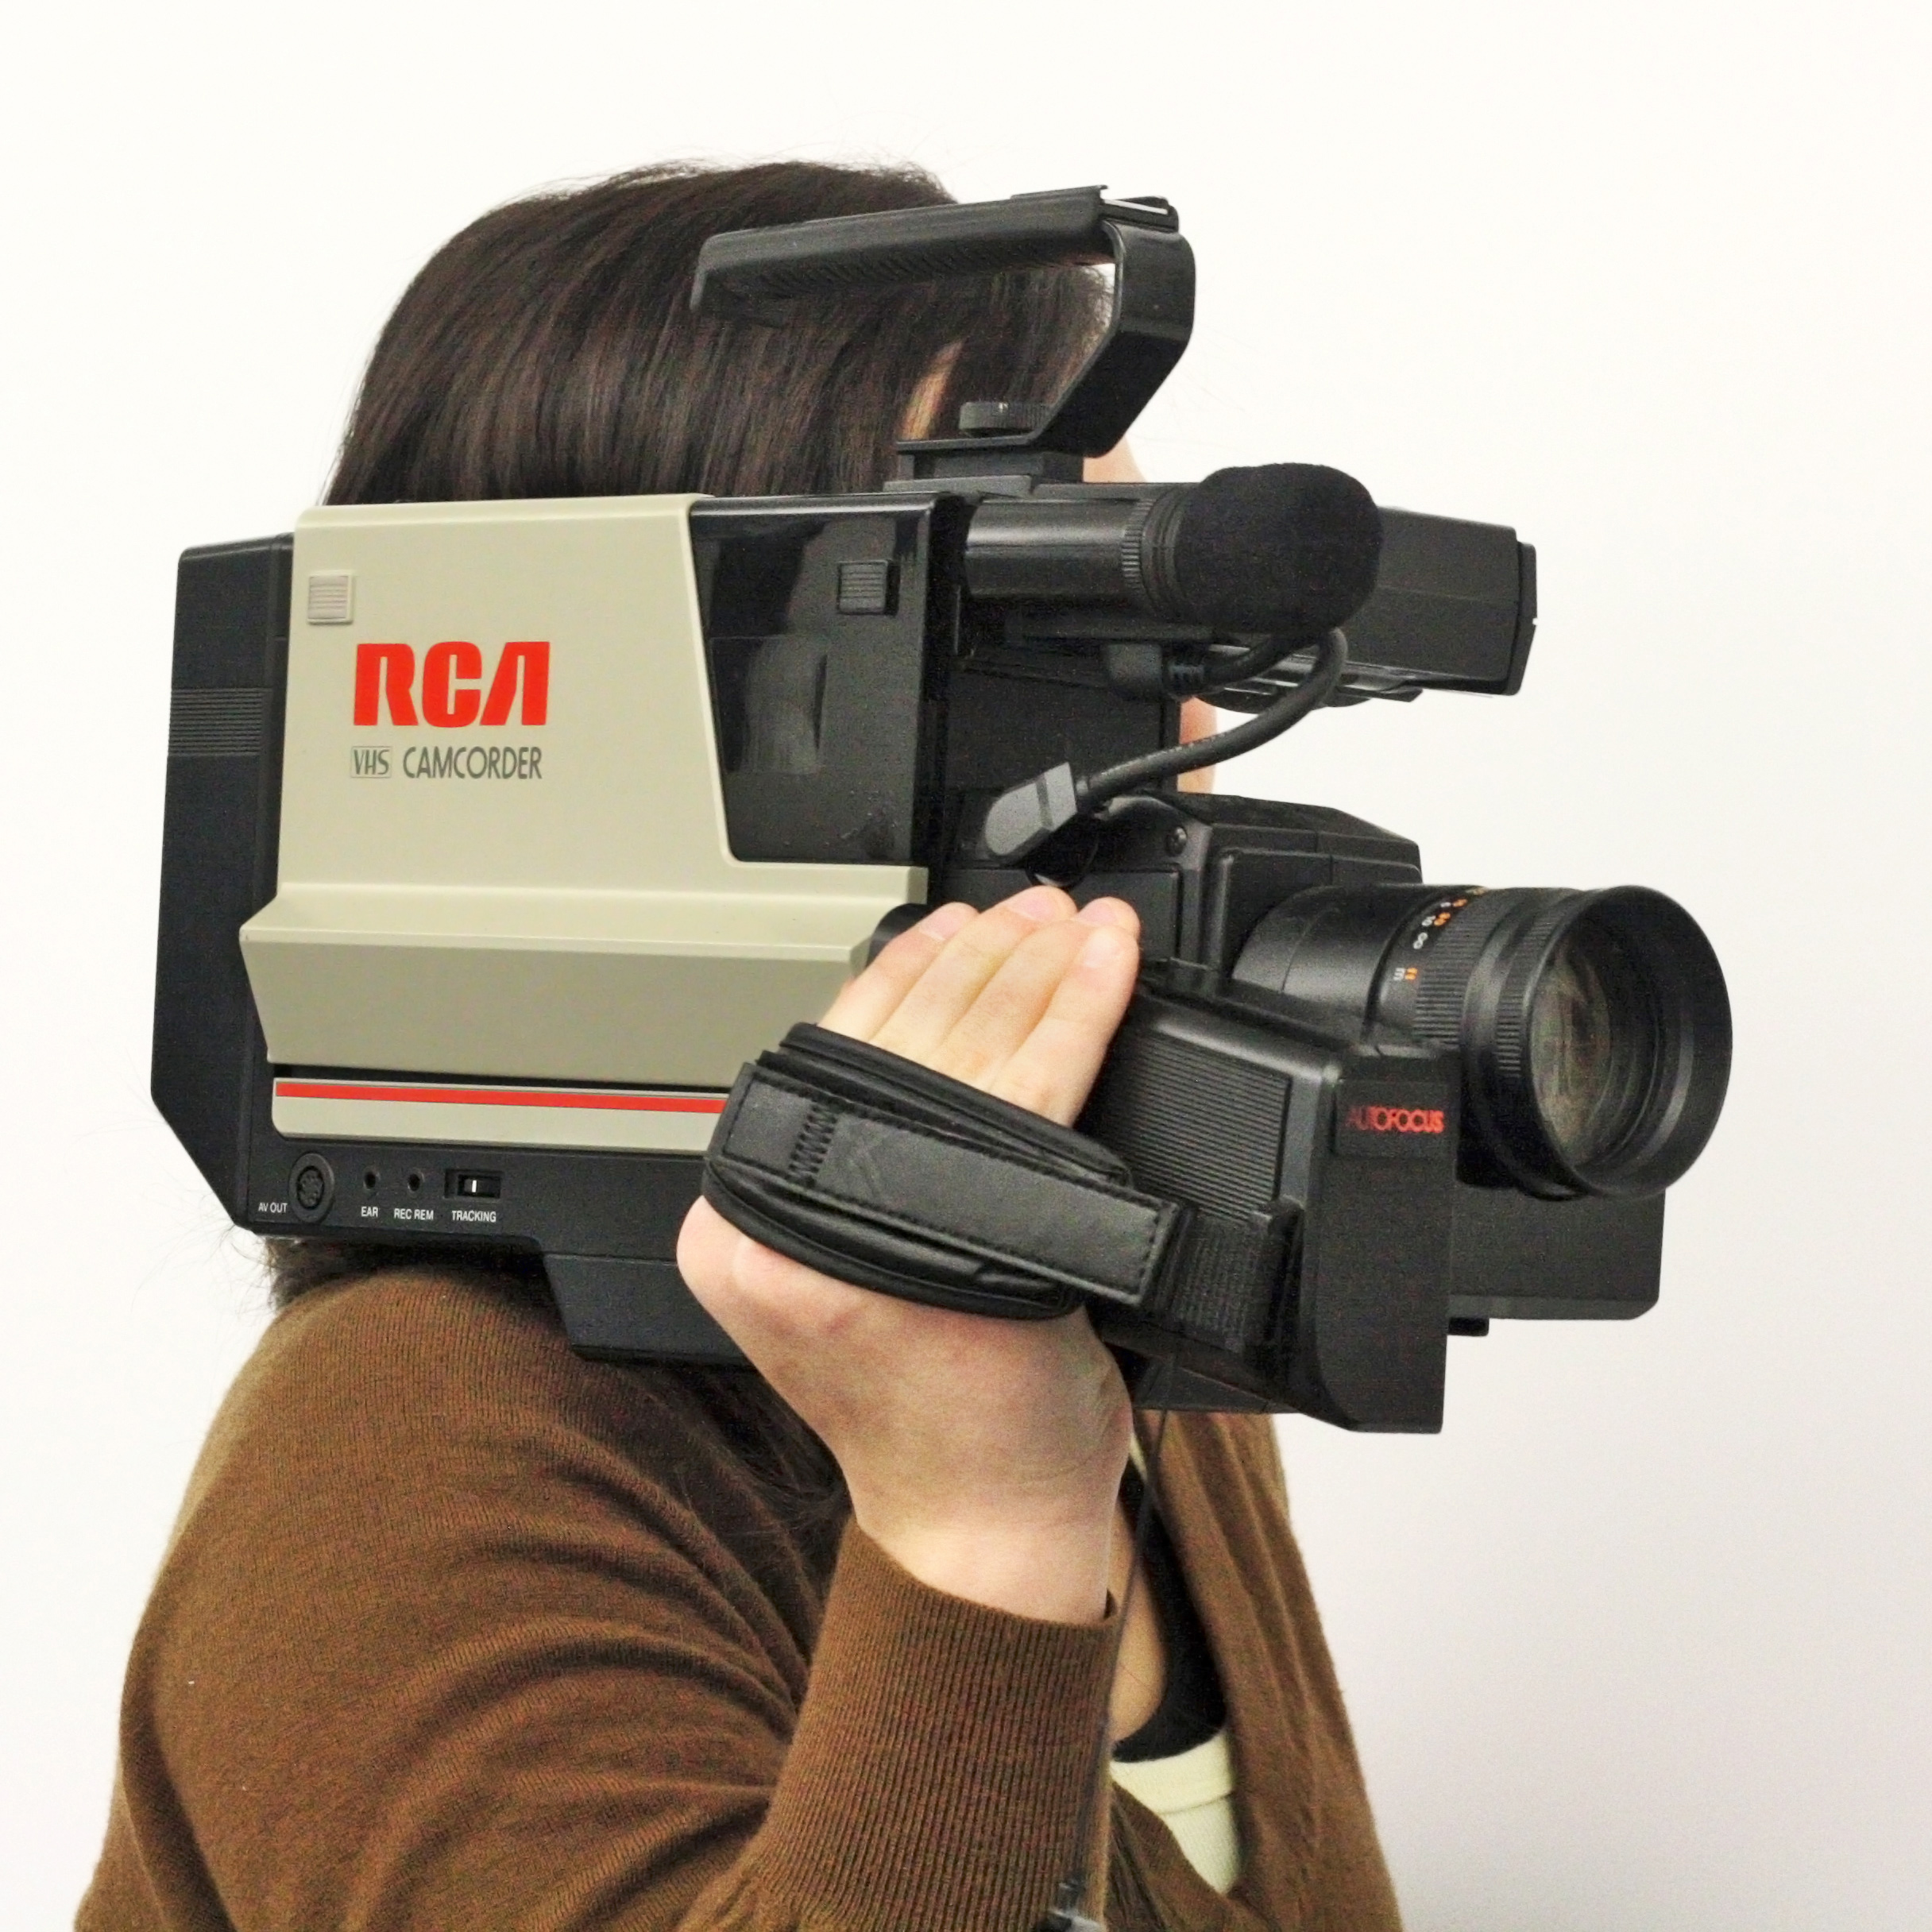
1970s & ‘80s
Sarnoff retired from RCA in 1970 and died in ‘71.
Paley waived CBS’s mandatory retirement in 1966 and remained chairman of the board till 1983. He returned in 1987 and died in 1990.
The rise of ABC and the youth demographic for advertisers in the 1970s.
The advent of cable, satellite, and videotape rental markets in the 1980s.

Slide 21
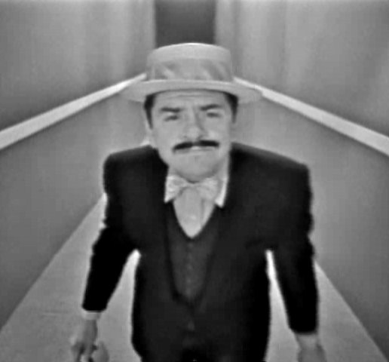
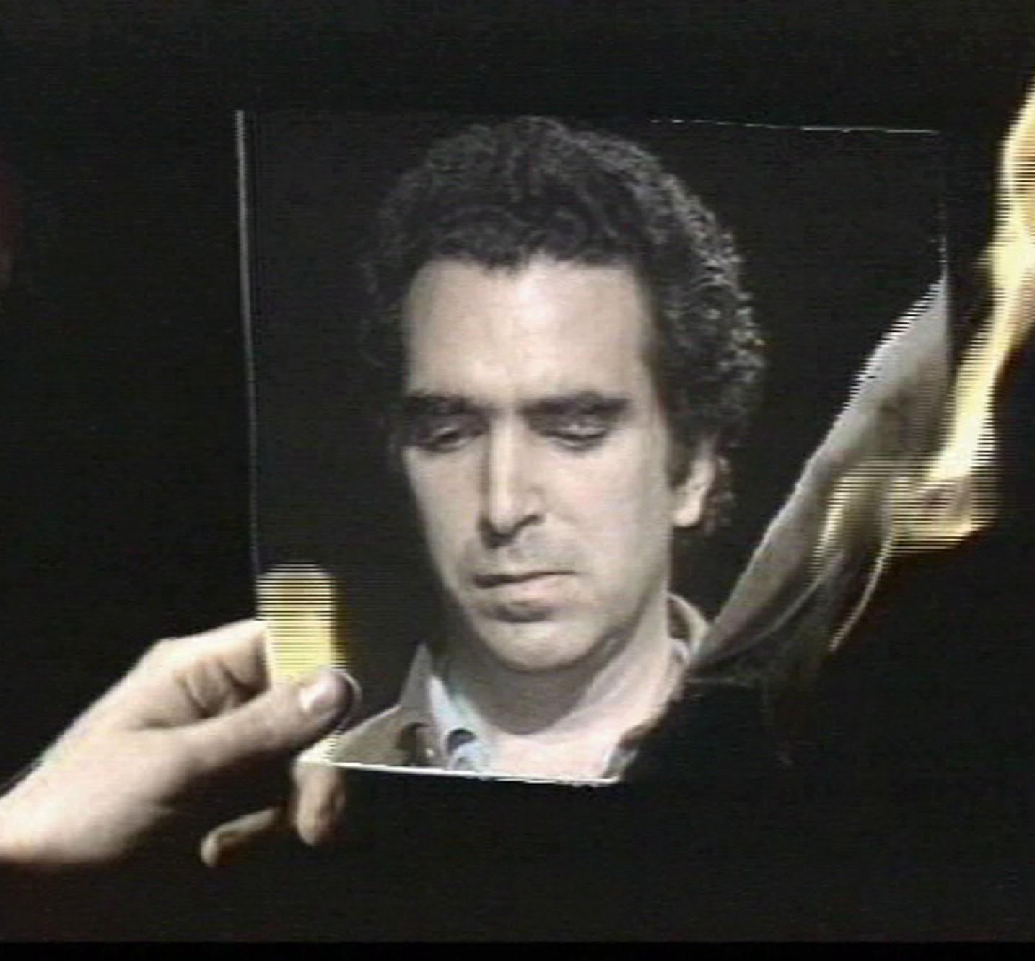
Eugene (1961) Dir. Ernie Kovacs
Three Transitions (1973) Dir. Peter Campus
Comparative Analysis:

Slide 22
Eugene (1961) Dir. Ernie Kovacs
Three Transitions (1973) Dir. Peter Campus
Comparative Analysis: What do these two videos show and tell us about video technology?

Slide 23
Eugene (1961) Dir. Ernie Kovacs
Three Transitions (1973) Dir. Peter Campus
Comparative Analysis:

Slide 24
Eugene (1961) Dir. Ernie Kovacs
Three Transitions (1973) Dir. Peter Campus
Comparative Analysis: What do these two videos show and tell us about the relationship between television and early video art in the U.S.?

Slide 25
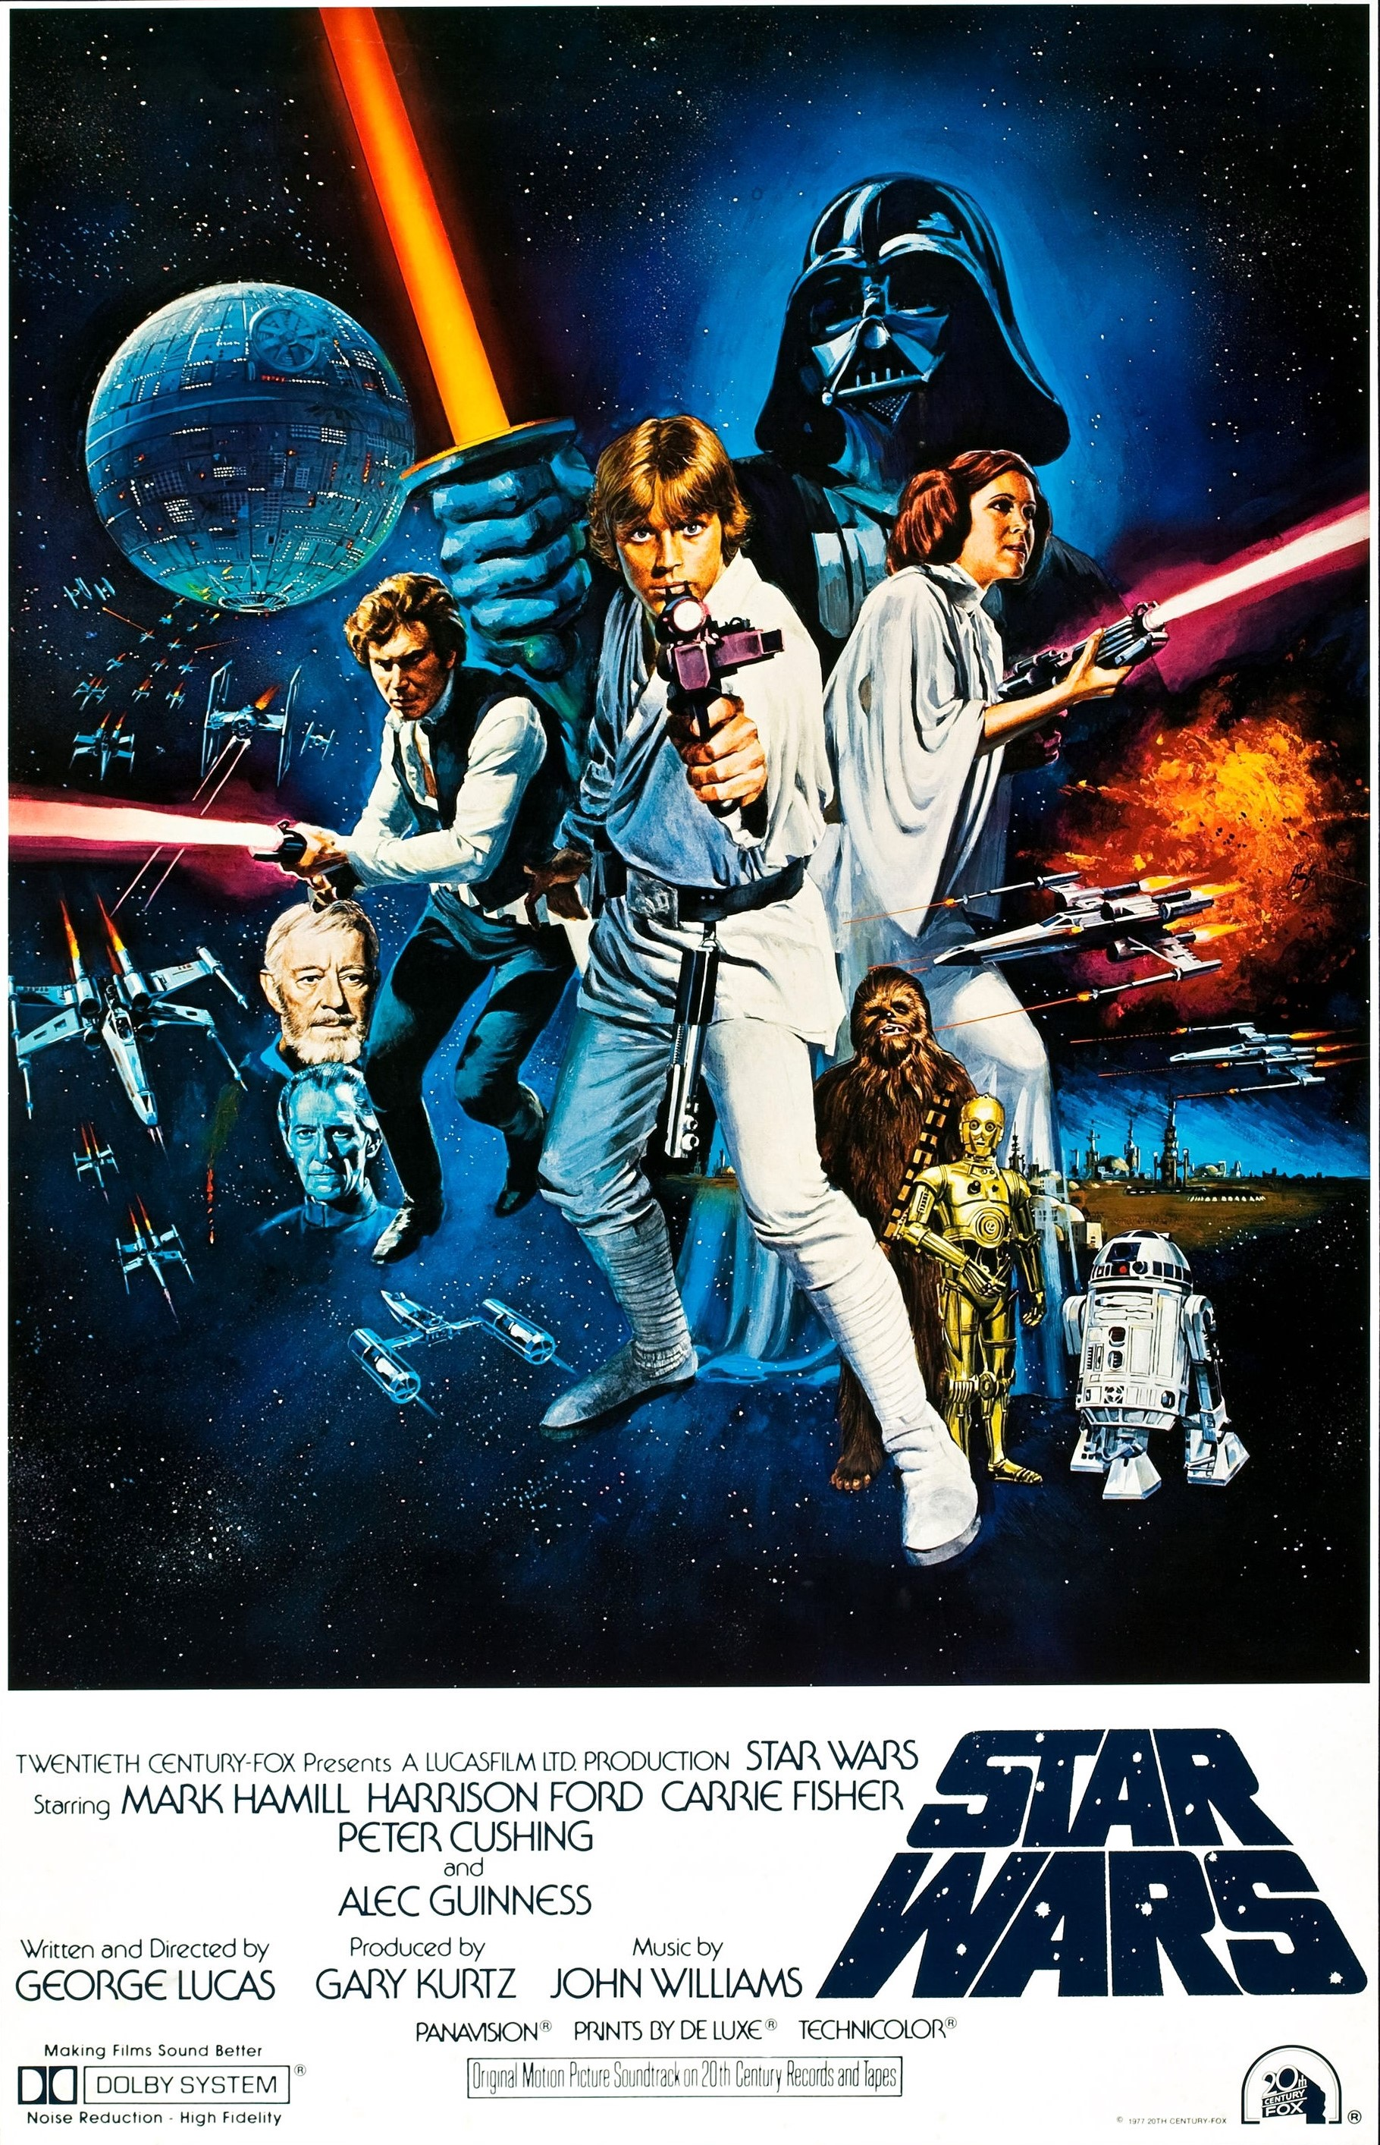
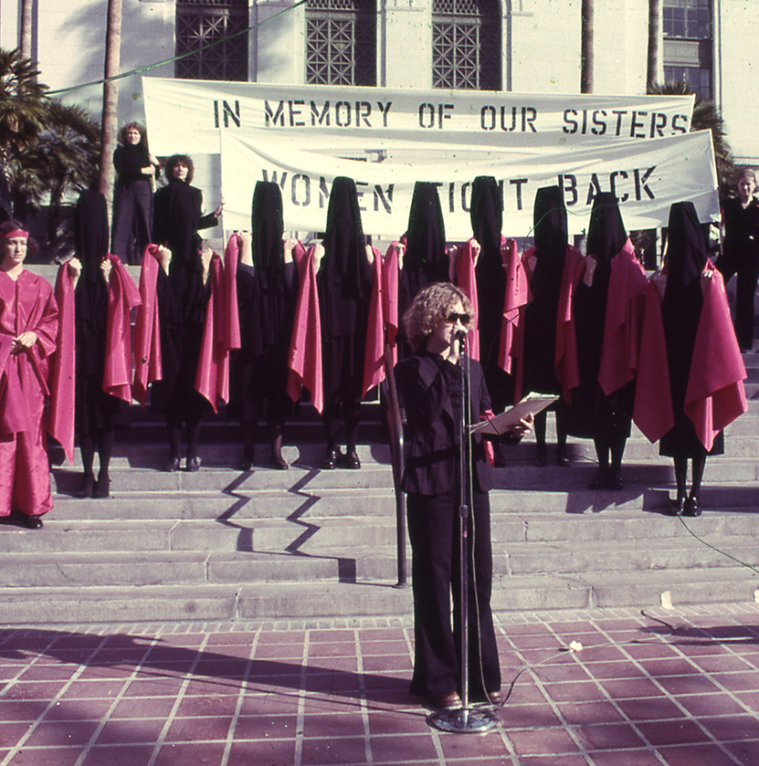
The 1970s – the “Me” Decade?

Slide 26
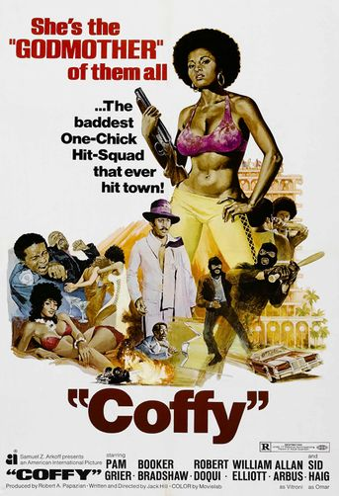
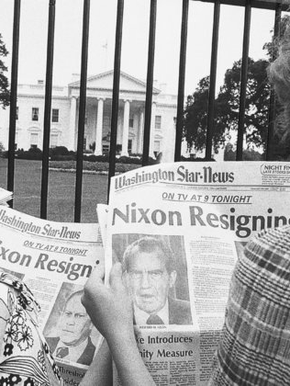
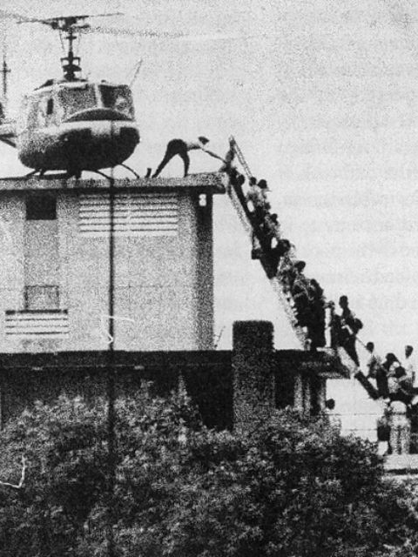
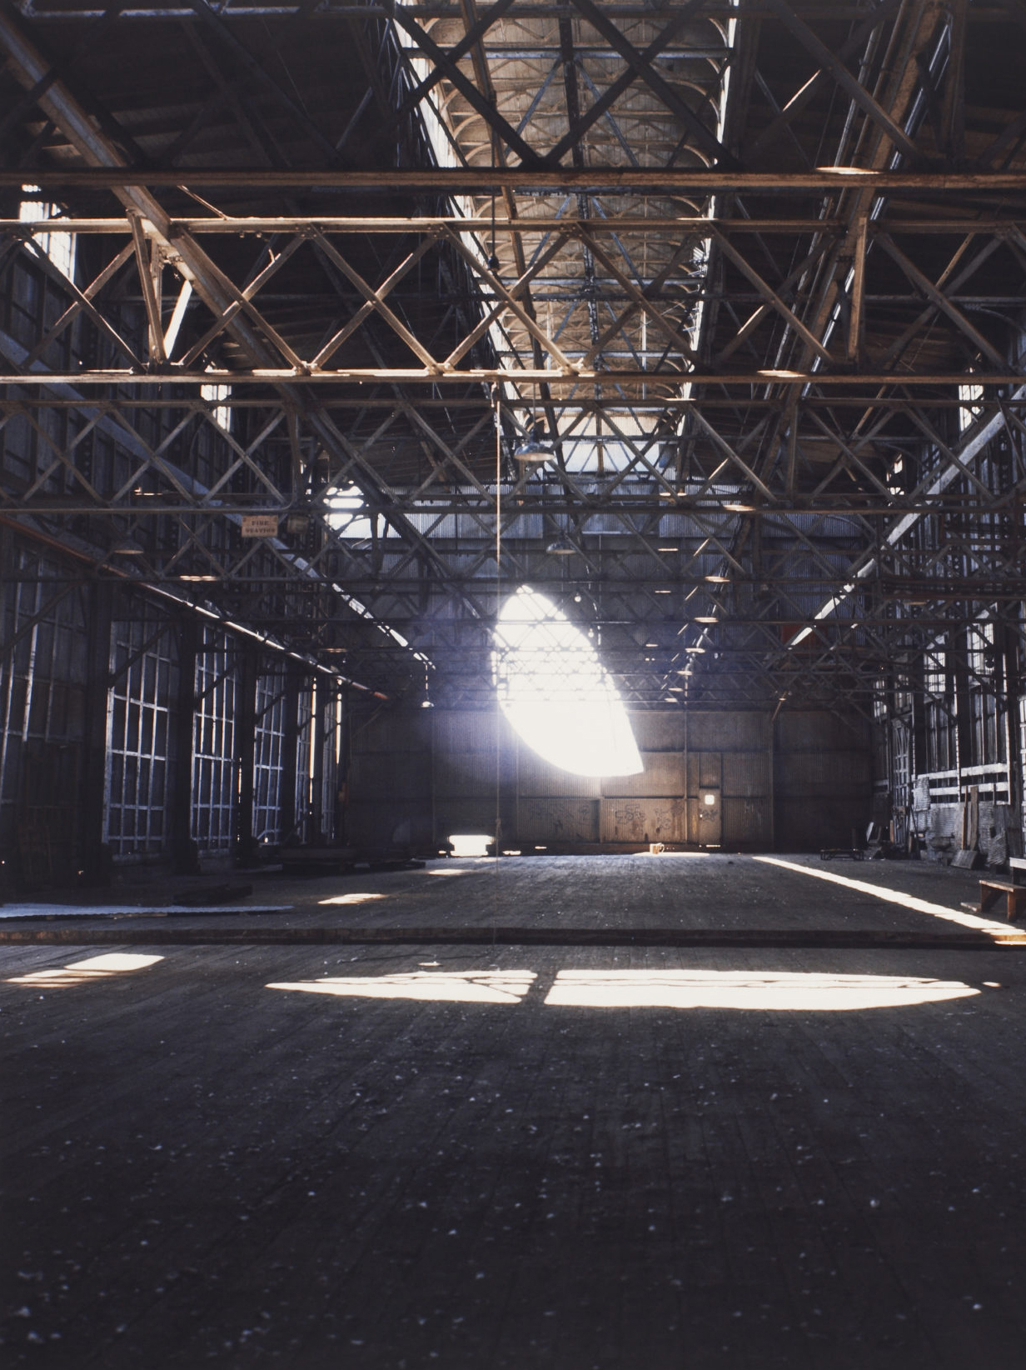

Protest movements from the ‘60s continued –including gay liberation, women’s movement (second wave feminism), Asian American Movement, and others.
Late 1960s – early ‘70s: power to the people, anti-discrimination legislation, affirmative action, ERA.
Watergate scandal – Nixon resigned on August 8, 1974.
April 30, 1975 – US evacuation out of its embassy in Saigon; the end of the Vietnam War.
Rise of the modern ”blockbuster” (e.g. Star Wars, 1977) as well as independent and genre films (e.g. Blaxploitation).
Anti-establishment in the art world - conceptual art, body art, performance art, happenings, and other non-traditional forms.

Slide 27
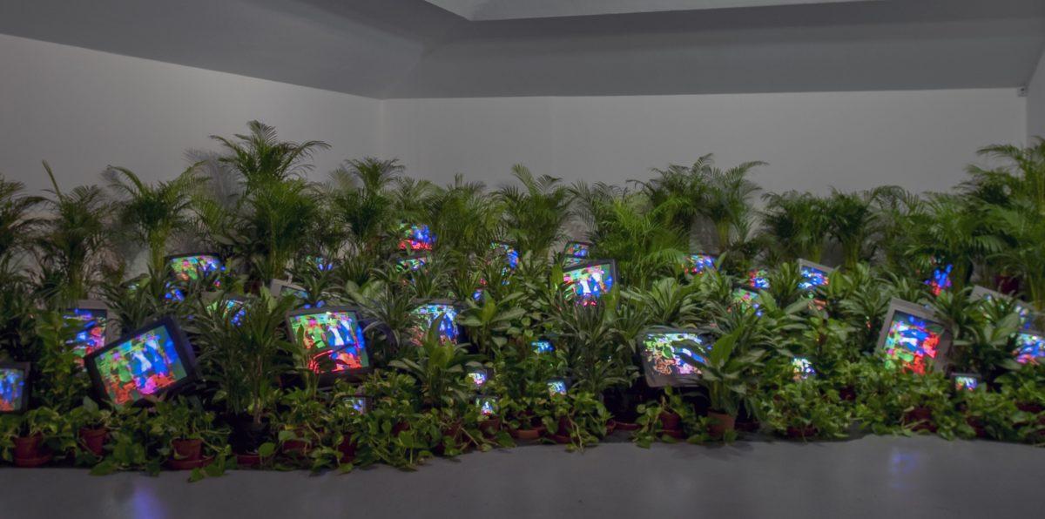
Early U.S. Video Art:
Based on your reading of the articles by Paik and Ross, as well as your observations of excerpts from Paik’s early work, how would you characterize early video art in the U.S.?
Nam June Paik, TV Garden, 1974-77

Slide 28
Early U.S. Video Art:
Nam June Paik, TV Garden, 1974-77

Slide 29
Early U.S. Video Art:
Countercultural
Nam June Paik, TV Garden, 1974-77

Slide 30
Early U.S. Video Art:
Countercultural
Interdisciplinary (“radical pluralism”)
Nam June Paik, TV Garden, 1974-77

Slide 31
Early U.S. Video Art:
Countercultural
Interdisciplinary (“radical pluralism”)
Experimental
Nam June Paik, TV Garden, 1974-77

Slide 32
Early U.S. Video Art:
Countercultural
Interdisciplinary (“radical pluralism”)
Experimental
  New technologies – satellite broadcast, video synthesizers
Nam June Paik, TV Garden, 1974-77

Slide 33
Early U.S. Video Art:
Countercultural
Interdisciplinary (“radical pluralism”)
Experimental
  New technologies – satellite broadcast, video synthesizers
Critical
Nam June Paik, TV Garden, 1974-77

Slide 34
Early U.S. Video Art:
Countercultural
Interdisciplinary (“radical pluralism”)
Experimental
  New technologies – satellite broadcast, video synthesizers
Critical
  Engages with popular culture (e.g. network TV)
Nam June Paik, TV Garden, 1974-77

Slide 35
Early U.S. Video Art:
Participatory
Nam June Paik, TV Garden, 1974-77

Slide 36
Early U.S. Video Art:
Participatory
  Both individual artists as well as collectives
Nam June Paik, TV Garden, 1974-77

Slide 37
Early U.S. Video Art:
Participatory
  Both individual artists as well as collectives
  Other artists and audience often a part of the work
Nam June Paik, TV Garden, 1974-77

Slide 38
Early U.S. Video Art:
Participatory
  Both individual artists as well as collectives
  Other artists and audience often a part of the work
Video as idea, document, sculpture, installation, information
Nam June Paik, TV Garden, 1974-77

Slide 39
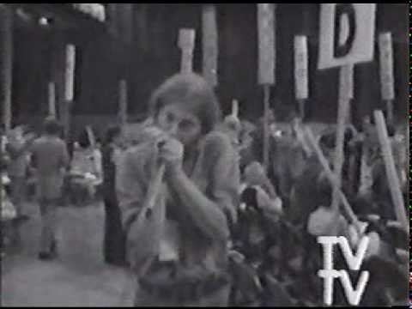
Video as Counterculture:
The class will divide into two groups
Each group will discuss, analyze, and identify the thesis statement (or main argument) from the Boyle and Rosler readings, respectively.
Then discuss the thesis statement your group as identified in relationship to one of these videos: Four More Years (Boyle) and Media Burn (Rosler)
Top Value Television, Four More Years, 1972

Slide 40
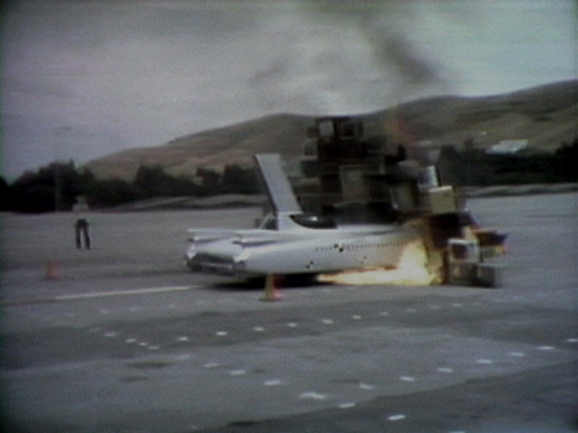
Video as Counterculture:
In your discussion, consider the following:
Does what you observe and understand in your video support the thesis statement?
Are there ways the video challenge or complicate the thesis argument?
Conversely, does the thesis or the reading inform, change, or otherwise inform your understanding of the video?
Ant Farm & T.R. Uthco, Media Burn, 1976

Slide 41
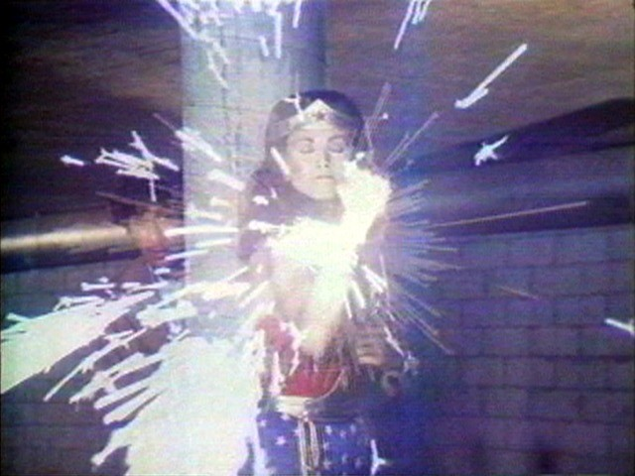
Watch:
Dara Birnbaum, Technology / Transformation: Wonder Woman, 1978

Slide 42
Video as Counterculture:
Does Rosler or Boyle’s thesis argument extend to this work?

Slide 43
Video as Counterculture:
Does Rosler or Boyle’s thesis argument extend to this work?
If so, why?

Slide 44
Video as Counterculture:
Does Rosler or Boyle’s thesis argument extend to this work?
If so, why?
If not, why not?

Slide 45
Video as Counterculture:
Does Rosler or Boyle’s thesis argument extend to this work?
If so, why?
If not, why not?
How about any of the ideas in the Ross or Paik reading?

