Slide 1
VIDEO & DIVERSITY
Week 6: TV Culture
& Early Video Art

Slide 2
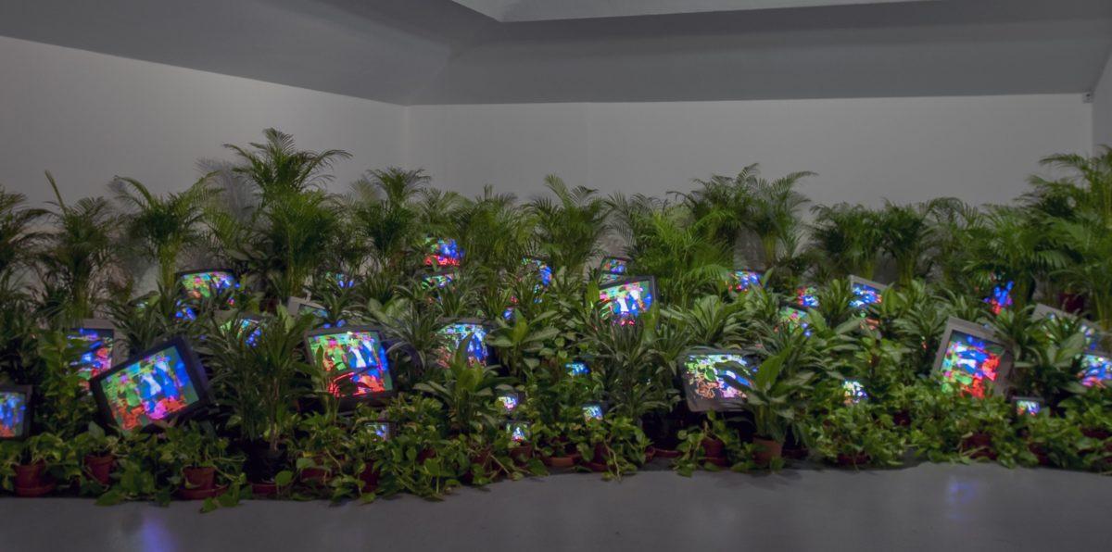
Early U.S. Video Art:
Based on your reading of the articles by Paik and Ross, as well as your observations of excerpts from Paik’s early work, how would you characterize early video art in the U.S.?
Nam June Paik, TV Garden, 1974-77

Slide 3
Early U.S. Video Art:
Nam June Paik, TV Garden, 1974-77

Slide 4
Early U.S. Video Art:
Countercultural
Nam June Paik, TV Garden, 1974-77

Slide 5
Early U.S. Video Art:
Countercultural
Interdisciplinary (“radical pluralism”)
Nam June Paik, TV Garden, 1974-77

Slide 6
Early U.S. Video Art:
Countercultural
Interdisciplinary (“radical pluralism”)
Experimental
Nam June Paik, TV Garden, 1974-77

Slide 7
Early U.S. Video Art:
Countercultural
Interdisciplinary (“radical pluralism”)
Experimental
  New technologies – satellite broadcast, video synthesizers
Nam June Paik, TV Garden, 1974-77

Slide 8
Early U.S. Video Art:
Countercultural
Interdisciplinary (“radical pluralism”)
Experimental
  New technologies – satellite broadcast, video synthesizers
Critical
Nam June Paik, TV Garden, 1974-77

Slide 9
Early U.S. Video Art:
Countercultural
Interdisciplinary (“radical pluralism”)
Experimental
  New technologies – satellite broadcast, video synthesizers
Critical
  Engages with popular culture (e.g. network TV)
Nam June Paik, TV Garden, 1974-77

Slide 10
Early U.S. Video Art:
Participatory
Nam June Paik, TV Garden, 1974-77

Slide 11
Early U.S. Video Art:
Participatory
  Both individual artists as well as collectives
Nam June Paik, TV Garden, 1974-77

Slide 12
Early U.S. Video Art:
Participatory
  Both individual artists as well as collectives
  Other artists and audience often a part of the work
Nam June Paik, TV Garden, 1974-77

Slide 13
Early U.S. Video Art:
Participatory
  Both individual artists as well as collectives
  Other artists and audience often a part of the work
Video as idea, document, sculpture, installation, information
Nam June Paik, TV Garden, 1974-77

Slide 14
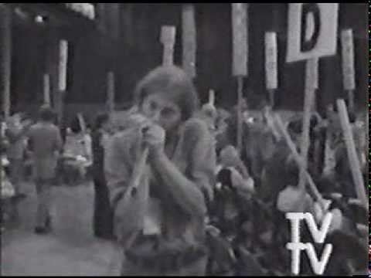
Video as Counterculture:
The class will divide into two groups
Each group will discuss, analyze, and identify the thesis statement (or main argument) from the Boyle and Rosler readings, respectively.
Then discuss the thesis statement your group as identified in relationship to one of these videos: Four More Years (Boyle) and Media Burn (Rosler)
Top Value Television, Four More Years, 1972

Slide 15
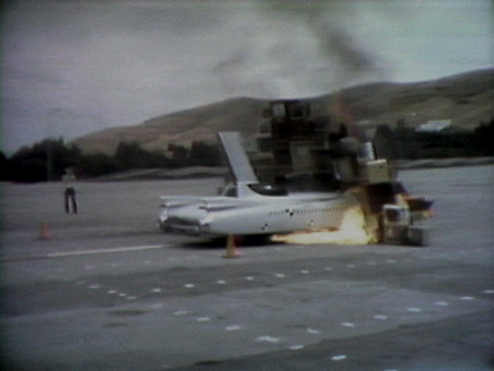
Video as Counterculture:
In your discussion, consider the following:
Does what you observe and understand in your video support the thesis statement?
Are there ways the video challenge or complicate the thesis argument?
Conversely, does the thesis or the reading inform, change, or otherwise inform your understanding of the video?
Ant Farm & T.R. Uthco, Media Burn, 1976

Slide 16
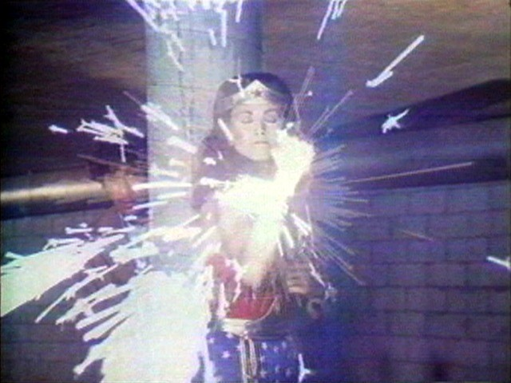
Watch:
Dara Birnbaum, Technology / Transformation: Wonder Woman, 1978

Slide 17
Video as Counterculture:
Does Rosler or Boyle’s thesis argument extend to this work?

Slide 18
Video as Counterculture:
Does Rosler or Boyle’s thesis argument extend to this work?
If so, why?

Slide 19
Video as Counterculture:
Does Rosler or Boyle’s thesis argument extend to this work?
If so, why?
If not, why not?

Slide 20
Video as Counterculture:
Does Rosler or Boyle’s thesis argument extend to this work?
If so, why?
If not, why not?
How about any of the ideas in the Ross or Paik reading?

Slide 21
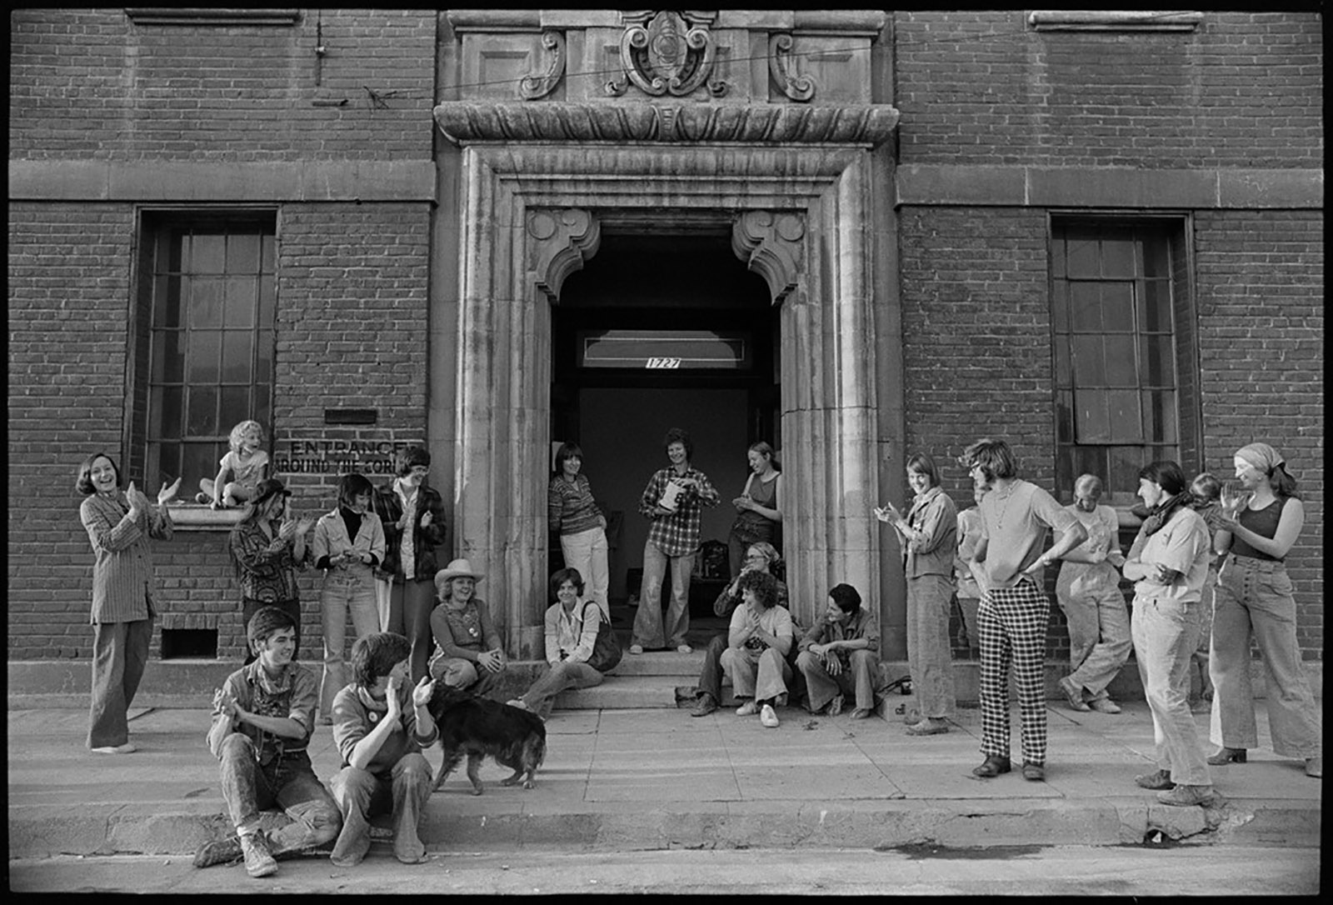
Feminist Video Art
in the 1970s
Women’s Building, Los Angeles, 1975

Slide 22
Feminist Video Art
in the 1970s
Vertical Roll (1972) by Joan Jonas
Always Love Your Man by Carla DeVito (1975)
Take Off by Susan Mogul (1974)
Vital Statistics of A Citizen, Simply Obtained by Martha Rosler (1977)

Slide 23
Feminist Video Art
in the 1970s
Working together, each group will create an introductory paragraph, with a clearly identifiable thesis statement, and summaries of 2-3 supporting arguments (i.e. the introduction for your second essay)

Slide 24
Feminist Video Art
in the 1970s
Your thesis and supporting arguments should reference at least one of the class readings for this week and its thesis, and use the two videos you all watched to construct your thesis as well as supporting arguments.

Slide 25
Feminist Video Art
in the 1970s
Additionally, your paragraph should incorporate, in a meaningful way, at least two of the following keywords and phrases: collective, consciousness-raising, giving voice to, oral history (or herstory), performance, self-reflexivity, social construction, the personal is political

Slide 26
Feminist Video Art
in the 1970s
Your paragraph will be read and discussed in class.

