Slide 1
VIDEO & DIVERSITY
Week 8: 1980s,
Public Access & Video Activism

Slide 2
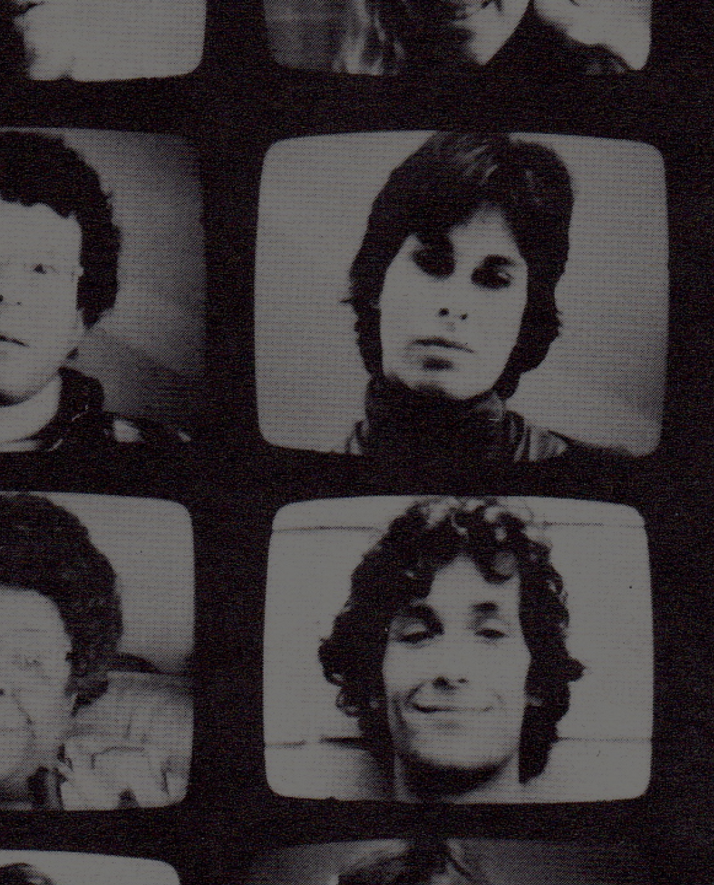
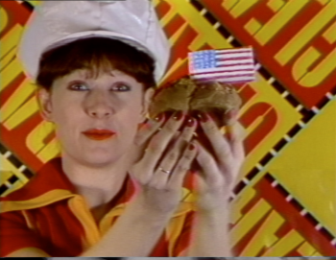
Comparative Analysis
Love Tapes (1971-2001)
Dir. Wendy Clarke
Made for TV (1984) Dir. Tom Rubinitz & Ann Magnuson

Slide 3
Comparative Analysis
Christine Tamblyn writes: “Video’s lack of an established tradition undoubtedly promotes experimentation, and its multichannel sound and image transcription predisposes artists to produce layered work.” (p. 405)
How do these two videos demonstrate or challenge her observation?

Slide 4
Comparative Analysis
Martha Gever argues: “Many women artists recognize that the project of counteracting descriptions of ‘reality’ that routinely objectify women would not be effective if the concept of ‘reality’ itself was not overhauled. That meant initiating a thorough and specific examination of the ways in which ‘real’ events and people were represented.” (p. 230)

Slide 5
Comparative Analysis
Do Clarke or Rubinitz and Magnuson’s videotapes support Gever’s argument? If so, in what ways?
How about the lived experiences and media practices of Kate Horsfield and Susan Mogul, both of whom participated in the Feminist video art movement?

Slide 6
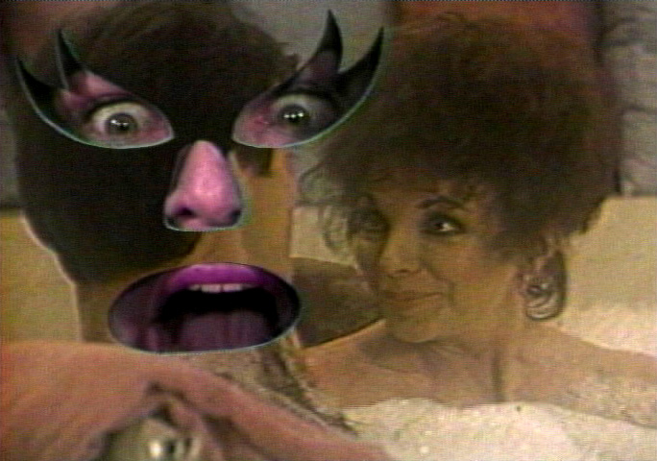
Comparative Analysis
Joan Does Dynasty (1986) Dir. Joan Braderman

Slide 7
Comparative Analysis
How do the videos, criticism and discourse, as well as lived experiences of U.S. feminist video art and artists support or challenge bell hooks’s definition of feminism?
What about other ideas (e.g. “the personal is political”, social construction, consciousness raising, performance, parody and humor) from this week’s reading on feminism?

Slide 8
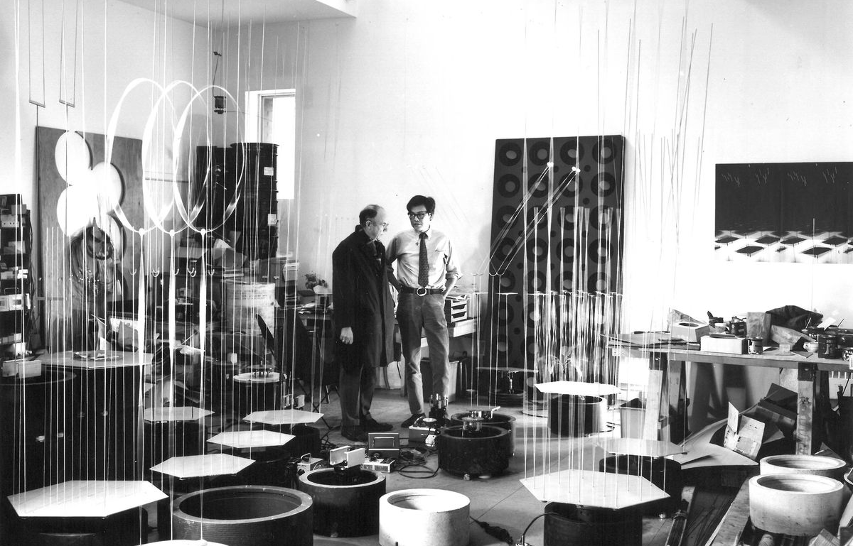
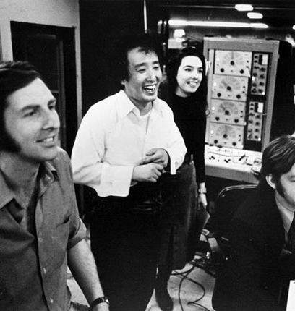
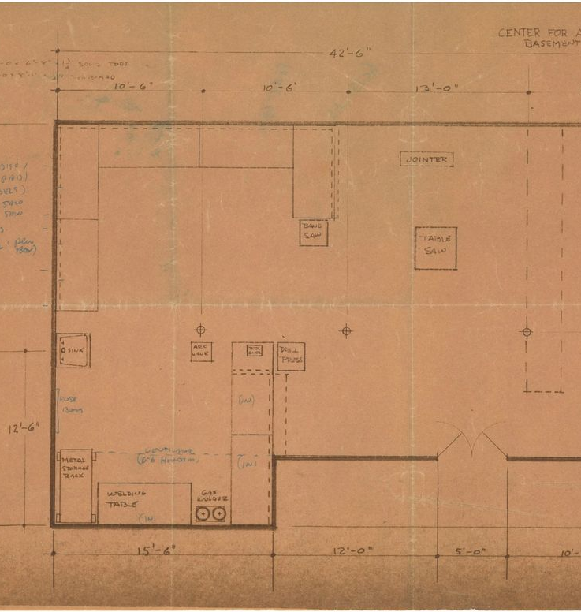
Video Art & Public Television
1960s:
Portable video equipment became available commercially
CPB (Corporation for Public Broadcast) established by Congress in 1967.
PBS (Public Broadcasting Service) in 1969.
WGBH (Boston) + CAVS (Center for Advanced Visual Studies) at MIT
KQED (west coast center) NCET (National Center for Experiments in Television

Slide 9
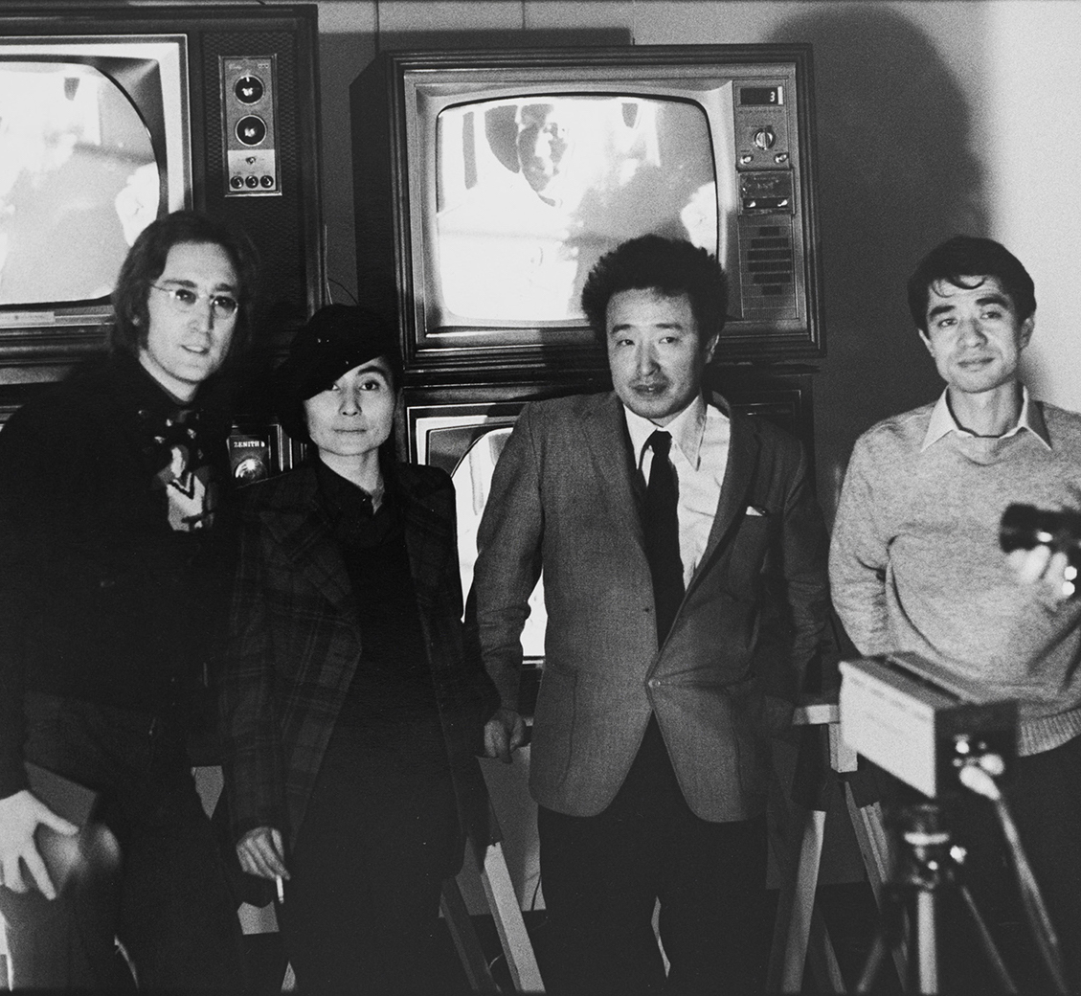
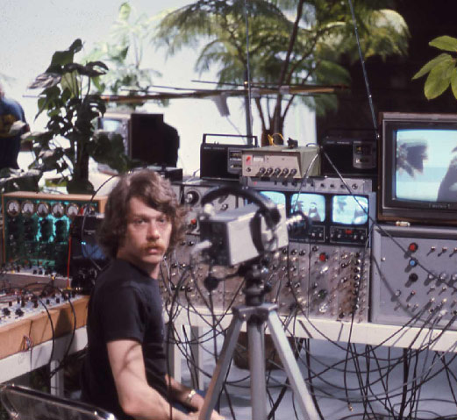
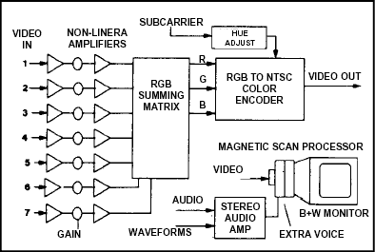
Video Art & Public Television
1970s:
Paik developed the Paik-Abe video synthesizer. Public funding decreased
1972 – The Very First On-The-Air Half-Inch Videotape Festival.
TV Laboratory at WNET
1974 – WGBH New Television Workshop
1974-1982 Artists Showcase

Slide 10
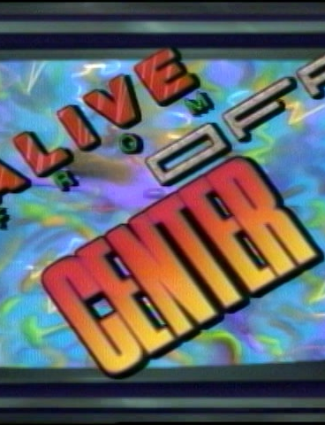
Video Art & Public Television
1980s:
3 public TV programs were developed to broadcast video art
Alive From Off Center (PBS)
New Television (WNET)
The Independents (The Learning Channel)

Slide 11
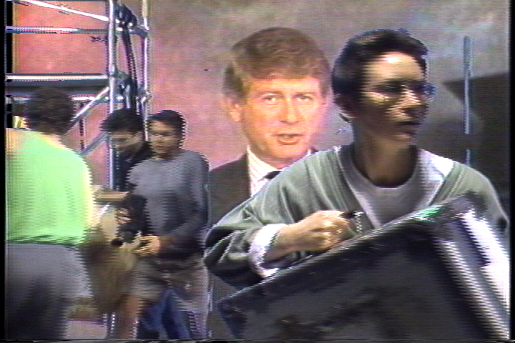
Paper Tiger Television
Unpacking The Revolution in A Box (1989) PTTV Ep.227

Slide 12
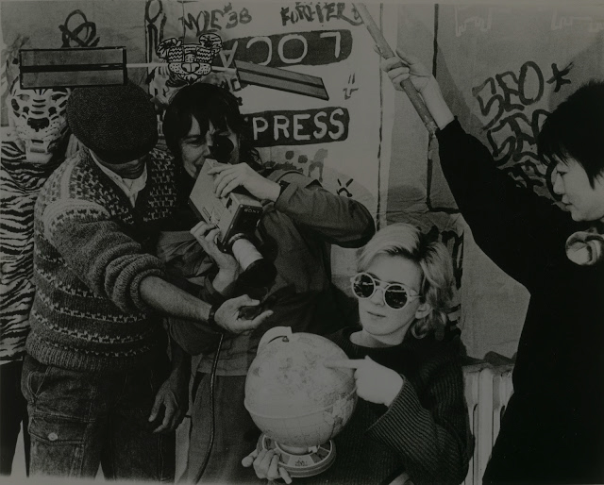
What is Video Activism?

Slide 13
What is Video Activism?
What is this “video revolution” that both Dan Rabbit and Ted Koppel both referred to? Are they the same thing?
What developments in video technology and marketing led to this “revolution”?

Slide 14

What is Video Activism?
According to Thomas Harding, what are the reasons for recent (he was writing in the late 1990s/early 2000s) insurgence of video activism?

Slide 15
What is Video Activism?
According to Thomas Harding, what are the reasons for recent (he was writing in the late 1990s/early 2000s) insurgence of video activism?
    A new wave of activism

Slide 16
What is Video Activism?
According to Thomas Harding, what are the reasons for recent (he was writing in the late 1990s/early 2000s) insurgence of video activism?
    A new wave of activism
    The failure of mainstream media to adequately cover social and environmental justice movements

Slide 17
What is Video Activism?
According to Thomas Harding, what are the reasons for recent (he was writing in the late 1990s/early 2000s) insurgence of video activism?
    A new wave of activism
    The failure of mainstream media to adequately cover social and environmental justice movements
    Improvement and availability of video equipment

Slide 18

What is Video Activism?
How does PTTV’s work compare to earlier examples of activist videos we watched in class? (e.g. Four More Years)

Slide 19
“In the hands of a video activist, a camcorder becomes a powerful political instrument that can deter police violence. An edit suite becomes a means for setting a political agenda. A video projector becomes a mechanism for generating mass awareness.” (p. 1)

Slide 20
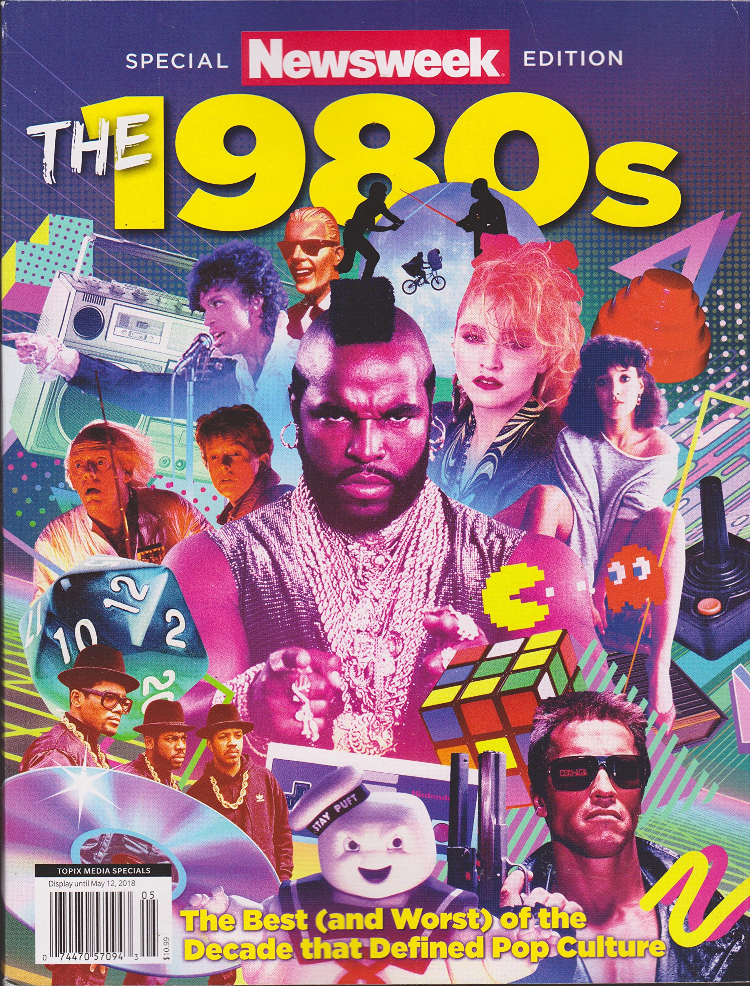
1980s: Historical Perspective

Slide 21

Case Study: AIDS Activist Videos

Slide 22
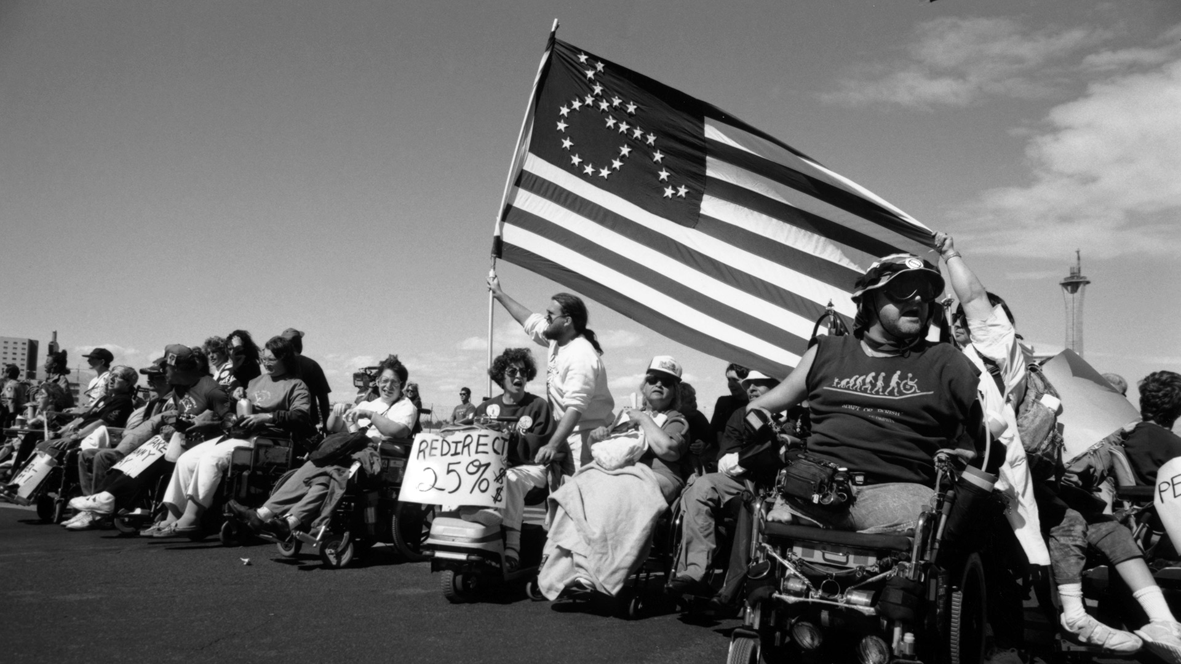
Context: Disability Rights Movement

Slide 23
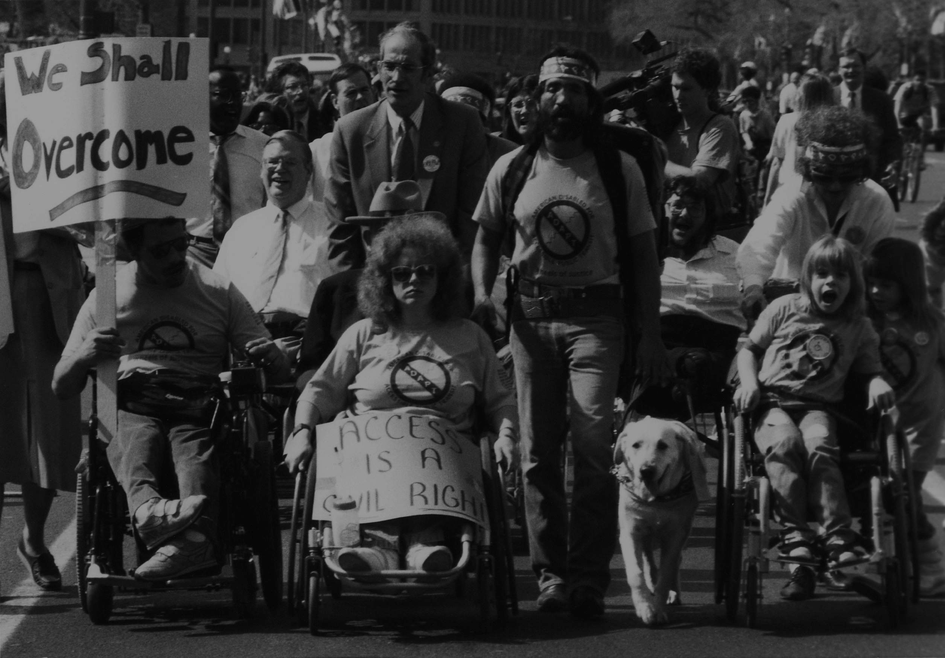
Disability Rights Movement
The 1960s civil rights movements did not include disability rights. It was not included in the 1964 Civil Rights Act until an amendment introduced it in 1971 and 1972.
Until recently, persons with disabilities were not considered a minority group.
“The lack of opposition to discrimination against persons with disabilities with respect to employment allowed long-held stereotypes and prejudices to continue unchallenged.” (p. 325)

Slide 24

Disability Rights Movement
What are some of the lessons we learnt from the DSM on healthcare, civil rights, and activism?

Slide 25
Disability Rights Movement
What are some of the lessons we learnt from the DSM on healthcare, civil rights, and activism?
It is imperative that those affected must be involved in determining the best methods for eliminating the problems created by oppression.

Slide 26
Disability Rights Movement
What are some of the lessons we learnt from the DSM on healthcare, civil rights, and activism?
Disability is often used as a synonym for victimization

Slide 27

Gran Fury, Kissing Doesn’t Kill Campaign, 1989

Slide 28
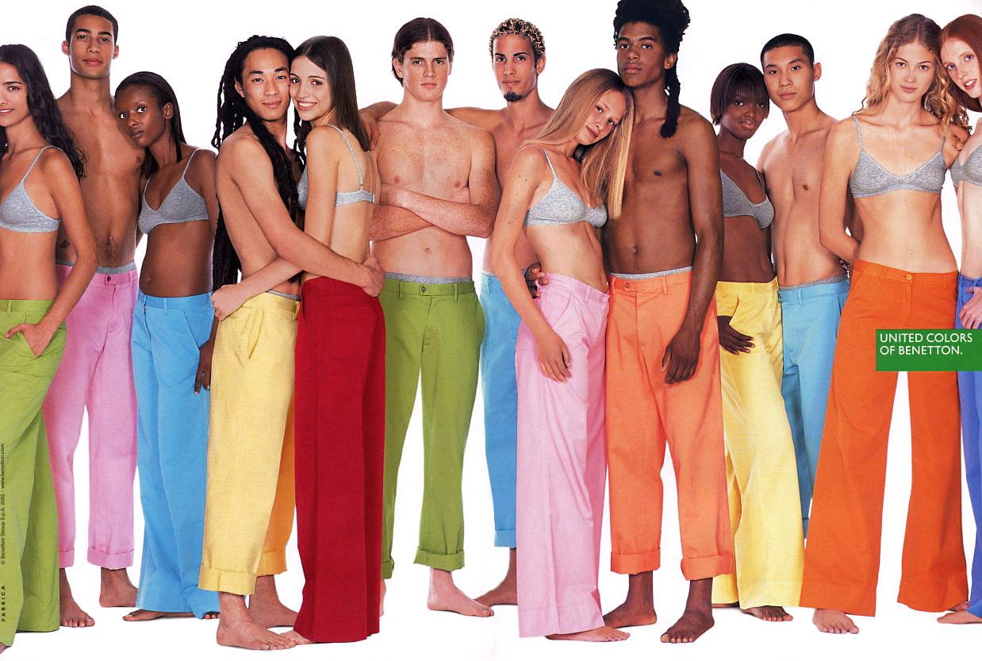

Slide 29
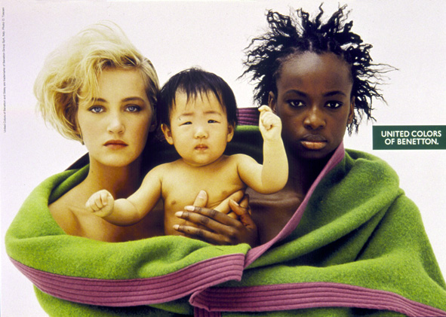

Slide 30
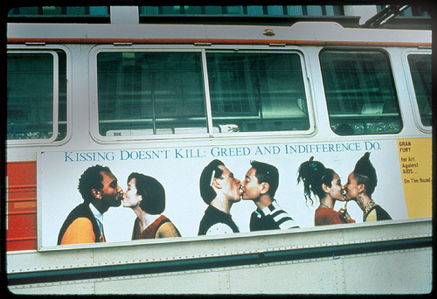
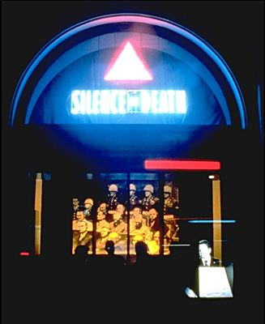
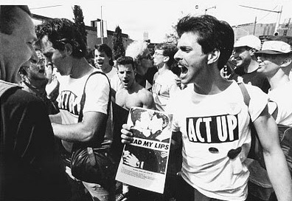

Slide 31
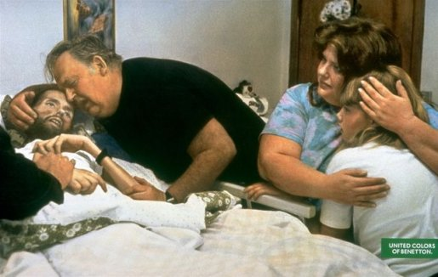

Slide 32
