Slide 1
VIDEO & DIVERSITY
Week 9:
Video & AIDS Activism

Slide 2
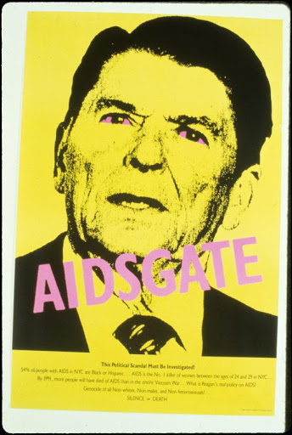
AIDS Demo Graphics
Graphics created by different AIDS activist and affinity groups, mostly used at direct actions

Slide 3

AIDS Demo Graphics
Graphics created by different AIDS activist and affinity groups, mostly used at direct actions

Slide 4
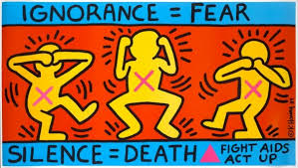
AIDS Demo Graphics
Graphics created by different AIDS activist and affinity groups, mostly used at direct actions

Slide 5

AIDS Demo Graphics
Graphics created by different AIDS activist and affinity groups, mostly used at direct actions

Slide 6
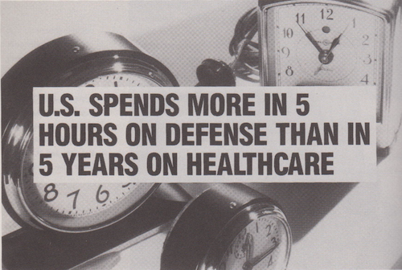
AIDS Demo Graphics
Graphics created by different AIDS activist and affinity groups, mostly used at direct actions

Slide 7

AIDS Demo Graphics
Graphics created by different AIDS activist and affinity groups, mostly used at direct actions

Slide 8
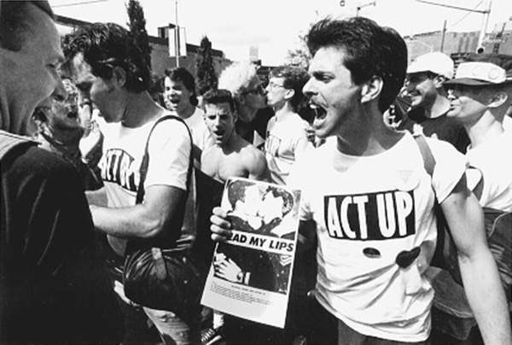
AIDS Demo Graphics
Graphics created by different AIDS activist and affinity groups, mostly used at direct actions

Slide 9
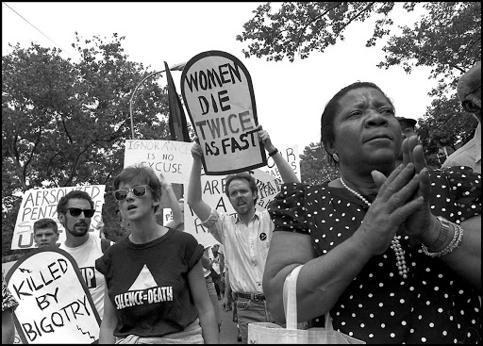
AIDS Demo Graphics
Graphics created by different AIDS activist and affinity groups, mostly used at direct actions

Slide 10
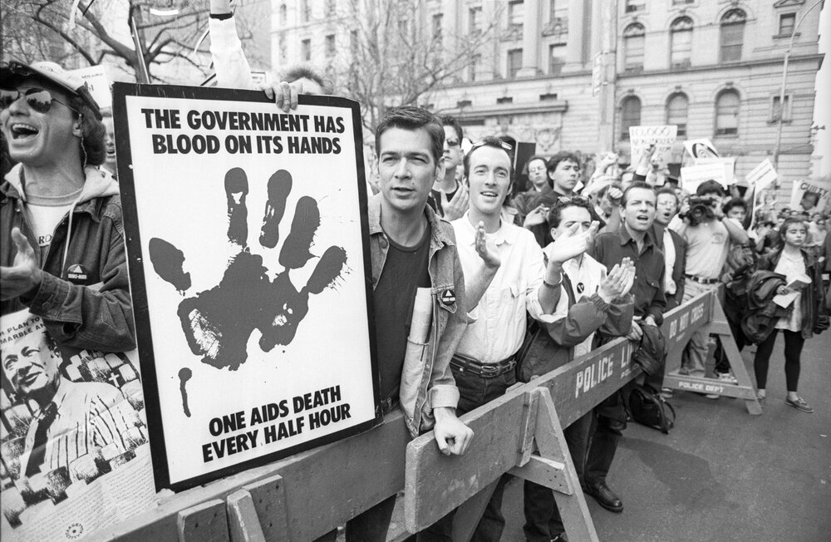
AIDS Demo Graphics
Graphics created by different AIDS activist and affinity groups, mostly used at direct actions

Slide 11
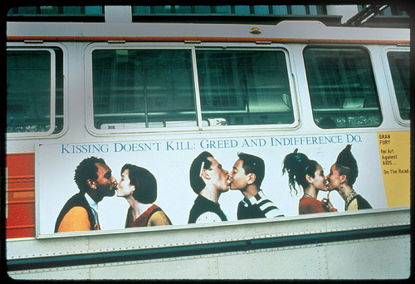
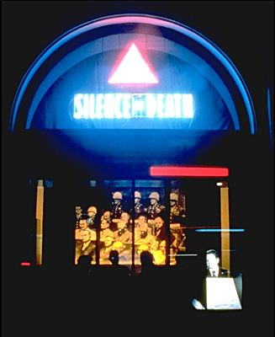
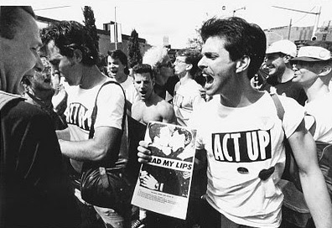

Slide 12
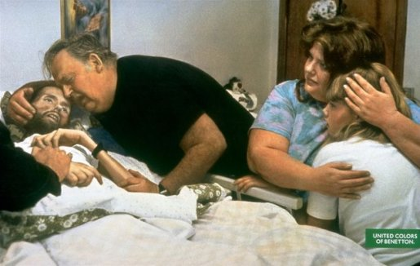

Slide 13
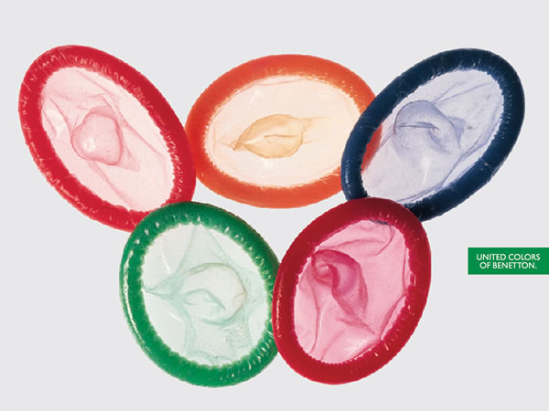

Slide 14
Discussion
According to the activists and scholars, (e.g. Juhasz, Saalfield, and others) what are the different kinds of AIDS videos?

Slide 15
Discussion
According to the activists and scholars, (e.g. Juhasz, Saalfield, and others) what are the different kinds of AIDS videos?
Provide examples from what you’ve watched

Slide 16
Discussion
Propaganda or agit prop (e.g. Kissing Doesn’t Kill)

Slide 17
Discussion
Propaganda or agit prop (e.g. Kissing Doesn’t Kill)
Educational (e.g. GMHC Safer Sex Shorts)

Slide 18
Discussion
Propaganda or agit prop (e.g. Kissing Doesn’t Kill)
Educational (e.g. GMHC Safer Sex Shorts)
Documentation (e.g. Testing The Limits)

Slide 19
Discussion
Propaganda or agit prop (e.g. Kissing Doesn’t Kill)
Educational (e.g. GMHC Safer Sex Shorts)
Documentation (e.g. Testing The Limits)
Community and public access (e.g. DIVA TV)

Slide 20
Discussion
Propaganda or agit prop (e.g. Kissing Doesn’t Kill)
Educational (e.g. GMHC Safer Sex Shorts)
Documentation (e.g. Testing The Limits)
Community and public access (e.g. DIVA TV)
Counter-surveillance

Slide 21
Discussion
Propaganda or agit prop (e.g. Kissing Doesn’t Kill)
Educational (e.g. GMHC Safer Sex Shorts)
Documentation (e.g. Testing The Limits)
Community and public access (e.g. DIVA TV)
Counter-surveillance
Media deconstruction and critique

Slide 22
Discussion
Propaganda or agit prop (e.g. Kissing Doesn’t Kill)
Educational (e.g. GMHC Safer Sex Shorts)
Documentation (e.g. Testing The Limits)
Community and public access (e.g. DIVA TV)
Counter-surveillance
Media deconstruction and critique
Who makes these videos, and for whom?

Slide 23
Discussion
Saalfield writes: “Here protest is the process, communication is our means of resistance, and everyone has a say” (p.27) How is this statement relevant to the production, distribution, and study of AIDS activist videos?

Slide 24
Discussion
Saalfield writes: “Here protest is the process, communication is our means of resistance, and everyone has a say” (p.27) How is this statement relevant to the production, distribution, and study of AIDS activist videos?
How much did developments in video technology during the 1980s and early ‘90s influenced AIDS activist videos?

Slide 25
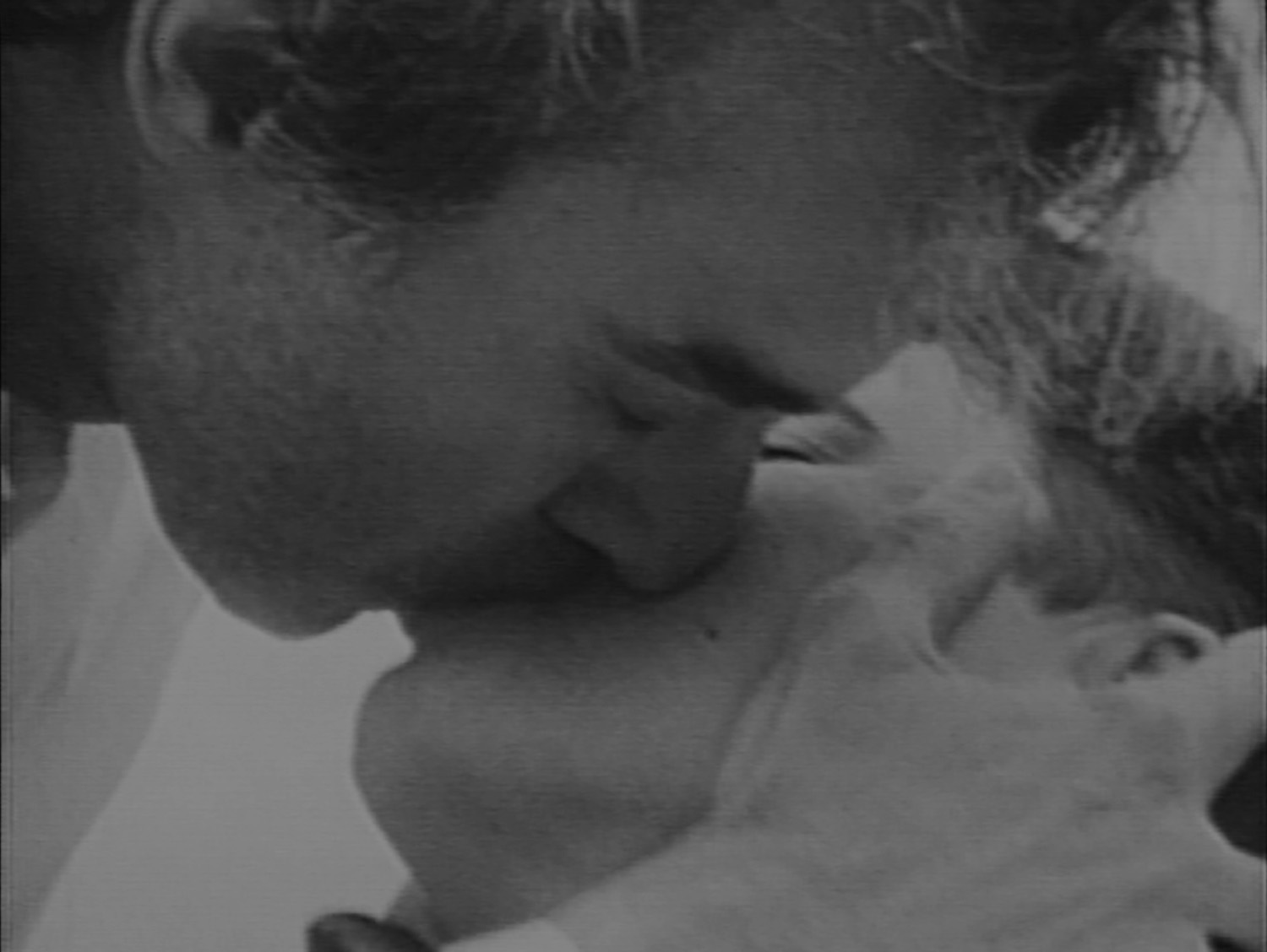
They are lost to vision altogether
(1989) Dir. Tom Kalin

Slide 26
ACTUP Oral History Project
www.actuporalhistory.org/

