Slide 1
ASIAN AMERICANS IN MEDIA
Week 7: Notions of Community, II— Chan Is Missing

Slide 2
Key Terms:
Asian American feature films
Asian American identity
Hyphenated identity / the interval
Assimilation / hybridity
Asian American subjectivity / Asian American identity
Postmodernism and film

Slide 3
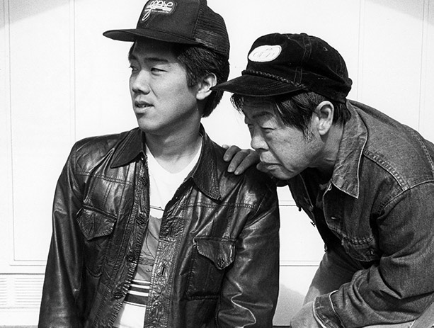
Chan Is Missing
(1982)
Dir. Wayne Wang
Starring Wood Moy, Marc Hayashi, Laureen Chew, Peter Wang

Slide 4
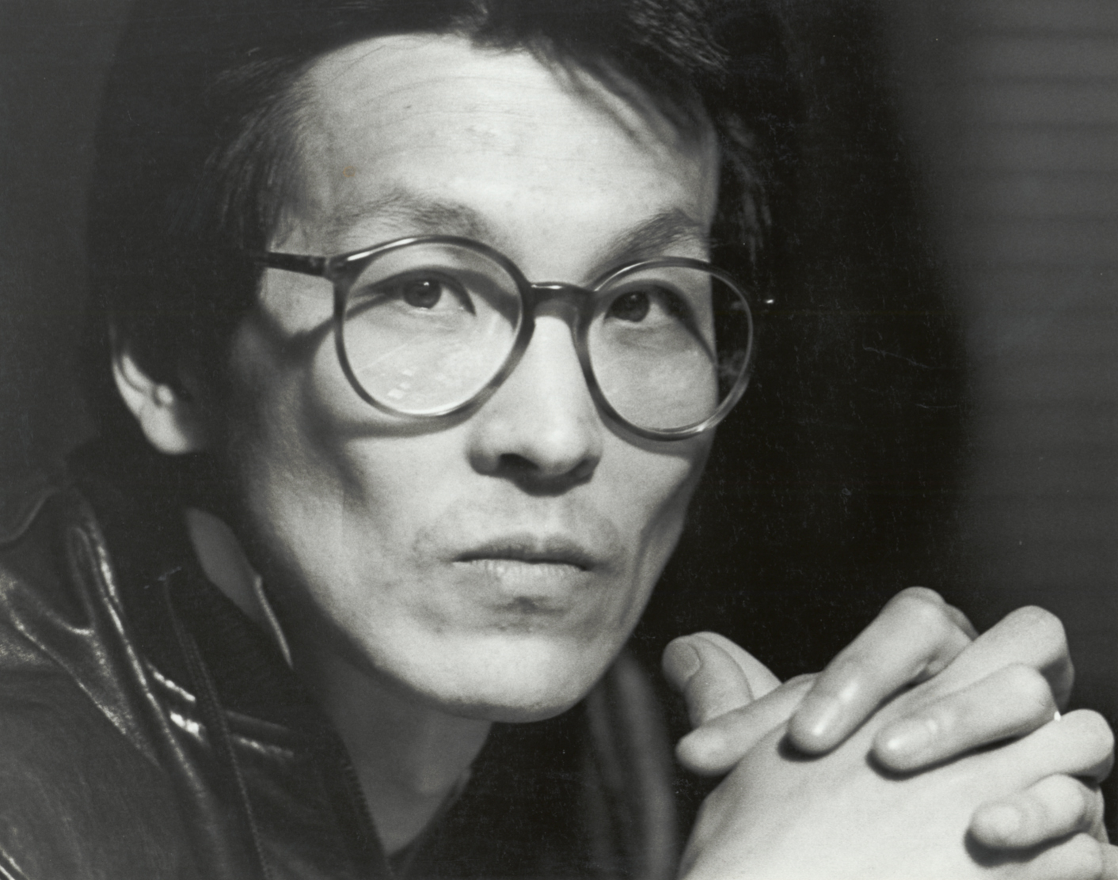
Wayne Wang
王穎
Born in Hong Kong, 1949, and named after his father’s favorite movie star -guess who?
Educated in H.K. and the U.S.; studied film and television at California College of Arts and Crafts

Slide 5
After graduating from CCA, Wang worked in activist and theater groups in San Francisco’s Chinatown.
Chan Is Missing is Wang’s second film; his first was A Man, a Woman and a Killer (1975), which he made while still in art school.
He subsequently made Dim Sum: A Little Bit of Heart (1985), Eat A Bowl of Tea (1989), Joy Luck Club (1993).

Slide 6
Not all of Wang’s films are “Asian American” in theme, e.g. Maid in Manhattan (2002)
Wang is one of the few Asian American filmmakers from his generation who successfully made a transition from the artist / activist / scholar mode to a more commercial career

Slide 7
He is still making films in the “indiewood” mode, recent titles include Smoke and Blue in The Face (both 1995), Center of The World (2001), A Thousand Years of Good Prayers and The Princess of Nebraska (both 2007), Snow Flower and the Secret Fan (2011)
Interviews in Moving The Image and Out of The Shadows

Slide 8
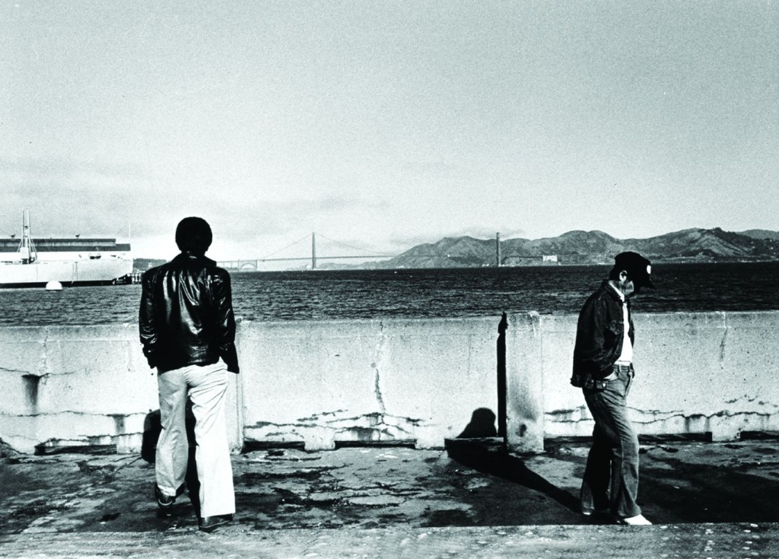

Slide 9
Chan Is Missing is one of the “first” Asian American independent feature films produced outside the studio system.
It was shot in B&W 16mm film, produced for less than $25,000.
The film was shot on location in San Francisco’s Chinatown, featuring its inhabitants, who often play themselves in largely improvised scenes

Slide 10
Filmed in English, Chinese (Cantonese and Mandarin), Spanish; early version were not subtitled. Also featured a soundtrack with music from different communities.
Based on a true story: the film was dedicated to Wong Cheen, the husband of one of Wang’s friends from Taiwan who went missing for several weeks.

Slide 11
Discussion Questions:

Slide 12
Discussion Questions:
Which communities are represented in the film? Describe them.

Slide 13
Discussion Questions:
Which communities are represented in the film? Describe them.
Who is the audience for this film?

Slide 14
Discussion Questions:
Which communities are represented in the film? Describe them.
Who is the audience for this film?
Who is Chan?

Slide 16
Discussion Questions:

Slide 17
Discussion Questions:
Is CIM similar to other feature narratives (BROKEN BLOSSOMS, DAUGHTER OF THE DRAGON, THE GOOD EARTH, FLOWER DRUM SONG) you’ve seen in this class so far?

Slide 18
Discussion Questions:
Is CIM similar to other feature narratives (BROKEN BLOSSOMS, DAUGHTER OF THE DRAGON, THE GOOD EARTH, FLOWER DRUM SONG) you’ve seen in this class so far?
If not, what other narrative films does it remind you of?

Slide 20
Discussion Questions:
What is the space of the ‘interval’ and the ‘hyphen’ that Feng discusses in his essay, and how do these ideas relate to this film?

Slide 21
Discussion Questions:
What is the space of the ‘interval’ and the ‘hyphen’ that Feng discusses in his essay, and how do these ideas relate to this film?
What do you think the protagonist (and by extension, Wang) meant when he said, “using the negative to emphasize the positive”?

