Slide 1
ASIAN AMERICANS IN MEDIA
Week 5: Birth of Asian American Independent Media—Ethno-Communications Films

Slide 2
Key Terms:
Asian American Movement / Third World Strike / Ethnic Studies
Counter culture
Independent media
Asian American media arts center
Cinéma vérité / direct cinema / anti-slick
Japanese American internment

Slide 3
Homecoming Game (1970)
Dir. Danny Kwan

Slide 4
Discussion Questions:

Slide 5
Discussion Questions:
How is this Asian American community similar to or different from the one we saw in Flower Drum Song?

Slide 6
Discussion Questions:
How is this Asian American community similar to or different from the one we saw in Flower Drum Song?
How about in comparison to the other films and Asian American communities we have seen thus far in class?

Slide 7
Discussion Questions:
How is this Asian American community similar to or different from the one we saw in Flower Drum Song?
How about in comparison to the other films and Asian American communities we have seen thus far in class?
How are these differences shown in this film?

Slide 8
What led to these changes in the representation of Asian Americans?

Slide 9
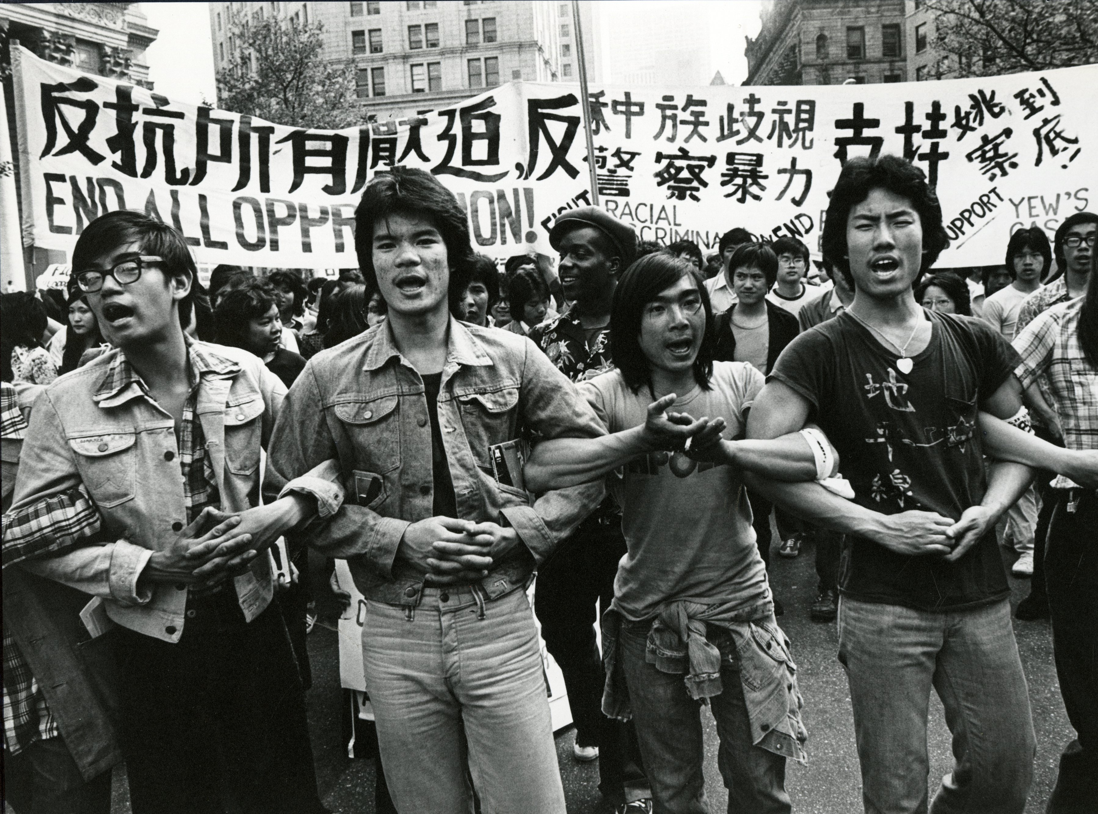
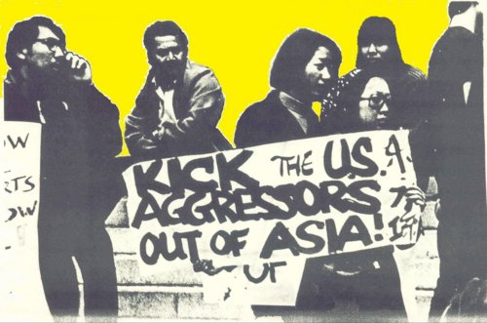
Asian American Movement in the 1970s

Slide 10
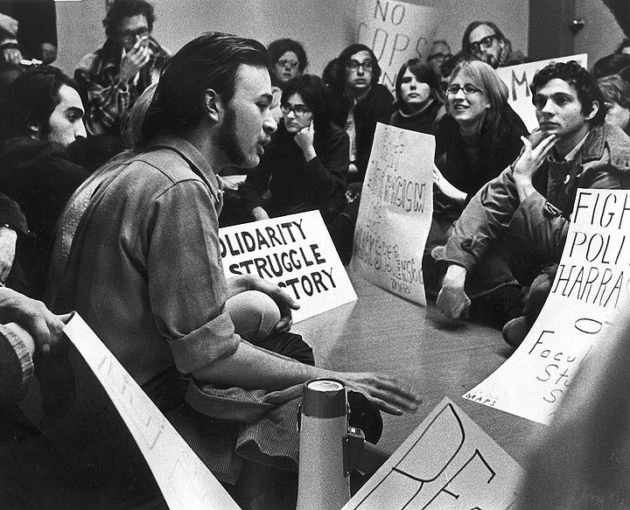
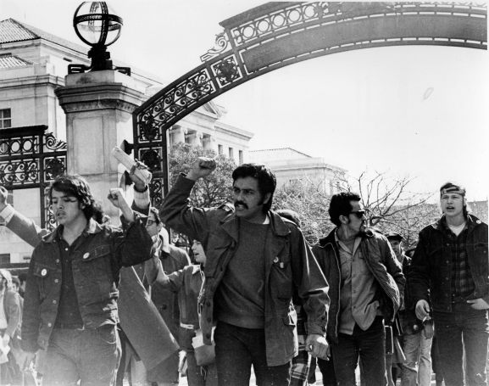
Influenced by the Third World Liberation Front strike for Ethnic Studies in the late 1960s; Black Panthers, and other racial civil rights movements

Slide 11
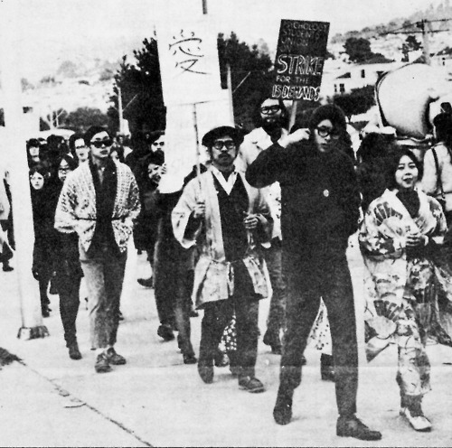
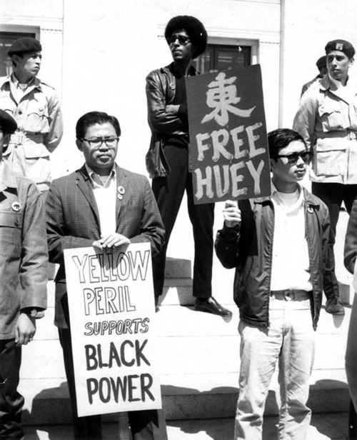

Slide 12
Ethno-Communications was a film production program founded at UCLA in the late 1960s and early 1970s by Asian, Chicano,
African American, and Native American students who were influenced by the social protest movements and counter culture of the time.

Slide 13
Its ethos was influenced by Third Cinema and other liberationist media movements, and especially by the films and writing of Latin American filmmakers including Glauber Rocha, Fernando Solanas, Octavio Getino, and Julio Garcia Espinosa.
First Asian American independent cinema?

Slide 14
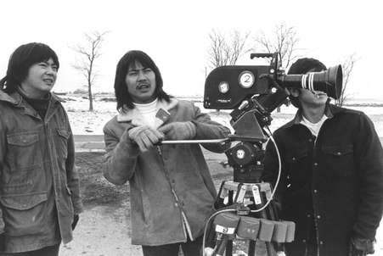
A number of Asian American graduates
of Ethno-Communications became the founders of Visual Communications (VC) the oldest Asian American media arts center, located in Little Tokyo in downtown Los Angeles.

Slide 15
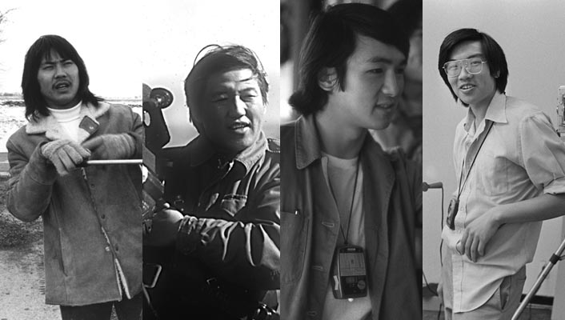
From left: Duane Kubo, Robert Nakamura, Alan Ohashi, and Eddie Wong

Slide 16
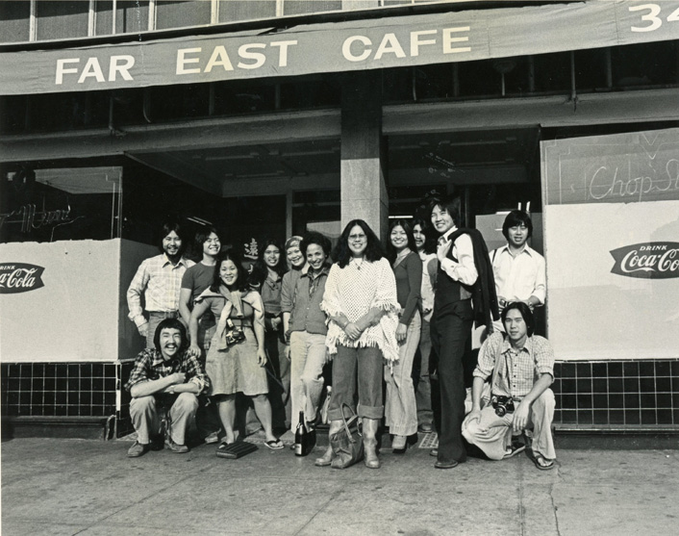

Slide 17
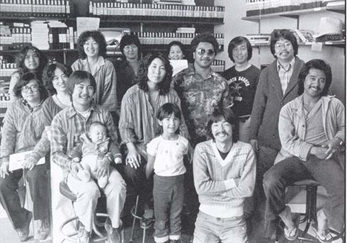

Slide 18
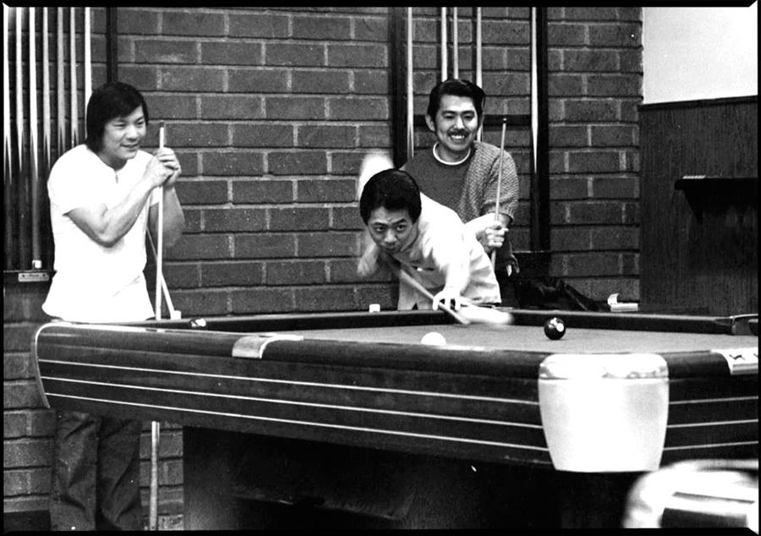
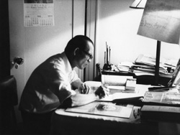
Comparative Analysis:
Yellow Brotherhood (1970, dir. Brian Maeda) / Wong Sinsaang (1971, dir. Eddie Wong)

Slide 19
Analyze:

Slide 20
Analyze:
Describe the filmic language of these films.

Slide 21
Analyze:
Describe the filmic language of these films.
How do these elements in the films influence or shape the representation of Asian Americans in them?

Slide 22
Analyze:
Describe the filmic language of these films.
How do these elements in the films influence or shape the representation of Asian Americans in them?
What prompted these changes?

Slide 23
Think about:

Slide 24
Think about:
Changes in U.S. historically, politically, socially

Slide 25
Think about:
Changes in U.S. historically, politically, socially
Changes in media technologies

Slide 26
Think about:
Changes in U.S. historically, politically, socially
Changes in media technologies
Changes in racial relations in the U.S. – how does this impact our previous discussion of the yellow peril, Cold War politics, assimilation, and the model minority myth?

Slide 27
Do you see or hear the formation of new Asian American communities in these films?

Slide 28
Do you see or hear the formation of new Asian American communities in these films? If so, describe them.

Slide 29
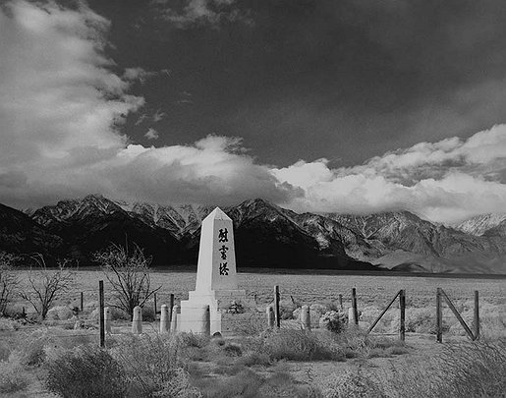
Manzanar (1970)
Dir. Robert Nakamura

Slide 30
Discussion Questions:

Slide 31
Discussion Questions:
How does this film compare to the other Ethno-Communication films?

Slide 32
Discussion Questions:
How does this film compare to the other Ethno-Communication films?
What does the title of the film refer to?

Slide 33
Discussion Questions:
How does this film compare to the other Ethno-Communication films?
What does the title of the film refer to?
What is your interpretation of the film’s language; its ending?

Slide 34
Sleepwalker (1971-2)
Dir. Laura Ho

Slide 35
Discussion Questions:

Slide 36
Discussion Questions:
How does this film compare to the other Ethno-Communication films?

Slide 37
Discussion Questions:
How does this film compare to the other Ethno-Communication films?
Is there something unique about it?

Slide 38
Discussion Questions:
How does this film compare to the other Ethno-Communication films?
Is there something unique about it?
Do you think that the fact this is a film directed by a woman (a first in our class!) makes it different?

Slide 39
Discussion Questions:
How does this film compare to the other Ethno-Communication films?
Is there something unique about it?
Do you think that the fact this is a film directed by a woman (a first in our class!) makes it different? Explain.

