Slide 1
How to list film titles in your academic writing:

Slide 2
How to list film titles in your academic writing:
The first time you mention a title, list the title, year of release, and name of director:

Slide 3
How to list film titles in your academic writing:
The first time you mention a title, list the title, year of release, and name of director:
Flower Drum Song (1961) Dir. Henry Koster

Slide 4
How to list film titles in your academic writing:
The first time you mention a title, list the title, year of release, and name of director:
Flower Drum Song (1961) Dir. Henry Koster
Flower Drum Song (1961) Dir. Henry Koster

Slide 5
How to list film titles in your academic writing:
The first time you mention a title, list the title, year of release, and name of director:
Flower Drum Song (1961) Dir. Henry Koster
Flower Drum Song (1961) Dir. Henry Koster
After that, under or italic the title:

Slide 6
How to list film titles in your academic writing:
The first time you mention a title, list the title, year of release, and name of director:
Flower Drum Song (1961) Dir. Henry Koster
Flower Drum Song (1961) Dir. Henry Koster
After that, under or italic the title:
Flower Drum Song or Flower Drum Song

Slide 7
ASIAN AMERICANS IN MEDIA
Week 6: Notions of Community, I— Fall of The I Hotel

Slide 8
Key Terms:
Asian American Movement
Oral history
An Asian American cinema
Manilatown / Manongs / bachelor society

Slide 9
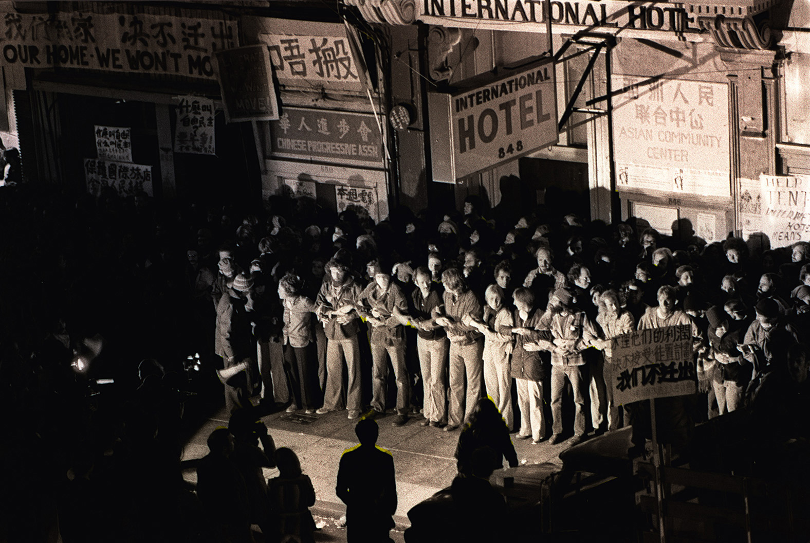
The Fall of The I-Hotel
(1977-83, revised in 1993) Dir. Curtis Choy

Slide 10
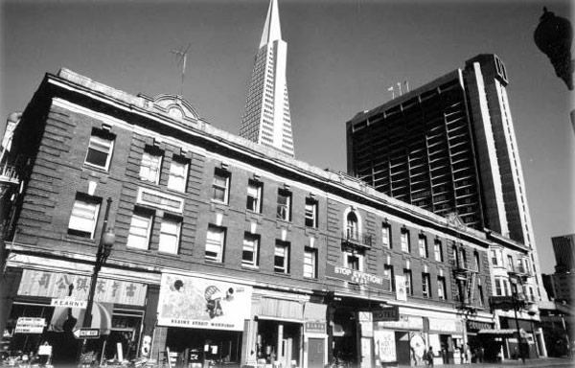
The International Hotel (I-Hotel) was built in 1907, and was located at the corner of Kearny and Jackson Streets in San Francisco.

Slide 11
This area was also known as Manilatown
The I-Hotel was a low-cost residential hotel. The monthly rent was about $50
There were 196 tenants living in the building in 1968, when the eviction notices were served
Most of the residents were elderly Filipino immigrant men, known as ‘Manongs’

Slide 12
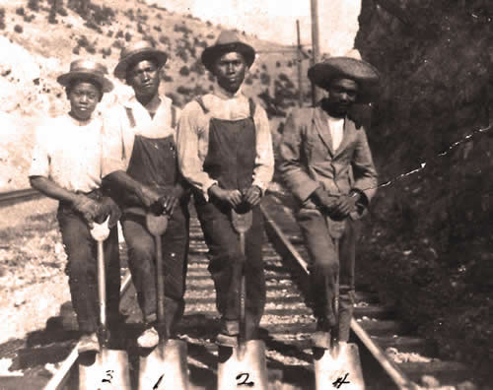
Manong:
“Manong” is an Ilokano word meaning “older brother”.
The manongs immigrated during the 1920s and ‘30s and were the first wave of Filipinos to come to the United States.

Slide 13
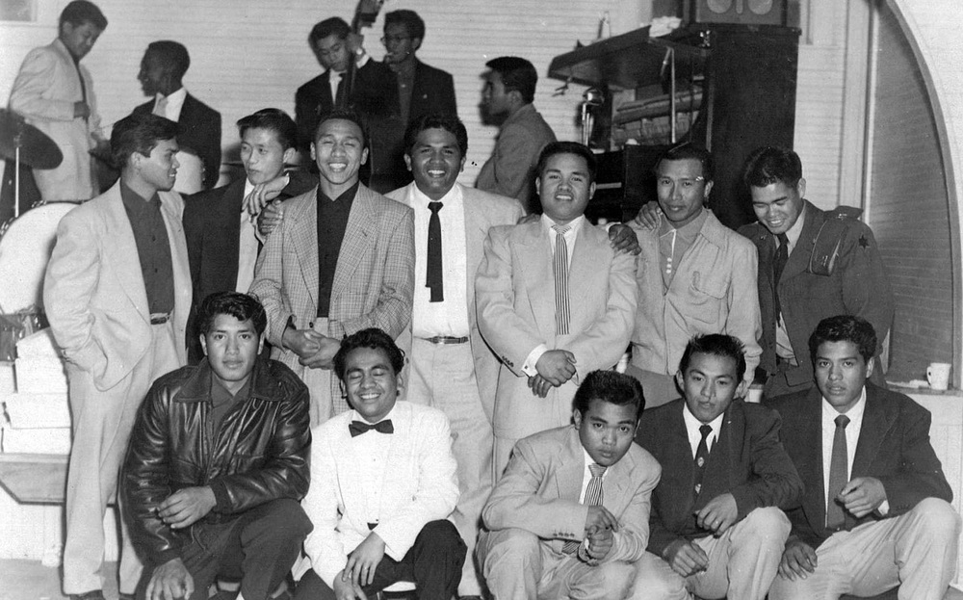
Young Filipino Americans in the 1950s

Slide 14
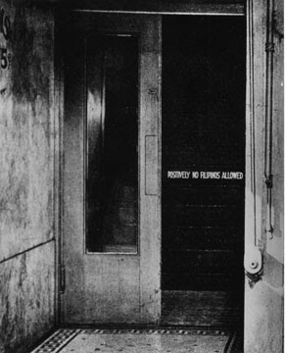
The manongs came at one of the worst times for the US economy. It was the start of the Great Depression and the continuance of mistreatment
towards the immigrant Filipinos. Many places had put up signs saying, “No Filipinos Allowed.”

Slide 15
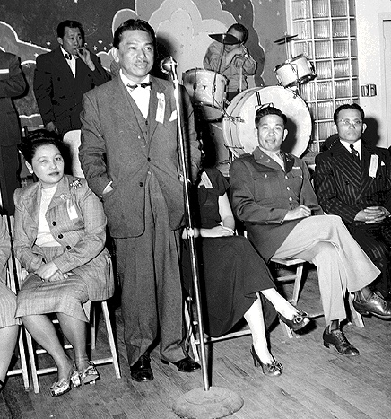
In addition, anti-miscegenation laws had been passed in order to prevent interracial marriage, which caused a lot of violence and arrests of Filipinos who were found intermingling with white American women.

Slide 16
Manongs farm workers were one of the first to organize politically. A group of Filipino farmworkers in Delano instigated the Delano Grape Strike of 1965 — which brought about the creation of the United Farm Workers Union (UFW)

Slide 17
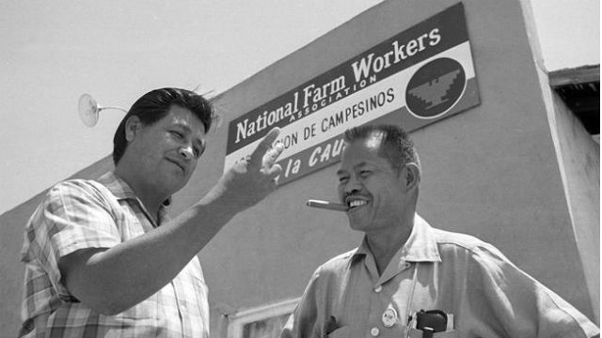
Cesar Chavez and Larry Itliong

Slide 18
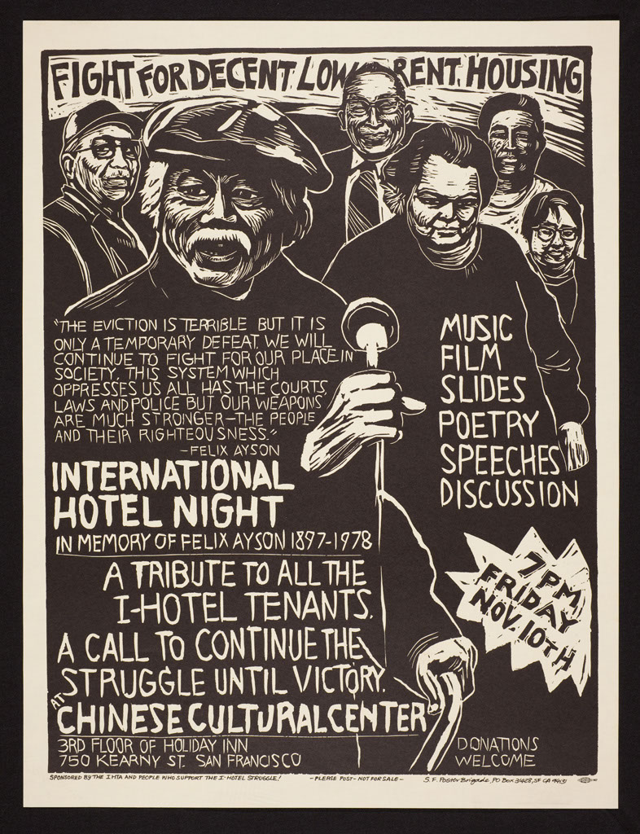
Kearny Street was also a center for Asian American political organizing and cultural production in the 1970s

Slide 19
Discussion Questions:

Slide 20
Discussion Questions:
How do you think the eviction of the I-Hotel is depicted in the film?

Slide 21
Discussion Questions:
How do you think the eviction of the I-Hotel is depicted in the film?
How does the filmic language influence the way we experience and see this eviction?

Slide 22
Discussion Questions:
How do you think the eviction of the I-Hotel is depicted in the film?
How does the filmic language influence the way we experience and see this eviction?
Do you think the representation was “objective”?

Slide 23
Discussion Questions:
How do you think the eviction of the I-Hotel is depicted in the film?
How does the filmic language influence the way we experience and see this eviction?
Do you think the representation was “objective”? Is “objectivity” possible or desirable in political documentaries?

Slide 25
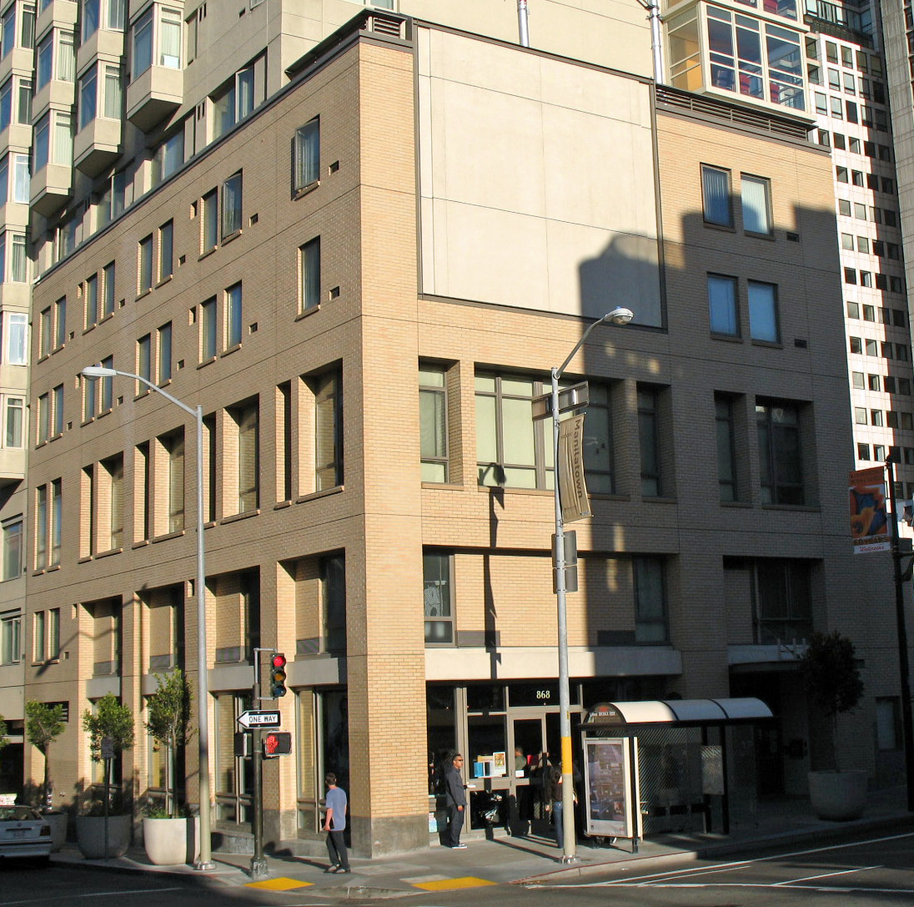
I-Hotel Today
Photo taken in 2008

Slide 26
In 1994 the site was acquired by the Roman Catholic Archdiocese of San Francisco and later sold to Chinatown Community Development Center.
In 2003, construction began on the new I-Hotel, and the building was completed on August 26, 2005.
The new building contains 105 apartments of senior housing, where the two remaining living residents of the original I-Hotel now live.

Slide 27
The new building also contains a ground-floor community center and a historical display commemorating the original I-Hotel.

Slide 28
Discussion Question:
Based on the films we have watched in class these two weeks, sketch out the common themes and approaches of early Asian American independent films:

Slide 29
Discussion Question:
Based on the films we have watched in class these two weeks, sketch out the common themes and approaches of early Asian American independent films:
Investigation of Asian American history

Slide 30
Discussion Question:
Based on the films we have watched in class these two weeks, sketch out the common themes and approaches of early Asian American independent films:
Investigation of Asian American history
Oral history / personal memory

Slide 31
Discussion Question:
Based on the films we have watched in class these two weeks, sketch out the common themes and approaches of early Asian American independent films:
Investigation of Asian American history
Oral history / personal memory
Non-traditional filmic language

Slide 32
Discussion Question:
Based on the films we have watched in class these two weeks, sketch out the common themes and approaches of early Asian American independent films:
Investigation of Asian American history
Oral history / personal memory
Non-traditional filmic language
Documentary / ethnography

Slide 33
Discussion Question:
Based on the films we have watched in class these two weeks, sketch out the common themes and approaches of early Asian American independent films:
Investigation of Asian American history
Oral history / personal memory
Non-traditional filmic language
Documentary / ethnography
Anti-slick

Slide 34
Discussion Questions:

Slide 35
Discussion Questions:
How does Renee Tajima define Asian American cinema?

Slide 36
Discussion Questions:
How does Renee Tajima define Asian American cinema?
How does your filmic example fit into her framework?

Slide 37
Discussion Questions:
How does Renee Tajima define Asian American cinema?
How does your filmic example fit into (or not fit into) her framework?

