Slide 1
ASIAN AMERICAN MEDIA IN COMMUNITIES
Week 3-4: Making Asian American Film & Video – VC & ACV

Slide 2
Topics:
The institution of Asian American film and video
CPB & minority consortia
Visual Communications and Asian CineVision
Institutional authorship
Asian American video art

Slide 3
Jun Okada
Associate Professor of English and Film Studies at SUNY Geneseo
PhD from UCLA, Making Asian American Film and Video is her first book.
Taught at Pitzer and the Claremont Colleges

Slide 4
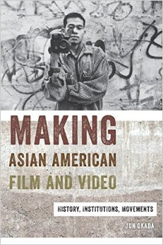
Making Asian American Film & Video: History, Institutions, Movements
A study of the institution of Asian American film and video – films, film festivals, discourse
Film genre, film movements,
Ethnic identity, identity politics
Institutional parameters, funding, programming, artistic freedom

Slide 5
“Without public media and its stance on diversity, the institution of Asian American film and video—films, film festivals, discourse—would not exist.

Slide 6
“Without public media and its stance on diversity, the institution of Asian American film and video—films, film festivals, discourse—would not exist. The analysis of Asian American film and video as a byproduct of a much larger phenomenon—the rise of public interest media—illuminates our understanding of minority media production and its problematic yet necessary historical relationship to the state.

Slide 7
“Without public media and its stance on diversity, the institution of Asian American film and video—films, film festivals, discourse—would not exist. The analysis of Asian American film and video as a byproduct of a much larger phenomenon—the rise of public interest media—illuminates our understanding of minority media production and its problematic yet necessary historical relationship to the state. This book explores precisely how public media and its intricate discourse of diversity enabled Asian American film and video while, at the same time, problematizing its purpose and transforming its goals.” (p. 2)

Slide 8
“Without public media and its stance on diversity, the institution of Asian American film and video—films, film festivals, discourse—would not exist. The analysis of Asian American film and video as a byproduct of a much larger phenomenon—the rise of public interest media—illuminates our understanding of minority media production and its problematic yet necessary historical relationship to the state. This book explores precisely how public media and its intricate discourse of diversity enabled Asian American film and video while, at the same time, problematizing its purpose and transforming its goals.” (p. 2)

Slide 9
ACV & VC: Comparative Discussion

Slide 10
ACV & VC: Comparative Discussion
Class divide into two groups;

Slide 11
ACV & VC: Comparative Discussion
Class divide into two groups;
Explore the web sites of VC and ACV as a group (you will need at least one laptop per group);

Slide 12
ACV & VC: Comparative Discussion
Class divide into two groups;
Explore the web sites of VC and ACV as a group (you will need at least one laptop per group);
Based on your understanding of these organization through studying their web sites, find 3 connections (e.g. mission statement, specific program, web page) that your group can make to what Okada says about them in the reading;

Slide 13
ACV & VC: Comparative Discussion
Present as a group: a) the mission and history of the organization, b) the connections you have found to the Okada reading

Slide 14
Discuss these terms: (if they have not already been covered in the presentations)

Slide 15
Discuss these terms: (if they have not already been covered in the presentations)
Minority consortia

Slide 16
Discuss these terms: (if they have not already been covered in the presentations)
Minority consortia
Politics of injury

Slide 17
Discuss these terms: (if they have not already been covered in the presentations)
Minority consortia
Politics of injury
Cinema of ethnic identity

Slide 18
Discuss these terms: (if they have not already been covered in the presentations)
Minority consortia
Politics of injury
Cinema of ethnic identity
Institutional authorship

Slide 19
Discuss these terms: (if they have not already been covered in the presentations)
Minority consortia
Politics of injury
Cinema of ethnic identity
Institutional authorship
Formal invention

Slide 20
Discuss these terms: (if they have not already been covered in the presentations)
Minority consortia
Politics of injury
Cinema of ethnic identity
Institutional authorship
Formal invention
Social justice content and message

Slide 21
Do you agree with Okada’s assessment of this period in the history of Asian American independent media?

Slide 22
Do you agree with Okada’s assessment of this period in the history of Asian American independent media?
Whether you do or not, (or have a complex view that is a combination of both) we will watch two independent Asian American media works from this period, and contextualize them within (and without) her analysis.

Slide 23
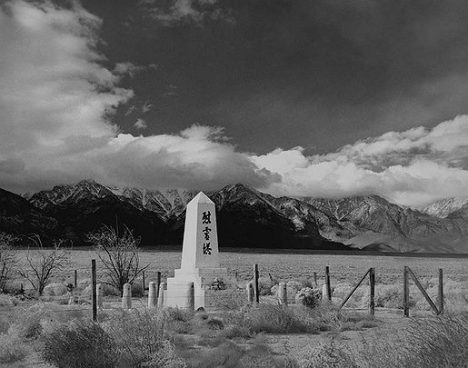
Manzanar (1970)
Dir. Robert Nakamura

Slide 24
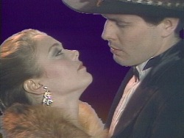
Vault (1984)
Dir. Bruce and Norman Yonemoto

