Slide 1
ASIAN AMERICAN MEDIA IN COMMUNITIES
Week 8-10: Asian American Media Activism

Slide 2
Topics:
Media activism
Cultural citizenship
Film and TV, advertising, online media
Audience and spectatorship
New media

Slide 3
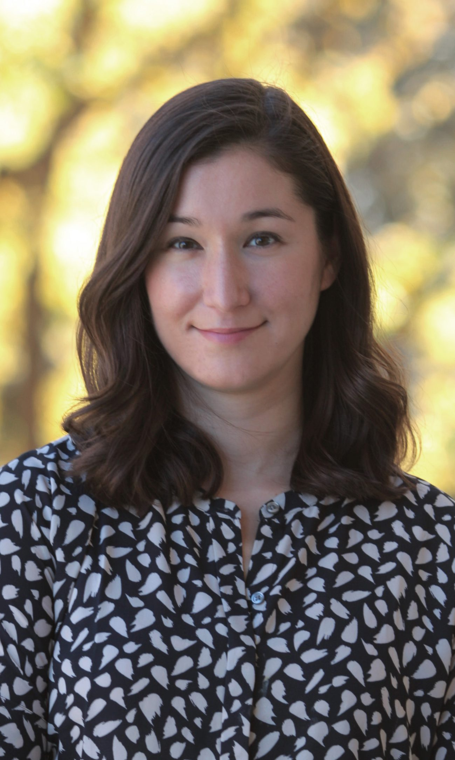
Lori Kido Lopez
Associate Professor of Media and Cultural Studies in the Department of Communication Arts, University of Wisconsin-Madison
PhD from USC, Asian American Media Activism is her first book.

Slide 4
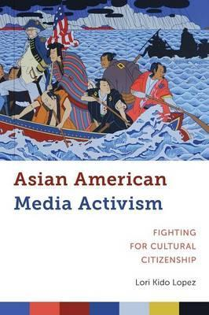
Asian American Media Activism: Fighting for Cultural Citizenship
“In this book I investigate not only how Asian American media activism takes place and evaluate what kinds of interventions might actually be effective, but I also use a media studies and cultural studies framework
to argue that these disagreements about media representation reflect different understandings of what cultural citizenship looks like for Asian Americans.” (p.4)

Slide 5
How does Lopez define cultural citizenship?

Slide 6
How does Lopez define cultural citizenship?
Citizenship

Slide 7
How does Lopez define cultural citizenship?
Citizenship
Legal

Slide 8
How does Lopez define cultural citizenship?
Citizenship
Legal
National

Slide 9
How does Lopez define cultural citizenship?
Citizenship
Legal
National
Rights and protections

Slide 10
How does Lopez define cultural citizenship?
Citizenship
Legal
National
Rights and protections
Citizenship and race

Slide 11
How does Lopez define cultural citizenship?
Citizenship
Legal
National
Rights and protections
Citizenship and race
“Citizenship has always been cultural” (Toby Miller quoted on p. 12)

Slide 12
How does Lopez define cultural citizenship?
Citizenship
Legal
National
Rights and protections
Citizenship and race
“Citizenship has always been cultural” (Toby Miller quoted on p. 12)
The process and performance of citizenship (p. 13)

Slide 13
How does Lopez define cultural citizenship?
Citizenship
Legal
National
Rights and protections
Citizenship and race
“Citizenship has always been cultural” (Toby Miller quoted on p. 12)
The process and performance of citizenship (p. 13) – what does Lopez mean by this?

Slide 14
How does Lopez define cultural citizenship?
Asian American citizenship

Slide 15
How does Lopez define cultural citizenship?
Asian American citizenship
Contradictory

Slide 16
How does Lopez define cultural citizenship?
Asian American citizenship
Contradictory
“Alien citizenship” (p. 16)

Slide 17
How does Lopez define cultural citizenship?
Asian American citizenship
Contradictory
“Alien citizenship” (p. 16)
Yellow peril

Slide 18
How does Lopez define cultural citizenship?
Asian American citizenship
Contradictory
“Alien citizenship” (p. 16)
Yellow peril
Exclusion acts and naturalization laws

Slide 19
How does Lopez define cultural citizenship?
Asian American citizenship
Contradictory
“Alien citizenship” (p. 16)
Yellow peril
Exclusion acts and naturalization laws
Both rejected and embraced

Slide 20
How does Lopez define cultural citizenship?
Asian American citizenship
Contradictory
“Alien citizenship” (p. 16)
Yellow peril
Exclusion acts and naturalization laws
Both rejected and embraced
Model minority

Slide 21
How does Lopez define cultural citizenship?
Asian American citizenship
Contradictory
“Alien citizenship” (p. 16)
Yellow peril
Exclusion acts and naturalization laws
Both rejected and embraced
Model minority
Multi-national-cultural citizenship

Slide 22
“Cultural citizenship is, then, intimately connected to media practices and images. In order for individuals to feel like their cultural practices are accepted and that people like them are included within the nation, they must see themselves and their specific communities represented within the media.” (p. 13)

Slide 23
“Cultural citizenship is, then, intimately connected to media practices and images. In order for individuals to feel like their cultural practices are accepted and that people like them are included within the nation, they must see themselves and their specific communities represented within the media.” (p. 13)
What agency does an audience have in relationship to media production?

Slide 24
“In this book I argue that within the work of Asian American media activists we can see a fight for a specific kind of cultural citizenship— one that relies on a collective notion of cultural citizenship.” (p.14)

Slide 25
“In this book I argue that within the work of Asian American media activists we can see a fight for a specific kind of cultural citizenship— one that relies on a collective notion of cultural citizenship.” (p.14)

Slide 26
“In this book I argue that within the work of Asian American media activists we can see a fight for a specific kind of cultural citizenship— one that relies on a collective notion of cultural citizenship.” (p.14)
“This book argues that while the stated goals of media activists might seem immediate—to recast a role, to demand an apology from producers, to hire an Asian American consultant or director, to produce more images of Asian Americans—what goes unstated is the connection between these achievements and the ultimate goal of cultural citizenship for Asian Americans.” (p.25)

Slide 27
“In this book I argue that within the work of Asian American media activists we can see a fight for a specific kind of cultural citizenship— one that relies on a collective notion of cultural citizenship.” (p.14)
“This book argues that while the stated goals of media activists might seem immediate—to recast a role, to demand an apology from producers, to hire an Asian American consultant or director, to produce more images of Asian Americans—what goes unstated is the connection between these achievements and the ultimate goal of cultural citizenship for Asian Americans.” (p.25)

Slide 28
“In this book I investigate the organizations and individuals who set their sights on improving mainstream media and other forms of media that are widely available and accessible to general audiences. These activists hope to take part in a broader social justice movement that extends beyond Asian American audiences to impact the way that Asian Americans are perceived and treated as cultural citizens.” (p.27)

Slide 29
“In this book I investigate the organizations and individuals who set their sights on improving mainstream media and other forms of media that are widely available and accessible to general audiences. These activists hope to take part in a broader social justice movement that extends beyond Asian American audiences to impact the way that Asian Americans are perceived and treated as cultural citizens.” (p.27)

Slide 30
“In this book I investigate the organizations and individuals who set their sights on improving mainstream media and other forms of media that are widely available and accessible to general audiences. These activists hope to take part in a broader social justice movement that extends beyond Asian American audiences to impact the way that Asian Americans are perceived and treated as cultural citizens.” (p.27)

Slide 31
Class Discussion:
How, according to Lopez, does new media facilitate Asian American media activism?

Slide 32
Class Discussion:
How, according to Lopez, does new media facilitate Asian American media activism?
How does new media connect media representation and the broader goal of fighting for cultural citizenship?

Slide 33
Class Exercise:
Work with your site group

Slide 34
Class Exercise:
Work with your site group
Design an online campaign for your group’s media event:
This can take a variety and combination of forms, from hashtags to a coordinated series of actions. Think about how the communities you are working with use and engage with new media—what would be effective for your community?

Slide 35
Class Exercise:
Work with your site group
Design an online campaign for your group’s media event:
This can take a variety and combination of forms, from hashtags to a coordinated series of actions. Think about how the communities you are working with use and engage with new media—what would be effective for your community?
Present your group’s campaign in class for discussion

