Slide 1
Dickson Experimental Sound Film (1894-5) Dir. William Dickson and Thomas Edison
Broken Blossoms (1919) Dir. D.W. Griffith
Old San Francisco (1927) Dir. Alan Crosland

Slide 2
Bonus scene: Singin’ in The Rain (1951) Dir. Gene Kelly and Stanley Donen

Slide 3
FILM SOUND
II. Film Sound Theories

Slide 4
Audio-Visual Analysis
Voice in Cinema
Feminist Film Theory
Film Music

Slide 5
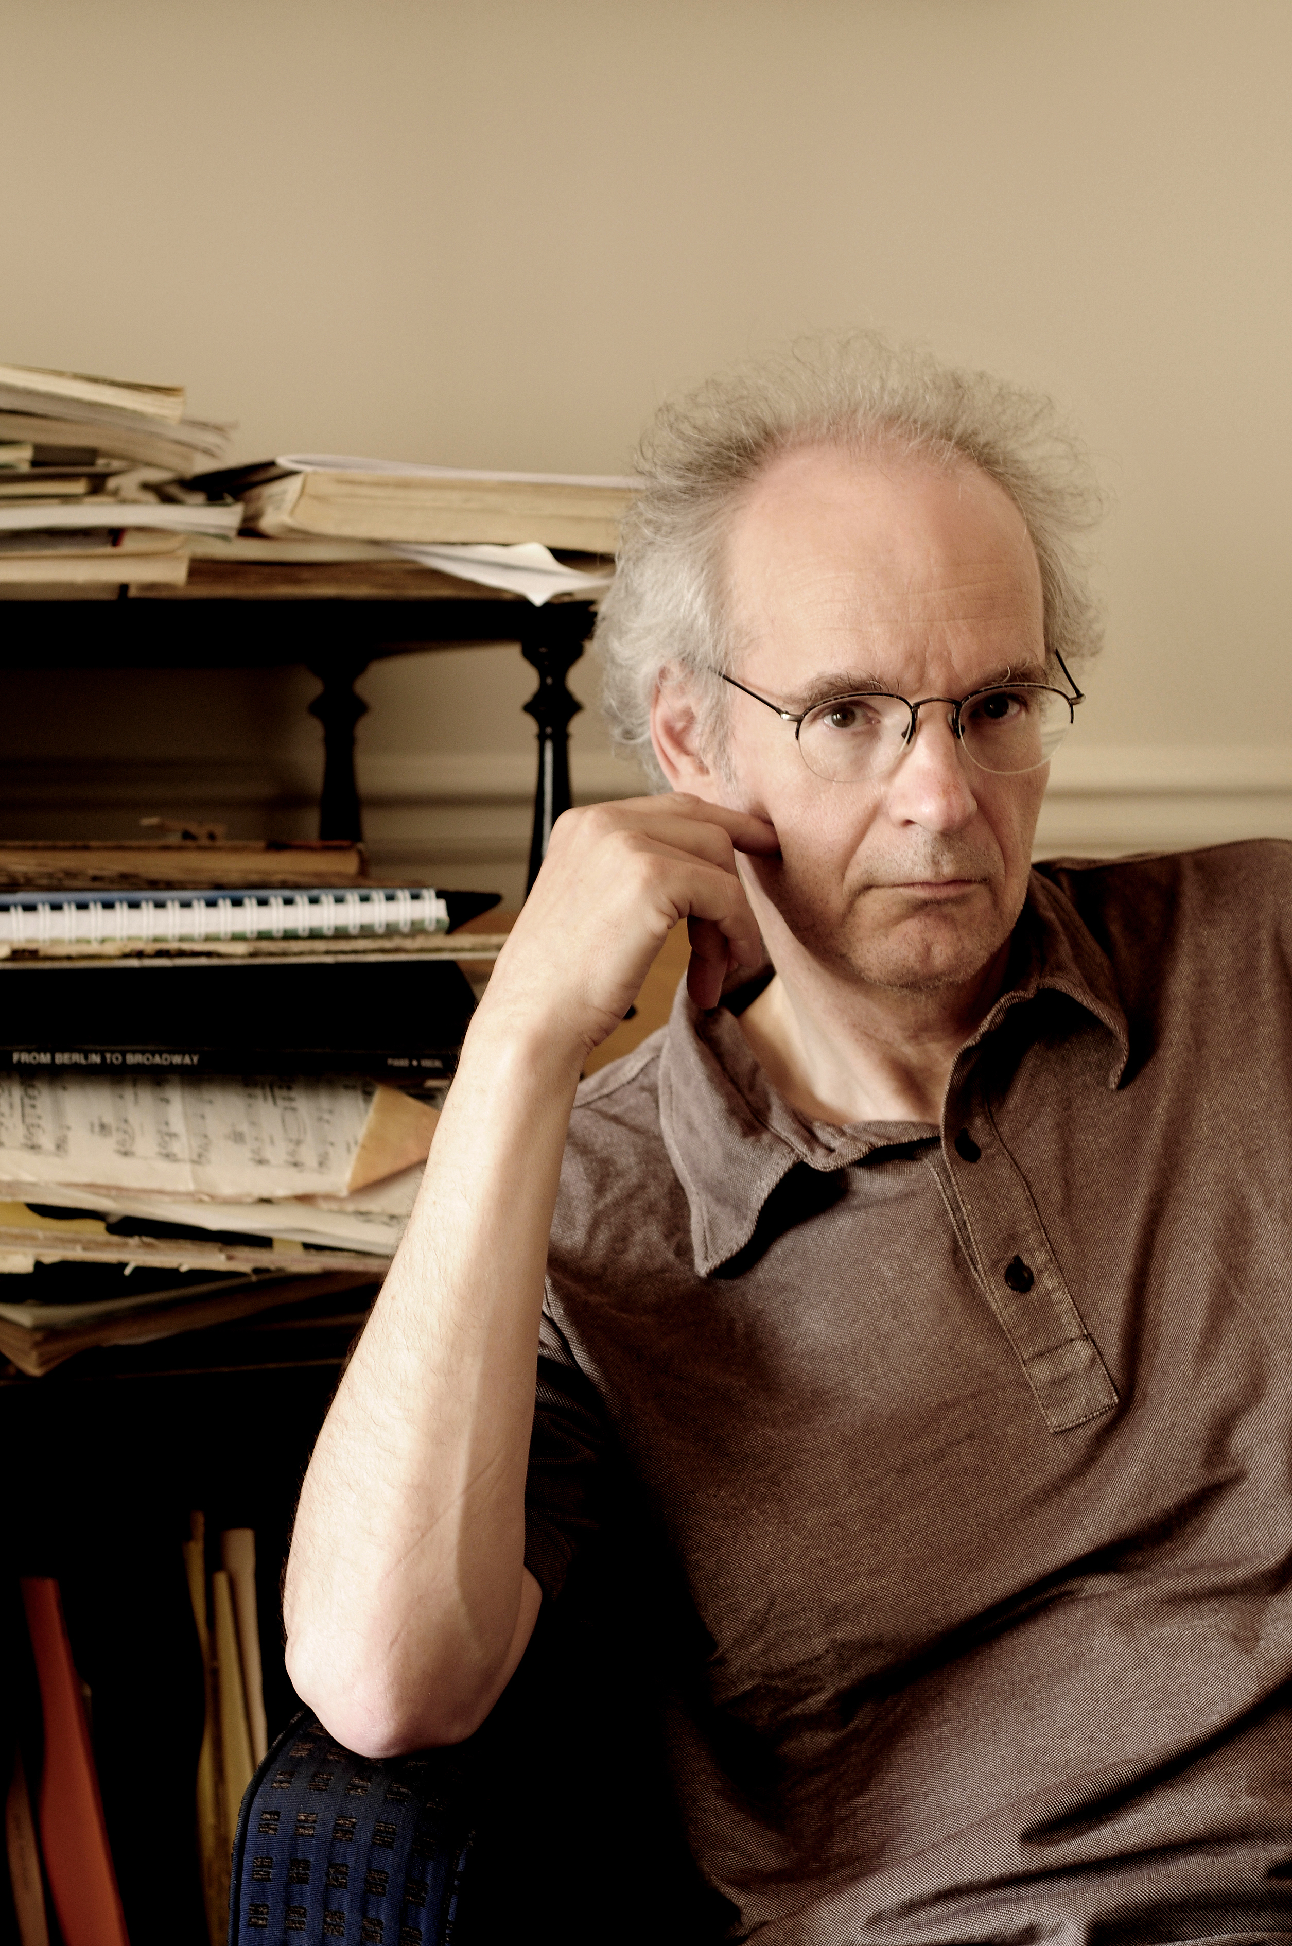
Michel Chion
He’s French (see 2nd pic) Trained as a composer under Pierre Schaeffer and Pierre Henry
Associate Professor at the University of Paris III: Sorbonne Nouvelle, where he is a theoretician and teacher of audio-visual relationships
He wrote at least six books on film sound, as well as monographs on filmmakers including Stanley Kubrick, Jacques Tati and David Lynch, and on films including EYES WIDE SHUT and THE THIN RED LINE

Slide 6
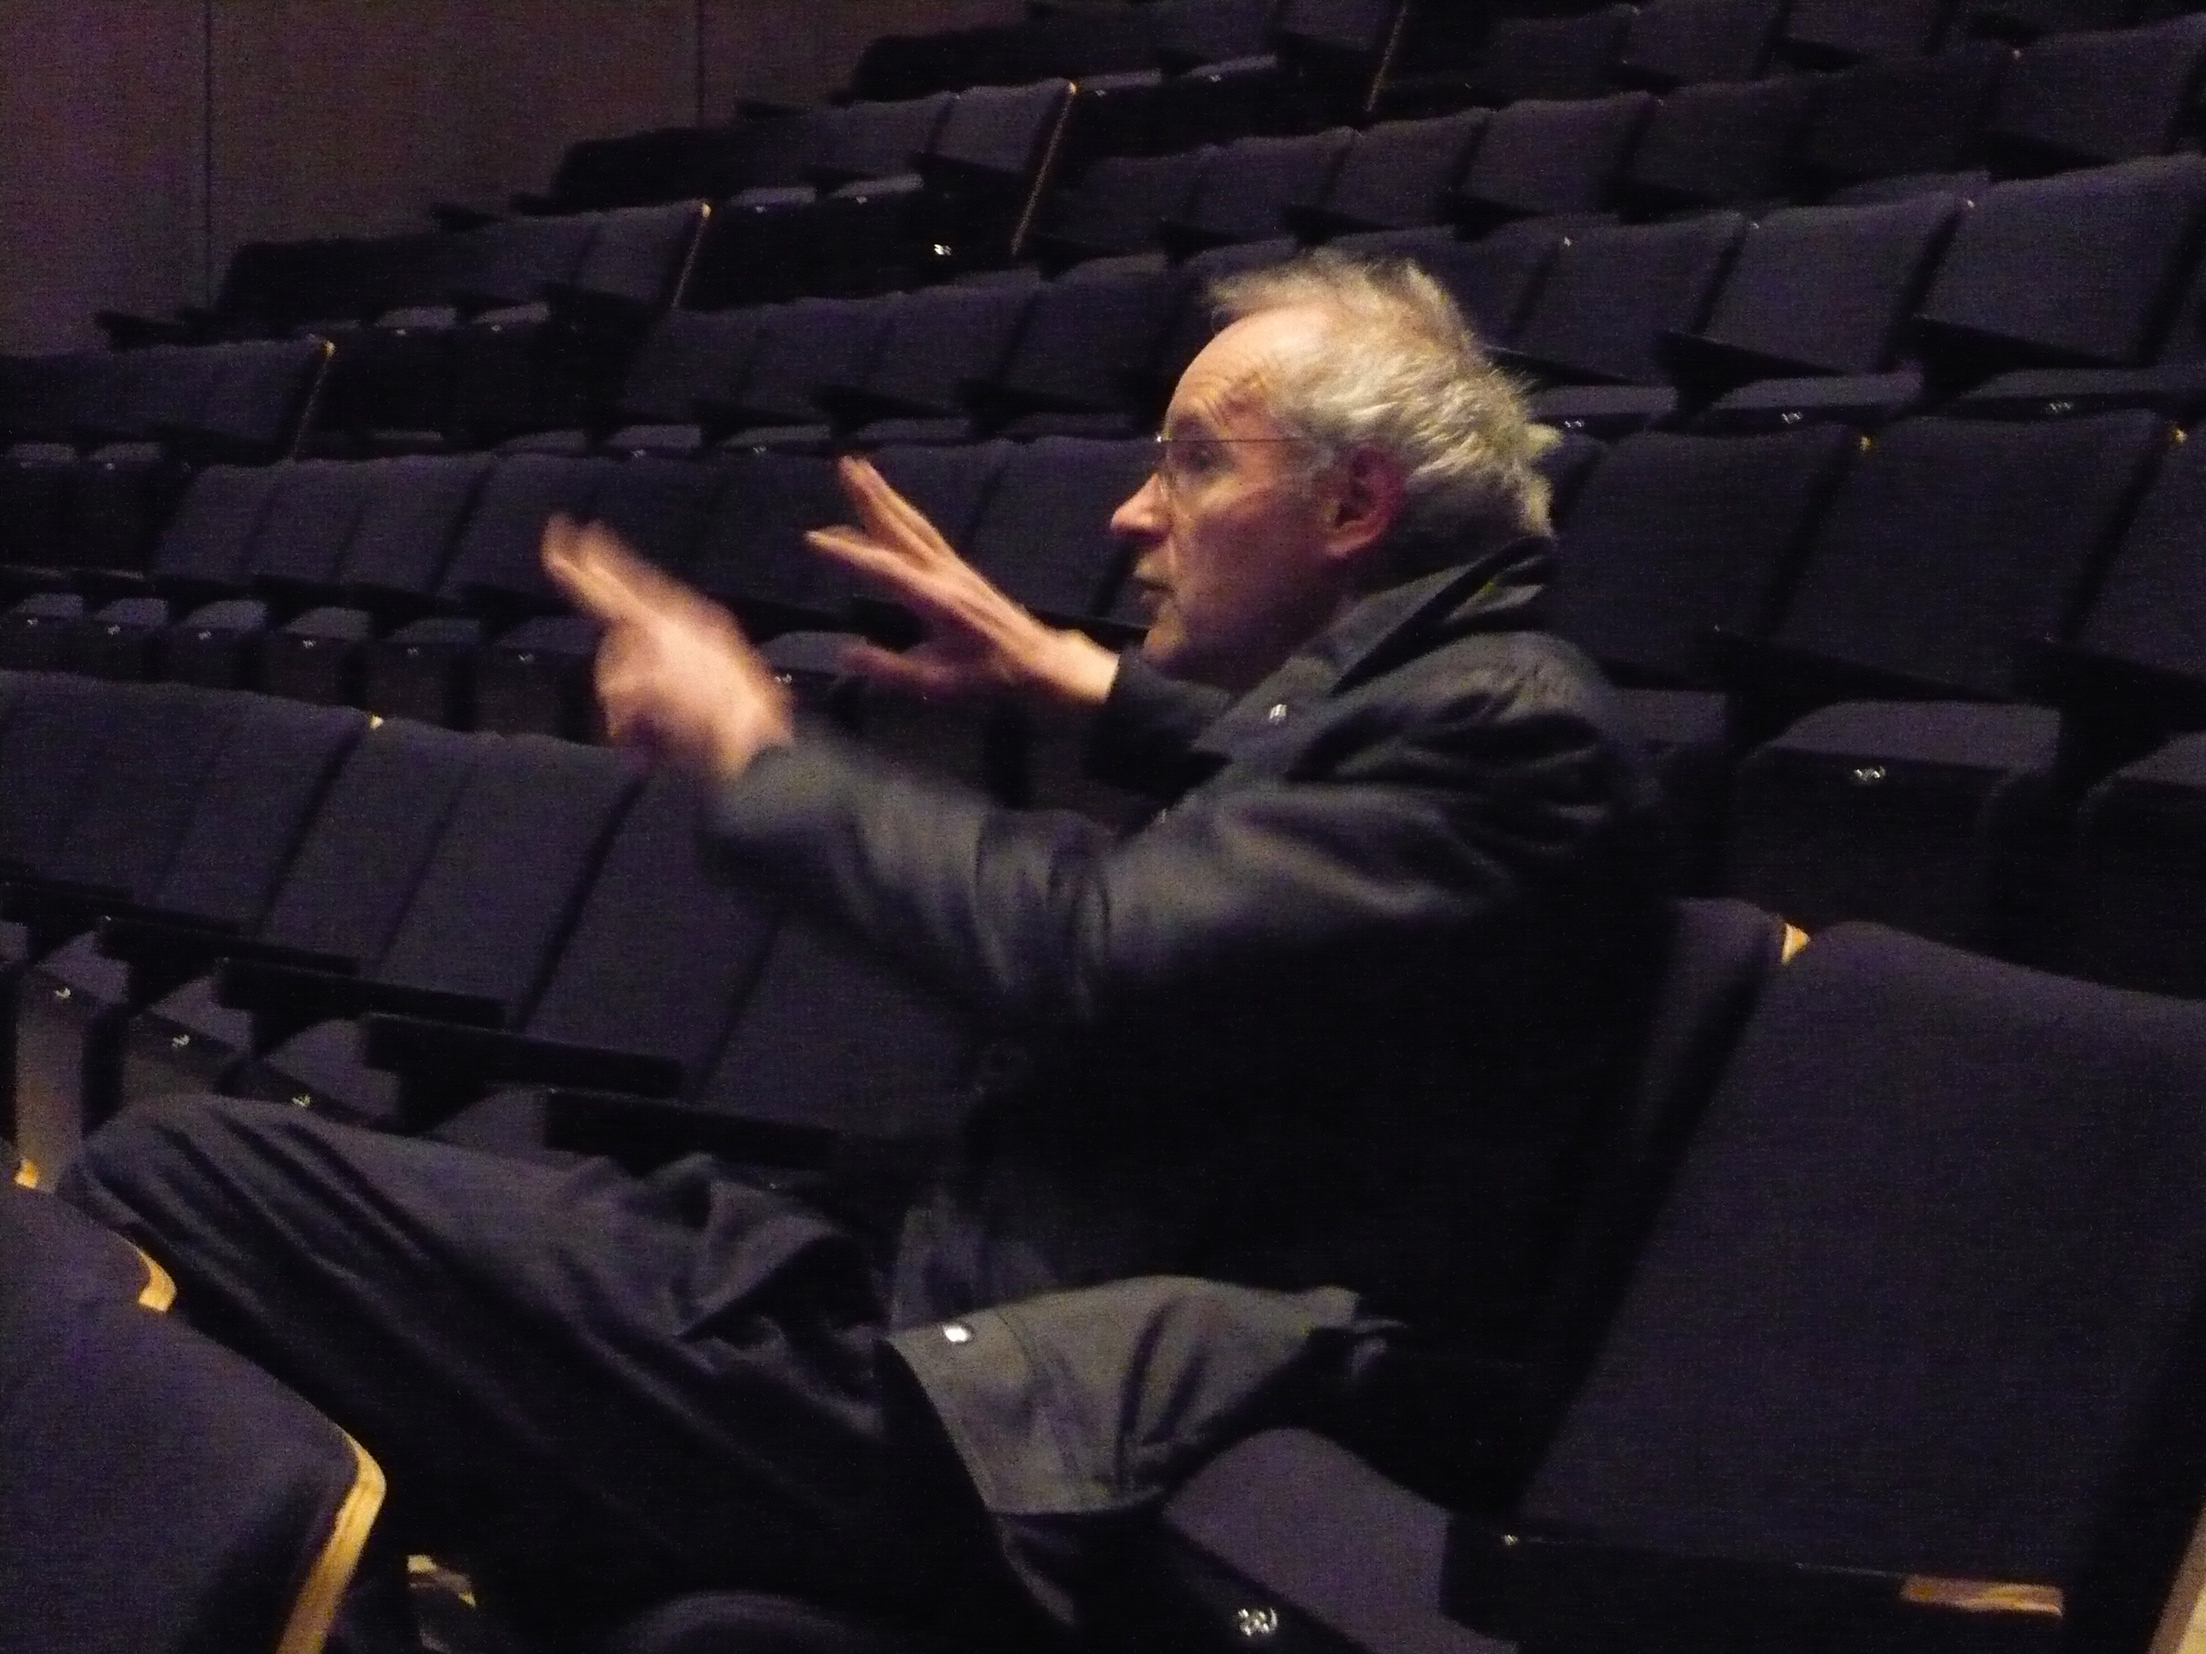

Slide 7
Audio-Vision: Sound on Screen
This book is concerned with audio-visual relationships (he calls it a contract) which can alter/expand our perception
In the book, Chion outlines a methodology for observing and analyzing these relationships (audio-visual analysis)

Slide 8
It is a summary of ideas Chion developed in his three earlier books
In the book, he writes predominantly about American and European feature-length narrative films in the book, but also touches on TV, video art, and music videos

Slide 9
Chion’s Key Concepts:
Added Value
Synchresis
Vococentrism
Verbocentrism
Music: empathetic / anempathetic
Spotting
Temporalization
Three Modes of Listening

Slide 10
Three modes of listening: casual / semantic / reduced
“There is no soundtrack” (p. 39) What do you think he means by this?
Sound units vs. sound events
Functions of sound in film: 4 kinds
Points of synchronization
Sound in relation to screen: 6 kinds
Music: pit vs. screen, active vs. passive
Point of Audition // POV

Slide 11
Chion’s Methodology:
Audio-visual analysis
Masking
Forced Marriage
Format for audio-visual analysis:
Film title/credit
Shot breakdown
Locating the dominants
Locating points of synchronization
Analysis: narrative, comparison, etc.

