Slide 1
FILM SOUND
Introduction: Sound and the Study of Sound

Slide 2
What is sound?

Slide 4
What is sound?

Slide 5
What is sound?
What are the differences between hearing and vision?

Slide 7
What is sound?
What are the differences between hearing and vision?

Slide 8
What is sound?
What are the differences between hearing and vision?
What are the similarities?

Slide 9
How do we study sound?

Slide 10
Can you define a culture of sound?

Slide 11
Can you define a culture of sound?
If so, how does your definition of sound culture compare to your definition of visual culture?

Slide 12
Key Concepts from Sterne:
Hearing requires positionality (p.4)
The study of sound is an emerging field
Sound studies is interdisciplinary, reflexive, aware of its own historicity, and critical
Sonic imagination (p.5)
Sound students (p.3)

Slide 13
The Art of Noises A Futurist Manifesto
Luigi Russolo (1833-1947)
Futurism in Italy
Art of Noises as a manifesto
Machine vs. Nature
Music vs. Noise

Slide 14
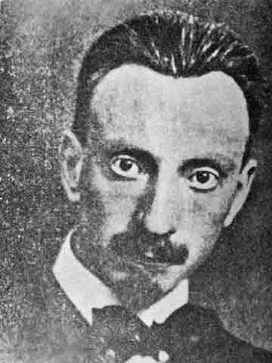
Luigi Russolo

Slide 15
Futurist Paintings by Luigi Russolo

Slide 16
“The evolution of music is comparable to the multiplication of machines”
“We must break out of this limited circle of sounds and conquer the infinite varieties of noise-sounds.”
“We want to give pitches to these diverse noises, regulating them harmonically and rhythmically.”

Slide 17
Six families of noises of the futurist orchestra :
Roars, Thundering, Explosions, Hissing roars, Bangs, Booms;
Whistling, Hissing, Puffing;
Whispers, Murmurs, Mumblings, Mutterings, Gurgling;
Screeching, Creaking, Rustling, Humming, Crackling, Rubbing;
Noises obtained by beating on metals, woods, skins, stones, pottery, etc.
Voices of animals and people, Shouts, Screams, Shrieks, Wails, Hoots, Howls, Death rattles, Sobs

Slide 18
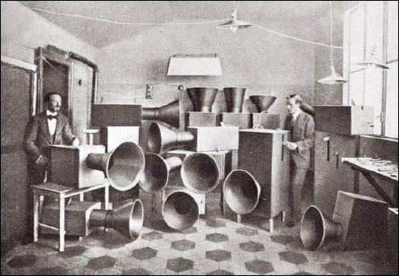
Intonarumori

Slide 19
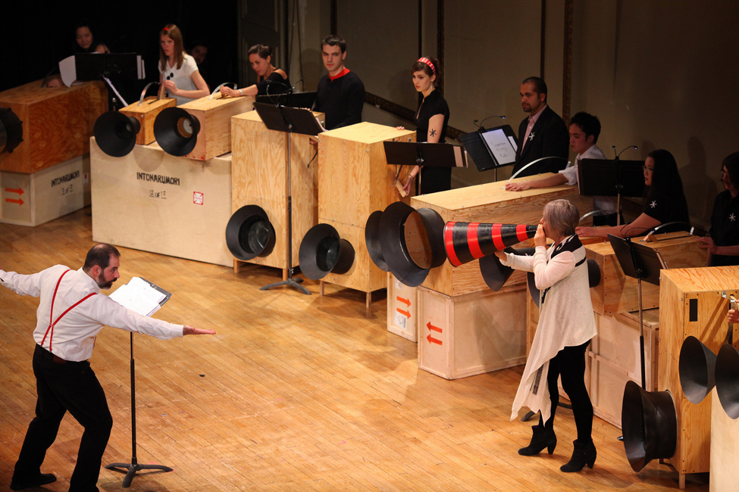
Intonarumori Today

Slide 20
FILM SOUND
I. ‘Silent’ to Sound Cinema

Slide 21
The Coming of Sound
Silent Film Sound
Sound Technology and Early Cinema

Slide 22
The Coming of Sound: U.S.
Mid 1920s to early 1930s
Neoclassical economic theory - 3 phases: invention, innovation, diffusion (Gomery)
Early efforts led by Warner Brothers, working with Western Electric/AT&T, financed by emerging media corporations and wealthy investors
Focused on singing and musical films

Slide 23
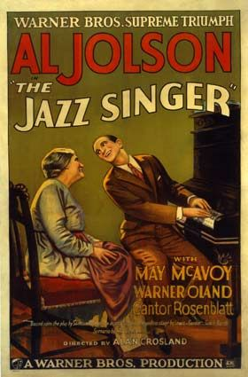
Case Study:
The Jazz Singer
(1927)

Slide 25
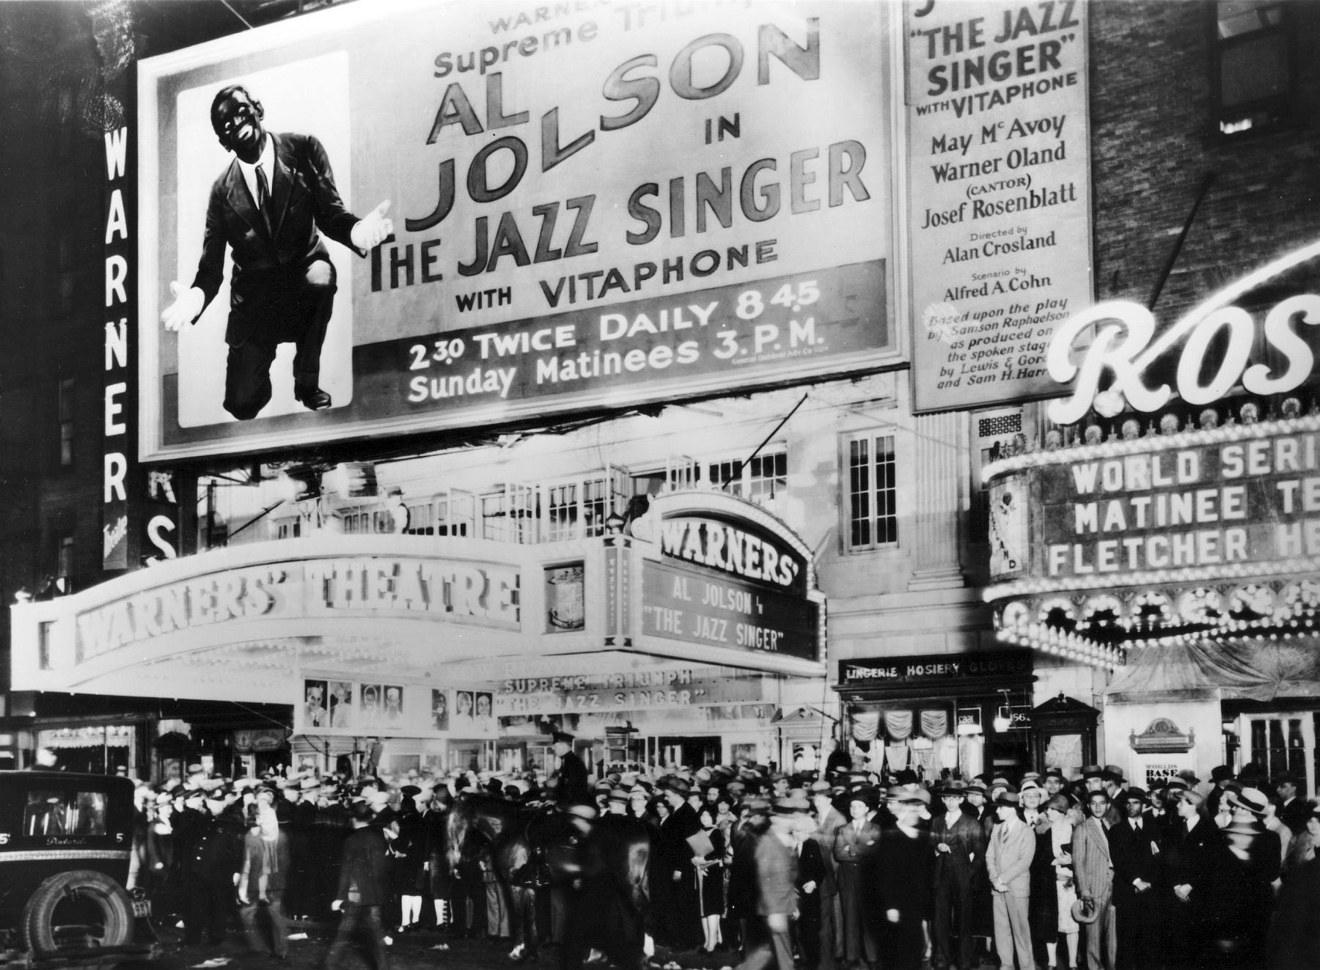

Slide 26
The Coming of Sound: Europe
U.S./Hollywood imperialism?
Marxist economic framework – focus on international exchange (Gomery)
Different rate of adoption; language conversion, (e.g. Dracula, 1931) cartel and quotas
Nationalism

Slide 28
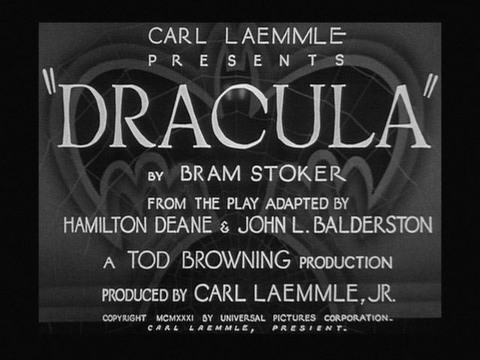

Slide 30
“It is too late for those who love the art of moving pictures to deplore the effects of this barbaric invasion. All they can do is try to cut their losses.” (Clair, p. 92)
“Sound is a two-edged invention, and it is most probable that its use will proceed along the line of least resistance, i.e. along the line of satisfying simple curiosity.” (Soviet Constructivists, p. 83)

Slide 31
“Though such ‘progressive’ means the screen has lost more than it has gained. It has conquered the world of voices, but it has lost the world of dreams.” (Clair, p. 95)
“They must not be tied to one another by naturalistic imitation but connected as the result of the interplay of action.” (Soviet Constructivists, p. 84)

