Slide 1
II. Film Sound Theories
5. Filmic Sound Spaces

Slide 2
Sound Theory Sound Practice
Edited by Rick Altman (1992)
With essays by James Lastra, Michel Chion, and others

Slide 3
The Soundscape of Modernity: Architectural Acoustics and The Culture of Listening in America, 1900-1933
by Emily Thompson (2002)

Slide 4
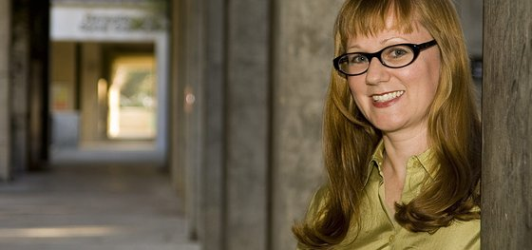
Emily Thompson

Slide 5
Professor of History at Princeton University
MacArthur Fellow (AKA “genius award”) in 2005
Her book-in-progress, Sound Effects, will examine the working lives of sound engineers, editors, musicians, projectionists, and other technicians associated with the production and exhibition of films in the U.S.,1925-1933.

Slide 6
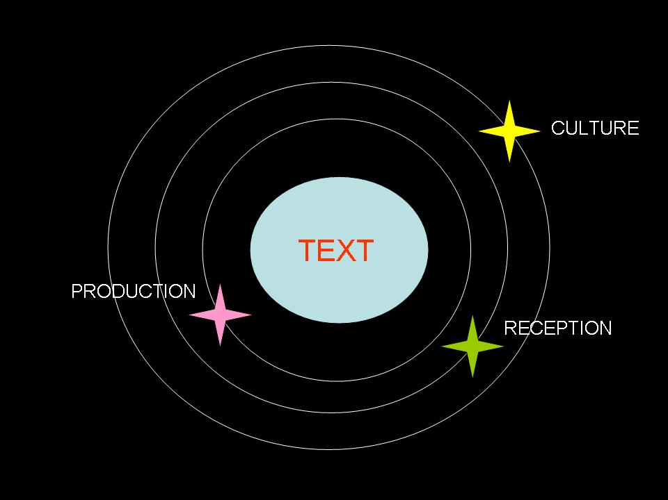
Cinema as Text (Traditional Film Studies)

Slide 7
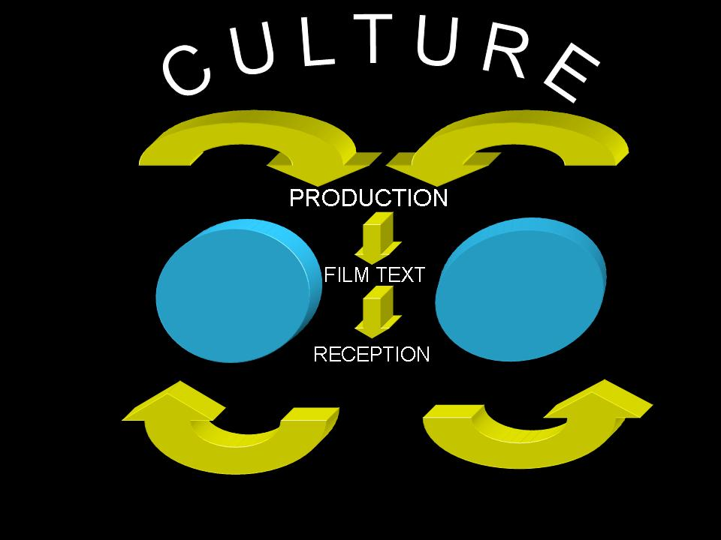
Cinema as Event (Altman’s Model)

Slide 8
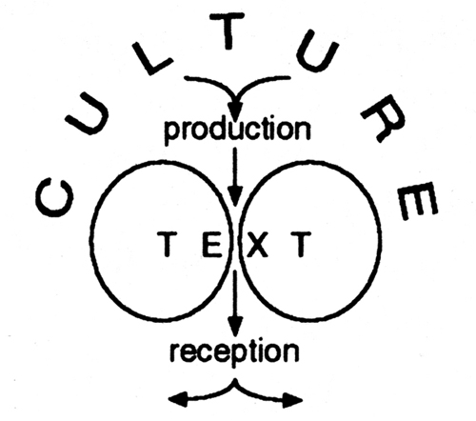

Slide 9
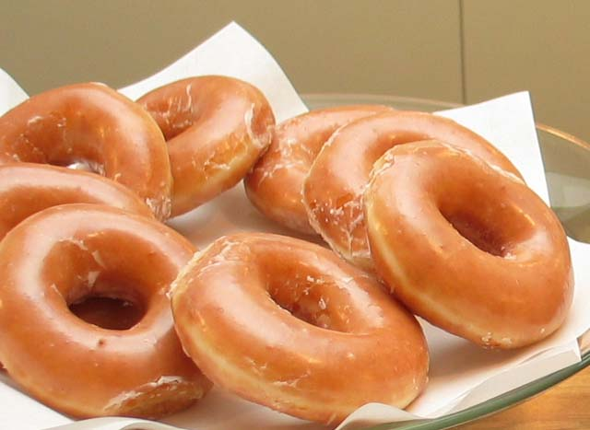

Slide 10
CINEMA AS EVENT
From production to reception, and vice versa (think flying donuts!)
Multiplicity
Three-Dimensionality
Materiality
Heterogeneity
Intersection
Performance
Mutli-Discursivity
Instability

Slide 11
Mediation
Choice
Diffusion
Interchange

Slide 12
SOUND AS EVENT
The production of sound is a material event: vibration, medium, changes in pressure – the composite nature of sound
The sound narrative: naming of sound, “our ears tell us,” Rashomon phenomenon
The recording of a sound event: representation, spatial signature, double (recording/reproduction)

Slide 13
“…recordings are thus always representations, interpretations, partial narratives that must nevertheless serve as our only access to the sounds of the past” (p.27)

Slide 14
Fallacies In Film Sound Theory:
Historical
Ontological
Reproduction
Nominalism
Cinema as index

Slide 15
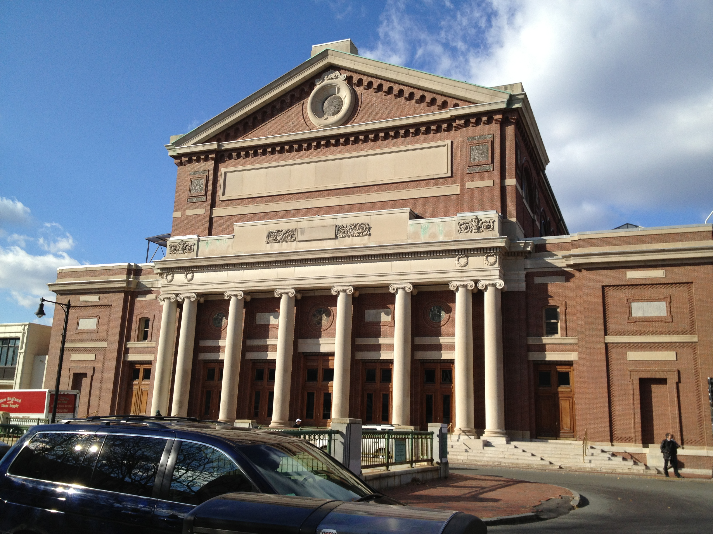
SYMPHONY HALL, BOSTON

Slide 16
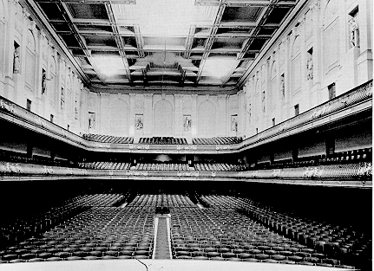

Slide 17
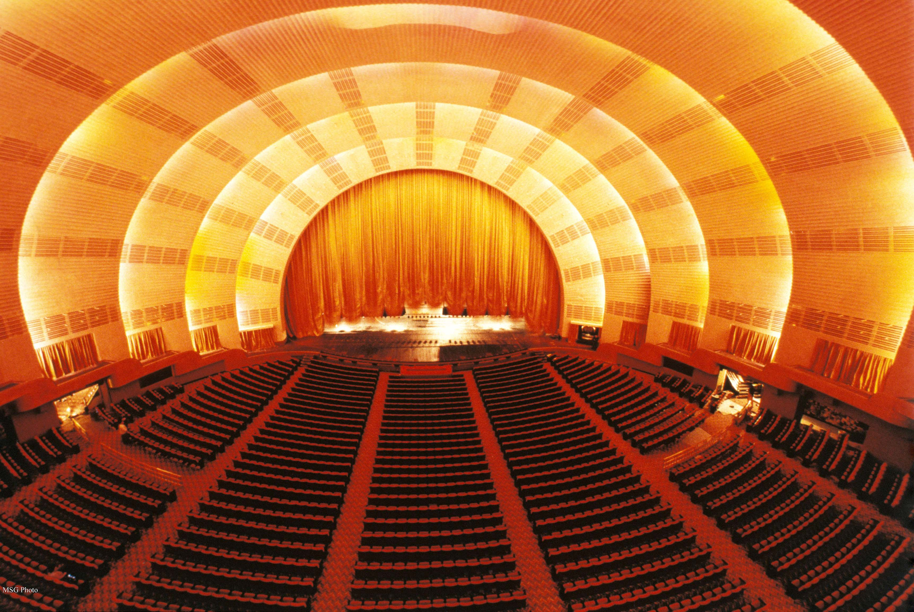
RADIO CITY MUSIC HALL, NEW YORK

Slide 18
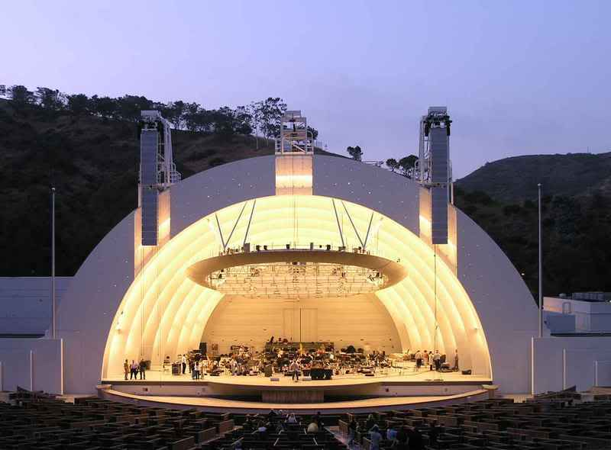
HOLLYWOOD BOWL, LOS ANGELES

Slide 19
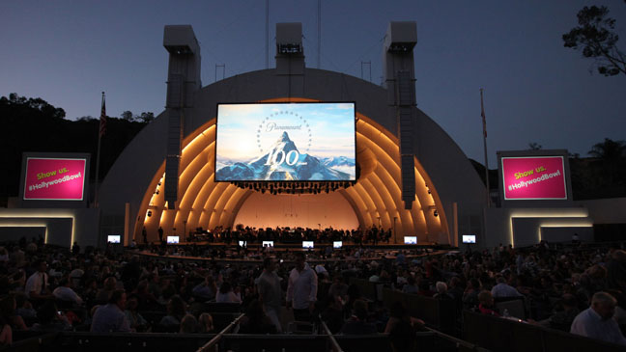

Slide 20
The Electroacoustic Soundscape:
The merging of architectural acoustics and electrical acoustics
Telephone, radio, public address system, phonograph, motion pictures
The development of synchronized and amplified sound for film exhibition

Slide 21
Wiring “silent” movie theaters for sound
Recording studios
Motion picture studios
Motion picture sound: from The Jazz Singer to Singin’ in The Rain

Slide 22
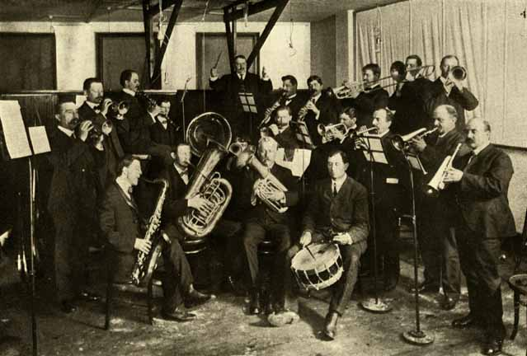
Edison Recording Studio in New York, 1904

Slide 23
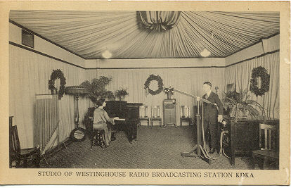
KDKA Broadcast Studio in Pittsburgh, 1924

Slide 24
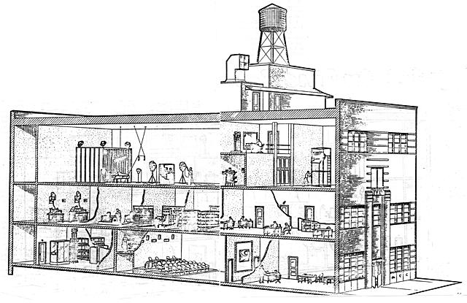
Bell Laboratories Sound Picture Studio at 151 Bank Street, New York; opened in 1929

Slide 25
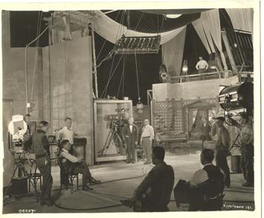
The making of The Voice from the Screen (1926), in Vitaphone’s Manhattan Opera House studio

Slide 26
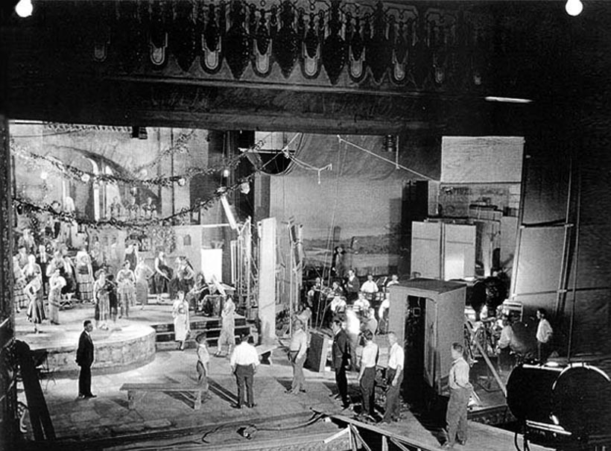

Slide 27
Motion Picture Sound:
1926-28 – mainly film version of staged musicals
Late 1920s to early ‘30s – the moved from shooting in mic-ed sets (immobile microphones) to the use of boom mics
“…by 1930 the sound track ‘came to be seen more as an ensemble constructed in postproduction rather than as a record of an acoustical performance’” (Donald Crafton quoted p. 279)

Slide 28
Focus on recording uniformly “close-up” sound, use of sound concentrators, ribbon microphones, etc.
The use of reverberant chamber and “noise machines” to produce a simulated sense of space and place.
Vococentrism of sound engineers

Slide 29
“In its commodified nature, in its direct and nonreverberant quality, in its emphasis on the signal and its freedom from noise, and its ability to transcend traditional constraints of time and space, the sound of the sound track was just another constituent of the modern soundscape. Indeed, the sound track epitomized the sound of modern America.” (p. 284)

