Slide 1
SOUND, ART, & POWER
Week 11: Media Soundscapes – Direct Listening & Observation

Slide 2
October, 2013, New York City:
Soundings: A Contemporary Score (MoMA)
William Anastasi: Sound Works, 1963-2013 (Hunter College)
Janet Cardiff, The Forty Part Motet (the Cloisters)

Slide 3
October, 2013, New York City:
Soundings: A Contemporary Score (MoMA)
William Anastasi: Sound Works, 1963-2013 (Hunter College)
Janet Cardiff, The Forty Part Motet (the Cloisters)
Emeka Ogboh, The Song of the Germans (The Power Plant, Toronto, 2018)

Slide 4
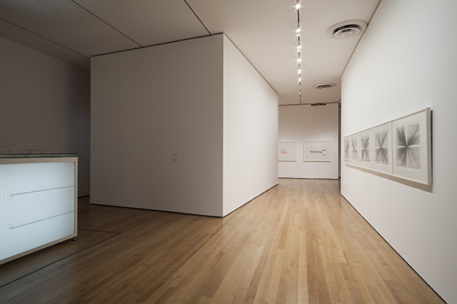
Soundings: A Contemporary Score

Slide 5
Soundings: A Contemporary Score
August 10-November 3, 2013
Museum of Modern Art, New York

Slide 6
Soundings: A Contemporary Score
August 10-November 3, 2013
Museum of Modern Art, New York
Curated by Barbara London

Slide 7
Soundings: A Contemporary Score
August 10-November 3, 2013
Museum of Modern Art, New York
Curated by Barbara London
Group exhibition:

Slide 8
Soundings: A Contemporary Score
August 10-November 3, 2013
Museum of Modern Art, New York
Curated by Barbara London
Group exhibition:
16 artists

Slide 9
Soundings: A Contemporary Score
August 10-November 3, 2013
Museum of Modern Art, New York
Curated by Barbara London
Group exhibition:
16 artists
M(11) / F(5)

Slide 10
Soundings: A Contemporary Score
August 10-November 3, 2013
Museum of Modern Art, New York
Curated by Barbara London
Group exhibition:
16 artists
M(11) / F(5)
All born after 1960

Slide 11
Soundings: A Contemporary Score
Artists are American, Australian, British, Danish, German, Japanese, Taiwanese, Norwegian, Scottish, and Uruguayan.

Slide 12
Soundings: A Contemporary Score
Artists are American, Australian, British, Danish, German, Japanese, Taiwanese, Norwegian, Scottish, and Uruguayan.
Drawing, sculpture, installation, video, and of course, sound; one outdoors installation by Stephen Vitiello (A Bell for Every Minute, 2010)

Slide 13
“MoMA’s major exhibition of sound” (MoMA web site and many reviews)
"I thought a lot about how I didn't want it to look like an equipment trade show, with just rooms of speakers.” (London quoted in Art in America)

Slide 14
“As commercial art galleries embraced media art and developing marketing strategies for it, museums hired media conservators to safeguard and preserve it for the future. This practical step, along with the burgeoning of interdisciplinary art practices, contributed to what is now a widespread acceptance of time-based media installation as a collectable art form.” (London, Soundings exhibition catalogue, p. 9)

Slide 15
“The MoMA show made me worried about sound-as-art and its future in the gallery. The show seemed to presume that, in order to make sound into something that can live comfortably in a collection, language and politics have to be dumped out of it.

Slide 16
In the effort to embrace the way sound is spatial and sculptural, or can be translated to a visual realm, the ‘plastic’ and physical qualities of sound are isolated and depoliticized.” (Jessica Feldman, “The Trouble with Sounding”, Ear/Wave/Event, Issue One, online)

Slide 17
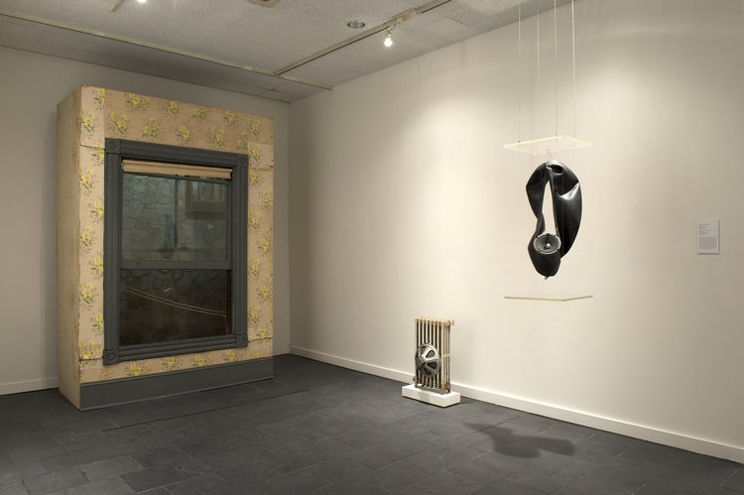
William Anastasi: Sound Works, 1963-2013

Slide 18
William Anastasi: Sound Works, 1963-2013
October 4 – November 30, 2013
Bertha and Karl Leubsdorf Gallery, Hunter College, New York
Curated by Max Weintraub
Solo exhibition: retrospective of Anastasi, an American artist based in New York, of works from a period of 50 years

Slide 19
William Anastasi: Sound Works, 1963-2013
About 20-25 works, consisting of drawings, media installations, and found object sculptures
An exhibition that ”examines the importance of sound in the work of [Anastasi], one of the key figures in the development of conceptual, process, and minimal art” (Weintraub, in Sound Works exhibition brochure, np)

Slide 20
William Anastasi: Sound Works, 1963-2013
The collective soundscape of the exhibition is, in fact, a realization of Anastasi’s original sound design for the 1966 Sound Objects exhibition that he devised in consultation with John Cage.

Slide 21
“Operating as an ensemble, Anastasi’s Sound Objects situate the visitor within a decidedly nonhierarchical field of noise. Indeed, much like the boundlessness of sound itself, one’s experience of Anastasi’s sonic environment is neither neatly contained nor tidy, as the sounds produced extend beyond the confines of their accompanying objects and into the space of the viewer’s existence.” (Weintraud, Sound Works exhibition catalogue, p. 16)

Slide 22
“Operating as an ensemble, Anastasi’s Sound Objects situate the visitor within a decidedly nonhierarchical field of noise. Indeed, much like the boundlessness of sound itself, one’s experience of Anastasi’s sonic environment is neither neatly contained nor tidy, as the sounds produced extend beyond the confines of their accompanying objects and into the space of the viewer’s existence.” (Weintraud, Sound Works exhibition catalogue, p. 16)

Slide 23
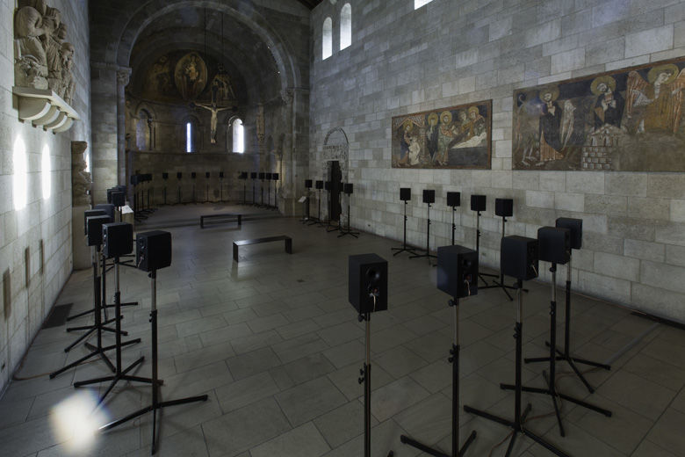
Janet Cardiff, The Forty Part Motet, 2001

Slide 24
Janet Cardiff, The Forty Part Motet (A reworking of ‘Spem in Alium” by Thomas Tallis 1556/1557), 2001
September 10 – December 8, 2013
The Cloisters, a branch of the Metropolitan Museum of Art, New York
Installed in the Fuentidueña Chapel at the Cloisters.

Slide 25
“Constructed in the manner of a medieval cloister, the building is in fact a hybrid of architectural elements spanning 11th through 16th centuries that were assembled together using modern materials and techniques in the 1920s and ‘30s. One could argue that The Cloisters is itself an installation.

Slide 26
“Constructed in the manner of a medieval cloister, the building is in fact a hybrid of architectural elements spanning 11th through 16th centuries that were assembled together using modern materials and techniques in the 1920s and ‘30s. One could argue that The Cloisters is itself an installation.

Slide 27
The Fuentidueña Chapel, where a 12th century Spanish apse is combined with a modern nave, shows this architectural hybridity. It is also a space that is often used for concerts of early music.” (TINST, p. 153)

Slide 28
Janet Cardiff, The Forty Part Motet, 2001
14-minute sound installation

Slide 29
Janet Cardiff, The Forty Part Motet, 2001
14-minute sound installation
Forty speakers, each one playing a discretely recorded vocal part sung by members of the Salisbury Cathedral Choir

Slide 30
Janet Cardiff, The Forty Part Motet, 2001
14-minute sound installation
Forty speakers, each one playing a discretely recorded vocal part sung by members of the Salisbury Cathedral Choir
This, as Cardiff said, is like stepping ”right inside the music” where “the listener would be able to really feel the sculptural construction of the piece by Tallis.” (Bad at Sports podcast)

Slide 31
Janet Cardiff, The Forty Part Motet, 2001
14-minute sound installation
Forty speakers, each one playing a discretely recorded vocal part sung by members of the Salisbury Cathedral Choir
This, as Cardiff said, is like stepping ”right inside the music” where “the listener would be able to really feel the sculptural construction of the piece by Tallis.” (Bad at Sports podcast)

Slide 32
“My near-epiphanic experience reminded me of the architect Stanley Saitowitz’s description of first visiting Mies van der Rohe’s Barcelona Pavilion: ‘I came to understand space the way a fish might understand water, if it could.’

Slide 33
…Somehow, Motet pulled the entire space into its composition, embedding the memory of the architecture with the memory of the piece.” (Terence Riley, “Hope in Any Other”, Affidavit, 1.2.2013)

Slide 34
“moved to tears,” “openly wept”

Slide 35
“moved to tears,” “openly wept”
“spirituality,” “sacredness,” “religiosity,” “transcendence,” “profundity”

Slide 36
“moved to tears,” “openly wept”
“spirituality,” “sacredness,” “religiosity,” “transcendence,” “profundity”
“a prayer on steroids”.
(Various sources – mostly reviews – see TINST endnotes)

Slide 37
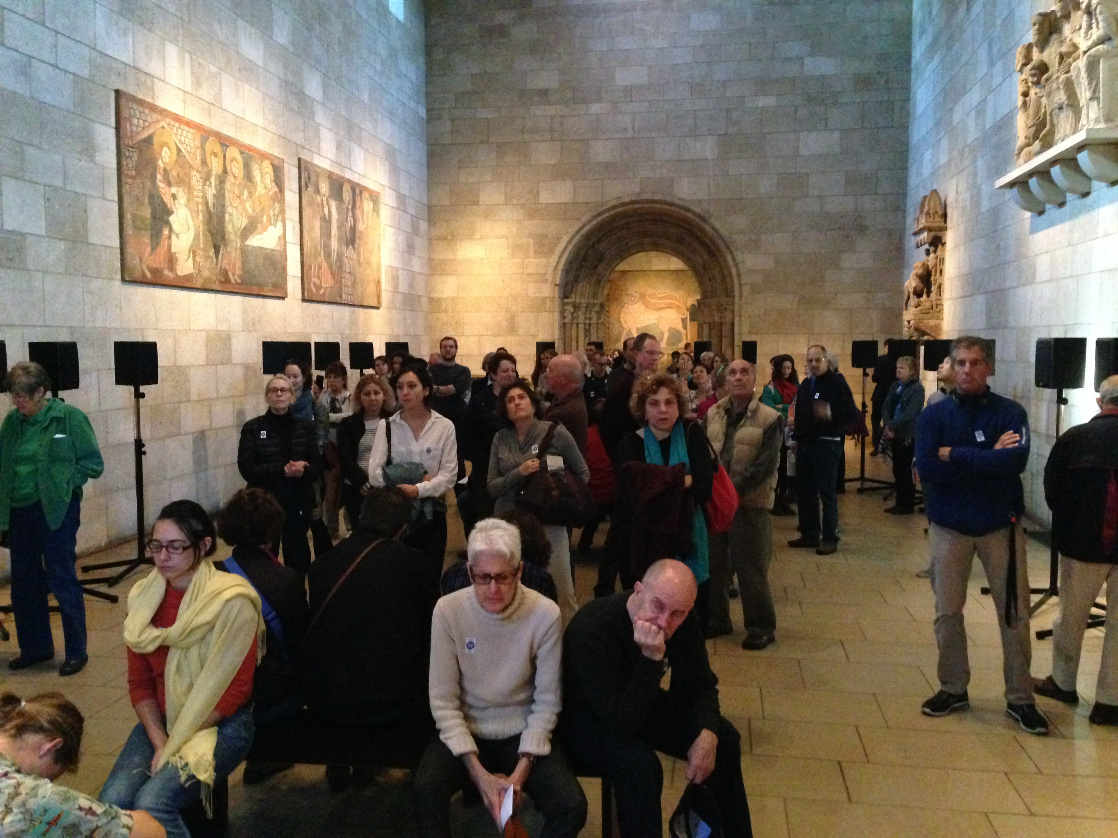
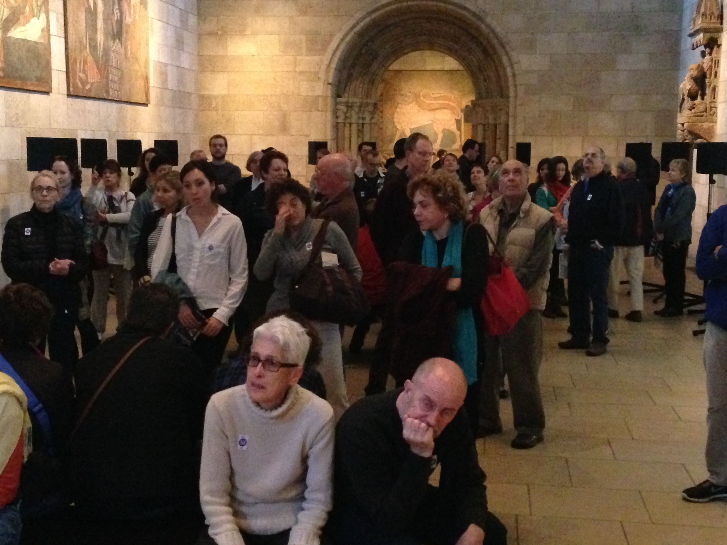
The Forty Part Motet at the Cloisters, 2013

Slide 38
The Forty Part Motet at the Cloisters, 2013

Slide 39
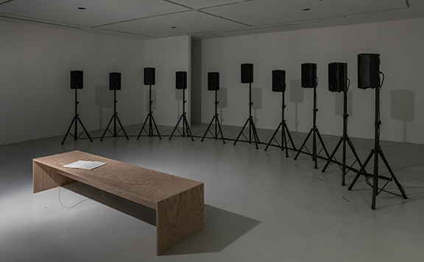
Emeka Ogboh, The Song of the Germans, 2015

Slide 40
Emeka Ogboh, The Song of the Germans / Deutschlandlied, 2015
January 27 – May 13, 2018
The Power Plant, Toronto, Canada
Curated by Nabila Abdel Nabi

Slide 41
Emeka Ogboh, The Song of the Germans / Deutschlandlied, 2015
January 27 – May 13, 2018
The Power Plant, Toronto, Canada
Curated by Nabila Abdel Nabi
Ogboh recorded the third stanza of the German national anthem sung by Bona Deus, a Berlin-based Afro-Gospel choir composed of African refugees living in Germany.

Slide 42
Emeka Ogboh, The Song of the Germans, 2015
Each singer is individually recorded singing the anthem in their mother tongue. The result is a chorus composed of 10 different African languages: Ibo, Yoruba, Bamoun, More, Twi, Ewondo, Sango, Douala, Kikongo and Lingala

Slide 43
Emeka Ogboh, The Song of the Germans, 2015
Each singer is individually recorded singing the anthem in their mother tongue. The result is a chorus composed of 10 different African languages: Ibo, Yoruba, Bamoun, More, Twi, Ewondo, Sango, Douala, Kikongo and Lingala
“…one singer starts the piece, then the others joining in at different points in the song, building up to the full choir.” (Arthur Carabott, programmer for the installation, on his web site)

Slide 44
“joyless”

Slide 45
“joyless”
“aching with loss”

Slide 46
“joyless”
“aching with loss”
Discussed almost exclusively in the secular terms of nationalism and globalization.
(Various sources – mostly reviews – see TINST endnotes)

Slide 47
“In his installation, the flatness and hardness of the acoustic architecture serve to foreground the linguistic and vocal elements in the performance by the Berlin-based Afro-Gospel choir Bona Deus, and their performative act of ‘Africanizing’ this Germanic text. This foregrounding of the hybrid and sometimes clashing nationalisms in the singing produce the distanced and critical response in many of The Song of the Germans’ audience and reviewers.” (TINST, p. 156-7)

Slide 48
The reverberant acoustic space produced by the polyphonic harmonies of Spem in Alium working in conjunction with the acoustic architecture of the Fuentidueña Chapel, on the other hand, draw the audience into its soundscape to produce the sense of immersion and belonging that for many are expressions of spirituality and transcendent emotion. (TINST, p. 157)

Slide 49
The contrast between the totalizing harmony in The Forty Part Motet and the cultural dissonance in The Song of the Germans, two formally similar media installations, amplifies Thompson’s findings on how cultural, political, and religious ideologies can alter and shape human perception of a soundscape. (TINST, p. 157)

