Slide 1
SOUND, ART, & POWER
Week 12: Media Soundscapes – Empirical Research, Institutional Practices

Slide 2
Empirical Research:
226 artists invited, 47 interviewed (online survey, email, Skype interviews)
Age: 23-83 (majority in their 40s to 60s)
About equal representation between men and women; all identified as cis-gender
Austria, Canada, Denmark, Croatia, France, Germany, Mexico, Norway, South Africa,

Slide 3
Spain, Sweden, Taiwan, Turkey, US, UK, Uruguay
All but two artist-respondents are currently based in Europe or North America
Most of the artist-respondents self-identify as trans or multi-disciplinary in their art practice.

Slide 4
Survey or Interview Questions:
Please describe or define your art practice (e.g. performance, installation, video artists, etc.) and the medium(a) you work in (e.g. video installation, multi-media performance, etc.)
Do you use sound in your work? How important is sound as an element in your work?
Please describe or outline your philosophy and/or method in working with sound. Name specific projects (title, year, medium) as examples when relevant.

Slide 5
Do you employ, commission, or collaborate with others on sound elements in your work? Name specific projects (title, year, medium) as examples when relevant.
How does sound function in relationship to space in your work (i.e. gallery, architecture, or outdoor spaces; also as soundscape in your soundtracks, recordings, remixes, etc.)?
How do the sound elements interact (or not) with the visual elements in your work?

Slide 6
Responses
On their practice:
“My art practice is research-based, comprising conversation, performance, workshop, installation, and text. I try to carry out research, production and (re)presentation concurrently when possible. Hence the medium I work with/in changes along the process dictated by the engagements of collaborators and participants.”

Slide 7
Responses
On their practice:
“I spend a lot of time resisting any demand to define my art practice. Definitions can be useful as shorthand, but they can also be detrimental in that they tend to foster assumptions that emerge out of the reductive act of categorization.”

Slide 8
Identification through their medium(a): video (and video art), film, installation (including sound installation, video installation, immersive environments), photography, performance, sculpture, and net art.
Self-identify as composers or sound recordists.
Also collectives, partnerships, or project-based collaborations.

Slide 9
Responses
Sound as an element in their work: methods, ideas, and practices
“Sound has been a major component of my work for the last 50 years. At times it is so important that without sound the work does not exist.”

Slide 10
Responses
Sound as an element in their work: methods, ideas, and practices
“I am interested in using sound as a way to study society and culture. Sound is my periscope—to use a visual metaphor—for the world. It’s an anthropological approach—social, cultural, and political.”

Slide 11
Two main approaches on how artist-respondents work with and think about sound:
One focuses on the exploration of the unique properties of sound
And the other where the artist-respondent focuses on how sound interacts with other elements in their work
Ideas and practices: site-specificity, music composition, social engagement, field or location recording, as well as voice, listening/perception, resonance, background noise, sound editing and production.

Slide 12
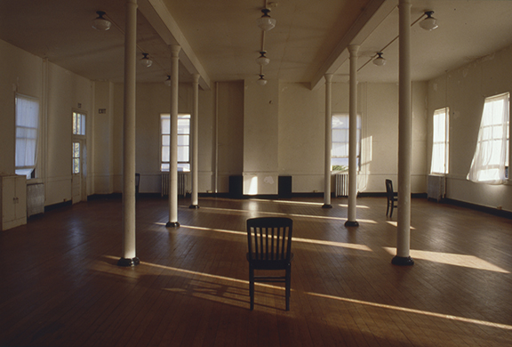
Lewis deSoto, AIR, 1989
Headlands Center for the Arts, Sausalito, CA

Slide 13
Perception and listening:
“To be able to be quiet and just listen is important to me, and that is what I am able to offer in my work. I don’t tell my audience what to think, I just want to create a space to listen. My recordings reveal sounds that are not immediately apparent at a place. This may initially be alienating, but it also opens up new possibilities.”

Slide 14
Perception and listening:
“Artists as well as audiences who are deaf or hard of hearing experience sound as vibration, as other people’s reaction, and as idea. Being deaf in a world of sound is like living in a foreign country, blindly following their cultural rules, customs and behaviors without ever questioning them. [As a Deaf artist] I didn't really have an awareness of sound until I started working with sound as medium. My work is all about the politics of sound.”

Slide 15
Perception and listening:
Pauline Oliveros (“deep listening”), Francisco Lopez (“profound listening”)
Specialized equipment including accelerometers, hydrophones, etc.
Questions of anthropocentricism and ability (what about deaf or hearing impaired artists and audiences?)

Slide 16
Perception and listening:
Listening as a tool for social engagement, community organizing, and popular education. Embodied listening as a potent political act
As collaborative act or practice (e.g. ARLA, Granular-Synthesis, San Francisco Threshold Choir, Ultra-red, and other, less formal or permanent collaborative relationships)

Slide 17
Responses
Space in relationship to their work:
“(i) sound alone makes a more fluid construction of space; (ii) almost all recorded sounds we listen to contain a virtual sonic space; (iii) precisely because of the role of space as medium for re-physicalization (and regardless of whether digital or analog), there is no such thing as ‘recorded sounds’”

Slide 18
Responses
Space in relationship to their work:
“It's similar to collaborating with a human, working with a site, both have their own concerns. I mean there is nothing more beautiful than placing a sound in a space and seeing how the space and the structure speak to each other. And it's really great with the acoustics that ‘process’ the sound.”

Slide 19
Responses
Space in relationship to their work:
Majority of the artist-respondents work with existing spaces
All point out that space is necessary for an acoustic experience
Artist-respondents also discuss the soundscapes in their media installations and performances in relationship to ideas of site-specificity, mapping, architectural acoustics, and immersion.

Slide 20
On sonic realism – as standardized in Classical Hollywood cinema:
“Many of my works are based on the same principle: what you see is not what you get. One’s experience of the work as a listener is quite different from the visual appearance of the work and the experience of being an onlooker.”

Slide 21
On sonic realism – as standardized in Classical Hollywood cinema:
“…the sound can either complement the visual or create a separate audio environment. Often it is necessary to use sync sound to create a sense of ‘realness’ in the video, and just as often it is necessary to create an entirely separate ambience, composed of multiple processed audio elements to achieve a transformation of the real.”

Slide 22
On sonic realism – as standardized in Classical Hollywood cinema:
the mix between the acoustics of the exhibition spaces and the media soundscape of a work creates a hybrid acoustic space that is not entirely illusionistic nor ”realistic”.

Slide 23
Contemporary art museums and galleries, as well as other institutions that present media art, configure our listening and viewing experiences of media installations and performances through their budgets, personnel, and departments; the design and construction of their exhibition spaces as well as their preparatory practices; their calendar and scheduling; and their process and criteria of selecting artists and exhibitions. (TINST, p. 157)

Slide 24
Institutional Practices:
Seven art institutions located in the U.S., Australia, and Hong Kong
All were founded post-1960, and most began their exhibition of contemporary art between the 1970s to the 1990s.
All are public institutions or a part of educational institutions: ranging from artist-run spaces to campus art galleries to museums
All exhibit contemporary media installations and performances

Slide 25
All “white cube” spaces (with one exception)
Dedicated audio-visual teams or contractual worker (event-planning model) and A/V kits
Group interviews with curators, preparators, managers, and exhibition designers, with a focus on those who specialize in contemporary media art.

Slide 26
Interview Questions:
Please describe how you work with media artists on exhibition design (layout, architecture, signage, etc.) for their installations or performances. You can speak generally or use specific examples.
How is working with a media artist on their installation or performance unique or different from working with other artists (e.g. a painter or sculptor)?

Slide 27
What accommodations or modifications does your institution make for presenting media installations or performances?
Do you think your institution is designed or equipped to present audio-visual media?
How about other art institutions – any comes to mind as exemplary in their presentation of audio-visual media?

Slide 28
Responses
On white cube spaces:
“…the worst acoustics for controlling sound, but the best look for contemporary art.” (my emphasis)

Slide 29
Responses
On white cube spaces:
“Whoever designed these spaces do not understand how an art gallery functions, because they put thermostats and outlets right in the middle of the wall, but did not install any outlets high enough so we can plug in media equipment like projectors. The spaces behind the walls and ceiling are inaccessible so there is no way to make media equipment and cables disappear—it is always challenging to install media art in these spaces.”

Slide 30
Make the spaces as flexible as possible
Gallery spaces are retrofitted, adding power and media access points in its walls, floors, or ceilings
Architectural elements to mount projectors and speakers
The ability to (temporarily) install soundproofing materials
Construct spaces to contain the media soundscape of specific works

Slide 31
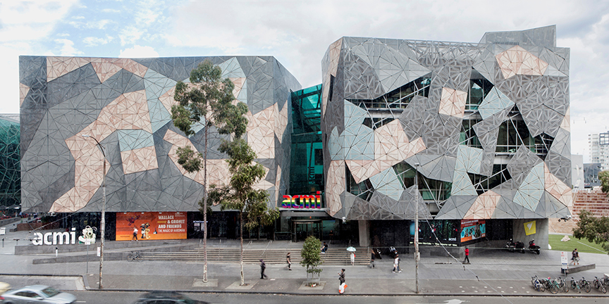
Australian Centre for the Moving Image (ACMI) in Melbourne

Slide 32
Designed by Bates Smart Architects and opened in 2002.
ACMI began as a film center and evolved into a lending media library, cinematheque, education program, and exhibition space.
2 cinemas and 3 gallery spaces (2 dedicated to non-permanent exhibitions)
Black box spaces

Slide 33
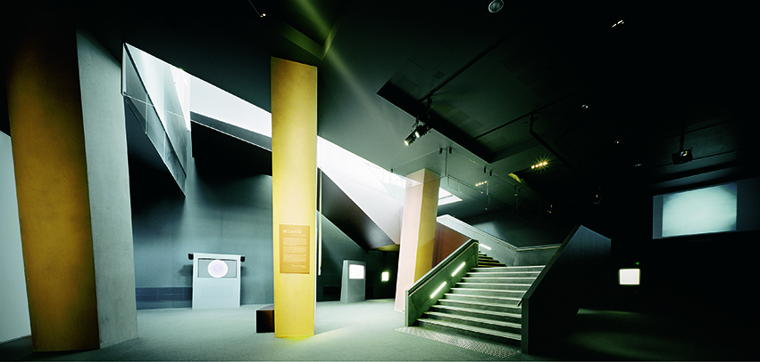
Australian Centre for the Moving Image (ACMI) in Melbourne

Slide 34
Interview with Sarah Tutton, Senior Curator, & Chris Harris, Head of Exhibition Production
“…there is no existing state that the galleries have to go back to, therefore all the shows look different. There are no internal walls in the galleries. So we do not try to fit the work into an existing space, but rather, build the spaces for each work or exhibition.” (ST)

Slide 35
Interview with Sarah Tutton, Senior Curator, & Chris Harris, Head of Exhibition Production
“…all the galleries are carpeted for sound absorption, and the main gallery floor has a computer-access design. The walls, floors, and ceiling of the galleries all have built-in media conduits—ACMI uses the BrightSign media system, which plays MEPG media files. Depending on what the artist wants, we can create a customized space for each work in an exhibition.” (CH)

Slide 36
Interview with Sarah Tutton, Senior Curator, & Chris Harris, Head of Exhibition Production
“…there is really no ambient sound in our gallery spaces to begin with…We are not that precious about our building.” (ST+CH)

Slide 37
Black box spaces reference the design and construction of theaters and cinemas as much as art galleries and museums
They are just as flexible as white cube spaces, and perhaps more so when it comes to the exhibition of media installations and performances.
Black box galleries are rare (limited to theaters, lecture halls, etc.) and often relegated to the basement

Slide 38
Discussion:
Are architects and designers of contemporary art spaces unaware of or not concerned with the specific needs of exhibiting media art?

Slide 39
Discussion:
Are architects and designers of contemporary art spaces unaware of or not concerned with the specific needs of exhibiting media art?
Then why show audio-visual media in galleries at all, especially at institutions that have cinemas and theater spaces designed and constructed specifically for this purpose?

Slide 40
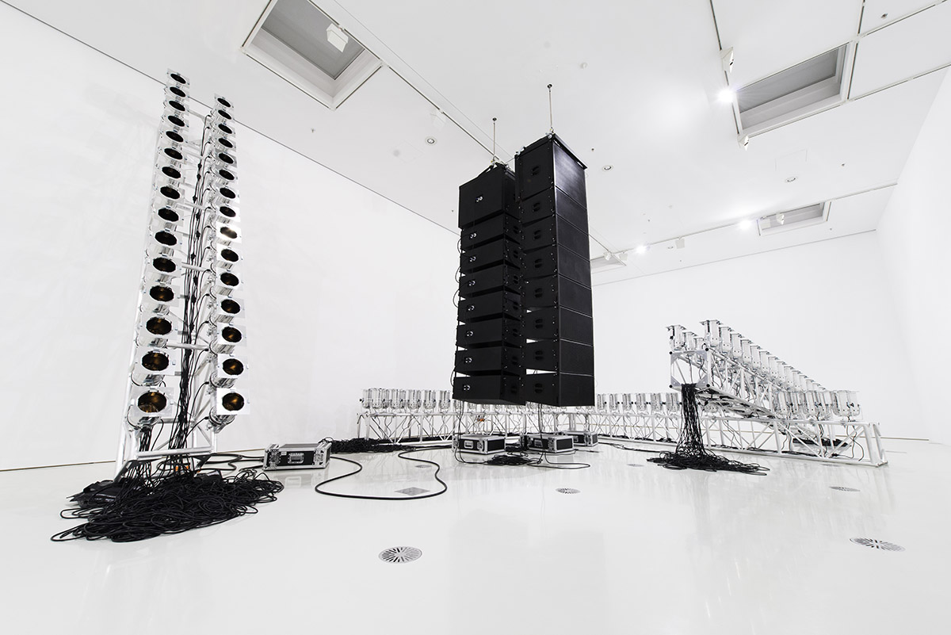
Marco Fusinato,
Aetheric Plexus (Broken X), 2013

Slide 41
“If I’d had more space, I would have put in [a] noise work by Marco… But that kind of piece, real noise, means ‘how do I contain it?’”
“You can’t have 20,000 watts of white light burning someone’s face off”
“The politics of these institutions are complex.”

Slide 42
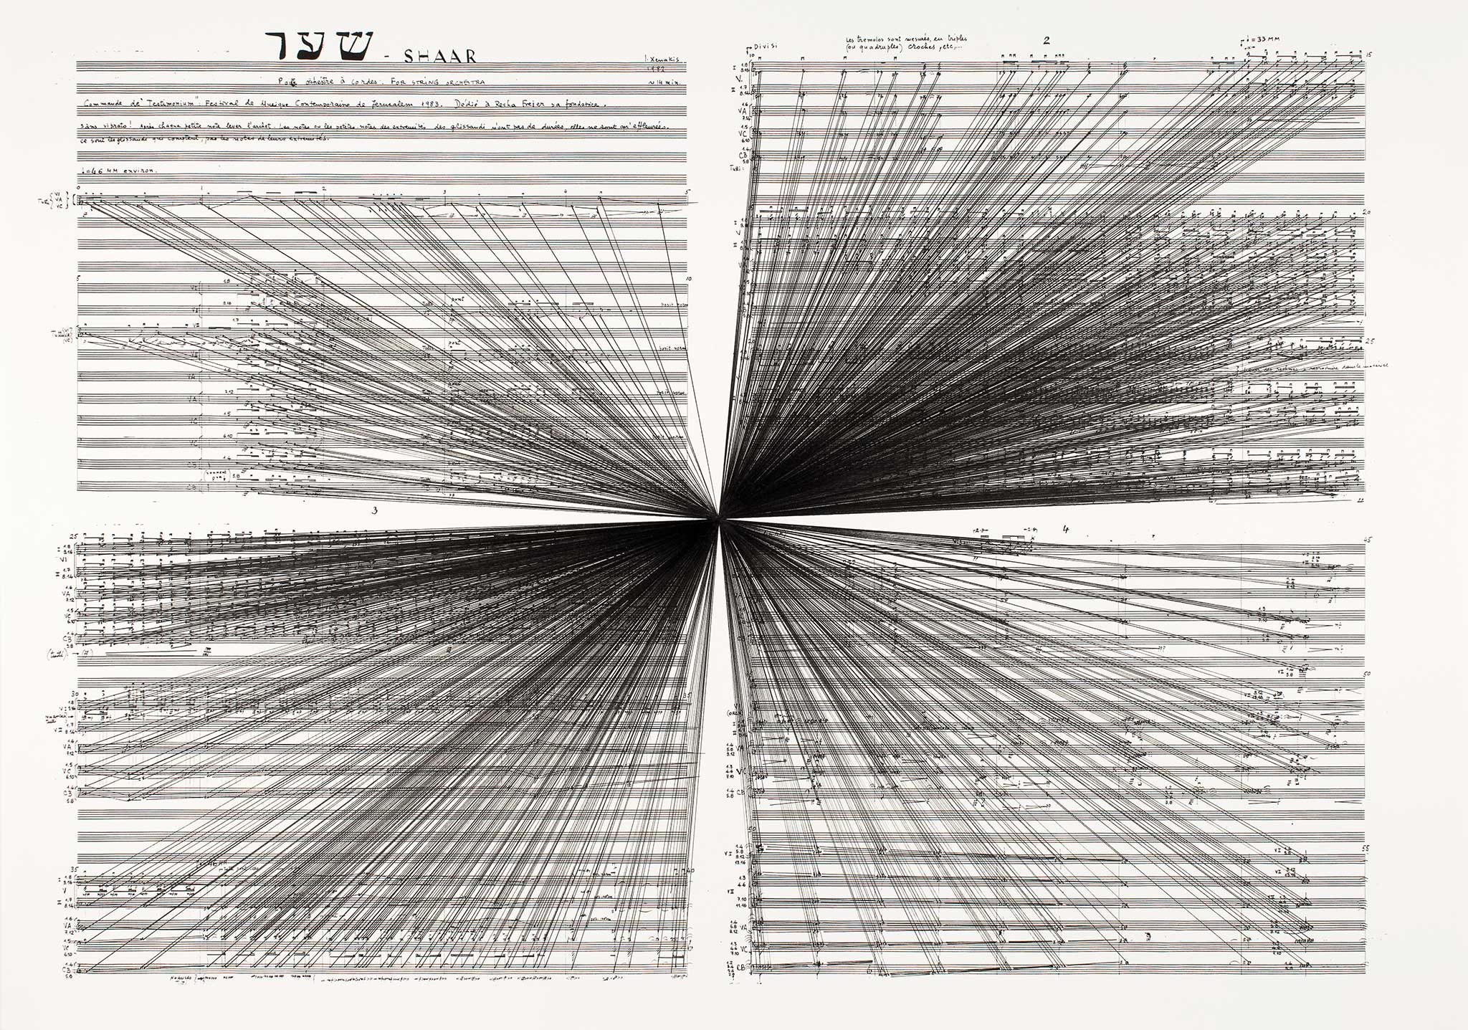
Marco Fusinato, Mass Black Implosion (Shaar, Iannis Xenakis), 2012

Slide 43
Group Work & Discussion:
You are now a group of curators and exhibition designer at an art gallery or museum (you can choose one you know, or imagine/design one!) tasked with presenting one of Fusinato’s Aetheric Plexus installations:
How will your institution present this work? What modifications (to the architecture, exhibition hours, and other logistical or policy considerations) will you make? Will you ask the artist to change or modify their work?

Slide 44
Group Work & Discussion:
You are now a group of curators and exhibition designer at an art gallery or museum (you can choose one you know, or imagine/design one!) tasked with presenting one of Fusinato’s Aetheric Plexus installations:
Depending on the strategy(ies) you decide to adopt for this exhibition, are you working towards sonifying your institution?

Slide 45
Group Work & Discussion:
You are now a group of curators and exhibition designer at an art gallery or museum (you can choose one you know, or imagine/design one!) tasked with presenting one of Fusinato’s Aetheric Plexus installations:
Or is your institution (of which you are a part) active shaping Fusinato’s work into your ocularcentric paradigm, thereby isolating, commodifying, and ultimately depoliticizing sound?

