Slide 1
SOUND, ART, & POWER
Week 15: Notes on Acoustic Time

Slide 2
“…space indexes the distribution of sound, and time indexes the motion of sounds. Yet acoustic time is always spatialized; sounds are sensed as connecting points up and down, in and out, echo and reverb, point-source and diffuse. And acoustic space is likewise temporalized, sounds are heard moving, locating, placing points in time” (Steven Feld, “Waterfalls of Song”, pp. 97-98)

Slide 3
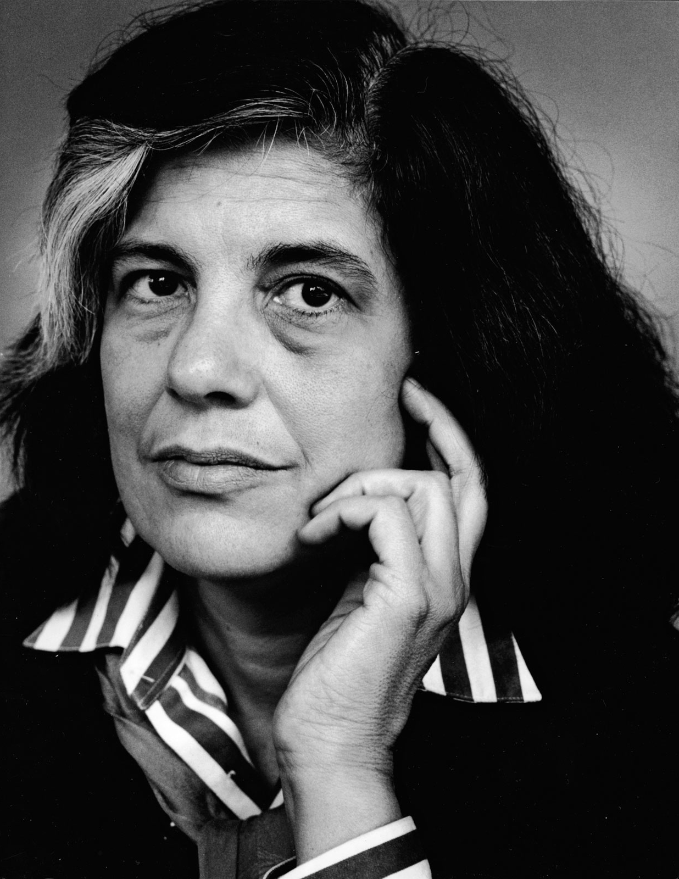
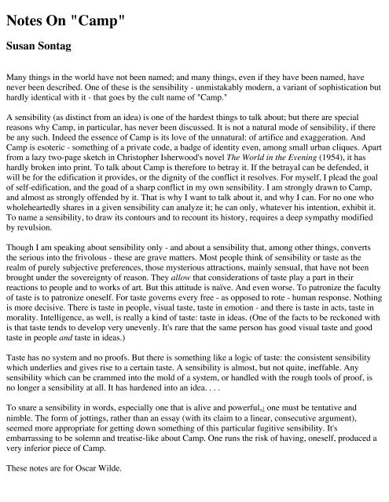

Slide 4
The 4th Rubric: Time

Slide 5
The 4th Rubric: Time
Remix (author as DJ)

Slide 6
The 4th Rubric: Time
Remix (author as DJ)
A numbered list (same as the Sontag format)

Slide 7
The 4th Rubric: Time
Remix (author as DJ)
A numbered list (same as the Sontag format)
“Collage-as-method” (Irene Noy)

Slide 8
The 4th Rubric: Time
Remix (author as DJ)
A numbered list (same as the Sontag format)
“Collage-as-method” (Irene Noy)
“Cultural materialist approach to a series of resonant events” (Jennifer Stoever)

Slide 9
The 4th Rubric: Time
Remix (author as DJ)
A numbered list (same as the Sontag format)
“Collage-as-method” (Irene Noy)
“Cultural materialist approach to a series of resonant events” (Jennifer Stoever)
Resonance

Slide 10
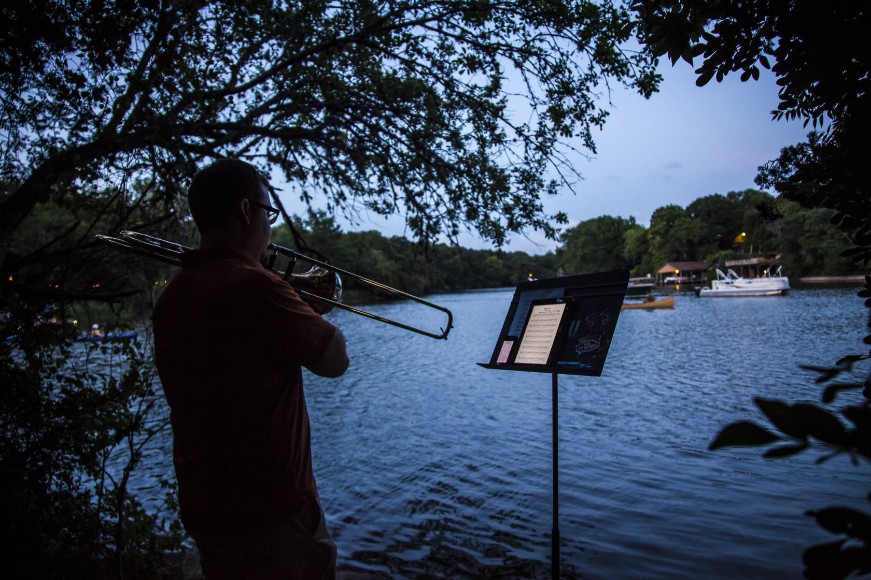
R. Murray Schafer, Music for Wilderness Lake: for 12 Trombones, 1979

Slide 11
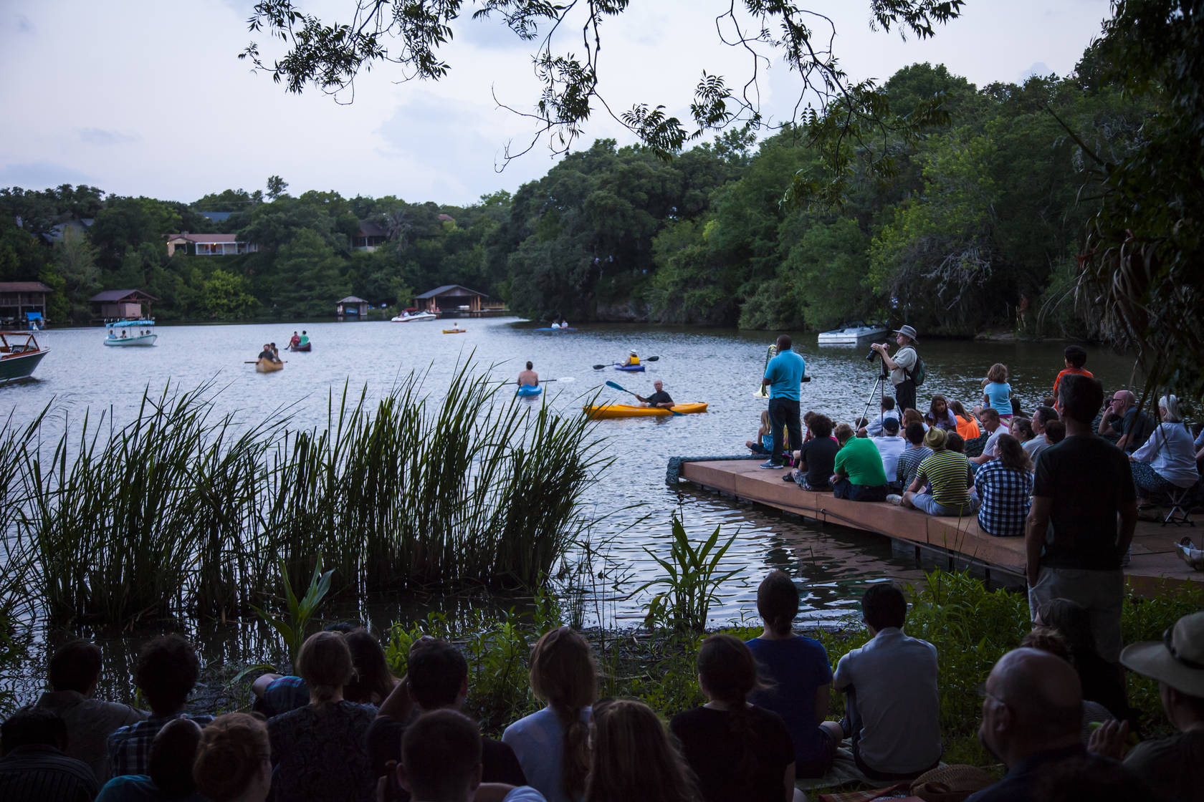
Performance in 2014 at Laguna Gloria in Austin, TX.

Slide 12
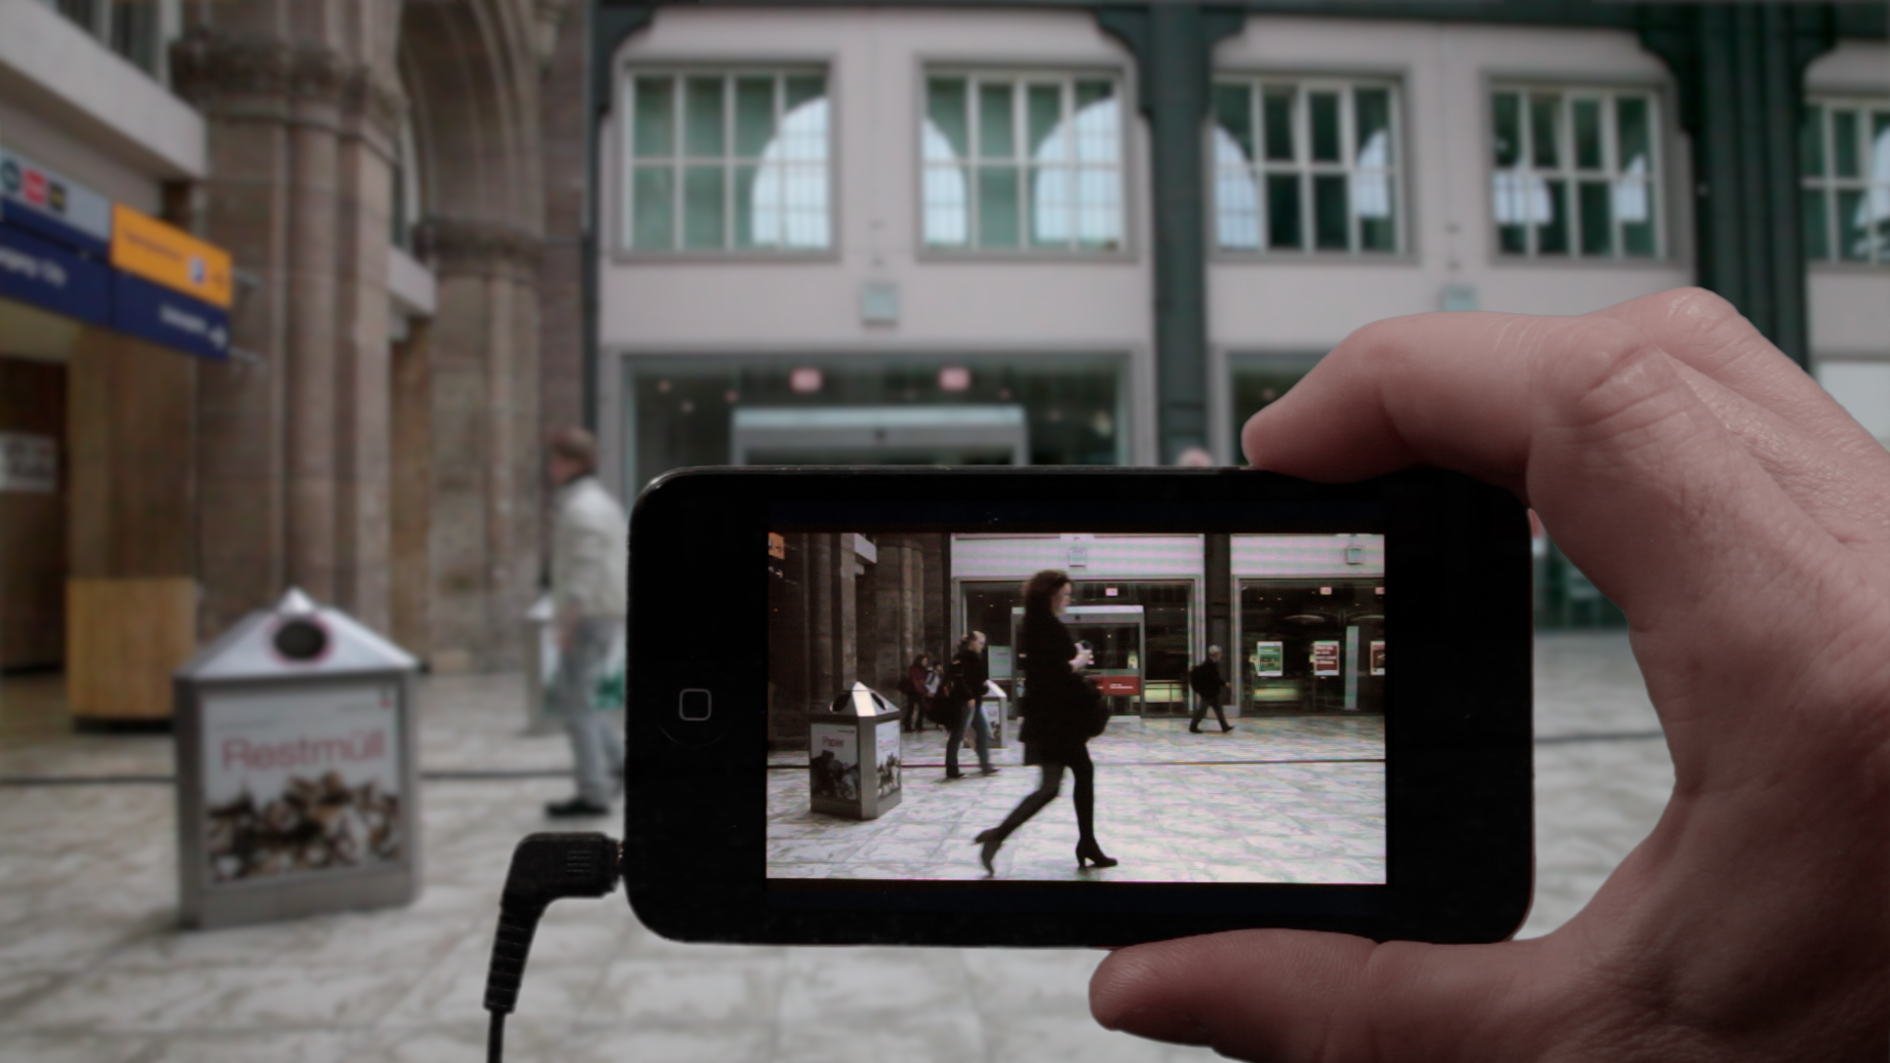
Janet Cardiff & George Bures Miller, Alter Bahnhof Video Walk, 2012

Slide 13
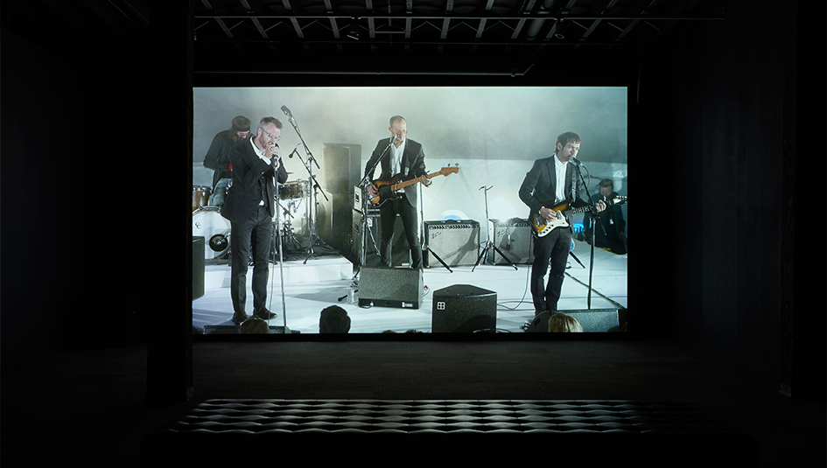
Ragnar Kjartansson & The National, A Lot of Sorrow, 2013-14

Slide 14
“In the process of compiling these notes, I re-read ‘There is No Soundtrack’ through the rubric of time. These entries on the subject are not finite, nor their relationality fixed. They signal both the ending of the present project, and the beginning of new ones.” (TINST, p. 230)

