Slide 1
SOUND, ART, & POWER
Week 3:
Voice in Media
Disembodied Voices

Slide 2
“Unique”
(Adriana Cavarero)

Slide 3
“pure auto-affection”
(Jacques Derrida)

Slide 4
“…the stuff of consciousness.”
(Jonathan Sterne)

Slide 5
“The voice and nothing more.”
(Mladen Dolar)

Slide 6
Two powerful ideas about the voice in the Western metaphysical and linguistic traditions:

Slide 7
Two powerful ideas about the voice in the Western metaphysical and linguistic traditions:
Voice as the guarantor of truth and self-presence (the voice expresses self and identity; subjectivity)

Slide 8
Two powerful ideas about the voice in the Western metaphysical and linguistic traditions:
Voice as the guarantor of truth and self-presence (the voice expresses self and identity; subjectivity)
The sounding, material voice (material vocality)

Slide 9
Voice in Media:
Theories of the voice (liberation movements, identity politics, subject formation – psychoanalysis, feminism)
Chion: “There are voices, and then everything else.” (The Voice in Cinema, p. 5)
Vococentrism
Verbocentrism
Synchronization

Slide 10
Voice & Disembodiment:
Power of the disembodied voice (Connor, Chion, Doane and Bonitzer)
Schizophonia (Schafer)
History (Altman)
Feminist film theory (Silverman, Doane)

Slide 11
According to Silverman, Hollywood’s sonic vraisemblable, codified in its standards and conventions, ‘stresses unity and anthropomorphism. It subordinates the auditory to the visual track, nonhuman sounds to the human voice, and “noise” to speech. It also contains the human voice within the fiction or diegesis’.

Slide 12
Silverman further points out that sonic vraisemblable is sexually differentiated, where ‘a complex system of displacements which locate the male voice at the point of apparent textual origin, while establishing the diegetic containment of the female voice’.

Slide 13
In The Acoustic Mirror, she argues that the stress points in Hollywood cinema, where the impression of reality through sound begins to unravel, are symptoms—not unlike the involuntary speech or actions a patient exhibits under psychoanalysis—that are indicative of the cultural illusion or fantasies covering up, repressing, or disavowing the instability and loss inherent in the process of subject formation.

Slide 14
And these illusions and fantasies are usually enacted upon the bodies of women in film. (TINST, p. 30)

Slide 15
Disembodied Voices:
Radical otherness
“As soon as the sound is detached from its source, no longer anchored by a represented body, its potential work as a signifier is revealed. There is always something uncanny about a voice which emanates from a source outside the frame.” (Doane, p. 166)

Slide 16
Disembodied Voices:
Radical otherness
“As soon as the sound is detached from its source, no longer anchored by a represented body, its potential work as a signifier is revealed. There is always something uncanny about a voice which emanates from a source outside the frame.” (Doane, p. 166)

Slide 17
Disembodied Voices:
Radical otherness
“It is its radical otherness with respect to the diegesis which endows this voice with a certain authority.” (Doane, p. 168)

Slide 18
Disembodied Voices:
Radical otherness
“It is its radical otherness with respect to the diegesis which endows this voice with a certain authority.” (Doane, p. 168)

Slide 19
Disembodied Voices:
Radical otherness
“As a form of direct address, it speaks without mediation to the audience, bypassing the ‘characters’ and establishing a complicity between itself and the spectator—together they understand and thus place the image.”

Slide 20
Disembodied Voices:
Radical otherness
“Disembodied, lacking any specification in space or time, the voiceover is, as Bonitzer points out, beyond criticism—it censors the questions ‘Who is speaking?’, ‘Where?’, ‘In what time?’, and ‘For Whom?’” (Doane, p. 168)

Slide 21
Disembodied Voices:
Radical otherness
“Disembodied, lacking any specification in space or time, the voiceover is, as Bonitzer points out, beyond criticism—it censors the questions ‘Who is speaking?’, ‘Where?’, ‘In what time?’, and ‘For Whom?’” (Doane, p. 168)

Slide 22
Disembodied Voices:
Radical otherness
“Because it rises from the field of the Other, the voice-off is assumed to know: this is the essence of its power… The power of the voice is a stolen power, a usurpation.” (Bonitzer, Cahiers du Cinéma, p. 26)

Slide 23
Disembodied Voices:
Radical otherness
“Because it rises from the field of the Other, the voice-off is assumed to know: this is the essence of its power… The power of the voice is a stolen power, a usurpation.” (Bonitzer, Cahiers du Cinéma, p. 26)

Slide 24
Disembodied Voices:
Radical otherness
Picture lecturers / Montreur d’images / Conférencier

Slide 25
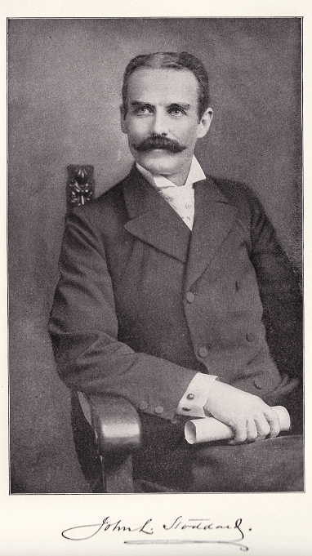
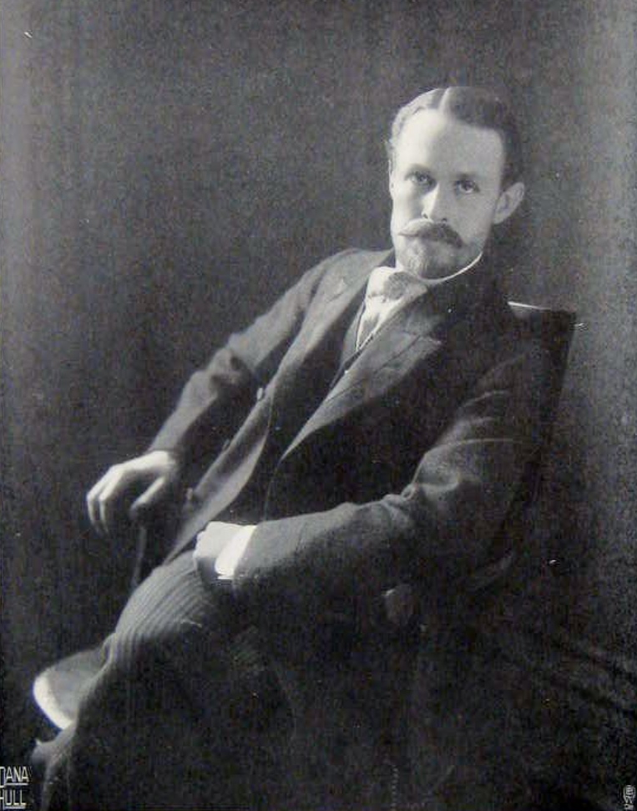
John L. Stoddard
(Career: 1879-1897)
E. Burton Holmes
(First lecture in 1890, designated as Stoddard’s successor in 1897)

Slide 26
Picture lecturers like Stoddard and Holmes:
Were active from 1890s to 1950s
Conférencier (educator, quasi-academic figures), bonimenteur (“bonus-liar”, explains and narrates existing films)
Used a mixture of photographs, hand-painted slides and reproduction of drawings or engravings
Made the first documentaries

Slide 27
“Since the dawn of time, voices have presented images, made order of things in the world, brought things to life and named them.” (Chion, The Voice in Cinema, p. 49)
Instead of simply repeating what the image say, the lecturer has the power to make the audience perceive something other than what the images actually show. The power of the lecturers lies not so much in their ability to explain the visual, but in the power to redefine the images according to an alternate set of values. (Altman, Silent Film Sound, pp. 71-72)

Slide 28
“Since the dawn of time, voices have presented images, made order of things in the world, brought things to life and named them.” (Chion, The Voice in Cinema, p. 49)
Instead of simply repeating what the image say, the lecturer has the power to make the audience perceive something other than what the images actually show. The power of the lecturers lies not so much in their ability to explain the visual, but in the power to redefine the images according to an alternate set of values. (Altman, Silent Film Sound, pp. 71-72)

Slide 29
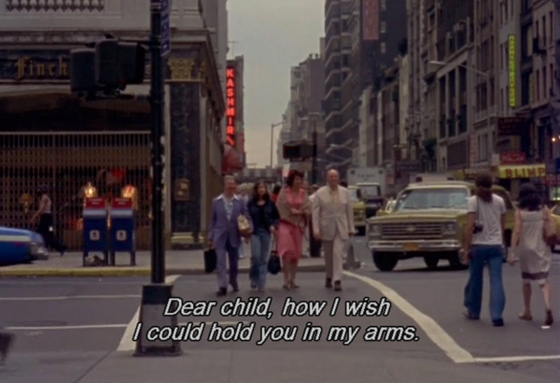
News from Home (1976)
Dir. Chantal Akerman

Slide 30
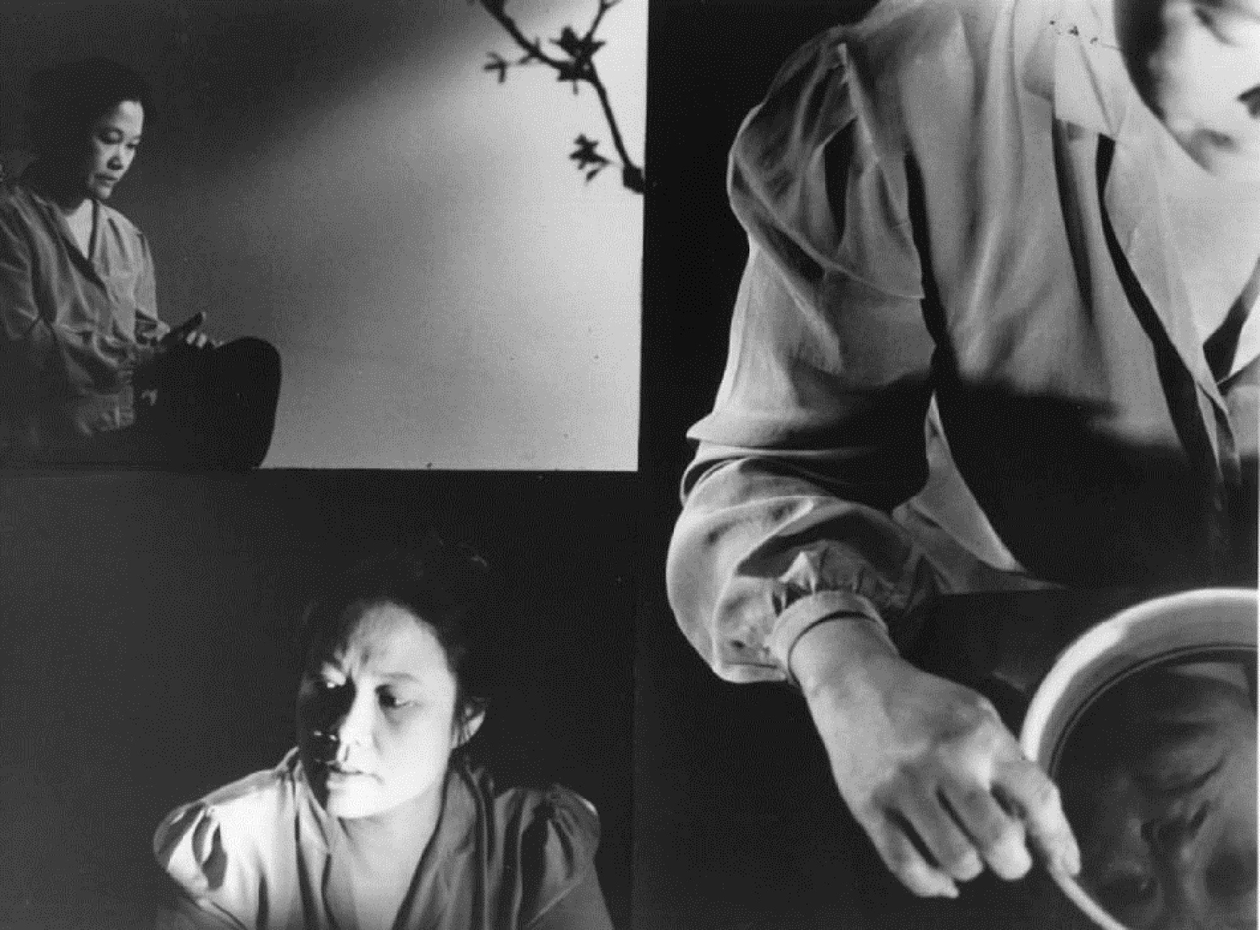
Surname Viet Given Name Nam
(1989) Dir. Trinh T. Minh-ha

Slide 31
Autoethnography

Slide 32
Autoethnography
Self-fashioning (James Clifford)

Slide 33
Autoethnography
Self-fashioning (James Clifford)
An ideal form of antidocumentary (Catherine Russell)

Slide 34
Autoethnography
Self-fashioning (James Clifford)
An ideal form of antidocumentary (Catherine Russell)
Disidentification (José Muñoz)

Slide 35
Autoethnography
Françoise Lionnet’s definition: “the defining of one's subjective ethnicity as mediated through language, history, and ethnographical analysis (Quoted in TINST, p. 32)
“…a kind of ‘figural anthropology’ of the self”
it ‘opens up a space of resistance between the individual (auto-) and the collective (-ethno-) where the writing (-graphy) of singularity cannot be foreclosed’.

Slide 36
Autoethnography
Françoise Lionnet’s definition: “the defining of one's subjective ethnicity as mediated through language, history, and ethnographical analysis (Quoted in TINST, p. 32)
“…a kind of ‘figural anthropology’ of the self”
it ‘opens up a space of resistance between the individual (auto-) and the collective (-ethno-) where the writing (-graphy) of singularity cannot be foreclosed’.

Slide 37
Autoethnography
This term…refers to instances in which colonized subjects undertake to represent themselves in ways that engage with the colonizer’s terms.
Autoethnography… involves partly collaborating with and appropriating the idioms of the conqueror (9)
Autoethnographic texts are typically heterogeneous on the reception end… (All from Mary Louise Pratt, Imperial Eyes, p. 9)

Slide 38
Autoethnography
This term…refers to instances in which colonized subjects undertake to represent themselves in ways that engage with the colonizer’s terms.
Autoethnography… involves partly collaborating with and appropriating the idioms of the conqueror (9)
Autoethnographic texts are typically heterogeneous on the reception end… (All from Mary Louise Pratt, Imperial Eyes, p. 9)

Slide 39
“Autobiography becomes ethnographic at the point where the film- or videomaker understands his or her personal history to be implicated in larger social formations and historical processes.

Slide 40
Identity is no longer a transcendental or essential self that is revealed, but a ‘staging of subjectivity’- a representation of the self as a performance. In the politicization of the personal, identities are frequently played out among several cultural discourses, be they ethnic, national, sexual, racial, and/or class based.

Slide 41
Identity is no longer a transcendental or essential self that is revealed, but a ‘staging of subjectivity’- a representation of the self as a performance. In the politicization of the personal, identities are frequently played out among several cultural discourses, be they ethnic, national, sexual, racial, and/or class based.

Slide 42
The subject ‘in history’ is rendered destabilized and incoherent, a site of discursive pressures and articulations.” (Russell, Experimental Ethnography, p. 276)

Slide 43
…autoethnographic performances by queers of color insert “a subjective, performative, often combative, ‘native I’ into ethnographic film’s detached discourse…” (Muñoz quoted in TINST, p. 33)

Slide 44
…autoethnographic performances by queers of color insert “a subjective, performative, often combative, ‘native I’ into ethnographic film’s detached discourse…” (Muñoz quoted in TINST, p. 33)

