Slide 1
SOUND, ART, & POWER
Week 4: Gender, Voiceover, Documentary & Travelogue

Slide 2
Autoethnography

Slide 3
Autoethnography
Self-fashioning (James Clifford)

Slide 4
Autoethnography
Self-fashioning (James Clifford)
An ideal form of antidocumentary (Catherine Russell)

Slide 5
Autoethnography
Self-fashioning (James Clifford)
An ideal form of antidocumentary (Catherine Russell)
Disidentification (José Muñoz)

Slide 6
Autoethnography
Françoise Lionnet’s definition: “the defining of one's subjective ethnicity as mediated through language, history, and ethnographical analysis (Quoted in TINST, p. 32)
“…a kind of ‘figural anthropology’ of the self”
it ‘opens up a space of resistance between the individual (auto-) and the collective (-ethno-) where the writing (-graphy) of singularity cannot be foreclosed’.

Slide 7
Autoethnography
Françoise Lionnet’s definition: “the defining of one's subjective ethnicity as mediated through language, history, and ethnographical analysis (Quoted in TINST, p. 32)
“…a kind of ‘figural anthropology’ of the self”
it ‘opens up a space of resistance between the individual (auto-) and the collective (-ethno-) where the writing (-graphy) of singularity cannot be foreclosed’.

Slide 8
Autoethnography
This term…refers to instances in which colonized subjects undertake to represent themselves in ways that engage with the colonizer’s terms.
Autoethnography… involves partly collaborating with and appropriating the idioms of the conqueror (9)
Autoethnographic texts are typically heterogeneous on the reception end… (All from Mary Louise Pratt, Imperial Eyes, p. 9)

Slide 9
Autoethnography
This term…refers to instances in which colonized subjects undertake to represent themselves in ways that engage with the colonizer’s terms.
Autoethnography… involves partly collaborating with and appropriating the idioms of the conqueror (9)
Autoethnographic texts are typically heterogeneous on the reception end… (All from Mary Louise Pratt, Imperial Eyes, p. 9)

Slide 10
“Autobiography becomes ethnographic at the point where the film- or videomaker understands his or her personal history to be implicated in larger social formations and historical processes.

Slide 11
Identity is no longer a transcendental or essential self that is revealed, but a ‘staging of subjectivity’- a representation of the self as a performance. In the politicization of the personal, identities are frequently played out among several cultural discourses, be they ethnic, national, sexual, racial, and/or class based.

Slide 12
Identity is no longer a transcendental or essential self that is revealed, but a ‘staging of subjectivity’- a representation of the self as a performance. In the politicization of the personal, identities are frequently played out among several cultural discourses, be they ethnic, national, sexual, racial, and/or class based.

Slide 13
The subject ‘in history’ is rendered destabilized and incoherent, a site of discursive pressures and articulations.” (Russell, Experimental Ethnography, p. 276)

Slide 14
…autoethnographic performances by queers of color insert “a subjective, performative, often combative, ‘native I’ into ethnographic film’s detached discourse…” (Muñoz quoted in TINST, p. 33)

Slide 15
…autoethnographic performances by queers of color insert “a subjective, performative, often combative, ‘native I’ into ethnographic film’s detached discourse…” (Muñoz quoted in TINST, p. 33)

Slide 16
Gender and Voiceover:

Slide 17
Gender and Voiceover:
“To the degree that the voice-over preserves its integrity, it also becomes an exclusively male voice.” (Silverman quoted in TINST, p. 34)

Slide 18
Gender and Voiceover:
“…most acousmêtres are masculine. Female acousmêtres in classical cinema are rare… This isn’t by chance, but really a sign of the times, an era when telling a story exposes the teller more than it used to.” (Chion, The Voice in Cinema, pp. 55-57)

Slide 19
Gender and Voiceover:
“The traditional expository mode of direct address relies on proximity between text and image: the words explicate the visuals, telling the spectator how he or she should interpret them; the potential for secondary, connotative meaning is limited. A crucial component of such an ‘unproblematic’ narration has traditionally been held to be the masculinity of the ‘voice of God’, the traditional tones of authority and universality.” (Stella Bruzzi, New Documentary, p. 57)

Slide 20
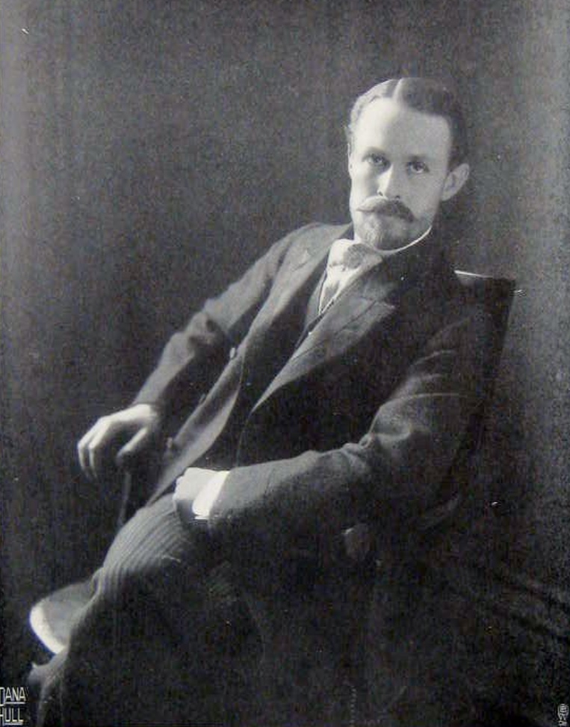
Gender and Voiceover:

Slide 21
Gender and Voiceover:

Slide 22
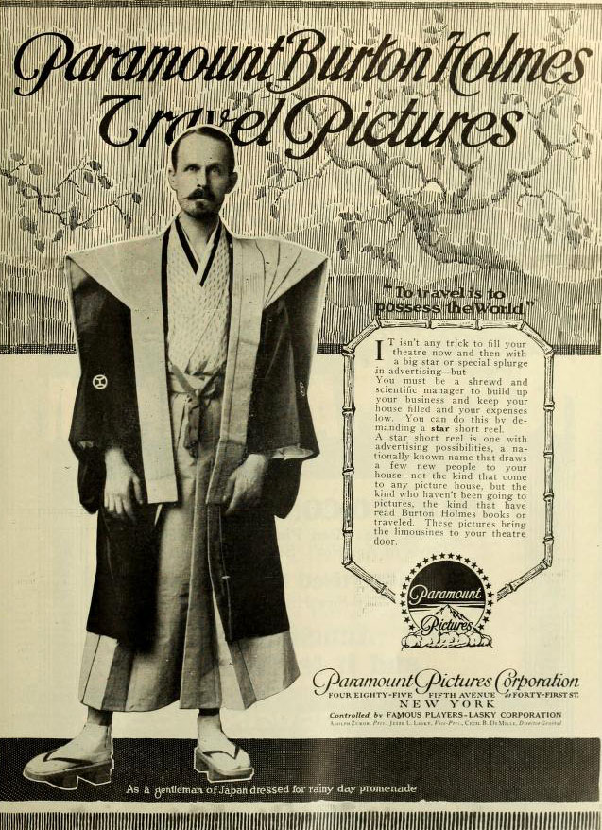
Gender and Voiceover:

Slide 23
Gender and Voiceover:
“…the question of empowering women through speech is highly problematic, because women’s relationship with language and speech has always been an uncomfortable one. Language, of course, is never neutral. It is the site where power relationships are most complex and pernicious; yet it is also a place of liberation.” (Trinh quoted in TINST, p. 44)

Slide 24
Gender and Voiceover:
(Thu Van interview, re-enacted by Khien Lai in Surname Viet Given Name Nam)

Slide 25
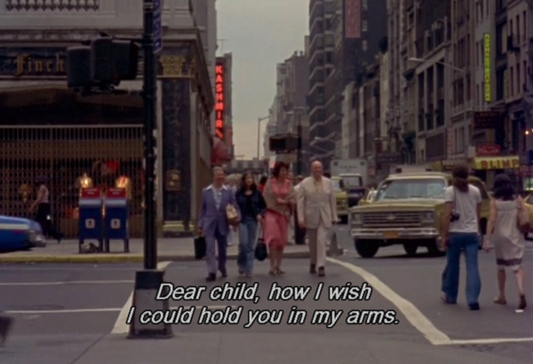
News from Home (1976)
Dir. Chantal Akerman

Slide 26
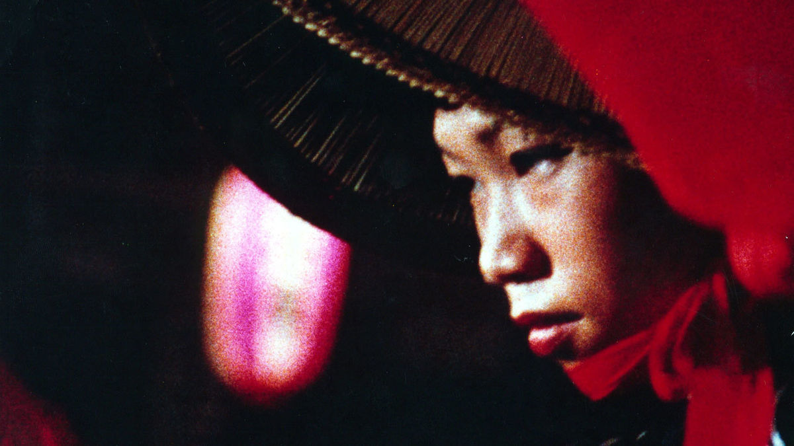
Sans Soleil / Sunless (1983)
Dir. Chris Marker

Slide 27
Comparative Analysis:
Basing your discussion on the scenes from these two films and referencing these films as a whole
Consider the both the realization and function of the female voiceover narrators in these films. How do these voices “define” or otherwise influence your perception—both audio and visual—of these films?
What is the audio-visual relationship(s) in these films?

Slide 28
Sans Soleil / Sunless (1983)
Dir. Chris Marker

Slide 29
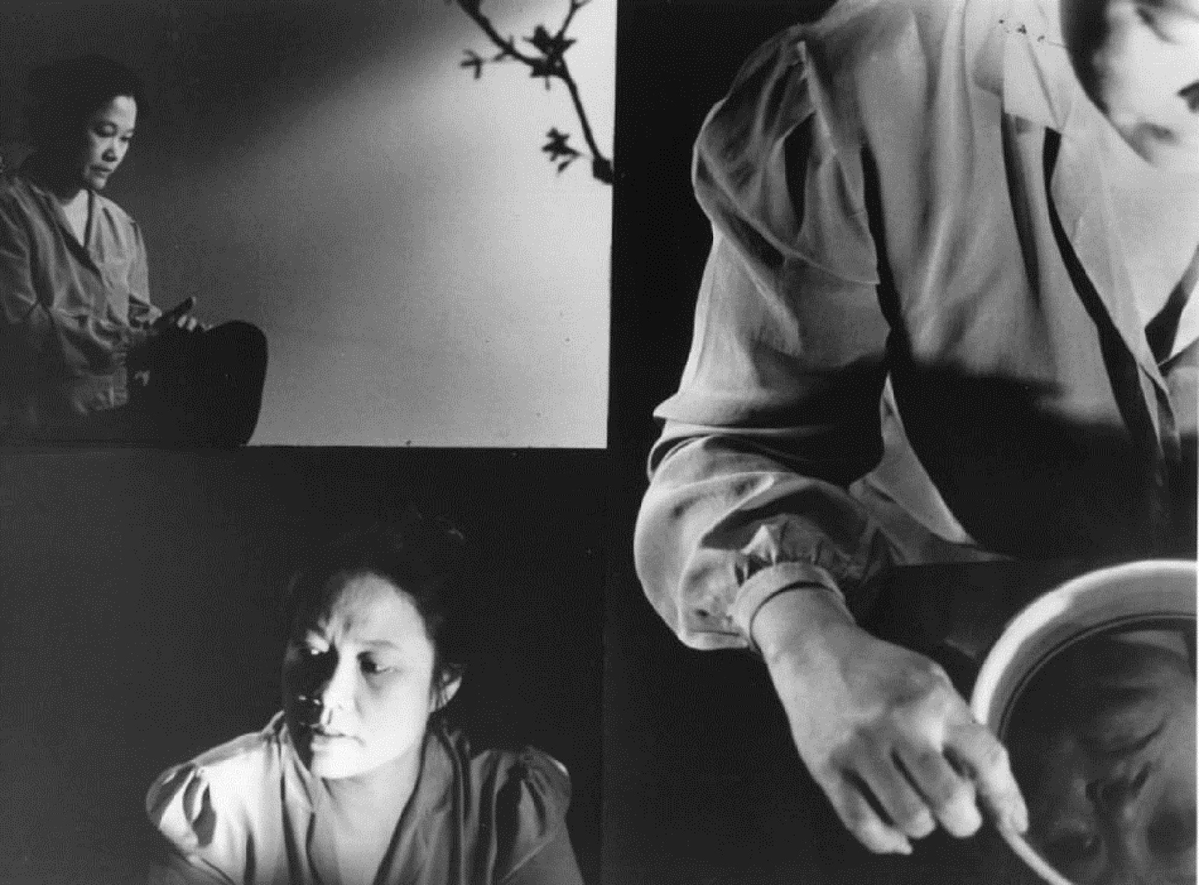
Surname Viet Given Name Nam
(1989) Dir. Trinh T. Minh-ha

Slide 30
Comparative Analysis:
Basing your discussion on the scenes from these two films and referencing these films as a whole
How are female voices positioned in these films?
How do these female voices speak to the broader issues of documentary, fiction, truth, and cross-cultural relations in these films?

Slide 31
Concluding Remarks:
Each group will focus on one film. Discuss and draft a statement regarding the relationship between voice, image and text in these three films:
News from Home (1976) Dir. Chantal Akerman
Sans Soleil / Sunless (1983) Dir. Chris Marker
Surname Viet Given Name Nam (1989) Dir. Trinh T. Minh-ha
Your statements should comment on or otherwise reference idea(s) from the class reading.

