Slide 1
SOUND, ART, & POWER
Week 6: Racialized Violence
& The Problem of Visuality

Slide 2
Ch 2: Noise, History, Violence

Slide 3
Ch 2: Noise, History, Violence
In this chapter, I further argue that, instead of emphasizing the visible evidence of lineage, chronology, and tangible documents, histories of aurality could be conceived and theorized through acoustic models. That is to imagine—heeding Sterne’s call for sonic imaginations—how the affect and ephemerality of sound can influence the conceptual premise and methodology in historical research and writing. This chapter proposes and experiments with the sound phenomena of reverberation and resonance as models for researching and conceptualizing history. (TINST, p. 67)

Slide 4
Ch 2: Noise, History, Violence
In this chapter, I further argue that, instead of emphasizing the visible evidence of lineage, chronology, and tangible documents, histories of aurality could be conceived and theorized through acoustic models. That is to imagine—heeding Sterne’s call for sonic imaginations—how the affect and ephemerality of sound can influence the conceptual premise and methodology in historical research and writing. This chapter proposes and experiments with the sound phenomena of reverberation and resonance as models for researching and conceptualizing history. (TINST, p. 67)

Slide 5
Resonance and Reverberation:
Reverberation – “a propagation effect in which a sound continues after the cessation of its emission,”(Augoyard & Torgue, Sonic Experience, p. 111)
Resonance - ‘the vibration, in air or through solids, of a solid element’ (Augoyard & Torgue, p. 99)

Slide 6
Resonance and Reverberation:
“While reason implies the disjunction of subject and object, resonance involves their conjunction. Where reason requires separation and autonomy, resonance entails adjacency, sympathy, and the collapse of the boundary between perceiver and perceived.” (Veit Erlmann, Reason & Resonance, pp. 9-10)

Slide 7
Resonance and Reverberation:
“While reason implies the disjunction of subject and object, resonance involves their conjunction. Where reason requires separation and autonomy, resonance entails adjacency, sympathy, and the collapse of the boundary between perceiver and perceived.” (Veit Erlmann, Reason & Resonance, pp. 9-10)

Slide 9
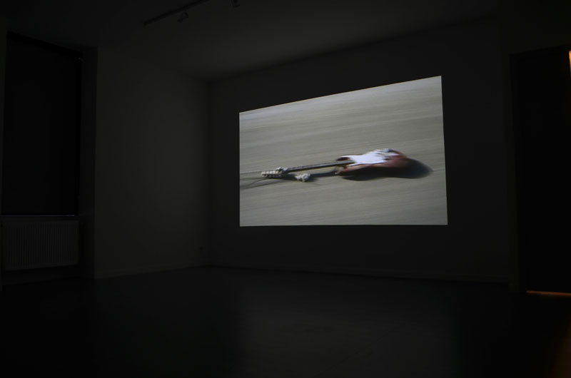
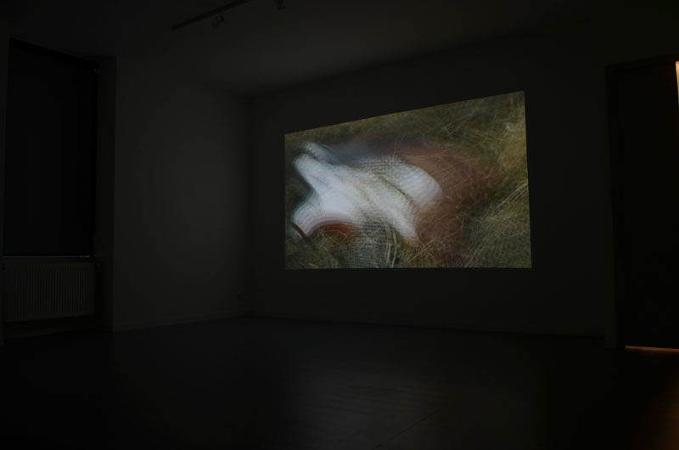
Christian Marclay, Guitar Drag, 2000
installation view

Slide 12
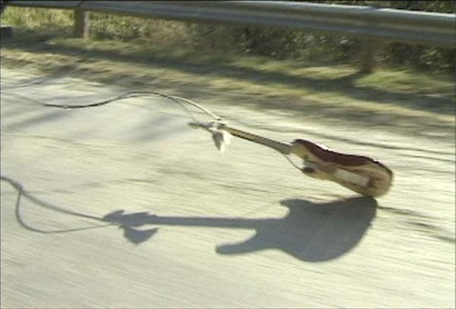

Slide 13
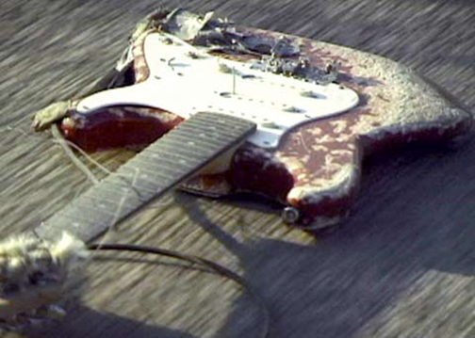

Slide 14
“It has to be a projection, it has to be loud, it has to be experienced in a black box where you can lose track of time and space, lose your balance. The image is jerky and you may get dizzy. It has to be a physical experience; though some people are exhilarated by the sound, its rock quality… It needs a certain scale.”
(Christian Marclay in conversation with Kim Gordon, quoted in TINST, p. 69)

Slide 15
“It has to be a projection, it has to be loud, it has to be experienced in a black box where you can lose track of time and space, lose your balance. The image is jerky and you may get dizzy. It has to be a physical experience; though some people are exhilarated by the sound, its rock quality… It needs a certain scale.”
(Christian Marclay in conversation with Kim Gordon, quoted in TINST, p. 69)

Slide 16
“Here, the electric guitar is, as an anthropomorphized and sonified body, a resonator in the conceptual but not acoustical sense. The reverberating force of the noise it produces causes sympathetic vibrations in other resonating bodies in the histories of lynching, racialized violence, medicine, and in the development of modern sound technology.” (TINST, p. 71)

Slide 17
“Here, the electric guitar is, as an anthropomorphized and sonified body, a resonator in the conceptual but not acoustical sense. The reverberating force of the noise it produces causes sympathetic vibrations in other resonating bodies in the histories of lynching, racialized violence, medicine, and in the development of modern sound technology.” (TINST, p. 71)

Slide 18
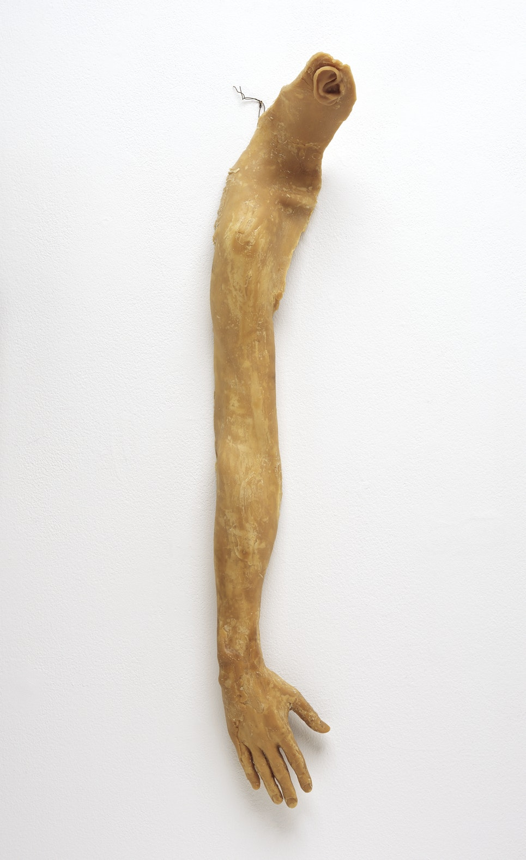
Christian Marclay,
From Hand to Mouth, 1994

Slide 19
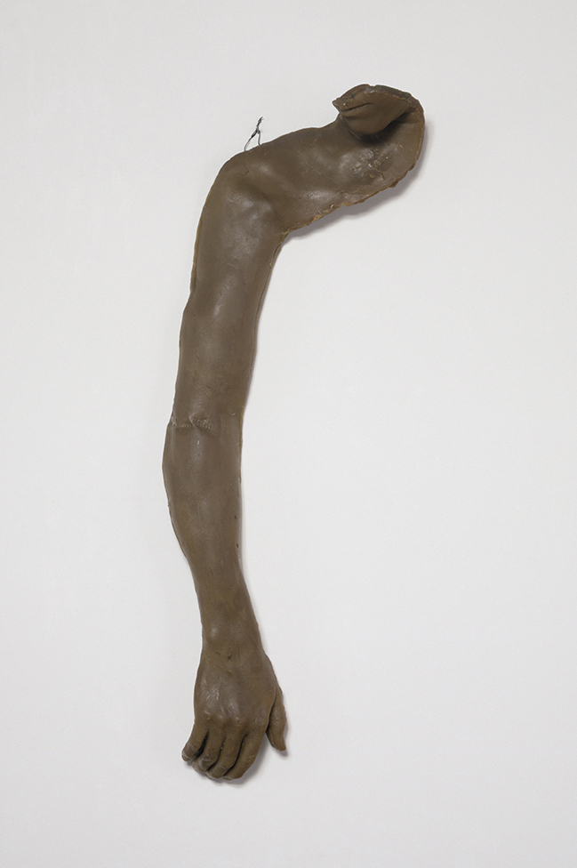
Christian Marclay,
From Hand to Ear, 1994
Bruce Nauman,
From Hand to Mouth, 1967

Slide 20
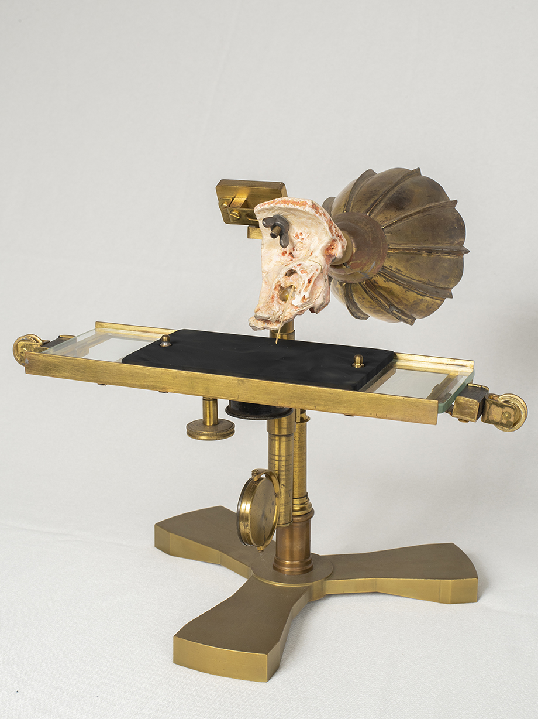
The Ear Phonautograph, created by Alexander Graham Bell and Clarence Blake in 1874. Reconstructed at the Canada Science and Technology Museum in 2017. (Image on right)

Slide 21
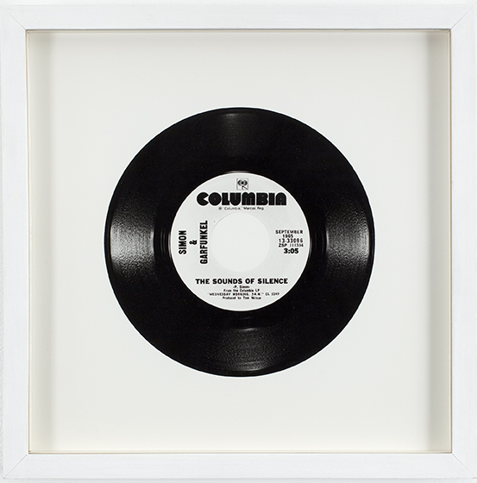
Christian Marclay,
The Sound of Silence,
1988

Slide 22
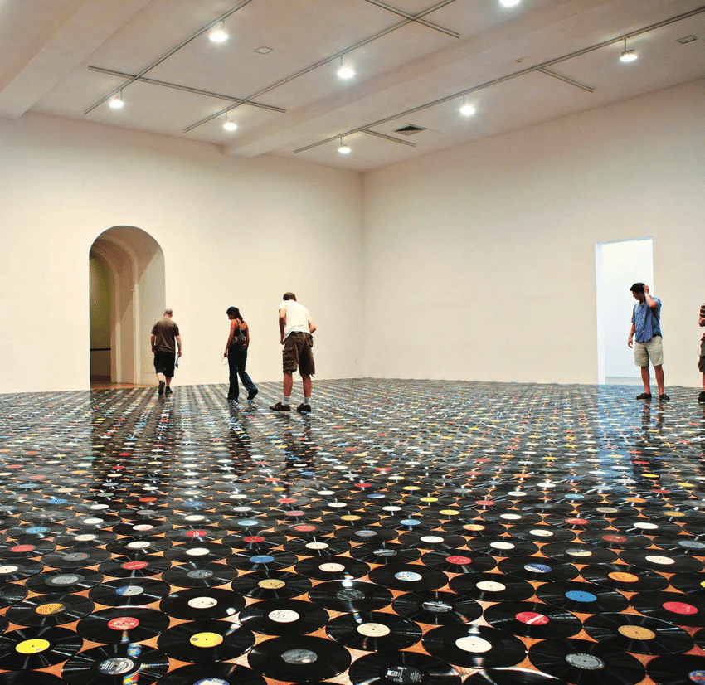
Christian Marclay, 2822 Records (PS1), 1987-2009

Slide 23
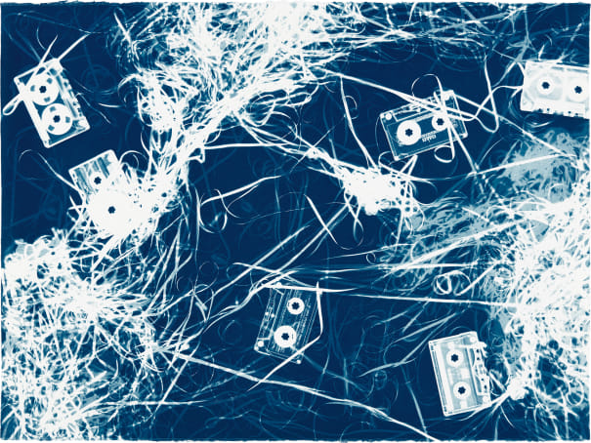
Christian Marclay,
Untitled (Luciano Pavarotti, Halo and Four Mix Tapes II), 2008

Slide 24
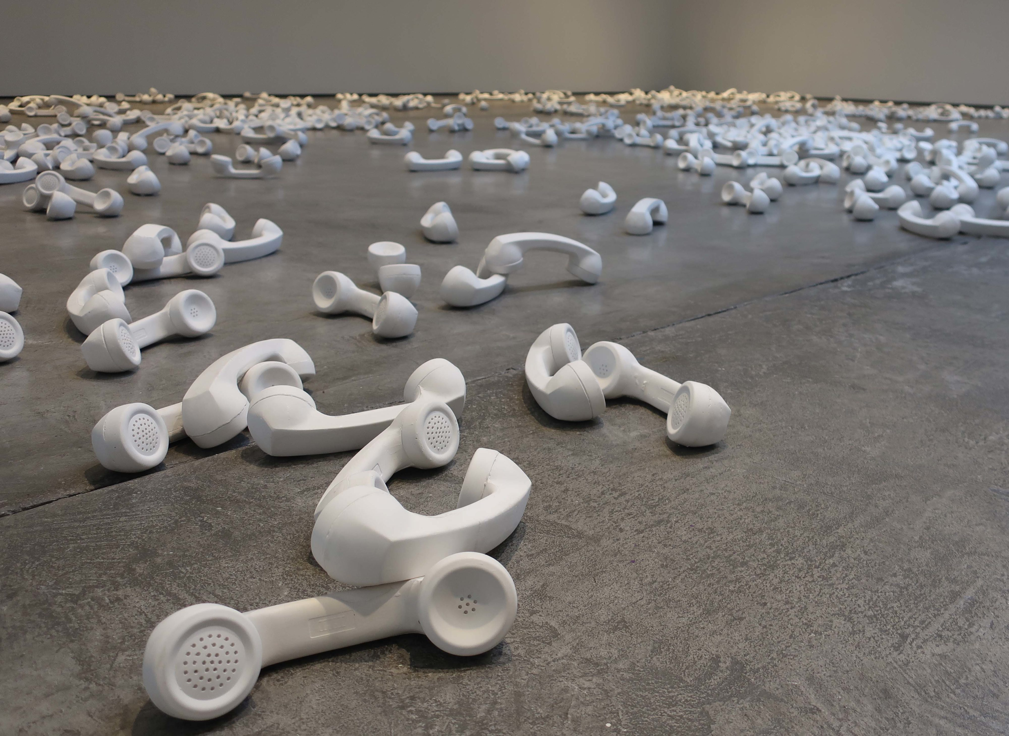
Christian Marclay, Boneyard, 1990

Slide 25
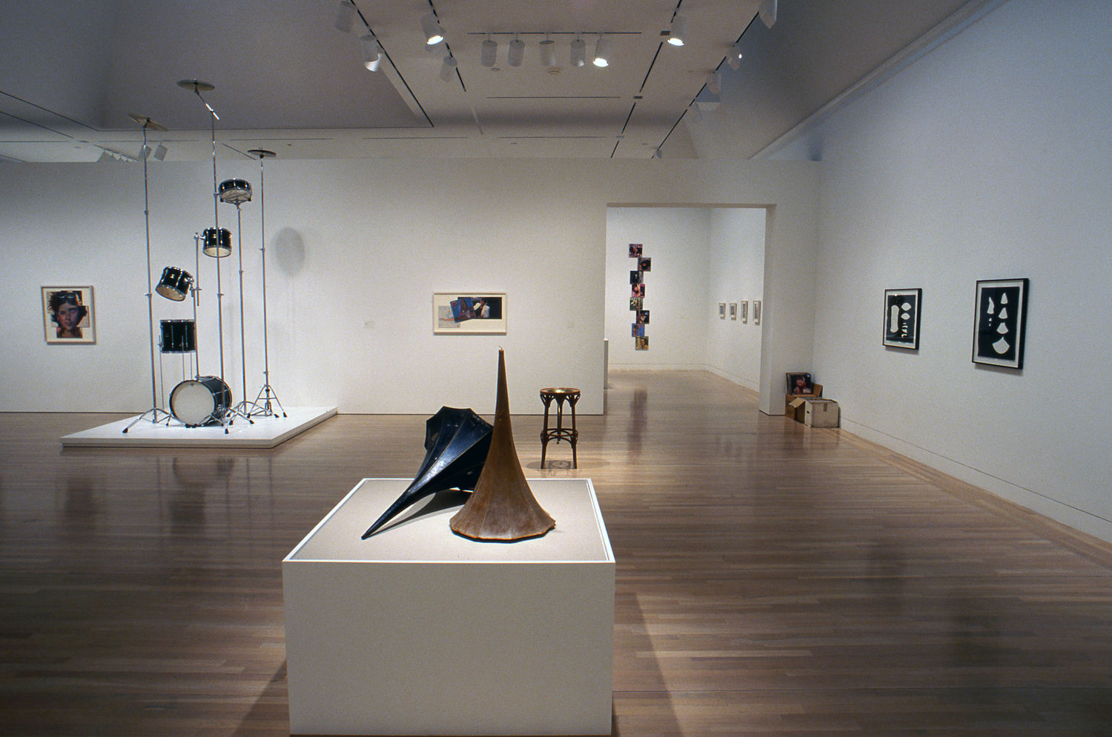
Christian Marclay exhibition at Hammer Museum in Los Angeles, 2003

Slide 26
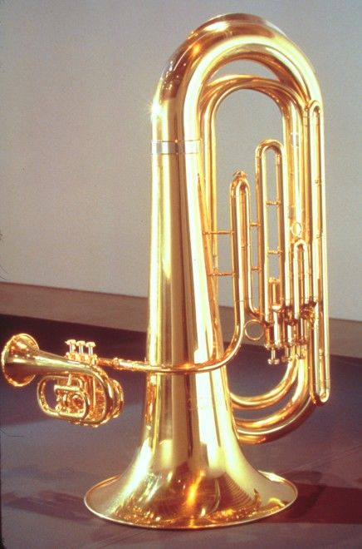
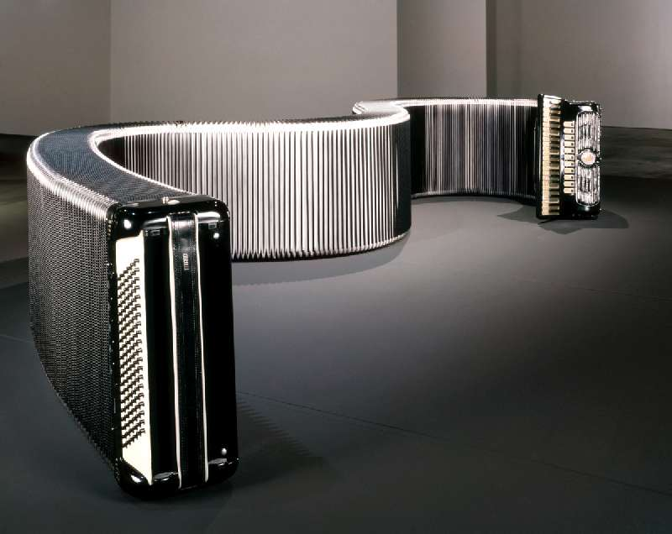
Christian Marclay, Liplock (l), Virtuoso (r),
both 2000

Slide 27
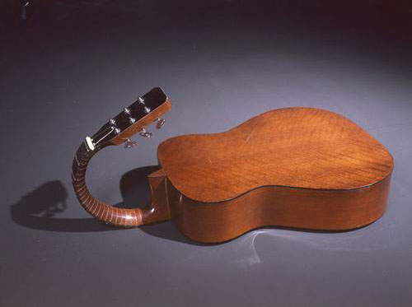
Christian Marclay, Vertebrate, 2000

Slide 28
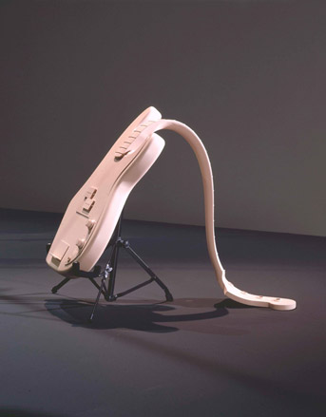
Christian Marclay, Prosthesis, 2001

Slide 29
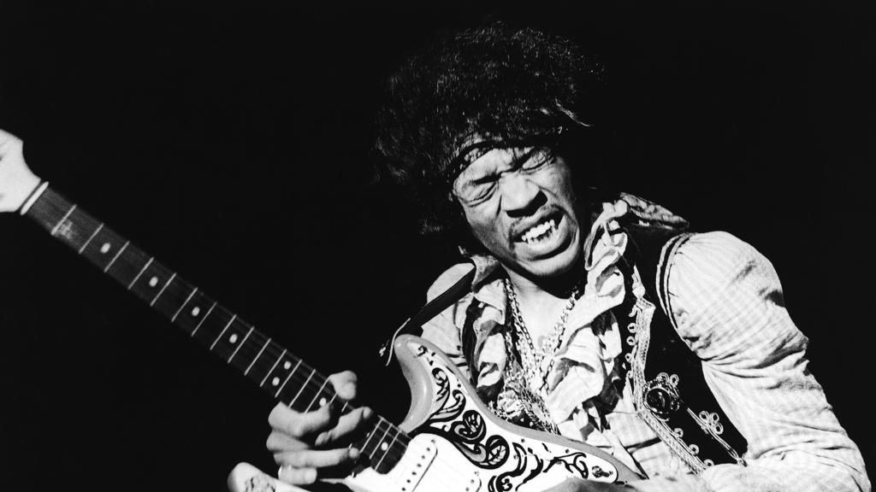

Slide 30
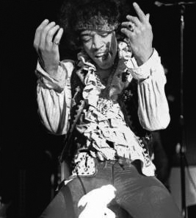
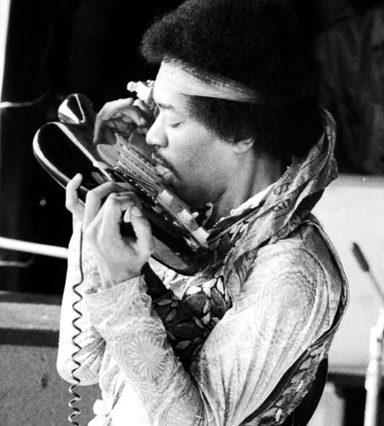
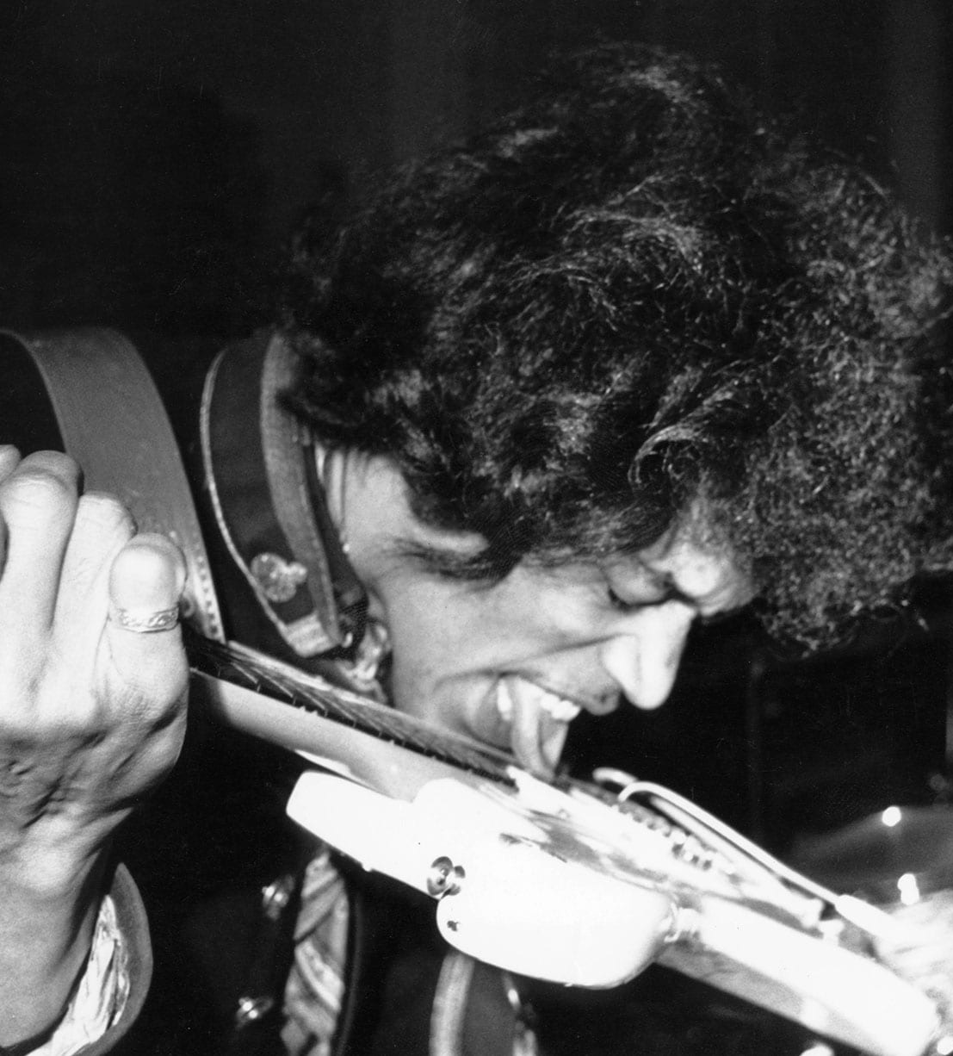
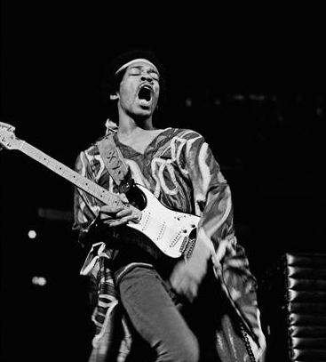

Slide 31
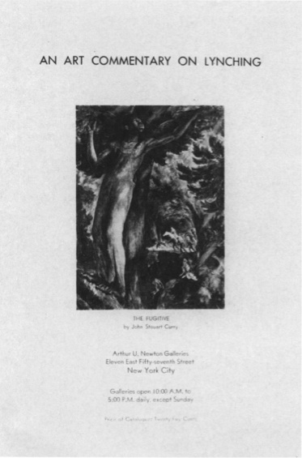

Slide 32
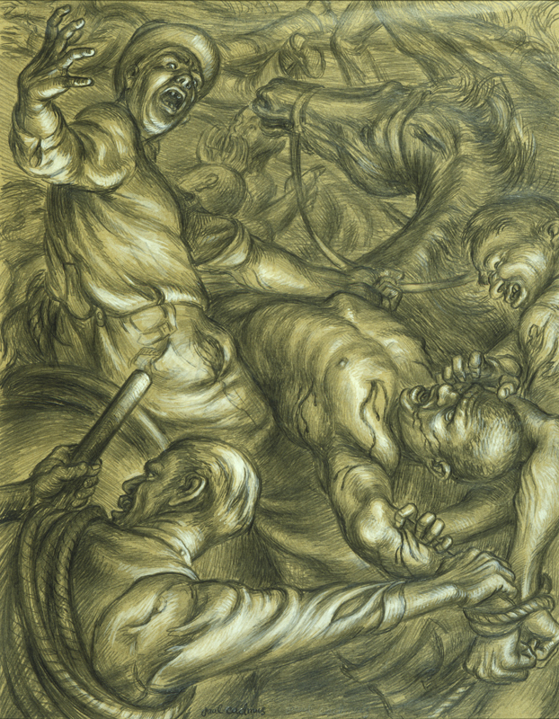
Paul Cadmus,
To The Lynching!
1935

Slide 33
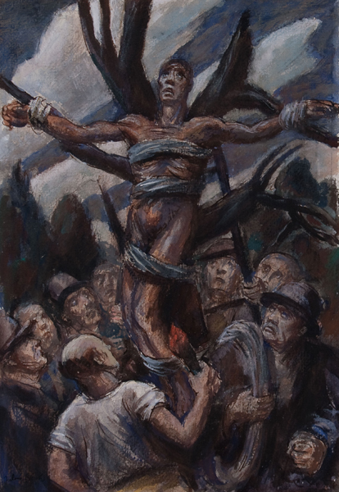
Julius Bloch, Lynching, 1933

Slide 34
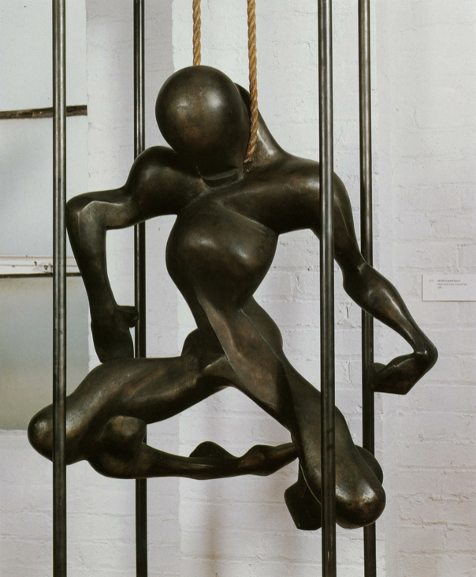
Isamu Noguchi, Death, (Lynched Figure), 1934

Slide 35
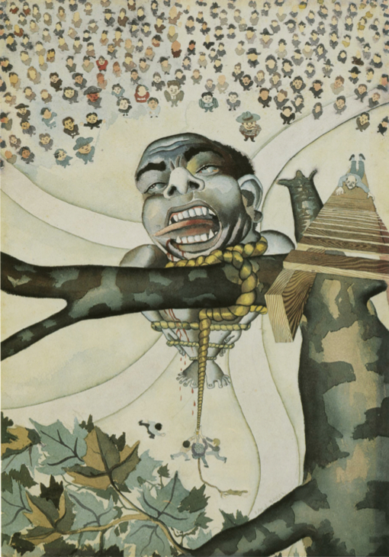
Samuel Joseph Brown, Jr.
The Lynching, 1934

Slide 36
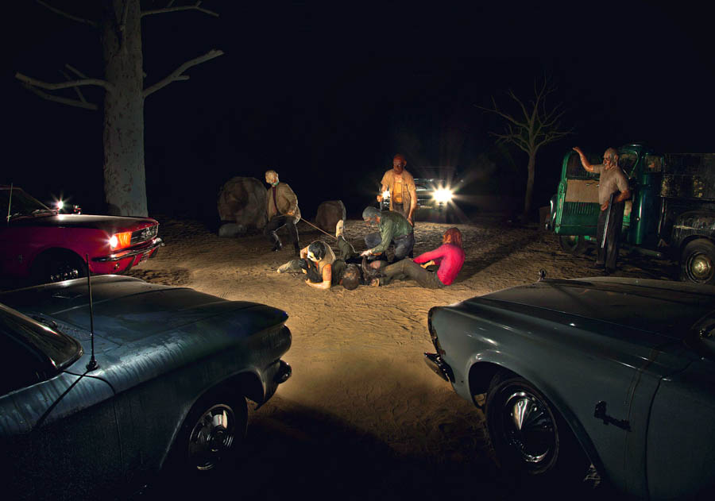
Edward Kienholz,
Five Car Stud, 1969-72

Slide 37
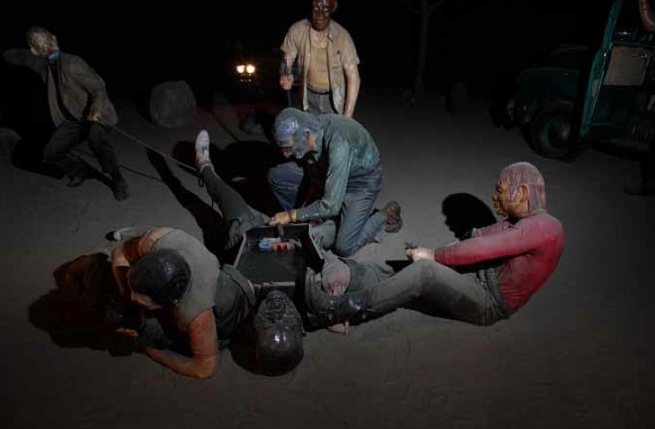
Edward Kienholz, Five Car Stud,
1969-72, detail shot

Slide 38
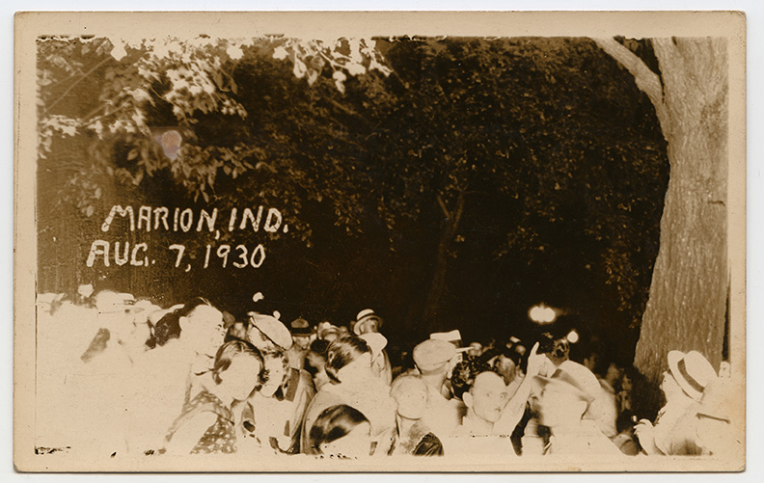
Ken Gonzales-Day, Marion, IN,
(Thomas Shipp & Abram Smith), 2006

Slide 39
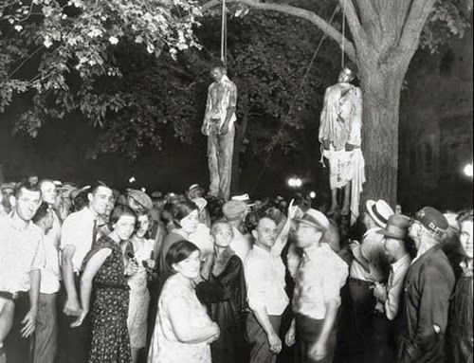
Photographic postcard of the lynching of Thomas Shipp and Abram Smith. August 7, 1930, Marion, Indiana.

Slide 40
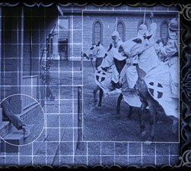
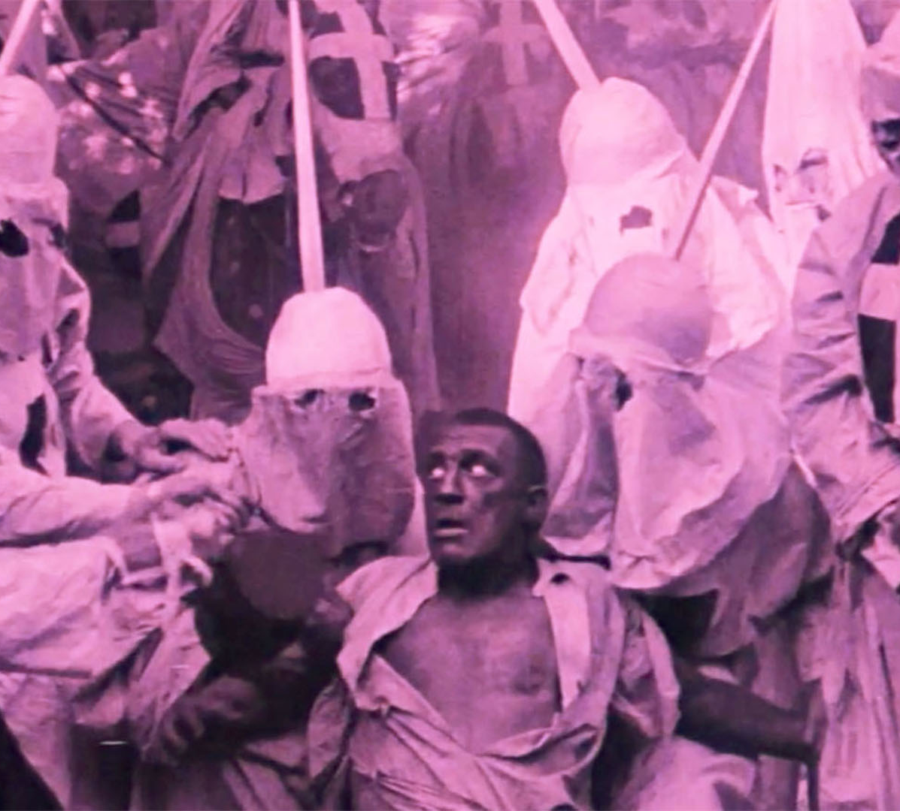
Paul D. Miller,
Rebirth of A Nation, 2004
The Birth of A Nation (1915)
Dir. D.W. Griffith

Slide 41
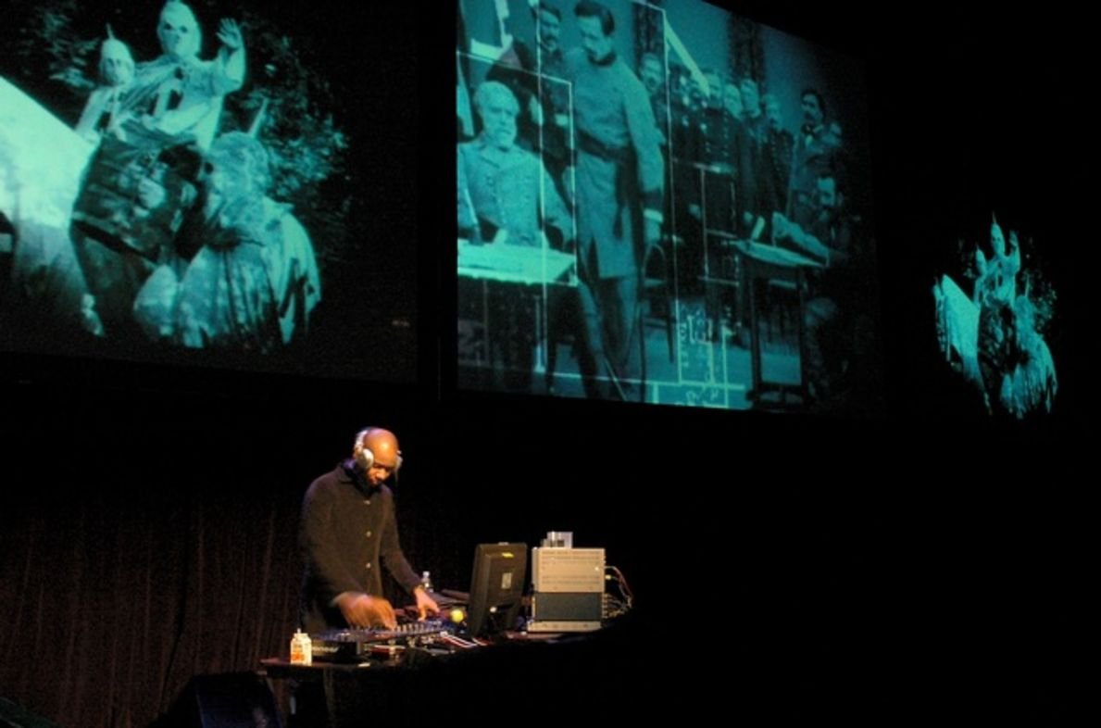
Miller performing Rebirth of A Nation at the Museum of Contemporary Art, Chicago, 2004

Slide 42
Chantal Akerman, Sud / South, 1999

Slide 43
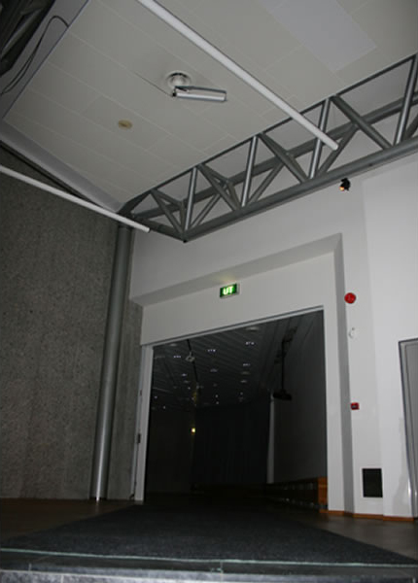
Camille Norment, Swing Low, 2009

Slide 44
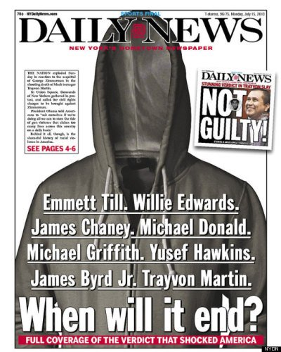

Slide 45
“The piece is charged with so many layers. At first I was ambivalent about responding directly to a race crime. There was something almost indecent about recreating this kind of violence, especially for a white artist. But because the video is also about so many other things, I felt I could do it. I never stress the connection with James Byrd, Jr. over other links, such as the rock-and-roll tradition of guitar smashing, or the destruction of instruments in Fluxus.” (Marclay quoted in TINST, p. 86)

Slide 46
“The piece is charged with so many layers. At first I was ambivalent about responding directly to a race crime. There was something almost indecent about recreating this kind of violence, especially for a white artist. But because the video is also about so many other things, I felt I could do it. I never stress the connection with James Byrd, Jr. over other links, such as the rock-and-roll tradition of guitar smashing, or the destruction of instruments in Fluxus.” (Marclay quoted in TINST, p. 86)

Slide 47
“All these references are there, and I think it really depends on the viewer’s interest, knowledge, and state of mind. People will have different readings of the video, and I want all these to be legitimate. Ultimately I made the video because of what happened to James Byrd, but all these other references allowed me to think of the guitar as this very anthropomorphic instrument that was already associated with violence, and with rebellion, and crazy youth. I think it’s fine when people walk out of there disgusted. I think it’s also fine when they walk out of there exhilarated. ” (Marclay quoted in TINST, p. 86)

Slide 48
“All these references are there, and I think it really depends on the viewer’s interest, knowledge, and state of mind. People will have different readings of the video, and I want all these to be legitimate. Ultimately I made the video because of what happened to James Byrd, but all these other references allowed me to think of the guitar as this very anthropomorphic instrument that was already associated with violence, and with rebellion, and crazy youth. I think it’s fine when people walk out of there disgusted. I think it’s also fine when they walk out of there exhilarated. ” (Marclay quoted in TINST, p. 86)

