Slide 1
INTRODUCTION TO FILM
Introduction: What is Film? and What is Film Studies?

Slide 2
La Sortie de l'Usine Lumière à Lyon (Workers Leaving the Lumiere Factory), 1895
Dir. Lumière brothers (Auguste and Louis)

Slide 3
This film was screened on December 28, 1895 at the Grand Café in Paris.

Slide 4
This film was screened on December 28, 1895 at the Grand Café in Paris.
This event is one of the first public film screenings in the history of cinema.

Slide 5
This film was screened on December 28, 1895 at the Grand Café in Paris.
This event is one of the first public film screenings in the history of cinema.
Many consider this event as marking the birth of cinema

Slide 6
L'arrivée d'un train en gare de La Ciotat (The Arrival of a Train at La Ciotat Station) , 1895
Dir. Lumière brothers (Auguste and Louis)

Slide 7
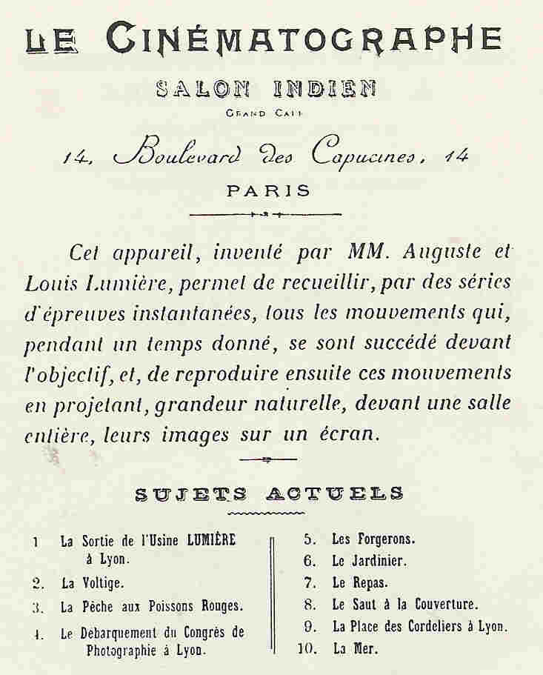
The program from the Lumiere brother’s screening at Salon Indien du Grand Cafe

Slide 8
What is Film?

Slide 9
What is Film?
What makes Workers Leaving the Lumiere Factory or Arrival of a Train at a Station a film?

Slide 10
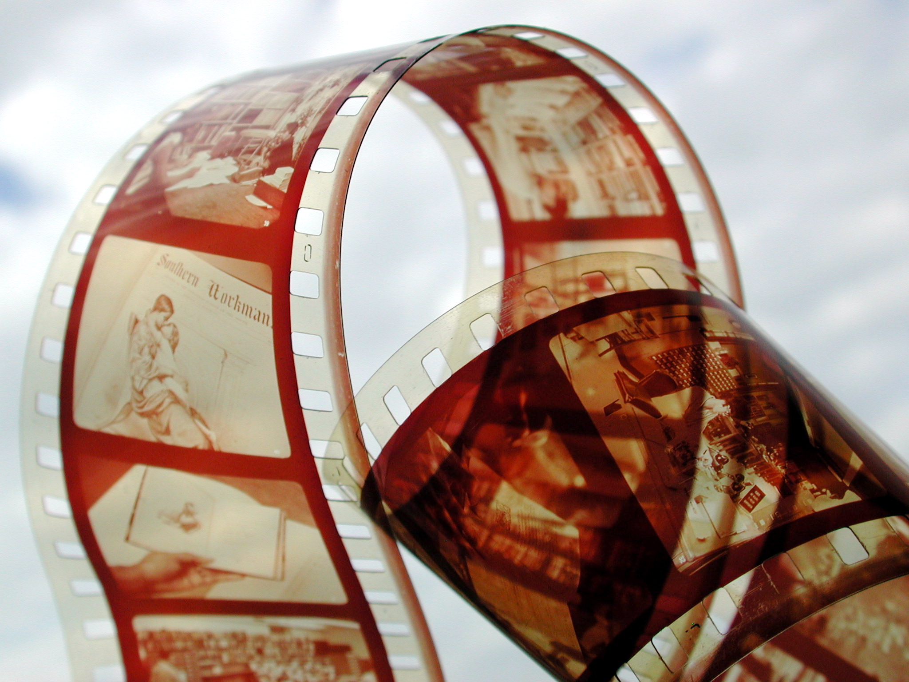
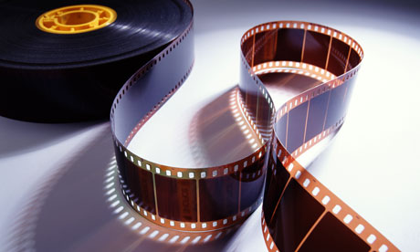
This is the film that we study in this class

Slide 11
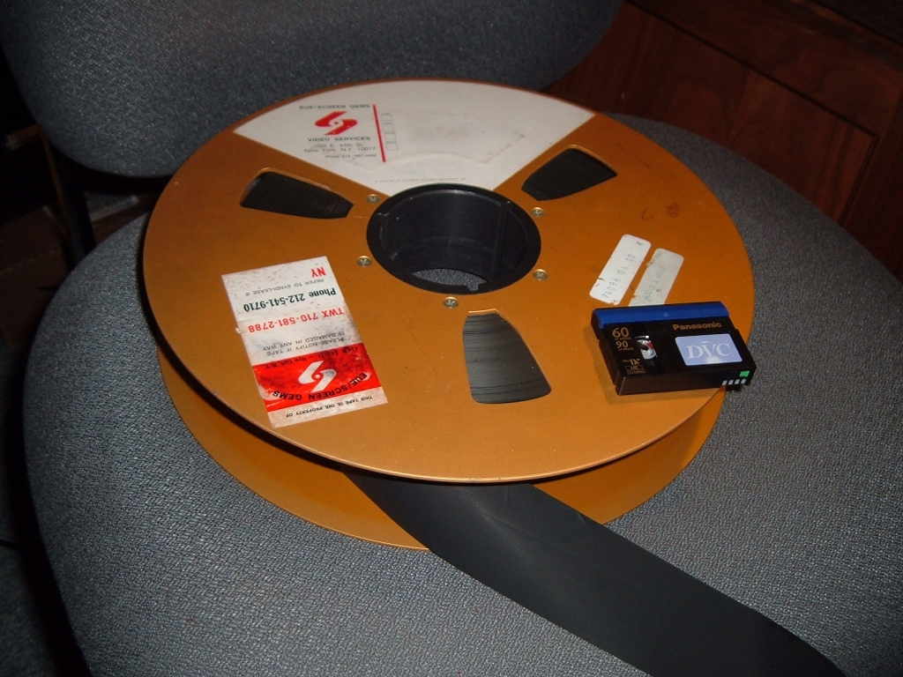
Film compared to video (analog)

Slide 12
Film strip compared to videotape

Slide 13
What is Film?

Slide 14
What is Film?
Chemical + mechanical medium

Slide 15
What is Film?
Chemical + mechanical medium
Celluloid

Slide 16
What is Film?
Chemical + mechanical medium
Celluloid
Emulsion

Slide 17
What is Film?
Chemical + mechanical medium
Celluloid
Emulsion
Device or machine (camera, printer, projector, screen)

Slide 18
What is Film?
Chemical + mechanical medium
Celluloid
Emulsion
Device or machine (camera, printer, projector, screen)
Light source

Slide 19
What is Film?
Chemical + mechanical medium
Celluloid
Emulsion
Device or machine (camera, printer, projector, screen)
Light source
Space or distance, surface

Slide 20
Optical illusion (artifice)

Slide 21
Optical illusion (artifice)
Persistence of vision

Slide 22
Optical illusion (artifice)
Persistence of vision
Phi phenomenon / stroboscopic effect

Slide 23
Optical illusion (artifice)
Persistence of vision
Phi phenomenon / stroboscopic effect
Critical flicker fusion (frame rate)

Slide 24
Optical illusion (artifice)
Persistence of vision
Phi phenomenon / stroboscopic effect
Critical flicker fusion (frame rate)
Apparent motion

Slide 25
Optical illusion (artifice)
Persistence of vision
Phi phenomenon / stroboscopic effect
Critical flicker fusion (frame rate)
Apparent motion
Diegesis*

Slide 26
Eadweard Muybridge Motion Photographs
(1878) for Leland Stanford

Slide 27
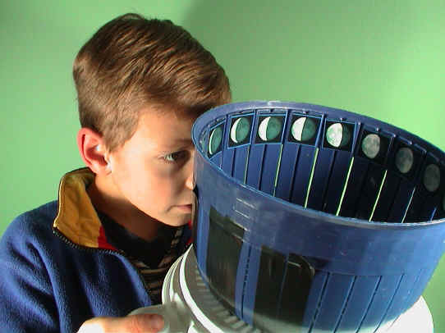
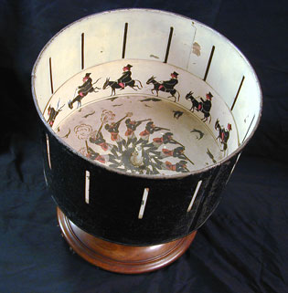
Examples of zoetropes:

Slide 28
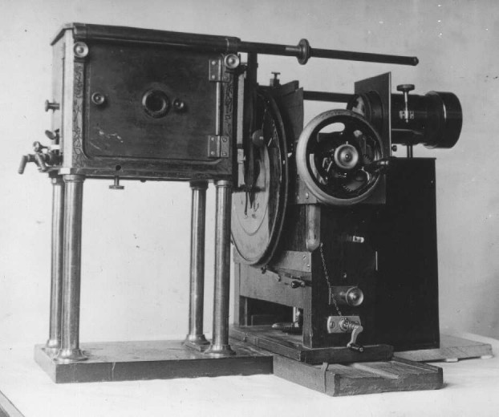
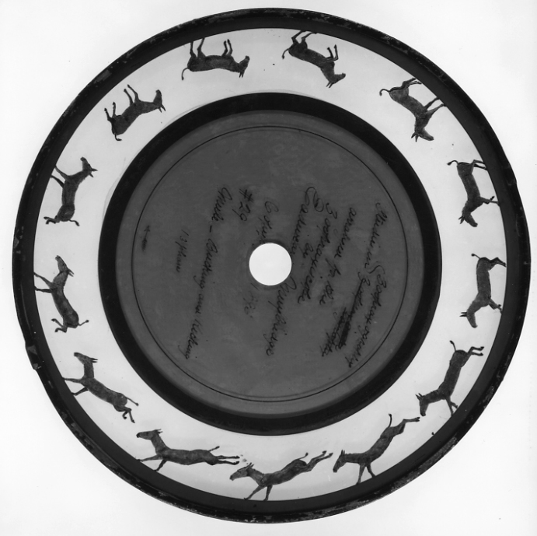
The zoopraxiscope was used by Muybridge
to animate his motion photography

Slide 29
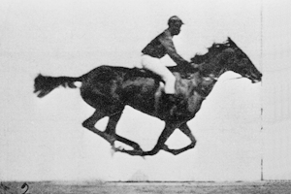
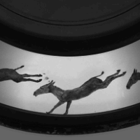

Slide 30
What is film studies?

Slide 31
What is film studies?
Film as culture

Slide 32
Film culture
Pre-cinematic forms, industries and systems

Slide 33
Film culture
Pre-cinematic forms, industries and systems
Photography (motion photography)

Slide 34
Film culture
Pre-cinematic forms, industries and systems
Photography (motion photography)
Theatre (plays, vaudeville, side-shows/circus)

Slide 35
Film culture
Pre-cinematic forms, industries and systems
Photography (motion photography)
Theatre (plays, vaudeville, side-shows/circus)
Music (opera, musical theatre, orchestral music, 19th Century Romantic music)

Slide 36
Illustrated songs

Slide 37
Illustrated songs
Picture lectures

Slide 38
Illustrated songs
Picture lectures
Magic lantern shows

Slide 39
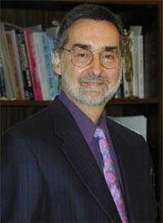
Robert Kolker
Robert Kolker is Emeritus Professor of English at the University of Maryland and Adjunct Professor of Media Studies at the University of Virginia.
He is the author of numerous works on film and media, including The Altering Eye; Film, Form, and Culture; and Media Studies: An Introductory Textbook.

Slide 40
“For [Walter] Benjamin, film’s lack of aura, lack of forbidding uniqueness, and its ease of access makes it the most social and communal of the arts. Film addresses the world, pierces through the realities of daily life like a surgeon’s knife and, by opening perceptions of the ordinary to the many, holds the possibility of engaging an audience in a social and cultural discourse, a mass engagement of the imagination unlike any other art form.” (Kolker, OGFS, pp. 12-13)

Slide 41
“For [Walter] Benjamin, film’s lack of aura, lack of forbidding uniqueness, and its ease of access makes it the most social and communal of the arts. Film addresses the world, pierces through the realities of daily life like a surgeon’s knife and, by opening perceptions of the ordinary to the many, holds the possibility of engaging an audience in a social and cultural discourse, a mass engagement of the imagination unlike any other art form.” (Kolker, OGFS, pp. 12-13)

Slide 42
What is film studies?
Film as culture
Film as industry

Slide 43
Film culture
Industry

Slide 44
Film culture
Industry
Pre-production (producer, screenwriter, casting, art director)

Slide 45
Film culture
Industry
Pre-production (producer, screenwriter, casting, art director)
Production (director, script supervisor, cast, photography unit, sound unit, special effects, make-up, costume, hair, set, catering, + more)

Slide 46
Post-production (editor, sound editor/designer, composer, labs)

Slide 47
Post-production (editor, sound editor/designer, composer, labs)
Distribution and exhibition (studio / distributor – vertical integration, film festival / market, sales, promotion, press / critics, theatre, home market, streaming)

Slide 48
What is film studies?
Film as culture
Film as industry
Film as art

Slide 49
What is film studies?
Film as culture
Film as industry
Film as art
Film form

Slide 50
What is film studies?
Film as culture
Film as industry
Film as art
Film form
Film as text

Slide 51
What is film studies?
Film as culture
Film as industry
Film as art
Film form
Film as text
Film in relation to society and ideology

Slide 52
Richard Dyer
Richard Dyer is an English academic currently holding a professorship in the Department of Film Studies at King's College London.
Specializing in cinema (particularly Italian cinema),
queer theory, and the relationship between entertainment and representations of race, sexuality, and gender.

Slide 53
His books include Heavenly Bodies: Film Stars and Society (1986), White (1997), The Culture of Queers (2002), and most recently, In the Space of a Song: The Use of Songs in Film (2012)

Slide 54
“The aesthetic dimension of a film never existed apart from how it is socially practiced, how it is received; it never exists floating free of historical and cultural particularity. Equally, the cultural study of film must always understand that it is studying film, which has its own specificity, its own pleasures, its own way of doing things that cannot be reduced to ideological formulations of what people (producers, audiences) think about it.” (Dyer, OGFS, pp. 9-10)

Slide 55
“The aesthetic dimension of a film never existed apart from how it is socially practiced, how it is received; it never exists floating free of historical and cultural particularity. Equally, the cultural study of film must always understand that it is studying film, which has its own specificity, its own pleasures, its own way of doing things that cannot be reduced to ideological formulations of what people (producers, audiences) think about it.” (Dyer, OGFS, pp. 9-10)

