Slide 1
INTRODUCTION TO FILM
Film Genres

Slide 3
What do these movie posters for the film tell you about its genre: conventions, iconography, audience, etc.?

Slide 4
What do these movie posters for the film tell you about its genre: conventions, iconography, audience, etc.?
In other words, what do you know about this film, even before you watched it?

Slide 5
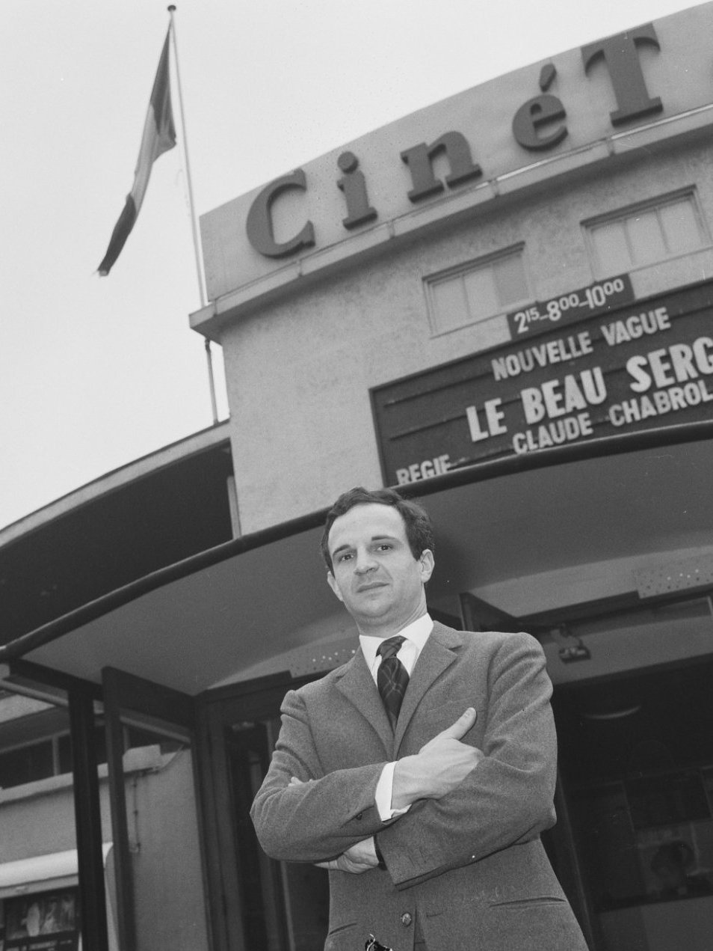
Auteur & Genre

Slide 6
Auteur & Genre
Film director and critic François Truffaut in 1965

Slide 7
Auteur
“Auteur theory” is a term coined by a group of French film critics-turned-filmmakers .
Collectively called the “French New Wave,” they include Francois Trauffaut (previous page), Jean Luc Goddard, and the U.S. critic Andrew Sarris
Genre
“Genre” means a kind of story or narrative, with common character types, plot lines, and settings.
Examples of film genres: musicals, science fiction, westerns, horror (with sub-genres like slasher films)

Slide 8
Auteur
Sarris thinks that there are three basic attributes to the director as the structuring force of a film: technical competence, coherent personal style, and vision (world view, idea, attitude).
“Master narrative”
Genre
Genre conventions can include plot development, characteristic film techniques, and iconography.
The influence of marketing forces and the factory-like studio system.

Slide 9
Auteur
The development of auteur theory made film studies possible as an academic discipline. (Kolker, Film, Form, & Culture, p. 138)
“A director really just makes one film over the course of his career” (Jean Renoir)
Genre
It has been argued that there are no definitive categorization of genre, and that genre classifications are correct only to a specific moment in history.
Genres rise and falls in cycles, reflecting social attitudes and values.

Slide 10
“Whether we study a genre’s history, its cultural functions, or its reflection of social trends, conventions remain our best point of departure.” (Film Art, p. 118)

Slide 11
Aliens (1986) Dir. James Cameron

Slide 12
Aliens genre analysis

Slide 13
Aliens genre analysis
Group work: Working in groups, each focusing on one (or two) of these film genres: western, horror, science fiction, women’s film, war film; identify which parts of the film fit into the conventions of these genres, and which parts do not.

Slide 14
Aliens genre analysis
Group work: What genre or genres constitute an effective and pertinent context for the reading of this film? (OGFS, p. 336)

Slide 15
Aliens genre analysis
Group work: What does our analyses of Aliens say about this film’s relationship to the individual genres we identified, and to the generic system as a whole?

Slide 16
Aliens genre analysis
Group work: What does our analyses of Aliens say about this film’s relationship to the individual genres we identified, and to the generic system as a whole?
Furthermore, what does our class analysis tell us about the inclusive and exclusive definitions of genre, as well as diversity in film genres?

